Slide 1
L.O. To know about Shabbat

Slide 2
Success Criteria
-Say some things Jewish people do for Shabbat
-Say why Jewish people do these things

Slide 3
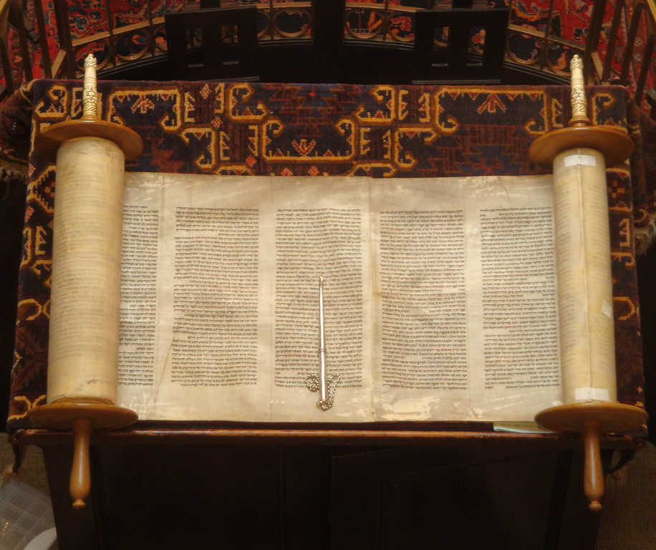
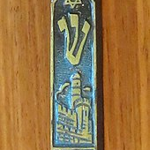
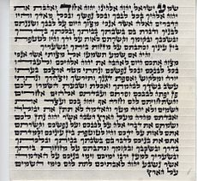

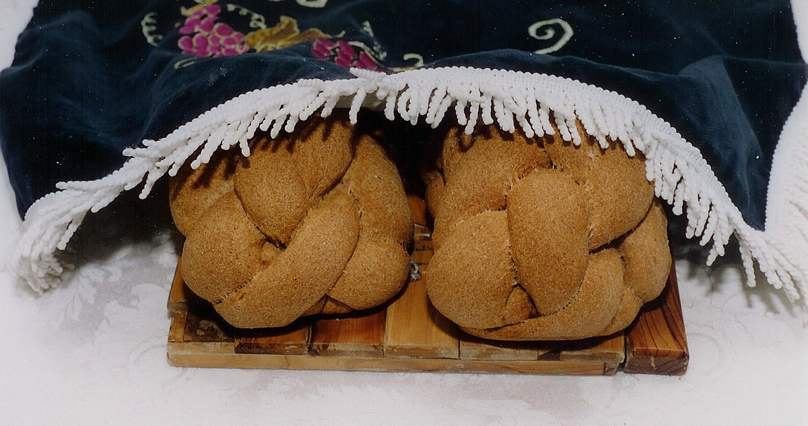
Can you match the pictures to these Jewish words?
Shema and Mezuzah
Challah Bread
Star of David
Torah
T
This Photo by Unknown author is licensed under CC BY-SA.
This Photo by Unknown author is licensed under CC BY-SA.

Slide 4
Watch a family get ready for Shabbat
https://www.bbc.co.uk/bitesize/clips/zs2hyrd

Slide 5


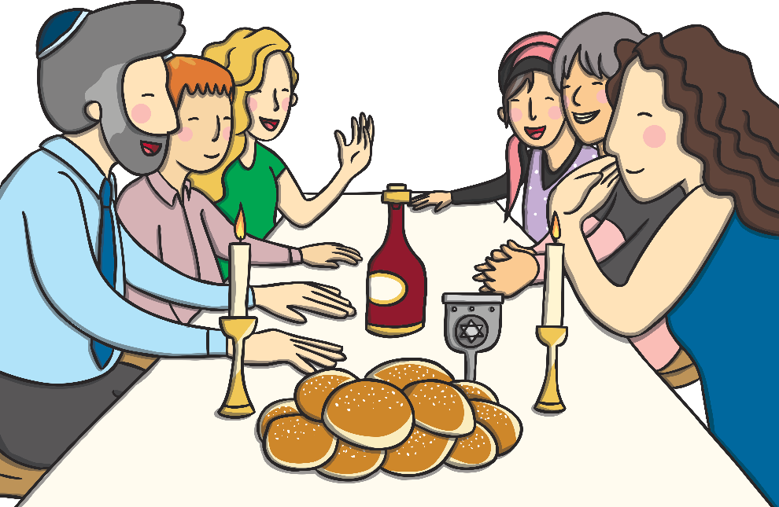
What Is Shabbat?
The Sabbath or Shabbat (the Hebrew word for ‘Sabbath’) is the seventh day of the week.
Jewish people celebrate the Sabbath every week.
The Sabbath begins at sunset on Friday and lasts until nightfall on Saturday.
Jewish people look forward to Shabbat as it is a time for resting. Time is spent eating and relaxing with family and friends.

Slide 6
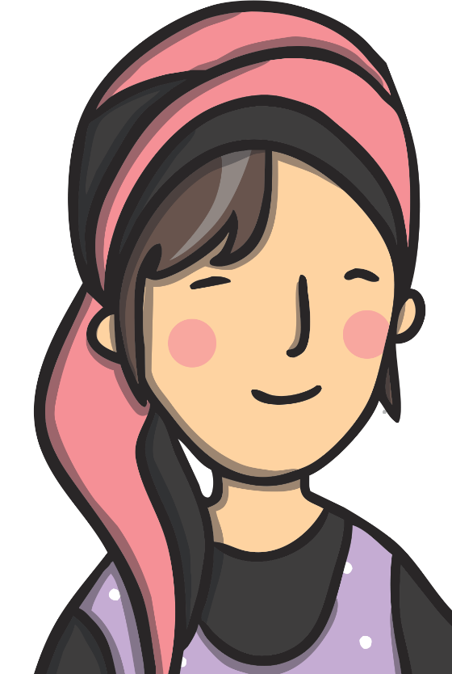

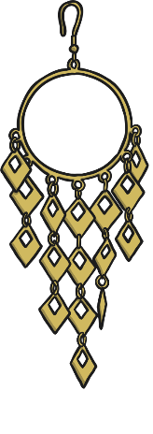
What Happens Before Shabbat?
As Shabbat is a time for resting, everything has to be ready before sunset on Friday.
Jewish families will go shopping, cook and clean before Shabbat starts and dress up in their best clothes.

Slide 7
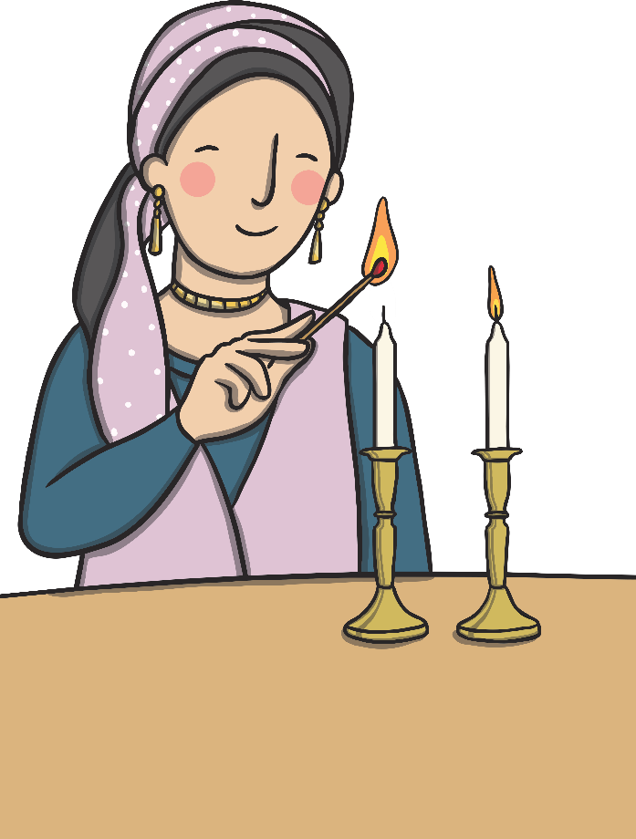
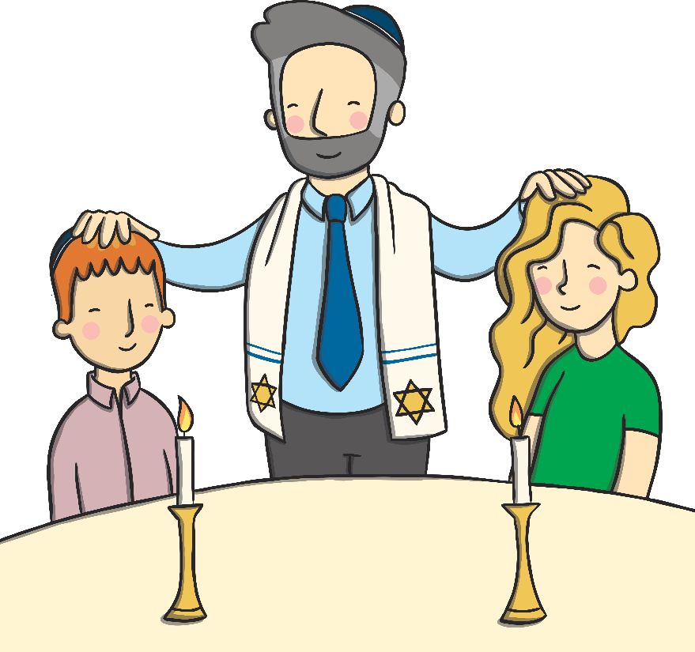
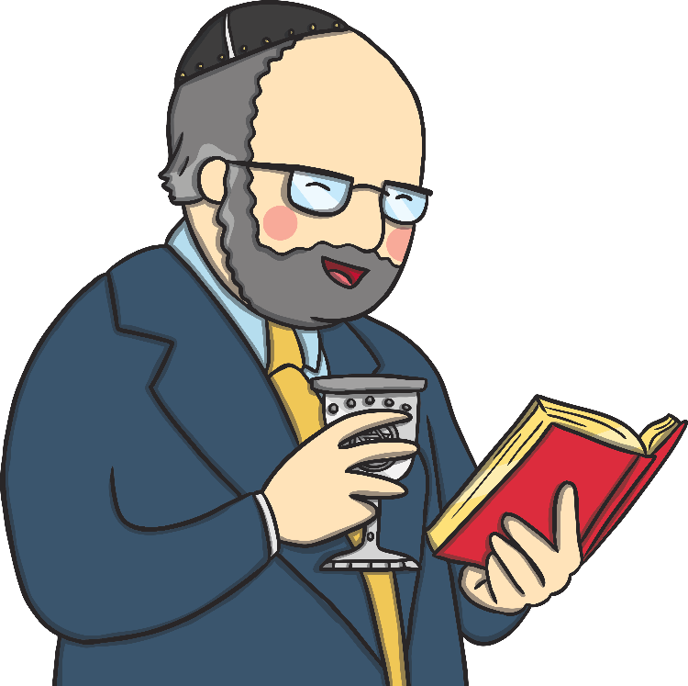


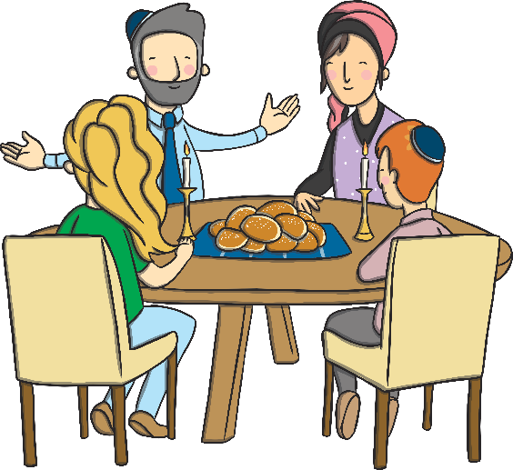
The Shabbat Meal
Just before sunset, two candles are lit by the woman of the house.
The father or grandfather of the house blesses the children.
The father of the house pours wine (or grape juice) into a special cup, says a blessing and passes the wine around.
Challah bread is uncovered, cut and sprinkled with salt.
Everyone sits down and eats the Shabbat meal.
Families talk about the week, tell stories and sing songs.

Slide 8
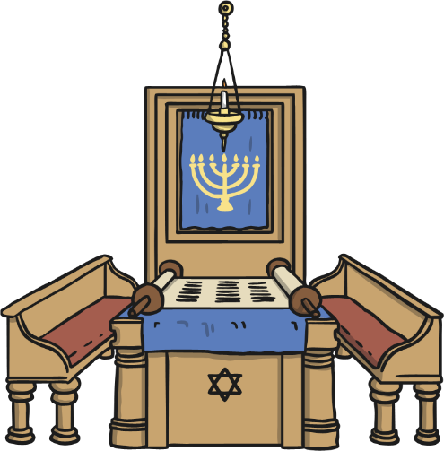
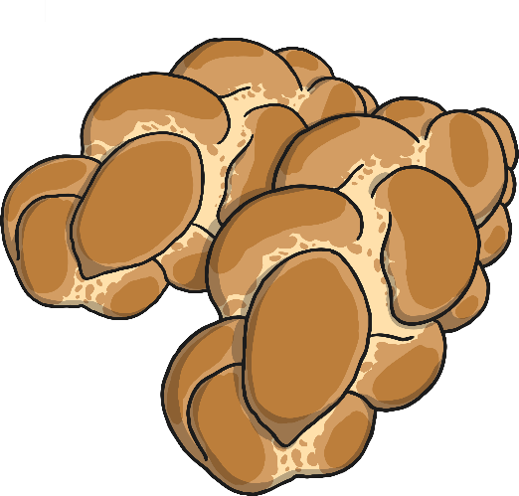
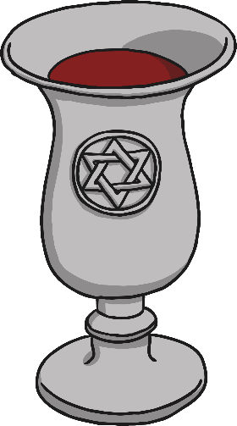
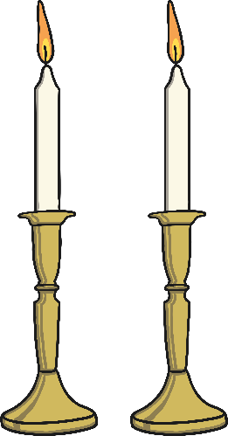
What Happens During Shabbat?
During Shabbat Jewish families will often visit the Synagogue. Special prayers are said and parts of the Torah are read out.
Every Jew must eat three meals during Shabbat and one of the meals must include bread.
The end of Shabbat is called Havdalah, which means ‘separation’. Havdalah separates Shabbat from the rest of the week. Blessings are said over wine, spices and candles.

Slide 9


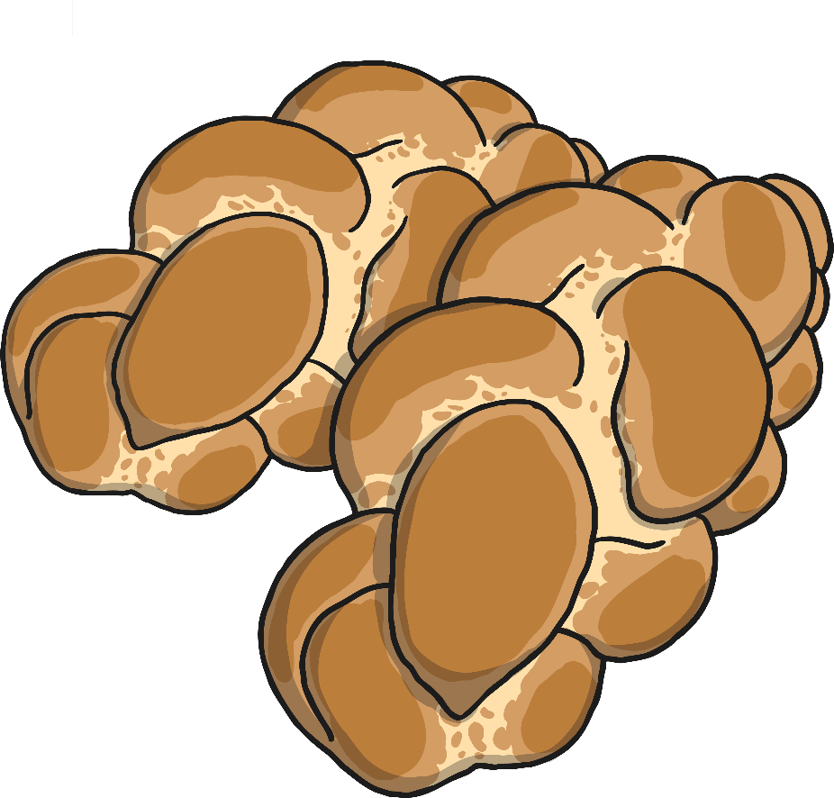




Shabbat Riddles
I am covered up on the Shabbat table.
I am made from flour, eggs, honey and salt.
I am braided.
You can eat me.
What am I?
Challah bread

Slide 10

Shabbat Riddles
We are on the Shabbat table.
We come as a pair.
You can light us.
What are we?
Candles

