Slide 1
LO: The Story of Moses

Slide 2
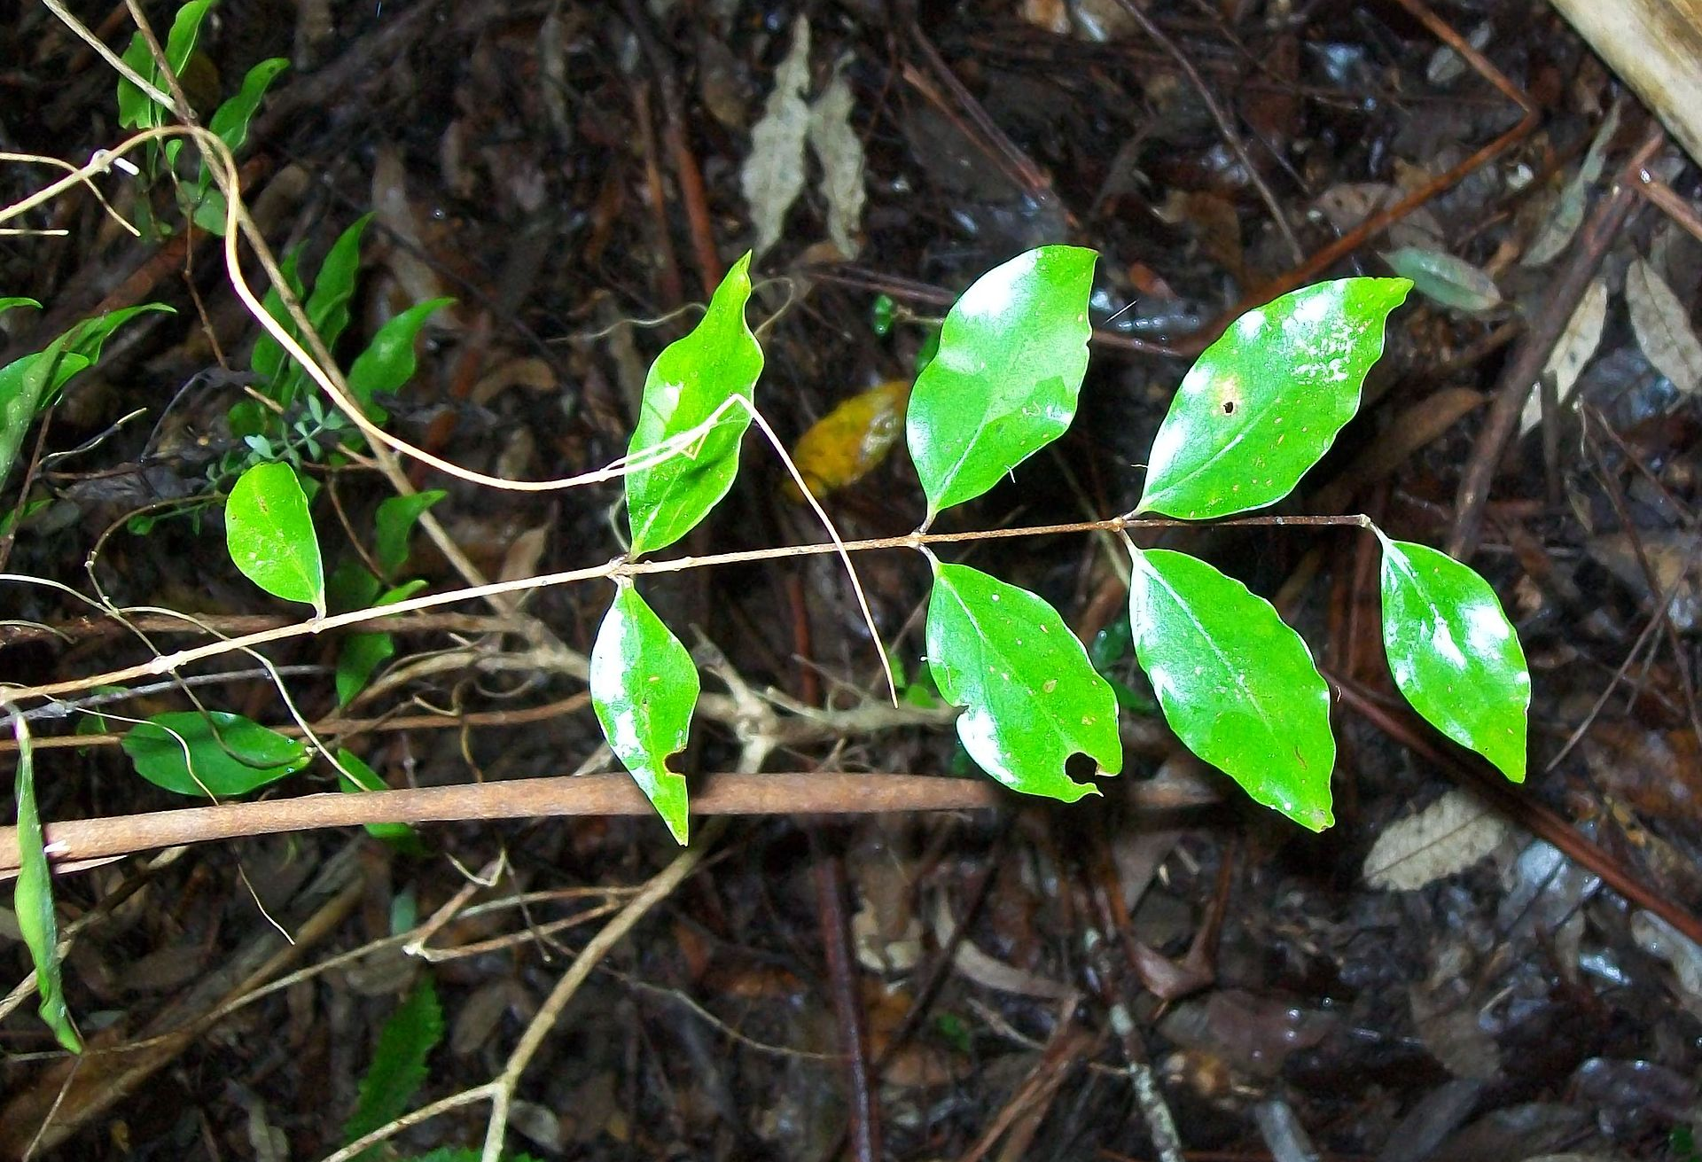
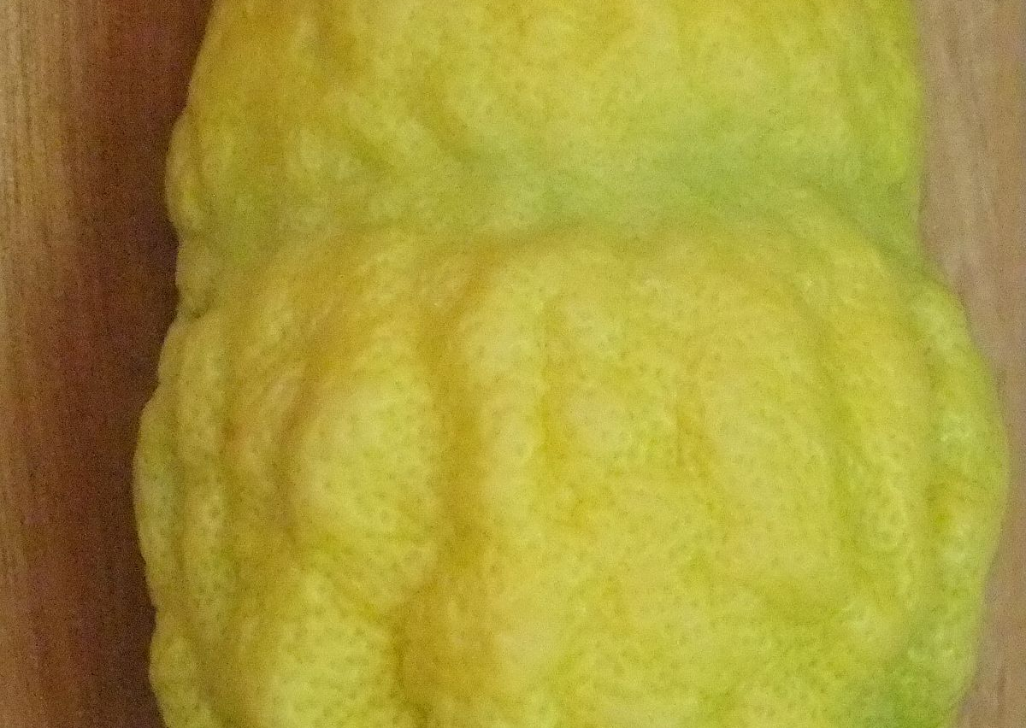
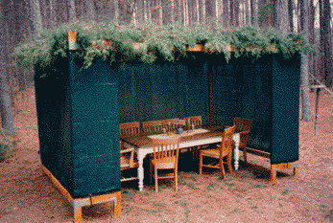

Let's recap Sukkot
Match the pictures to the words
A sukkah
An Etrog
Palm leaf
Myrtle
Why do they use these items?
This Photo by Unknown author is licensed under CC BY-SA.
This Photo by Unknown author is licensed under CC BY-SA-NC.

Slide 3
Why do they use the items listed?
Well done if you said to celebrate Sukkot
The Palm, Mrytle and Etrog is used to bless the Sukkah (tent) as thanks for the shade of the trees and fruits they could eat.

Slide 4
Moses led his people to the promise land where they lived in tents, this is why Sukkot is celebrated.
Watch this video to find out more about Moses:
https://www.bbc.co.uk/teach/class-clips-video/religious-studies-ks1-the-jewish-story-of-moses/zmfp382

Slide 5
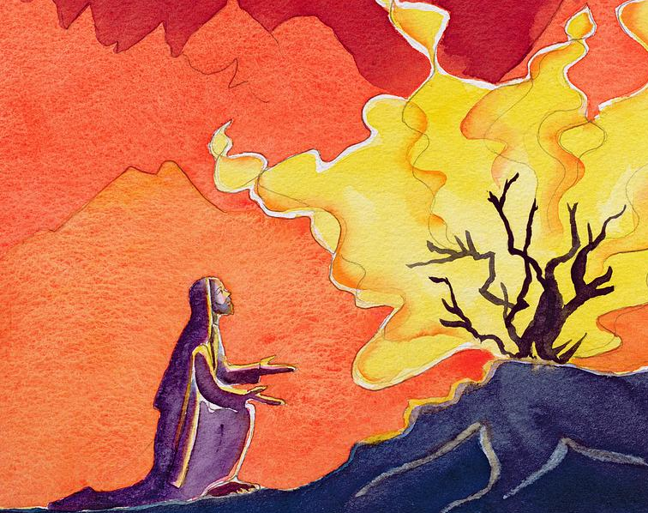
Your task year one
Can you draw a picture of the burning bush that Moses received his message from God.
This Photo by Unknown author is licensed under CC BY-SA-NC.

