Slide 1
LO: how do Jewish people live

Slide 2
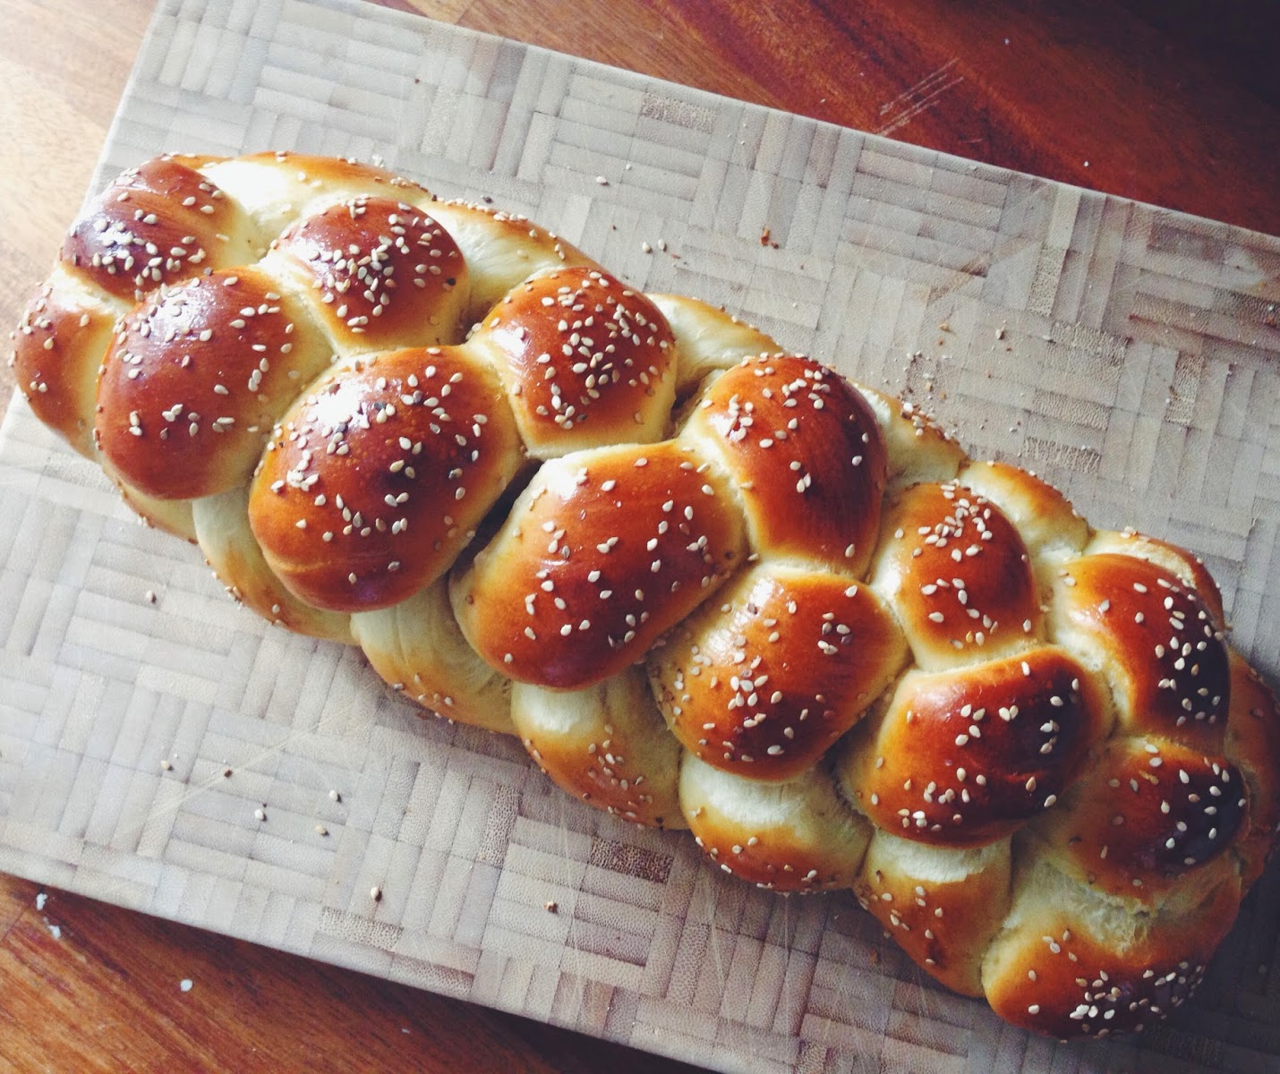
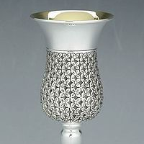
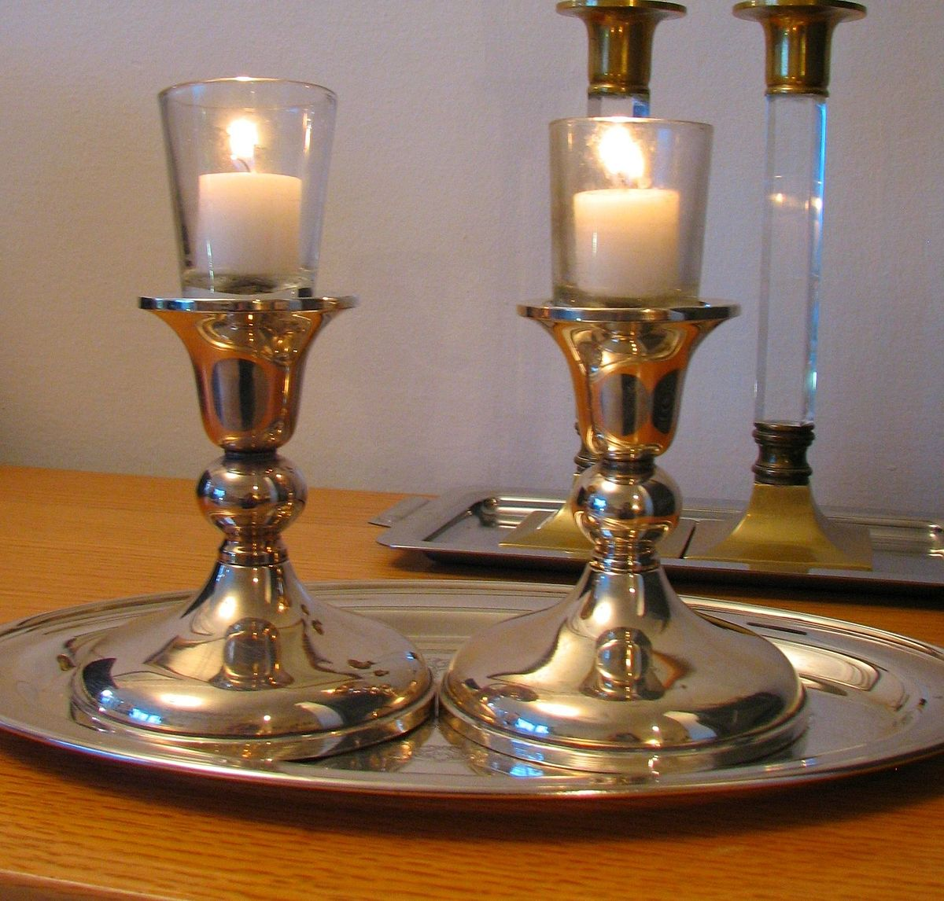
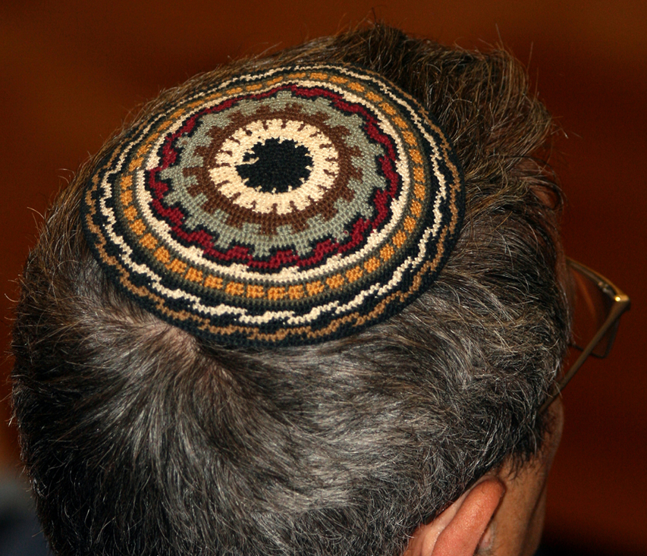
Match the picture the word.
Kiddish cup
Shabbat candles
Challah Bread
Kippar
This Photo by Unknown author is licensed under CC BY-SA.

Slide 3
Draw a picture of a Shabbat table
Watch this clip to remind you, what should be on the table.
https://www.bbc.co.uk/bitesize/clips/z3hyr82
There is also a Challah Bread recipe if you want to try baking one.

