Slide 2


Fastest Finger
Show me your pointing finger!
Can you point it up high?
Can you point it down low?

Slide 3

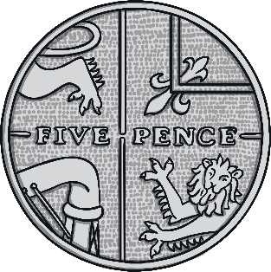
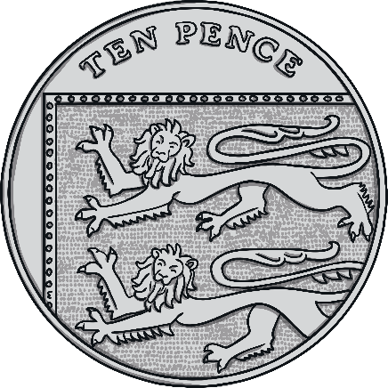
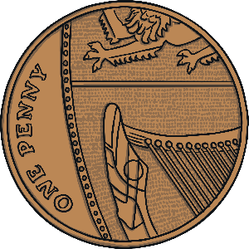


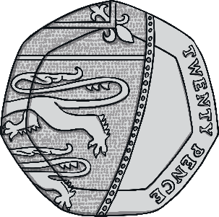

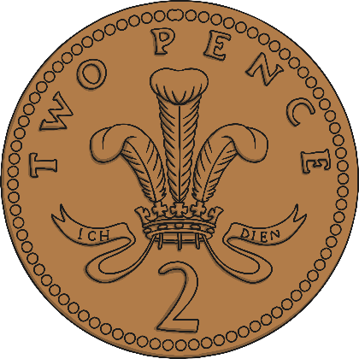
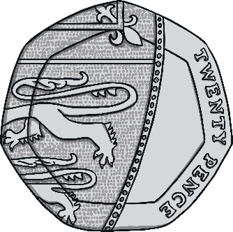
Find the Coins!
Who has the fastest finger?
Look for the correct coin and then shoot your finger up high.
If you are the fastest, you might get chosen to point to the correct coin.

Slide 4




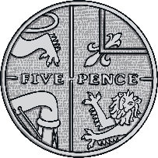
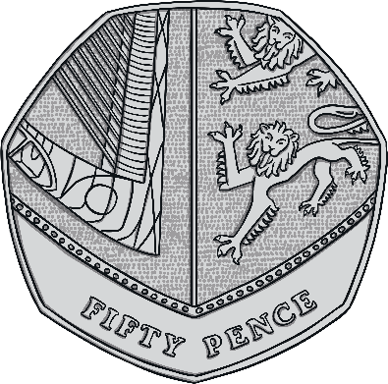

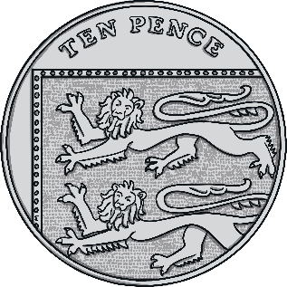
Daddy gives you some pocket money.
Which coin does he give you?
He gives you 5p.

Slide 5
Do you have the correct coin to buy a sweet?
A sweet costs 1p.

Slide 6
Hop onboard the train! Have you bought a ticket?
Which coin do you need?
The ticket costs 10p.

Slide 7
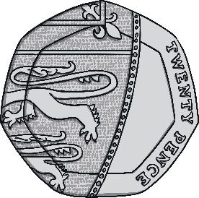
Off to the seaside! Do you have the correct coin to buy an ice cream?
Which coin do you need?
The ice cream costs 20p.

Slide 8
Can you buy some bread from the shop?
Which coin do you need?
The bread costs £1.

Slide 9
You have found a coin in your bag…
Show me the coin you found.
It was a 2p coin.

Slide 10
A trip to the fair!
Do you have the correct coin to go on the rollercoaster?
The rollercoaster costs £2.

Slide 11


Coin challenge!
Are you ready for a challenge?
This time you need to show me a pointing finger on both hands.
When you know the answer hold up both fingers.
You will need to point to 2 coins this time!

Slide 12

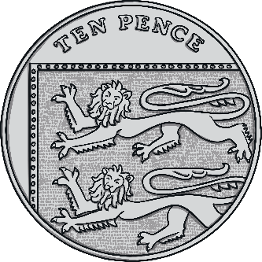
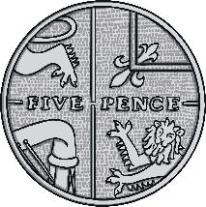


I have 2 coins in my pocket.
Which coins do I have?
I have 3p altogether.

Slide 13
It’s a hot day! Can you buy a cold drink?
Which 2 coins will you need?
A drink costs 2p.

Slide 14

I want to buy a comic.
Which 2 coins will you need?
The comic costs 4p.

Slide 15
Daddy gives me 2 coins for helping to clean my bike.
Which 2 coins will you need?
He gave me 6p.

Slide 16
I need to pay for my toy.
Which coins can I use?
My toy costs 7p.

Slide 17

Mummy gave me 2 coins to put in the parking ticket machine.
Which 2 coins did I use?
The parking ticket cost 10p.

