Slide 1

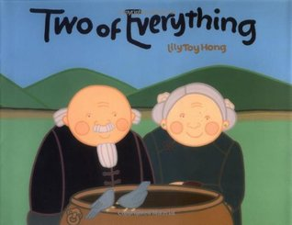
Two of Everything
Lily Toy Hong

Slide 2
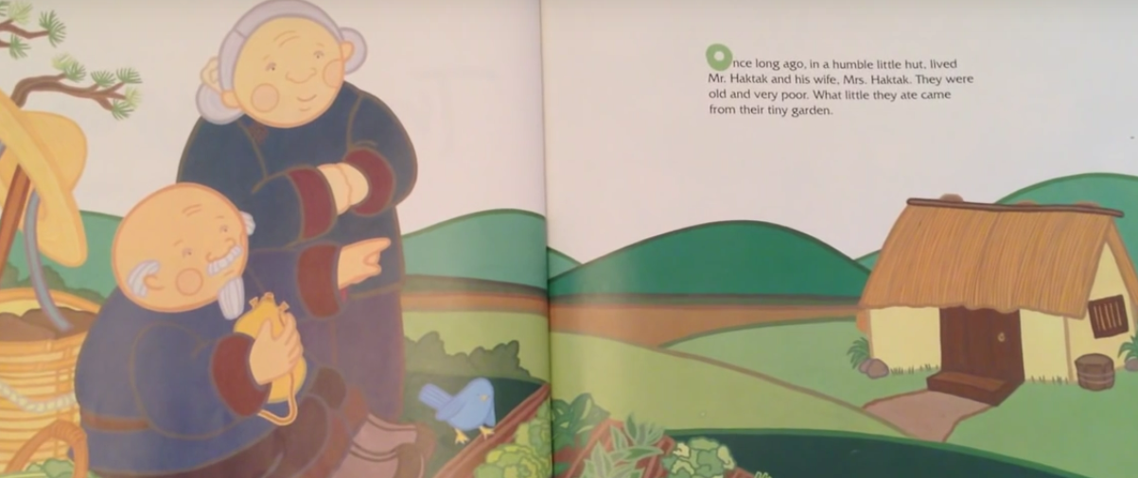
Once long ago, in a humble little hut, lived Mr Haktak and his wife Mrs Haktak. They were old and very poor. What little they had to eat came from their tiny garden.

Slide 3
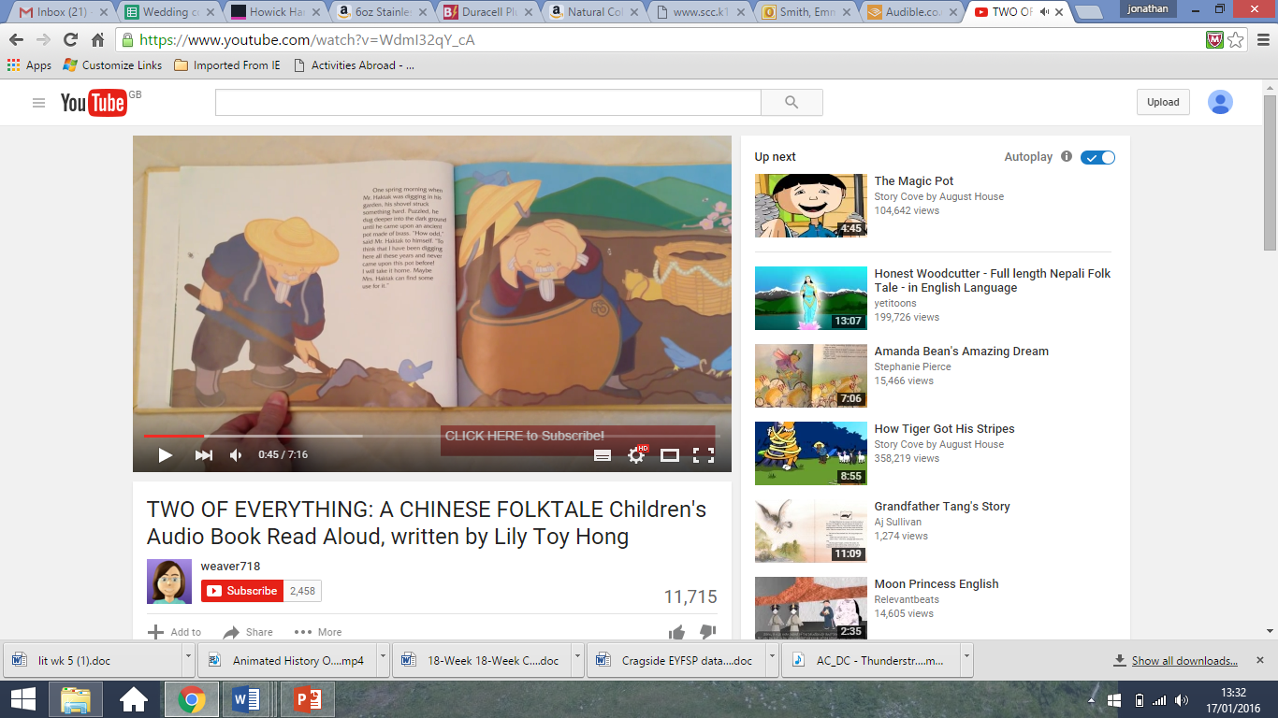
One spring morning when Mr Haktak was digging in his garden, his spade struck something hard. Puzzled, he dug deeper into the dark ground until he found an old pot. “How strange,” said Mr Haktak to himself. “To think that I have been digging here all these years and never came upon this pot before! I will take it home. Maybe Mrs Haktak can find some use for it.”
As he walked back to his house, his purse, which contained his last five gold coins, fell onto the ground,so he put it into the pot to carry it safely.

Slide 4
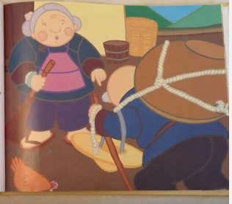
His wife greeted his at the door. “Hello dear husband, what is that strange looking pot?” Mr Haktak explained how he had dug it up in the garden. “I wonder what we can do with it,” said Mrs Haktak. “It looks too large to cook in and too small to have a bath in!”

Slide 5
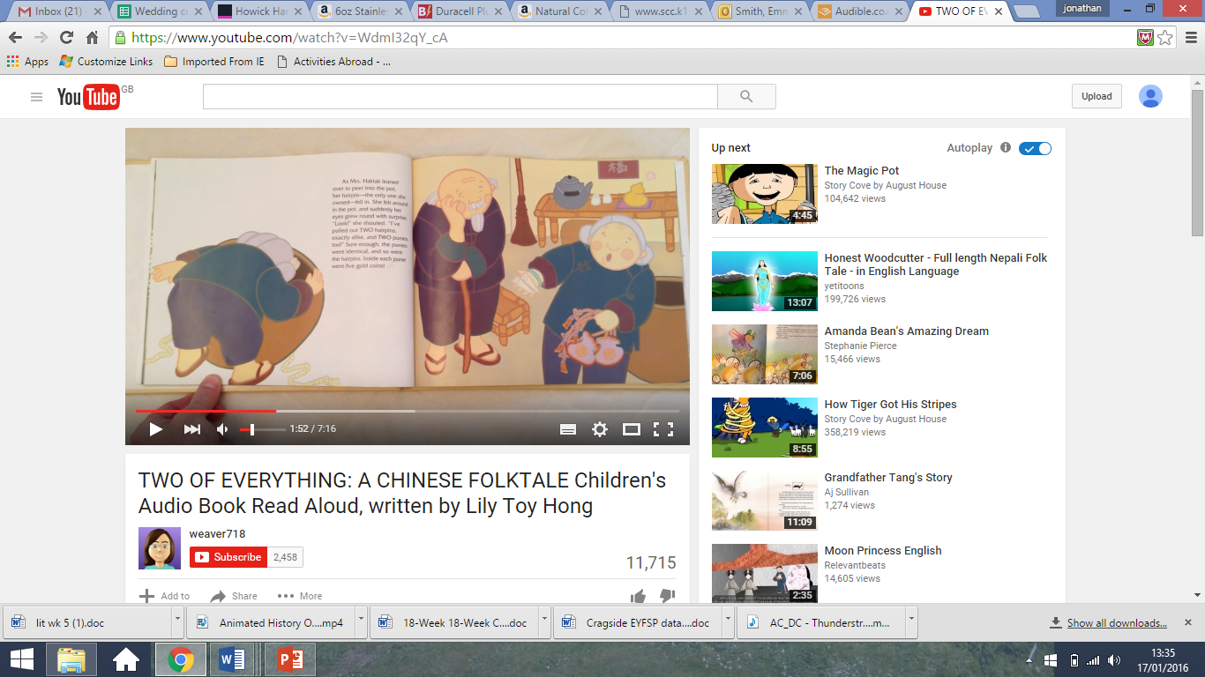
Mrs Haktak leaned over to peer into the pot and as she did her hairpin – the only one she owned – fell in! She felt around in the pot for it, and suddenly her eyes grew wide with surprise. “Look!” she shouted and she pulled out TWO hairpins, exactly alike and TWO purses! The purses were identical and so were the hairpins. Inside each purse were five gold coins!

Slide 6
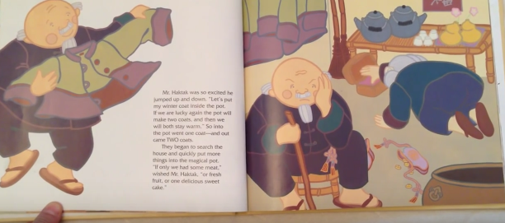
Mr Haktak was so excited he jumped up and down. “Let’s put my winter coat inside the pot…. if we are lucky again the pot will make two coats, and then we will both stay warm!” So into the pot went one coat….. and out came TWO!

Slide 7
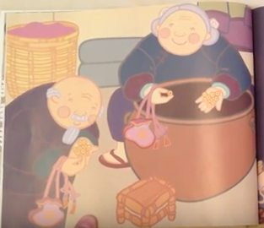
They began to search the house and quickly put more things into the magical pot. Each time they put one thing into the pot they pulled two out! Mrs Haktak smiled. “I know how we can get anything we want,” she said. She put their ten coins into one purse, then threw it into the pot.
Out came two purses each with ten coins in
“What a clever wife I have!” shouted
Mr Haktak. “Each time we put the purse in
we will take out twice as much money!”

Slide 8
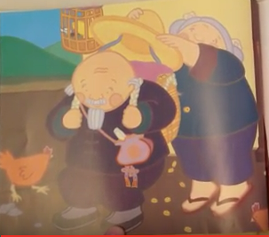
The Haktaks worked late into the night, filling and emptying the pot until the floor was covered with coins. Morning came, and off went Mr Haktak with a long list of things to buy in the village. Instead of vegetables, his basket was full of gold coins!

Slide 9
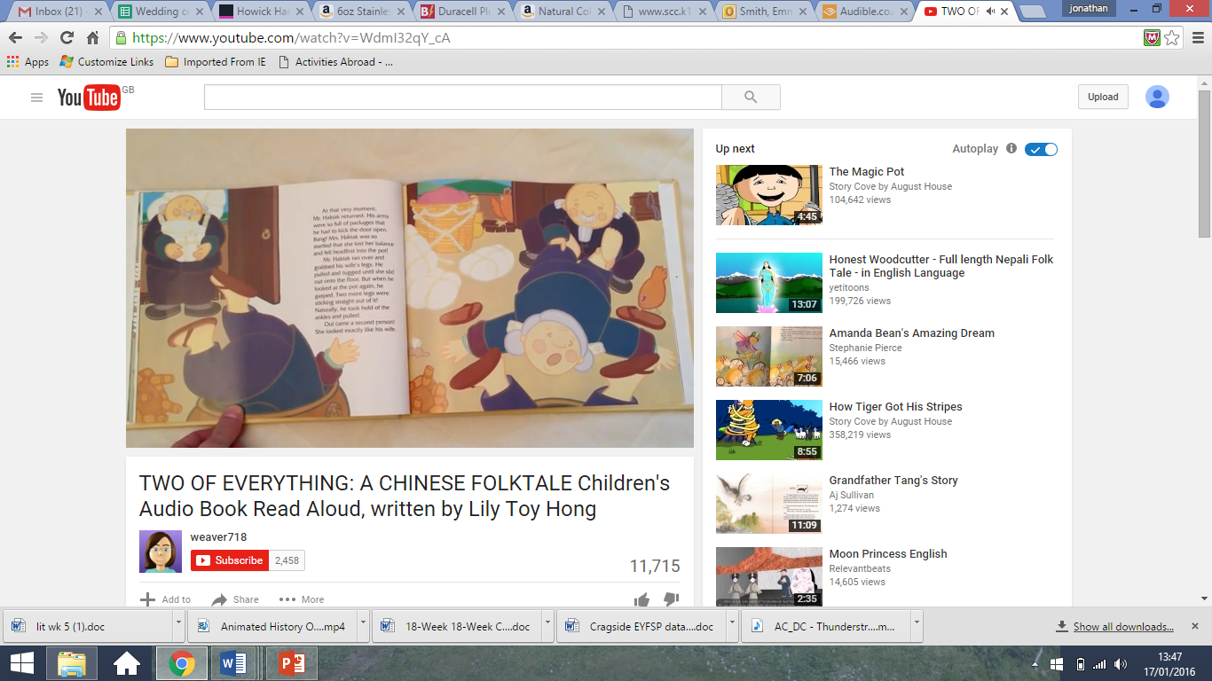
Mrs Haktak finished all of her jobs and as she walked past the strange looing pot she said “ Dear pot, I do not know where you came from but you are my best friend!” She bent over the pot to have a closer look inside.
Just at that moment, Mr Haktak returned
Home. His arms were so full of bags that he
had to kick the door open - BANG!
Mrs Haktak was so startled that she lost her
balance and fell headfirst into the pot!

Slide 10
Mr Haktak ran over and grabbed his wife’s legs. He pulled and tugged until she slid out onto the floor. But when he looked at the pot again, he gasped…two more legs were sticking out of it! He took hold of the ankles and pulled.

Slide 11
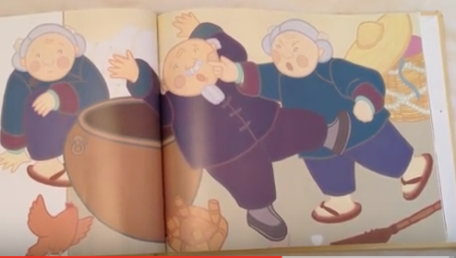
Out came a second person and she looked exactly like his wife! The new Mrs Haktak sat silently on the floor looking lost. But the first Mrs Haktak cried, “I am your one and only wife! Put that woman back into the pot right now!”
“No! I cant do that”, said Mr Haktak.
If I put her back in the pot it will give
us another one and we will have
three! One wife is enough for me!”

Slide 12
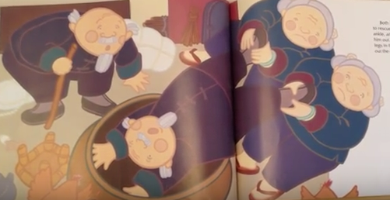
As he stepped back Mr Haktak tripped on one of the shopping bags and fell headfirst into the pot himself! Both Mrs Haktaks went to help him. Each grabbed an ankle and together they pulled him out. But of course were two more legs in the pot, so they pulled out the other Mr. Haktak too! “This pot is not as wonderful as we thought it was, now even our troubles are beginning to double.” said Mr Haktak.

Slide 13
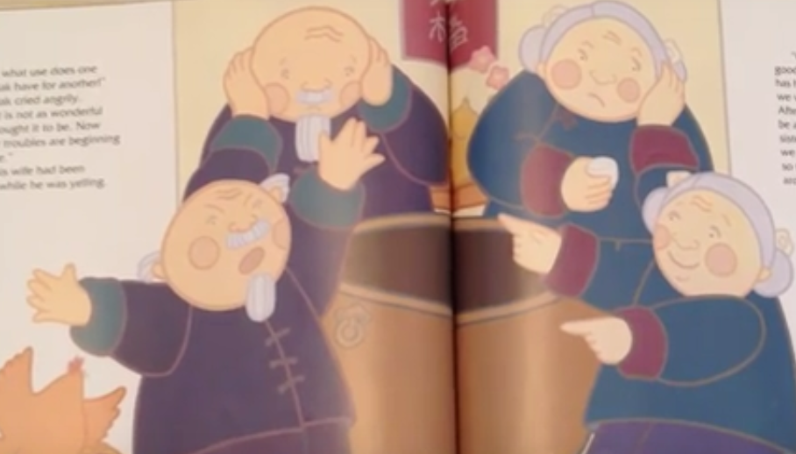
But his wife had been thinking. “Calm down husband,” she said. “It is good that the other Mrs Haktak has her own Mr Haktak. Perhaps we will become best of friends. After all we are so alike, he will be a brother to you and she a sister to me. With our pot we can make two of everything, so there will be plenty to go around.”

Slide 14
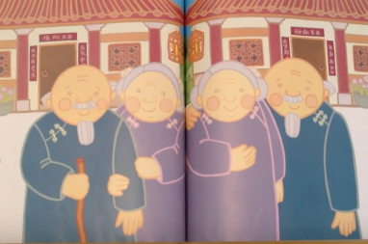
And that is what they did. The Haktaks built two fine new homes. Each house had identical teapots, rice bowls, silk embroideries, and bamboo furniture. From the outside the houses looked exactly alike, but there was one difference…
…hidden in one house was a big brass pot! Of course the Haktaks were always very careful not to fall into it again!

Slide 15
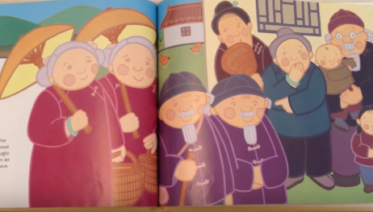
The new Haktaks and the old Haktaks did become good friends. The neighbours thought that the Haktaks had grown so rich that they decided to have two of everything – even themselves!
The End

