Slide 1
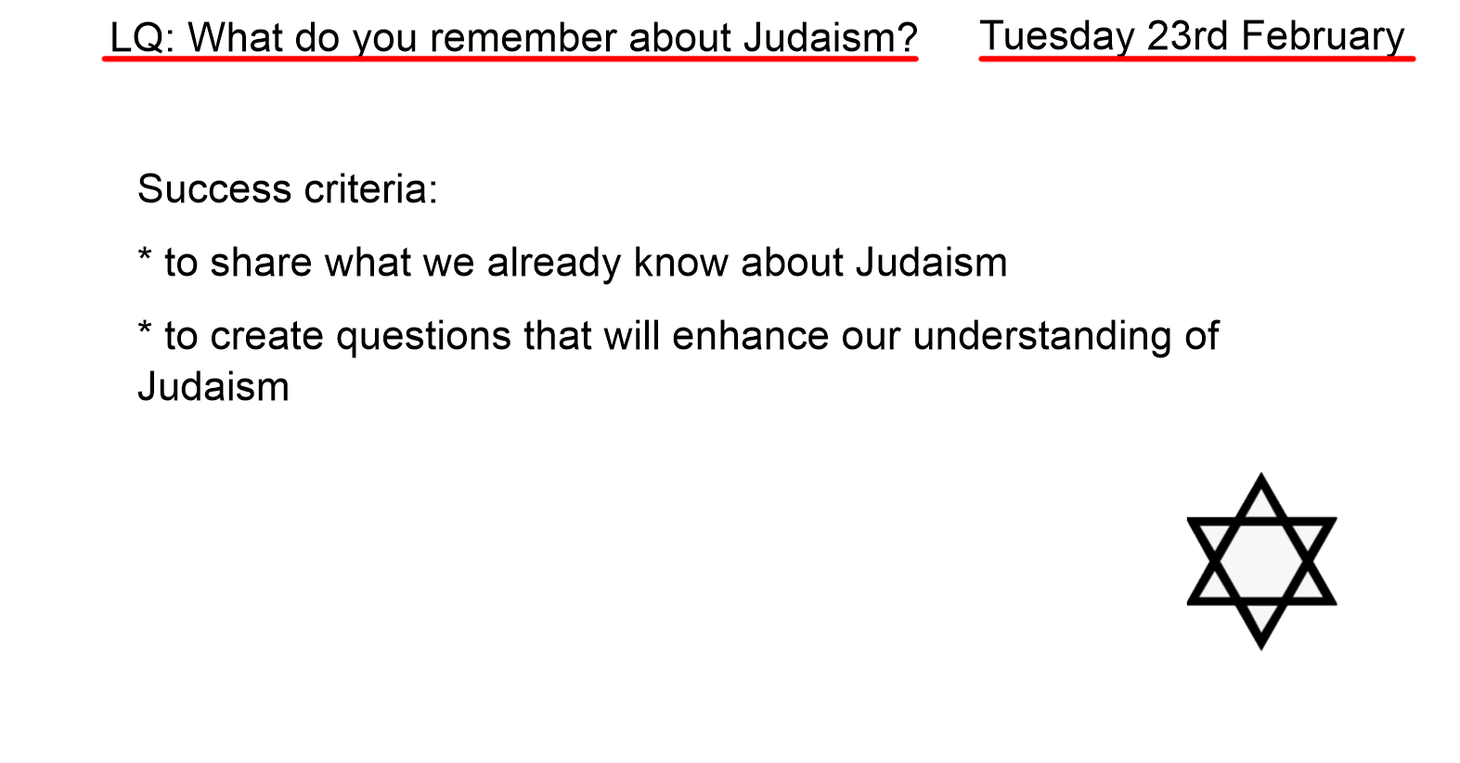

Slide 2
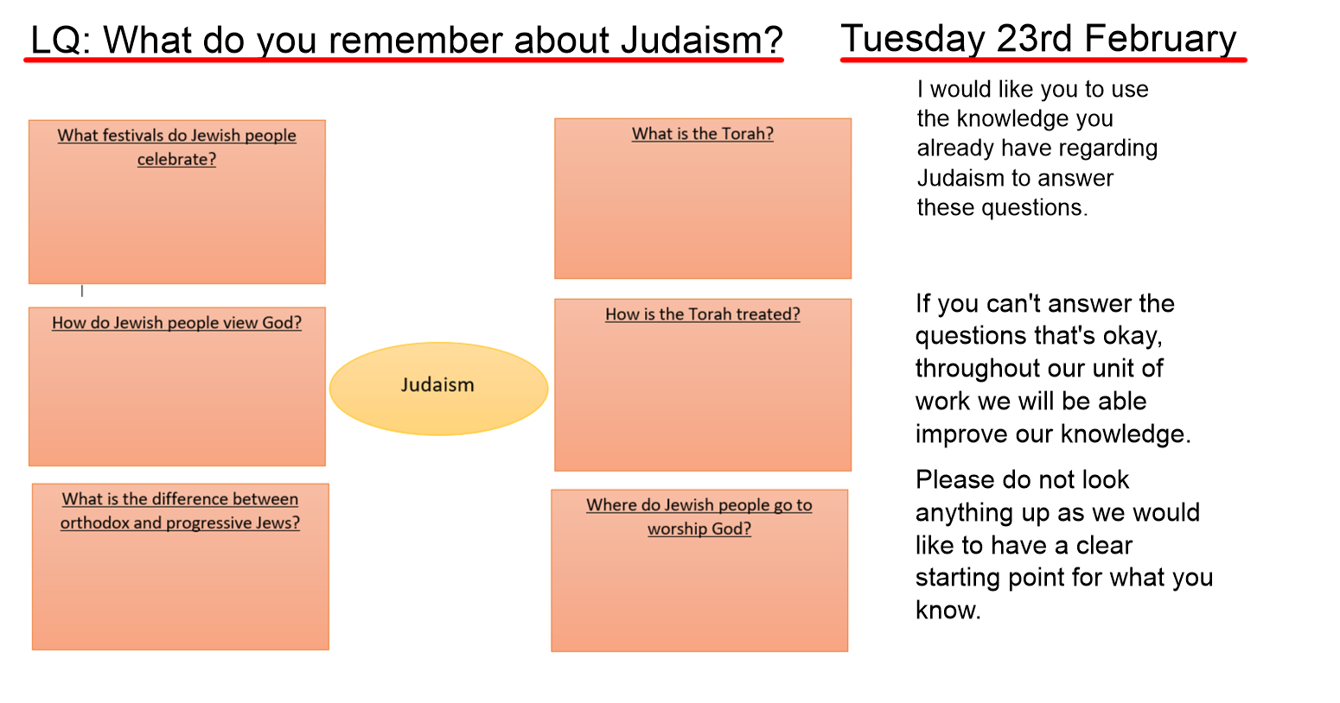

Slide 3
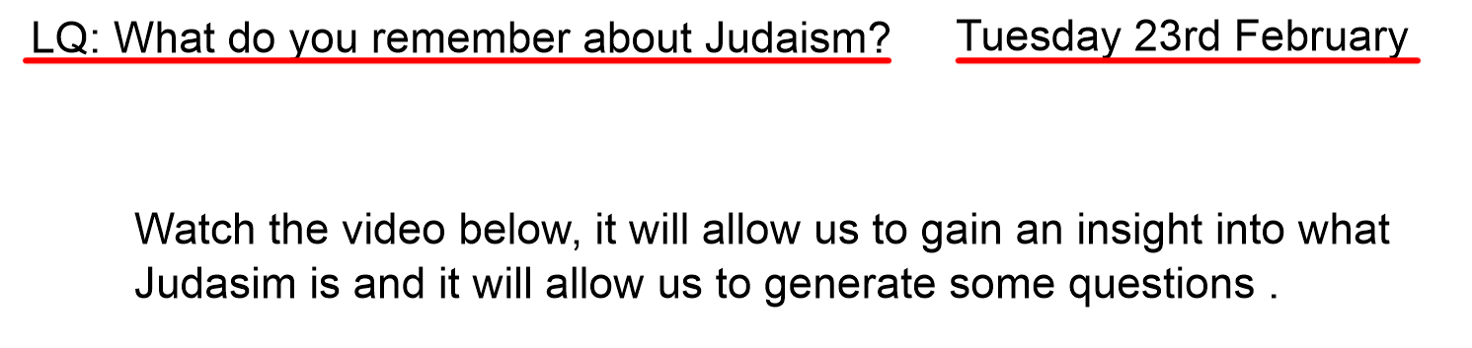
https://www.bbc.co.uk/bitesize/topics/znwhfg8/articles/zh77vk7

Slide 4


