Slide 1
LO: understand the timeline of Ancient Maya
Friday 29th January 2021
Success Criteria
Know when the Ancient Maya started
Make some comparisons of the Ancient Maya timeline to others

Slide 2
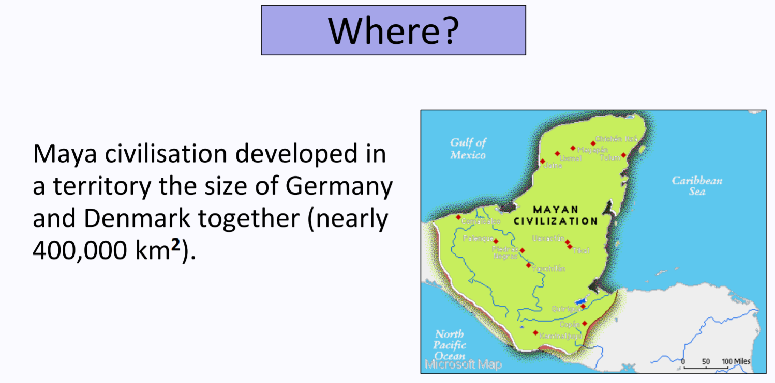

Slide 3
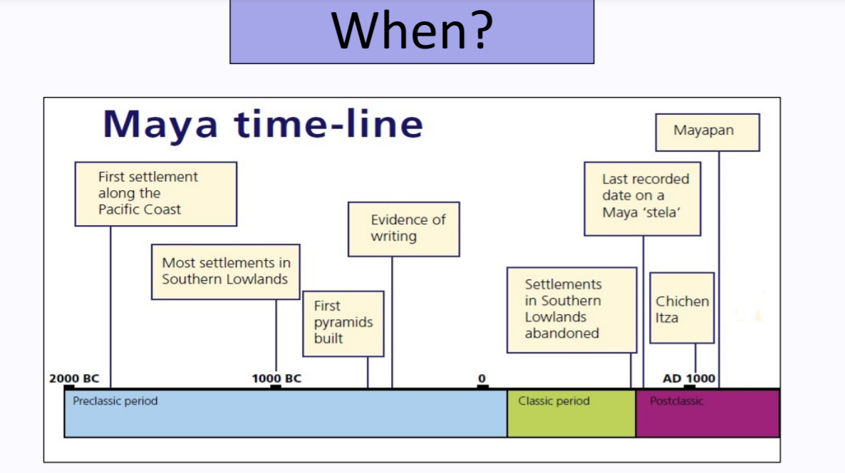

Slide 4
Scholars usually recognise three major periods in the history of Maya civilisation:
The Preclassic (2000 BCE – CE 300)
The Classic (CE 300-900)
The Postclassic (CE 900-1550)

Slide 5
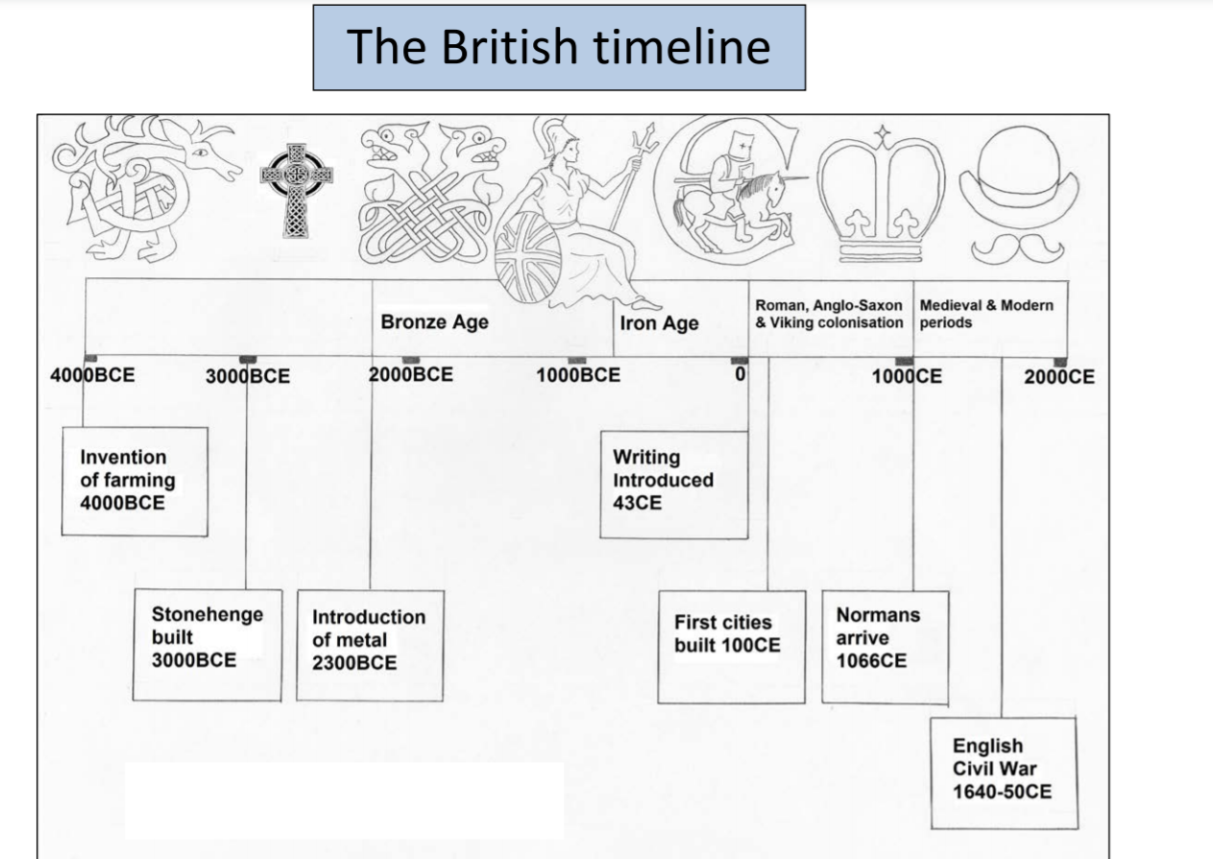

Slide 6
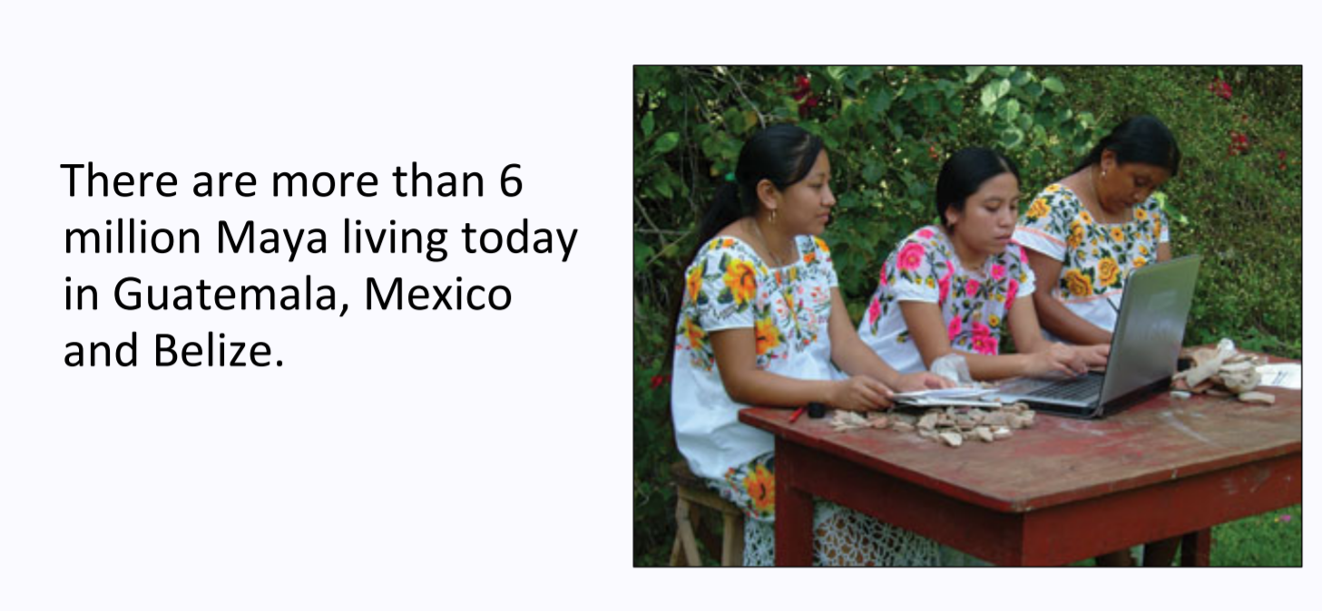
The Maya have continued to develop and adapt through the historic periods of European Colonisation (1550-1821), and the National Modern (1821 to date).

Slide 7
LO: to use sources and artefacts to find out about a society
Success Criteria:
Know what a primary and secondary source is
Compare different types of evidence – what do they tell us?

Slide 8
What types of sources do we use? Can you give some examples?

Slide 9
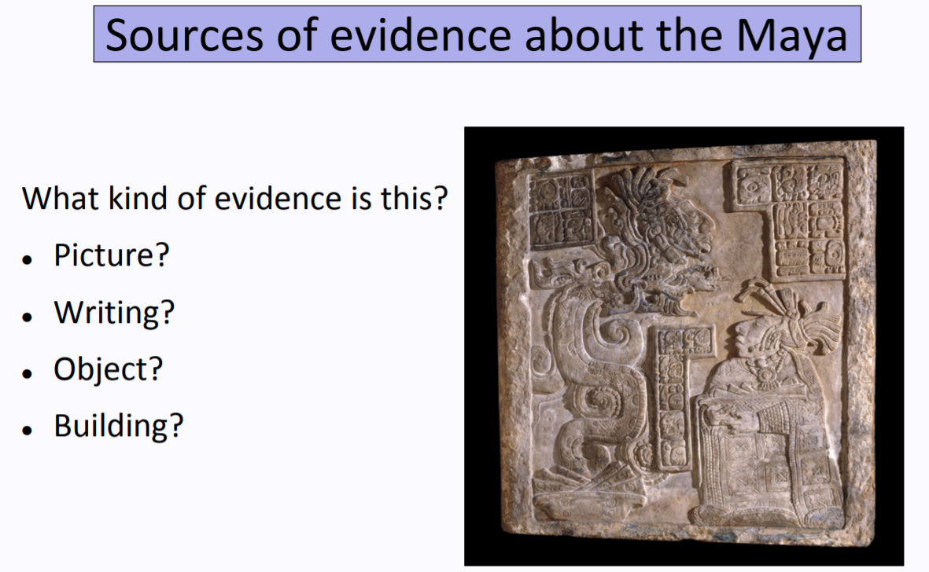

Slide 10
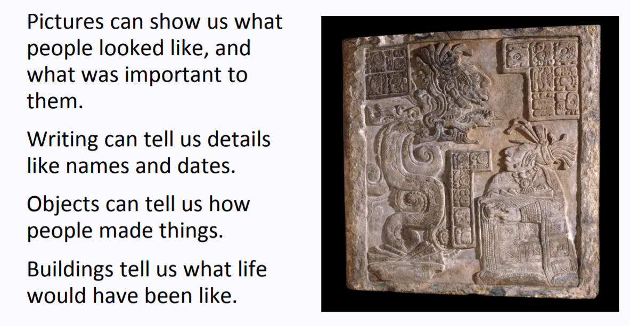

Slide 11
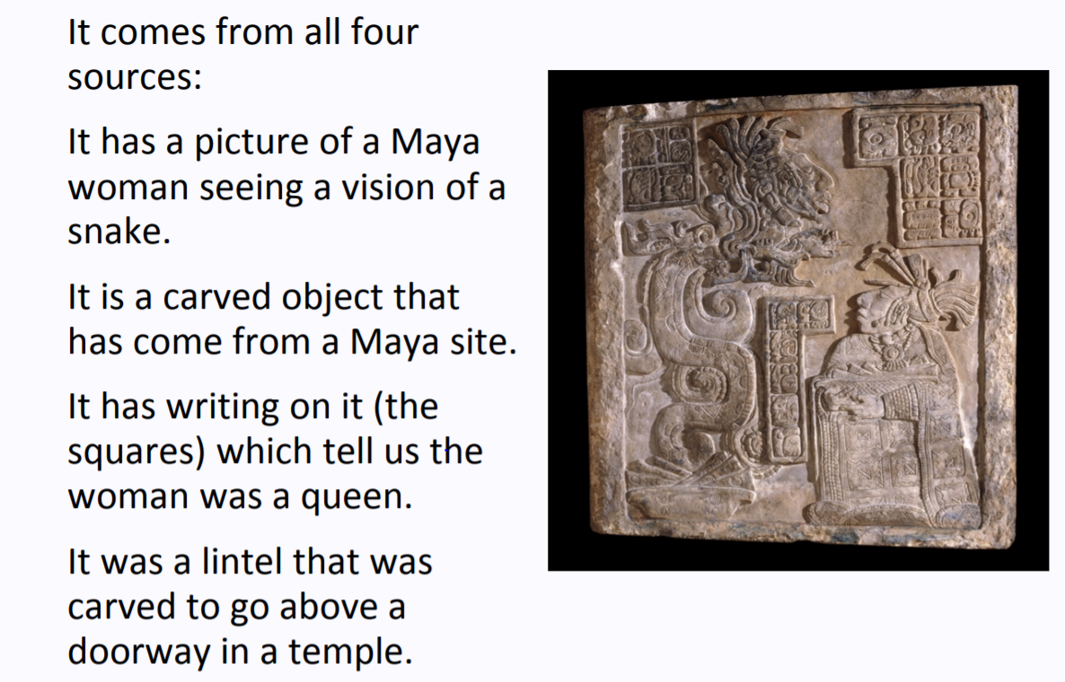

Slide 12
Today’s task
Look at the ‘Sources of information about the Maya’ document on website. Pick the source of information that you think is the most important/useful. Use the document ‘which source of evidence is most useful’ to find some argument prompts to support your answers and justification.
What can you find out about the Ancient Maya from these sources?

Slide 13
LO: LO: to use sources and artefacts to find out about a society
Success Criteria:
Know what a primary and secondary source is
Compare different types of evidence – what do they tell us?

