Slide 1
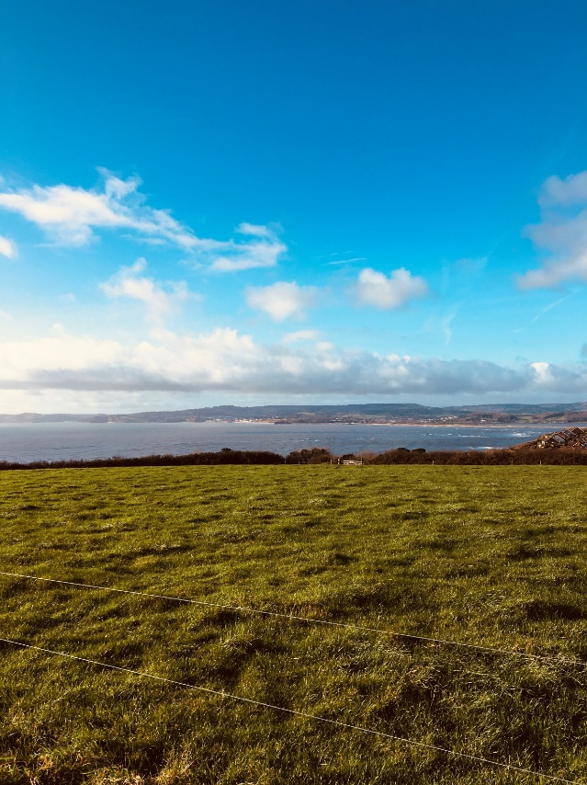
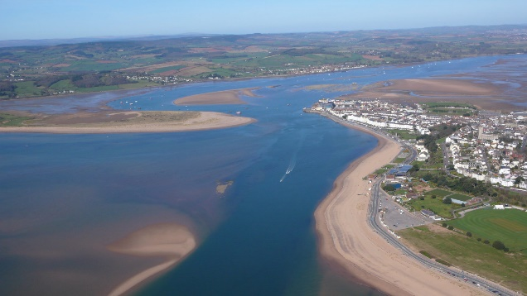
PHYSICAL geography
Photography competition
Clouds forming over the Exe estuary
Calling all budding Brixington Geographers!
This competition is to encourage our pupils to explore the land around them.
To take part, children should photograph an aspect of physical geography and explain it in a caption
Sandbanks emerge at the river’s mouth

Slide 2


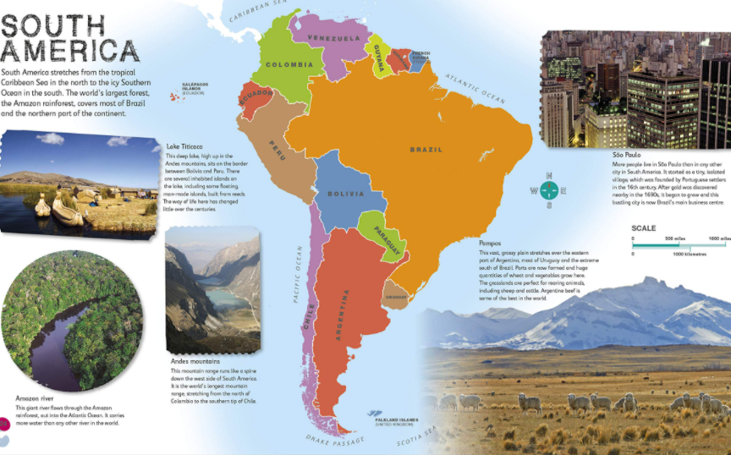
The theme for this
competition is
‘ Finding Physical Geography ’
in your locality
Ask your parents to submit your photos, with name, caption and class, to 4k@Brixington.devon.sch.uk
All you need to do is snap a fantastic shot of an element of physical geography and send in your entries with a short caption.
All entries submitted by Monday June 7th
First prize is a brand new atlas and global fame as the inaugural Brixington geography champion!
‘Physical geography’ means not made by humans.

