Slide 1
LO: to revise learning of key vocabulary

Slide 2
Success criteria
I can present my knowledge of computing vocabulary in a creative way
To explain what a bit and a byte is
To explain what binary code is and how it is used to transfer information

Slide 3
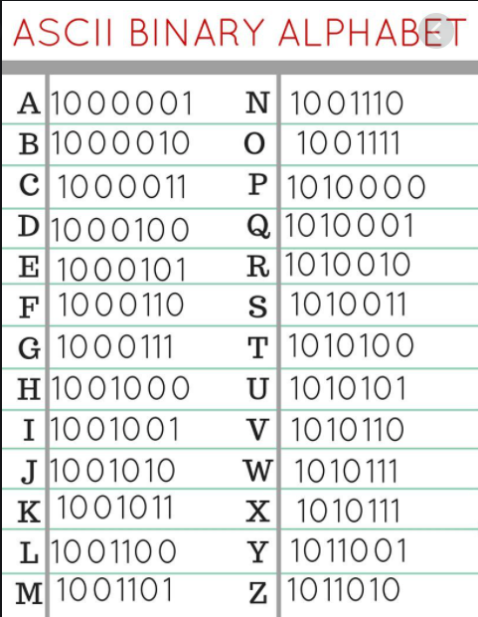
Warm up activity
Using the binary alphabet can you write out your name and tell me how many bits have been used and how many bytes have been used.
100110110100101010011100101110010011001110100111010001011010010
Mr Skinner 9 bytes and 72 bits

Slide 4
There are 8 bits in 1 byte
These bits joined together create a binary code
Binary code is the language used for computers to share information with each other
What sort of information is carried across in the binary code? Our bitmaps are binary code and they tell us what colour each pixel on our screen should be.
If I have more pixels, I wonder what will happen to the quality of my image? Will it be clearer or blockier?

Slide 5
Helpful links
https://www.bbc.co.uk/bitesize/topics/zf2f9j6/articles/z2tgr82
This link will remind us about bitmaps and pixels

Slide 6
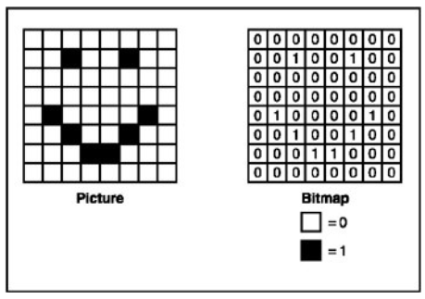
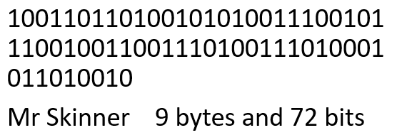
Independent task
Can you create a poster about our computing knowledge
Information you must have on your poster:
  Explanation of what a bit is and what a byte is (how many bits are there in a byte)
  Explanation of what binary code is with an example of binary code being used (you could add your warm up activity in as an example)
  An example of a bitmap with the image it is paired with

