Slide 1
LO: To understand how chronological order is used in biographical writing
Monday 25th January 2021

Slide 2

Quiz time!

Slide 3
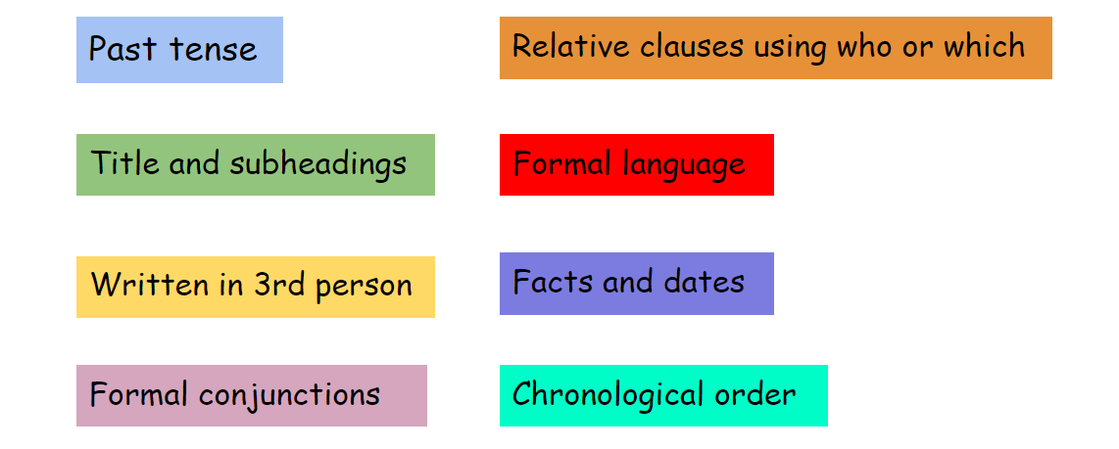
The features of a biography

Slide 4
Who are you writing your biography about?

Slide 5
Success criteria
To understand what chronological order is and why it is used
To organise my research into topic paragraphs
To organise my research into chronological order

Slide 6
Chronological order
Chronological order is a way of arranging actions, events, or things according to the time they occurred.
It is demonstrated by showing what happened first, what went on next, what came after that, and what took place last.

Slide 7
Can you sort these events into chronological order?
Have dinner
Wake up
Get ready for school
Go to sleep
Have lunch
Have breakfast
Go to school
Home time
Get ready for bed

Slide 8
Can you sort these events into chronological order?
1. Wake up
2. Have breakfast
3. Brush teeth
4. Get ready for school
5. Go to school
6. Have lunch
7. Home time
8. Have dinner
9. Get ready for bed
10. Go to sleep

Slide 9
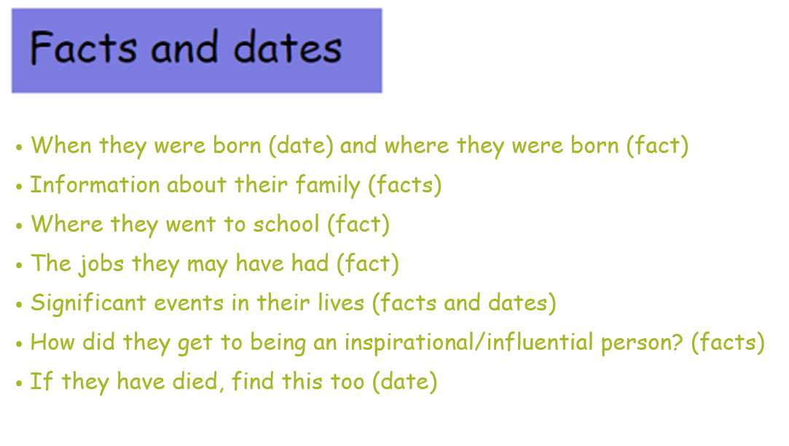
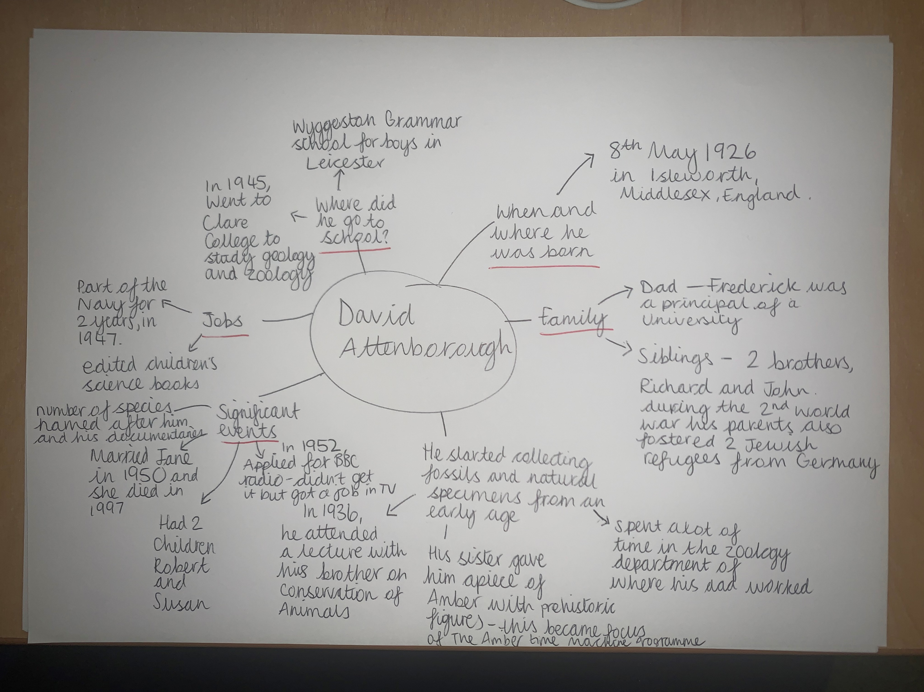
David Attenborough
Below is a mind-map of my research of David Attenborough.

Slide 10
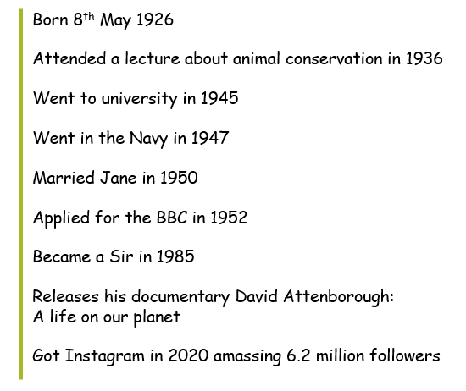
Timeline of David Attenborough’s life
in 2020

Slide 11
Organising your research into topic paragraphs
Introduction
Early life
How they became influential/ inspirational
Later life
Life now
or

Slide 12
Introduction
When and where they were born
Information about their family
Key information about them

Slide 13
Early life
Where they went to school
Any jobs they’ve had
Significant events that happened early on in their life

Slide 14
How they became influential/inspirational
What do they do that is influential or inspirational?
Why do they do that?
Have they had any obstacles to overcome in life?

Slide 15
If they’re no longer alive…
Later life
Significant events that happened later on in their life
Did they carry on their influential/ inspirational work?
When they died
Achievements

Slide 16
If they’re still alive…
Life now
Significant events that have happened recently
Are they still influential/ inspirational in what they do?
What have they got planned next in their life?
Any achievements

Slide 17
Organising research into paragraphs
Example: David Attenborough
Introduction
Born 8th May 1926 in Isleworth, Middlesex in England
Mum called Mary and Dad called Frederick, who was a principal of University College, Leicester
Brothers called Richard and John and Parents also fostered 2 Jewish refugees from Germany during WW2
He is a broadcaster, presenter and natural historian
He has 2 children called Robert and Susan
Early life
Went to Wyggseton Grammar school for boys in Leicester
Started collecting fossils from a young age
Spent a lot of time in the zoology depart at the university his dad worked at
In 1936, attended a lecture with his brother on animal conservation
In 1945, went to Clare College to Study Geology and Zoology
Jobs - he started in the Navy as part of his national service and he edited children’s science books
Married Jane in 1950
How they became influential/ inspirational
He applied for a job at the BBC in radio but wasn’t successful
In 1952, the BBC got in contact with him asking him to appear on TV
He is an advocate in protecting the environment, animal conservation
He has had many species of organisms named after him
He became a Sir in 1985
Life now
Has released many books, documentaries and films
Has won many awards
Released David Attenborough: A life on our planet in 2020
Had a short stint on Instagram in 2020, amassing 6.2 million followers
He plans to carry on his work for as long as he can

Slide 18
Now it’s your turn!
Once you’ve finished your research, sort your information into chronological order using the categories given.

