Slide 1
LO: to explore the adjectives petit(e) and grand(e)

Slide 2
Success criteria
To explore pronunciations of petit(e) and grand(e) in masculine and feminine form
To understand why pronunciations change in masculine and feminine form

Slide 3
Watch the clip below to begin exploring the adjectives petit(e) and grand(e)
https://www.youtube.com/watch?v=qqSrgPuYBQY
I recommend watching and listening to the clip above 2 or 3 times

Slide 4
What do you notice about the pronunciations of the words grand and grande?
What do you notice about the pronunciations of the words petit and petite?

Slide 5
What do I notice about the spellings?
Grande is feminine
Grand is masculine
Petite is feminine
Petit is masculine

Slide 6
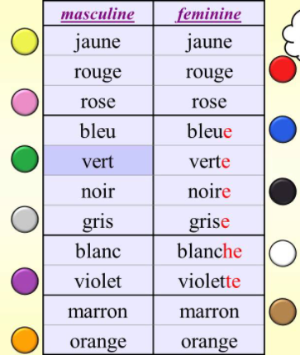
Masculine nouns
Feminine nouns
Un éléphant
Un lion
Un chat
Un furet
Un chien
Une baleine
Une souris
Une vache

Slide 7
Independent task
Using the nouns (animals) on the previous slide and your knowledge of colours, you need to create sentences describing the size and colour of the animals.
Can you create a sentence for each animal
Example:
An elephant is small and white
Un éléphant est petit et blanc
Remember to think about whether the noun is masculine of feminine, it might change how you spell your adjectives

