Slide 1
LO: Write a news article to show Jesus was the messiah

Slide 2
Success criteria
To use our knowledge from previous lessons (qualities in a saviour and qualities needed to help others) to show why Jesus was the messiah
To use our knowledge of Jesus to suggest why he was the messiah

Slide 3
Messiah
The person whom God will send to save humanity, believed by Christians to be Jesus (The anointed one). Hebrew form of the word Christ.
Can you think of stories about Jesus that shows qualities of being a saviour, or times when Jesus has helped others?

Slide 4
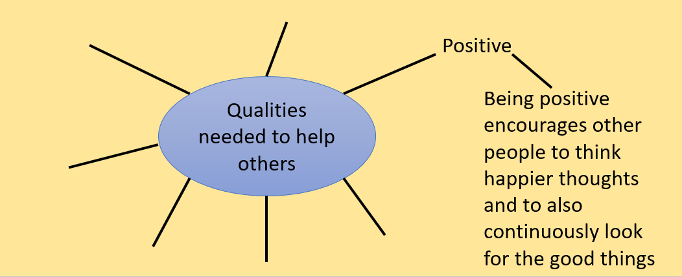
Use your knowledge from previous work (the next two slides should jog your memory) to help you with this next part

Slide 5
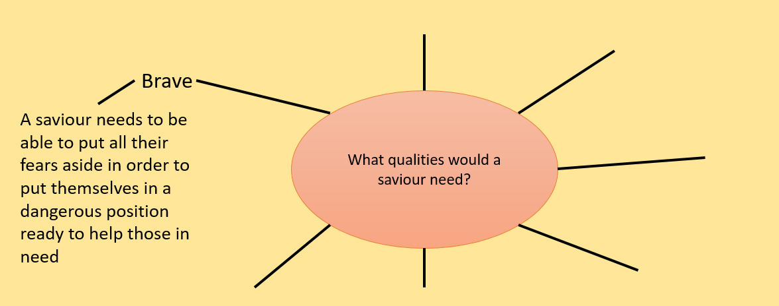

Slide 6
Imagine you are a journalist and you have to interview people about Jesus, what might they say?
Gather and jot down some ideas as you think about what some people might say about Jesus. You might want to interview his mother Mary and Joseph, maybe you could interview some of the wise men that travelled many days to see Jesus Christ.

Slide 7
Independent task
Write a news article that shows Jesus was the messiah.
A messiah is a saviour, use your previous lessons work on being a saviour and see if Jesus has any of those qualities. Explain How important those qualities are and whether you think continuously showed these qualities throughout his life on Earth.
You can include interviews from people close to Jesus that describe how good, kind and helpful Jesus was and whether that links into Jesus being the messiah
Please go to the next slide to see how to be successful when writing a newspaper article

Slide 8
How to be successful
Create an eye-catching headline (title)
Your first sentence should sum up what the article is about
Example: In this article we will be discussing our reasons for Jesus being the messiah
The article must be written in the 3rd person (he/she, they)
The article must be written in the past tense

