Slide 1
LO: to find words derived from root words with ie and ei

Slide 2
How do we create words starting from root words?
Prefix (letters placed in front of the root word to create a new word)
Example: un + happy = unhappy
Un, im, pre
Suffix (letters added to the end of root words to create a new word)
Example: believe + able = believable
ed, ing, able, er, tion, tist, ous
Can you explore using both a prefix and a suffix on a single root word?

Slide 3
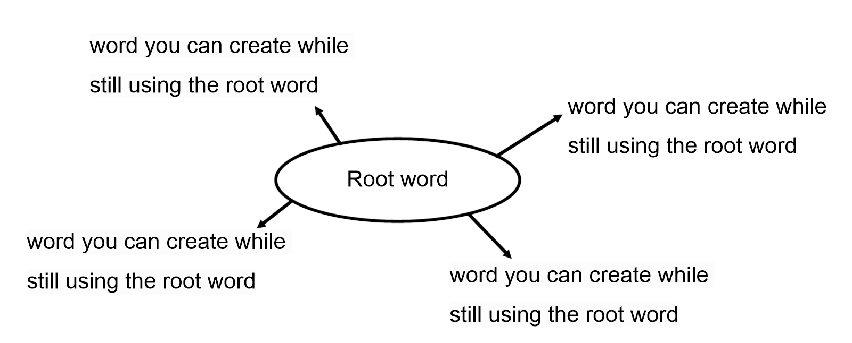

Slide 4
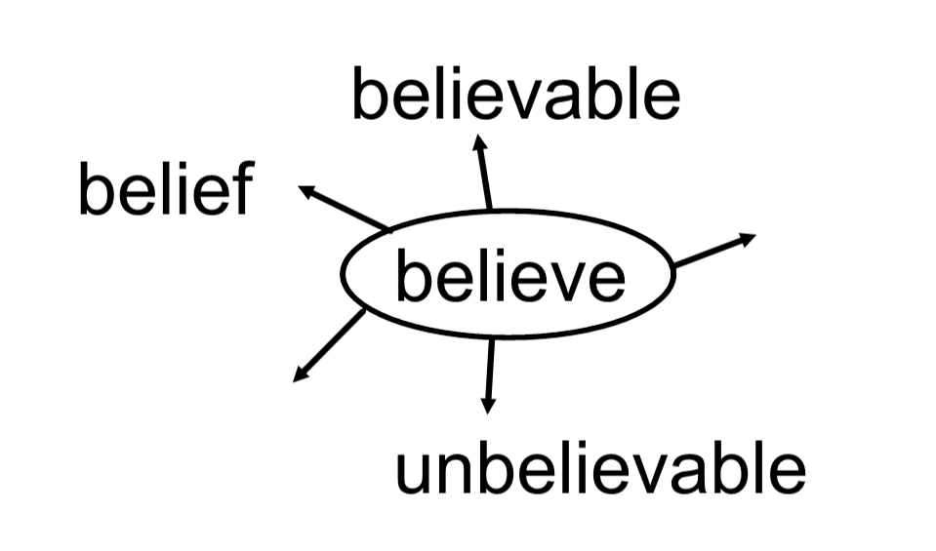
Example
What prefix and suffix can you see being used here?

Slide 5
Independent task
deceive
conceive
receive
perceive
believe
science
conscience
Using the root words in the list, can you create word webs (like the example on the previous slide)
What words can you derive from the root words?

