Slide 1



Safer Internet Day 2015
Let’s create a better internet together
Primary Assembly

Slide 2













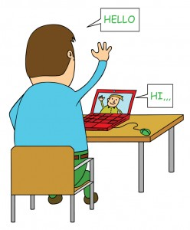


An inspiring and positive place!

Slide 3









What are the 3 best things about the internet for you?
Blogs
Video
Finding things out
Music
Games
Creating
News
Chatting

Slide 4


What do you think?
Imagine if we turned off the internet!
What would you do?
How would you feel?

Slide 5








What worries you when using the internet?
?
?
%&#*$!
Strangers
Mean comments/
behaviour
Viruses
Who would you tell if you had a problem online?
£
£
Spam/junk messages
Things you
didn’t want to see
Adverts

Slide 6

Good digital deeds
?
What can we do to make things better?

Slide 7



How can Sarah do a good digital deed?
Sarah is in Year 3 and loves going online. She lives in Brighton but her grandma lives far away. Sarah loves visiting her grandma but sometimes she worries about her grandma being alone in the house.
Sarah wants to talk to her grandma and show off her new ballet shoes, but she can’t show them to her over the phone. Calling on the phone also costs money. Sarah knows that Skype is free but her grandma doesn’t understand this because she is scared to use her computer.
Can Sarah do a good digital deed to help her grandma?
What could Sarah do to help her grandma feel less lonely?

Slide 8



How can Tom help?
Tom is in year 5. His favourite game online is Minecraft and he loves chatting to his school friends on it and building bigger and better castles.
One day though he came into school and he noticed his best friend Harry was more quiet than usual. He asked him what the problem was and Harry told him that on Minecraft the night before someone had destroyed the castle he had just created and was saying mean things to him. Harry said that this wasn’t the first time it had happened but he didn’t know how to stop it.
Tom could see that his friend Harry was upset and he wanted to help him. What good digital deed could Tom do for Harry?
Thumbs up or down if you think Tom should…

Slide 9


What should Chelsea do?
Chelsea is in year 2. One day, she was trying to get to her favourite game but she made a mistake when she was typing in the website. Suddenly a bright pop up appeared on the screen. It was colourful and flashing and it said to click to win a great prize!
The pop up also said though that you had to give your email address and full name to get to the next stage. Chelsea was excited about the prize but she was worried about giving her email address and full name out online.
She had heard that sometimes things like this can give your computer viruses so that it slows the computer down. She wanted to win all that money but she wasn’t really sure what to do.
Thumbs up if you think Chelsea should…
Notes:
This is an optional extra scenario

Slide 10


It’s up to you!
Thumbs up or down if you think Tom should…
Tell Harry not to be such a baby and to forget about it
Show Harry how to block people you don’t know and report it if people are mean
Tell Harry that he should tell an adult about the cyberbullying

Slide 11
It’s up to you!
Thumbs up or down if you think Chelsea should…
Type in her full name and click to try to win the money?
Tell a grown up so they can delete the pop up?

Slide 12
Be SMART online
SAFE | Keep your personal information safe
MEET | Friends made online are strangers; meeting them can be dangerous
ACCEPTING | Accepting files can be dangerous. If unsure, ask an adult!
RELIABLE | Not everyone or everything online is reliable or trustworthy
TELL | Always tell an adult if something online upsets or worries you

Slide 13
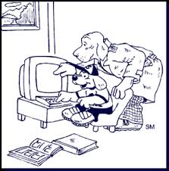

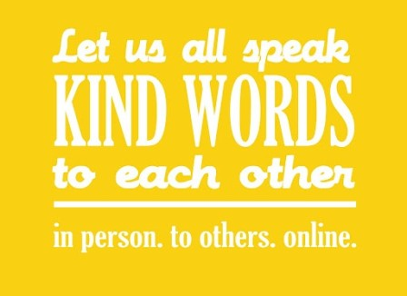
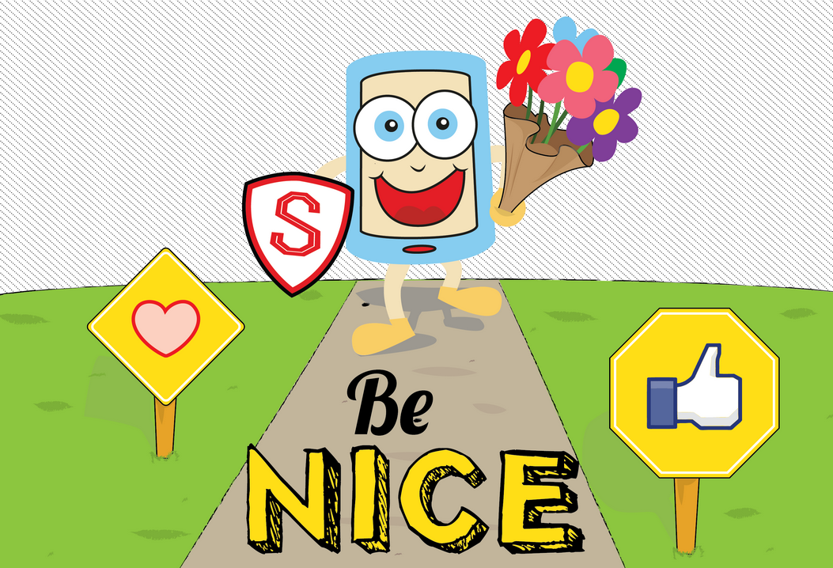
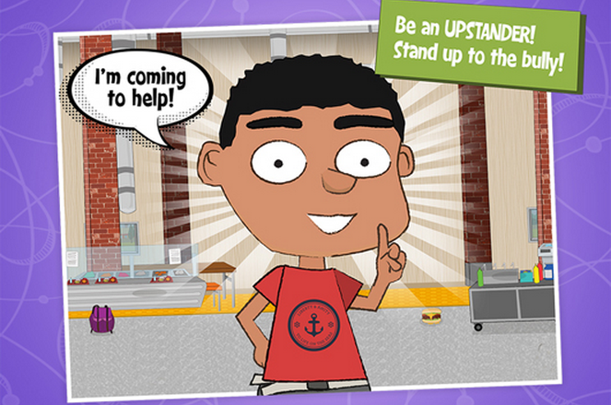

Good digital deeds
What will you do?

