Slide 1


Slide 3

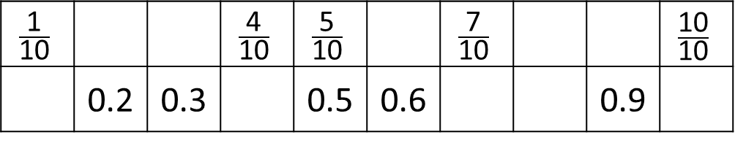
How many mm are there in 1 cm?
Complete the number tracks
Match the lengths to the correct lines.
6 cm
9 cm
4 cm
$$\frac{\text{1}}{\text{10}}$$ |  |  | $$\frac{\text{4}}{\text{10}}$$ | $$\frac{\text{5}}{\text{10}}$$ |  | $$\frac{\text{7}}{\text{10}}$$ |  |  | $$\frac{\text{10}}{\text{10}}$$
 | 0.2 | 0.3 |  | 0.5 | 0.6 |  |  | 0.9

Slide 4


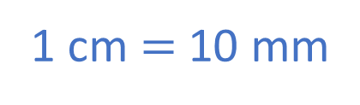



How many mm are there in 1 cm?
Complete the number tracks
Match the lengths to the correct lines.
6 cm
9 cm
4 cm
1 cm $=$ 10 mm
$$\frac{\text{2}}{\text{10}}$$
$$\frac{\text{1}}{\text{10}}$$ |  |  | $$\frac{\text{4}}{\text{10}}$$ | $$\frac{\text{5}}{\text{10}}$$ |  | $$\frac{\text{7}}{\text{10}}$$ |  |  | $$\frac{\text{10}}{\text{10}}$$
 | 0.2 | 0.3 |  | 0.5 | 0.6 |  |  | 0.9
$$\frac{\text{3}}{\text{10}}$$
$$\frac{\text{6}}{\text{10}}$$
$$\frac{\text{8}}{\text{10}}$$
$$\frac{\text{9}}{\text{10}}$$
0.1
0.4
0.7
0.8
.0
1

Slide 6
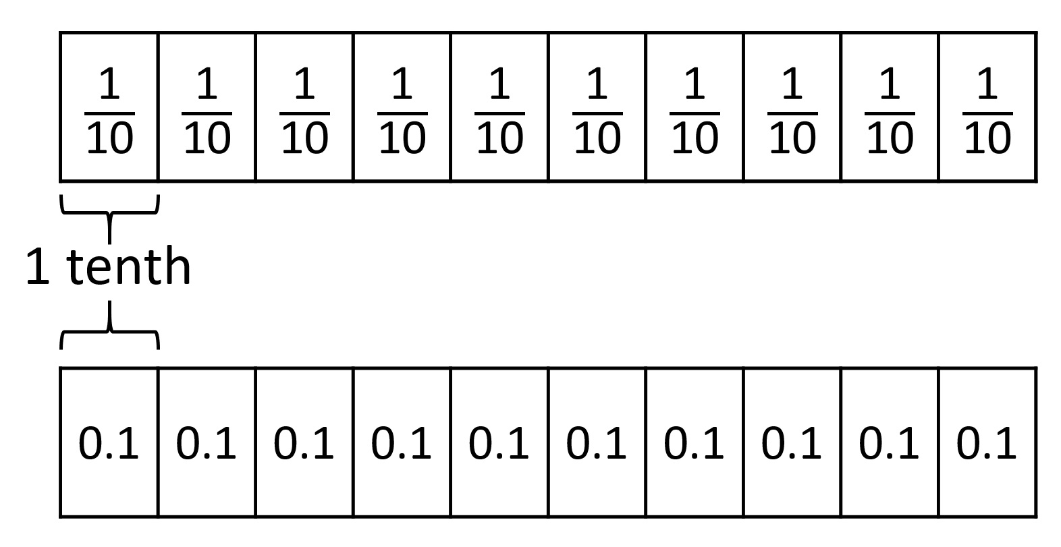
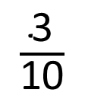
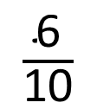
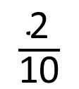
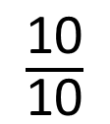
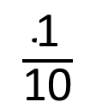
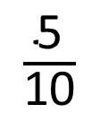
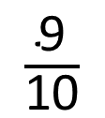
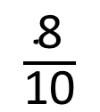
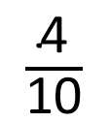
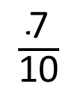
0
0.1
0.2
0.3
0.4
0.5
0.6
0.7
0.8
0.9
1
$\frac{\text{1}}{\text{10}}$
$\frac{\text{2}}{\text{10}}$
$\frac{\text{3}}{\text{10}}$
$\frac{\text{4}}{\text{10}}$
$\frac{\text{5}}{\text{10}}$
$\frac{\text{6}}{\text{10}}$
$\frac{\text{7}}{\text{10}}$
$\frac{\text{8}}{\text{10}}$
$\frac{\text{9}}{\text{10}}$
$\frac{\text{10}}{\text{10}}$

Slide 7
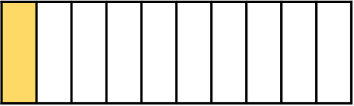
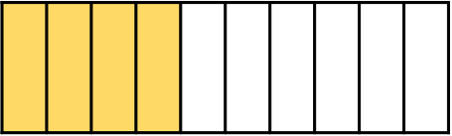
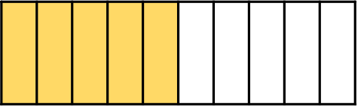
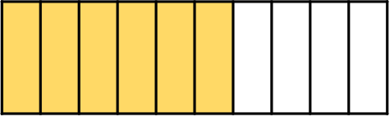
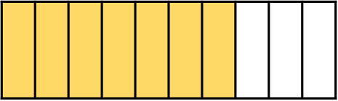
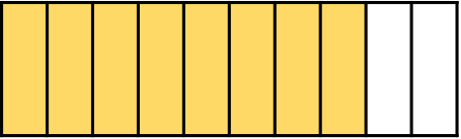
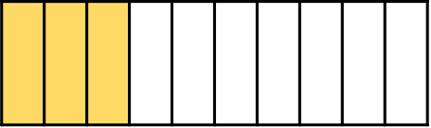
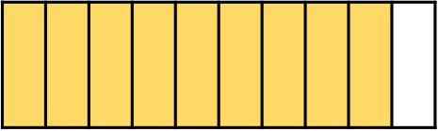

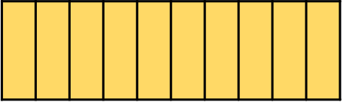
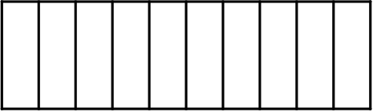
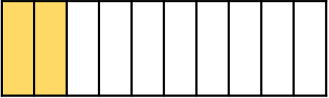
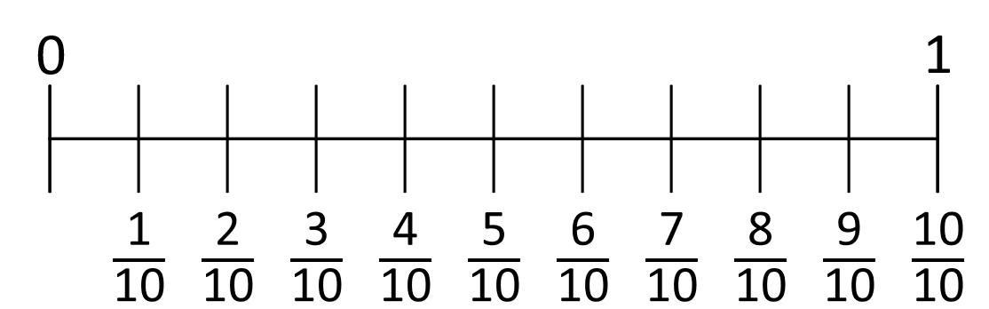









1.1
2
1.2
1.3
1.4
1.5
1.6
1.7
1.8
0.1
1.9
0.2
0.3
0.4
0.5
0.6
0.7
0.8
0.9
$\frac{\text{1}\text{1}}{\text{10}}$
$\frac{\text{12}}{\text{10}}$
$\frac{\text{13}}{\text{10}}$
$\frac{\text{14}}{\text{10}}$
$\frac{\text{15}}{\text{10}}$
$\frac{\text{16}}{\text{10}}$
$\frac{\text{17}}{\text{10}}$
$\frac{\text{18}}{\text{10}}$
$\frac{\text{19}}{\text{10}}$
$\frac{\text{20}}{\text{10}}$

Slide 8

Have a think
4
4.1
4.2
4.3
4.4
4.5
4.6
4.7
4.8
4.9
5
4
4.2
4.4
4.6
4.8
5
4
4.2
4.4
4.6
4.8
5
5.2
5.4
5.6
5.8
6

Slide 9
Have a go at questions
1 – 2 on the worksheet

Slide 10
9 cm
and 3 mm
4 cm
9.3 cm
There are 10 mm in 1 cm.
1 mm is one tenth of 1 cm.

Slide 11
Have a think
How long is the line?
10.8 cm
12 cm
and 8 mm
2 cm
12.8 cm
10 cm
0.8 cm
There are 10 mm in 1 cm.
1 mm is one tenth of 1 cm.

Slide 12
Have a go at question
3 - 5 on the worksheet

Slide 13

Have a think
Estimate the position of the numbers on the number line.
2.2
1.5
2.9
1
2
2.8
3

Slide 14
Have a go at the rest of the worksheet

