Slide 1
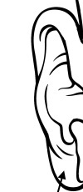
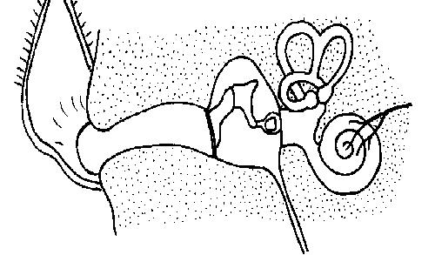
Name: Date: .
Know the parts of the ear and how we hear sounds
Auditory canal Auditory nerve Ear-drum Cochlea Outer ear
1)
2)
3)
4)
5)
6)

Slide 2
Know how we hear sounds
These statements about how we hear are jumbled up. You need to write them in the correct order.
The vibrations pass along the auditory nerve to your brain.
The ear-drum vibrates when a sound hits it.
Your brain sorts the message and you hear the sound.
Your outer ear channels the sound waves into your ear.
The vibrating ear-drum makes the little bones in your ear vibrate.
The sound waves travel along the auditory canal.

