Slide 1
LO: Understand how knowledge of the past is formed and create our own understanding

Slide 2
Success criteria
Put events in chronological order.
Use different research tools.
Be critical of what tools you are using.

Slide 3
How do we know about history?
What can we use to help us research history?

Slide 4
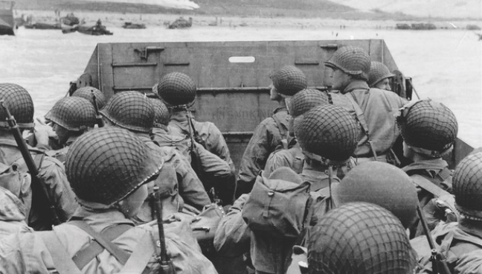
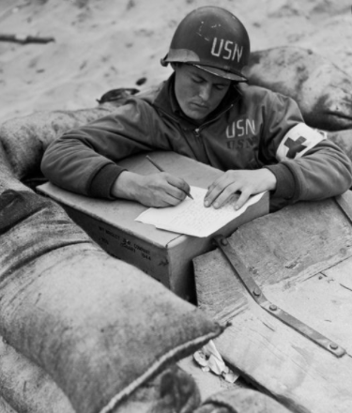
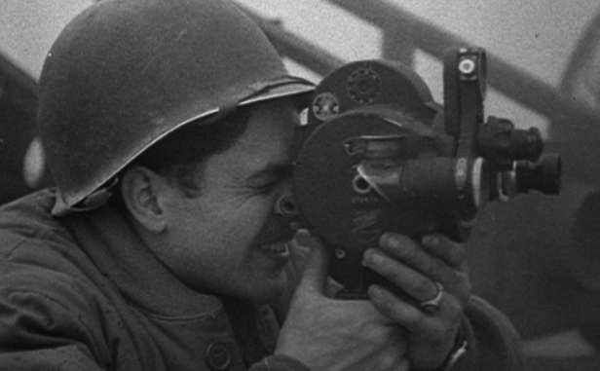
Primary and secondary sources
Primary source is information that has come directly from somebody that was at the event.
How might a primary source look?
  Pictures or photographs
  Audio recording or film
  Journals, letters or diaries
  Published books
  Government publications

Slide 5
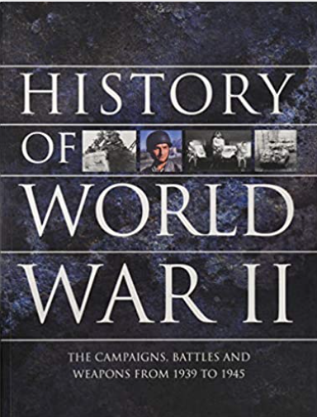
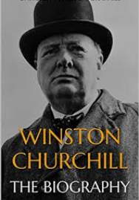
Primary and secondary sources
Secondary source are information that have been created by someone who was not at the event and wrote it at a later time.
How might a secondary source look?
  Textbooks
  Journal articles that analyse research
  Biographies
  Books that analyse research

Slide 6
How to be a good researcher
When researching, we must be critical of everything we read.
How do I know something is fact?
How do I know if it is an opinion?
Is the source reliable?
Is the source valid?

Slide 7
Reliable
Definition
  Good in quality and can be trusted
Valid
Definition
  Something that is acceptable

Slide 8
When searching for information on the internet, how do we know if a website is reliable and valid?
Wikipedia, while it has loads of information is written by anybody. Is that a reliable source?
Pause this video and watch the link below, then have a really good think of whether you could see primary or secondary sources being used. How do you know and why?
https://www.bbc.co.uk/teach/class-clips-video/history-ks2-geography-of-world-war-two/zv99rj6

Slide 9
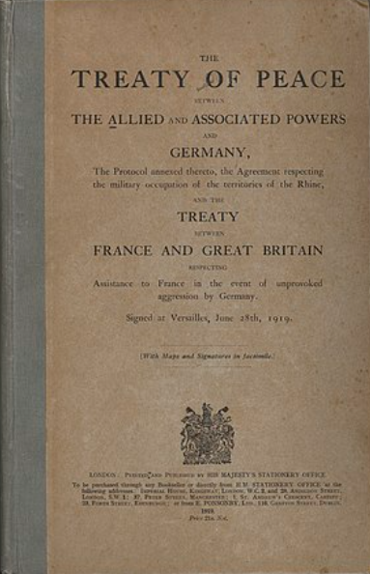
Treaty of Versailles 1919
At the end of World War 1 peace was made, this peace is called the Treaty of Versailles.
If you were head of the Allies, what sort of deal would you have offered Germany? Would you have been lenient? Would you have been average? Or would you have been very harsh?

Slide 10
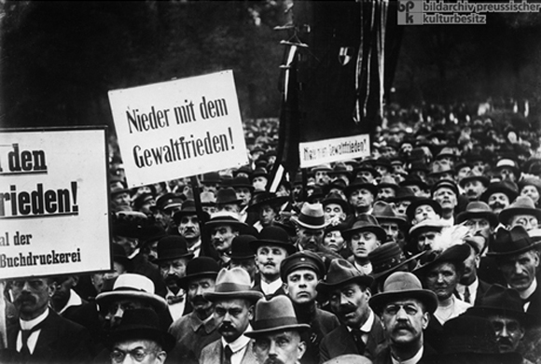
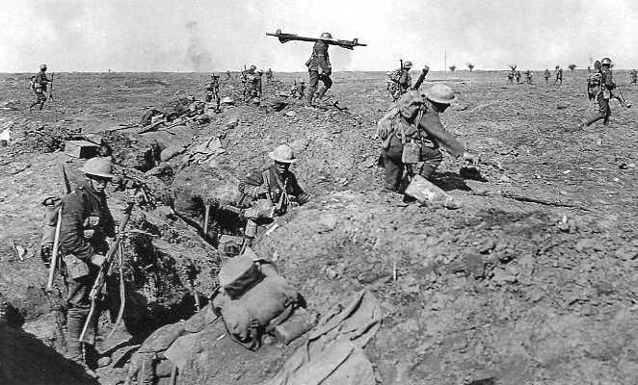
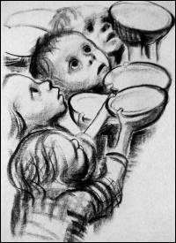
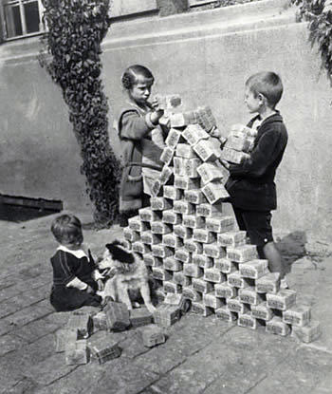
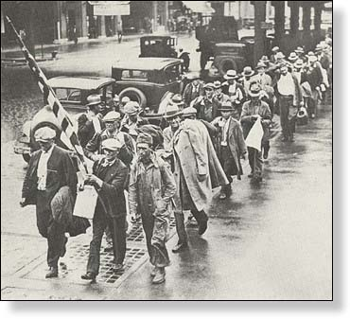
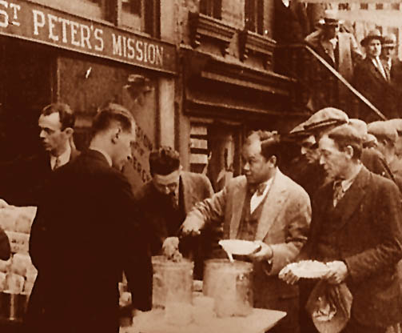
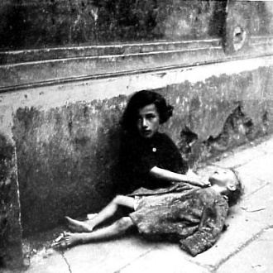
How did the Second World War start?
In 1918 Germany lost World War 1. Britain, France and America won World War 1.
Germany had to give up land and was banned from having any of its own army.
Germany also had to pay lots of war reparations (money) to Britain and France for starting the war.
By 1928 Germany had almost no money.
There was no work for anyone and many people were starving

Slide 11
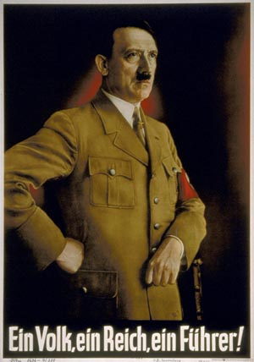
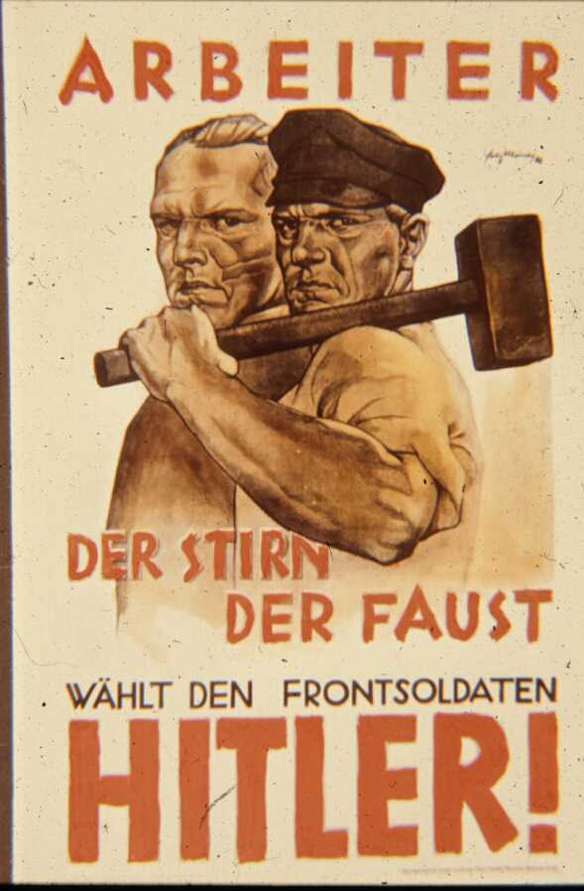
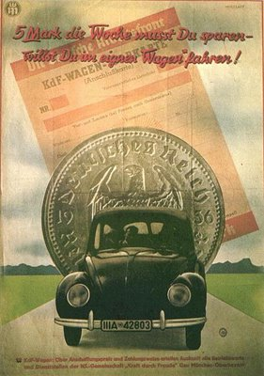
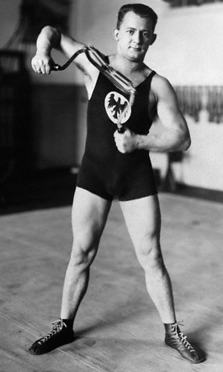
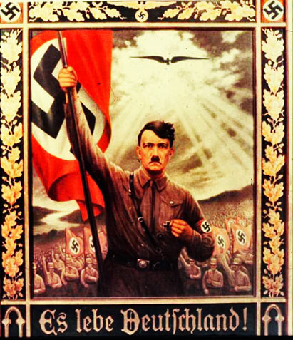
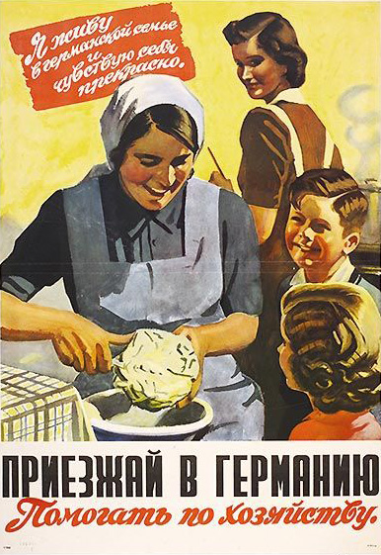
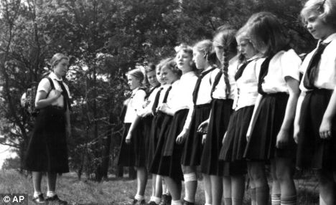

In 1933 a man named Adolf Hitler became the leader of the German government and the leader of Germany.
He had big plans for his country and started to build up Germany’s strength by putting people back to work building, making and becoming a fit and healthy people

Slide 12
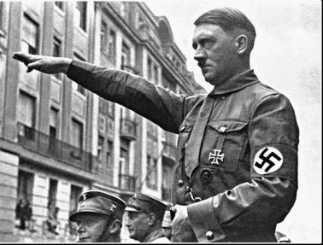
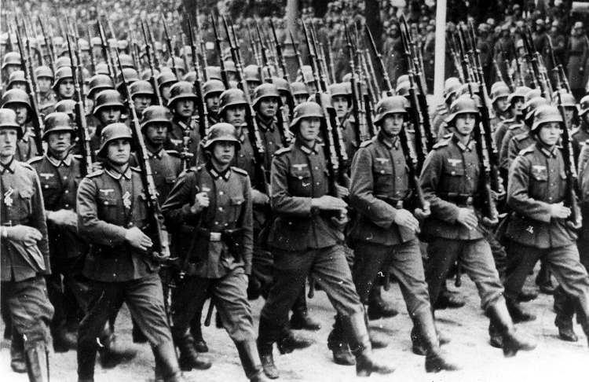
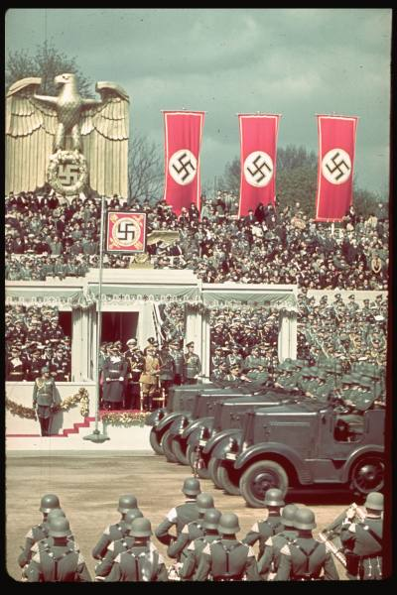
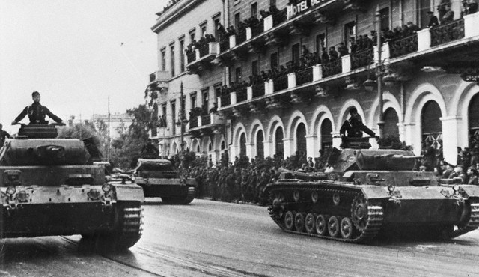
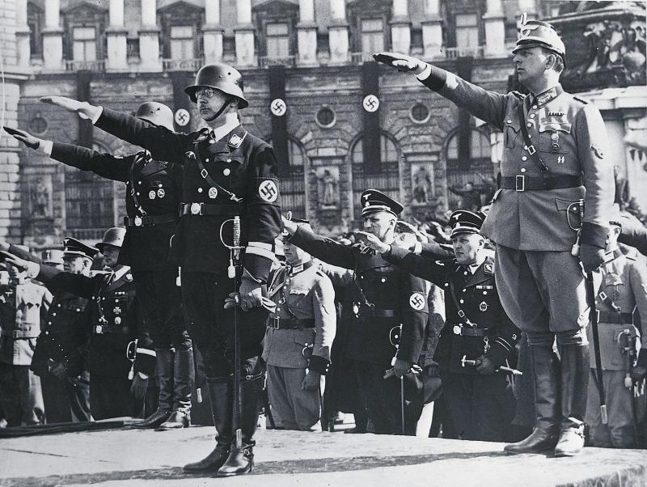
Hitler also started to build up a huge army.
By 1935 Germany had become one of the strongest and most powerful countries in the world. But Hitler believed the German people were the best in the world, he believed they were superior.

Slide 13
Independent task
Can you please create a timeline of events leading up to WWII (these events will be provided).
Using your researching skills can you find and use reliable sources to correctly place the events of WWII in chronological order

