Slide 1
LO: I can describe and investigate helpful and unhelpful micro-organisms.

Slide 2
Success criteria
I know what a micro-organism is
I know whether a micro-organism is helpful or harmful to the human body
I will be able to plan an investigation

Slide 3
What are micro-organisms?
Micro-organisms are very tiny living things that can not be seen by your naked eye. This means you need a microscope in order to see them.
They live on and in our bodies as well as being all around us, they can be found in the air and in water. They can be found in almost every habitat on earth!

Slide 4
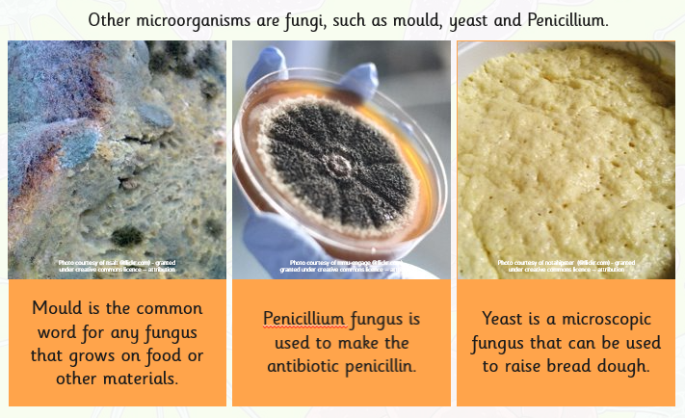
Micro-organisms

Slide 5
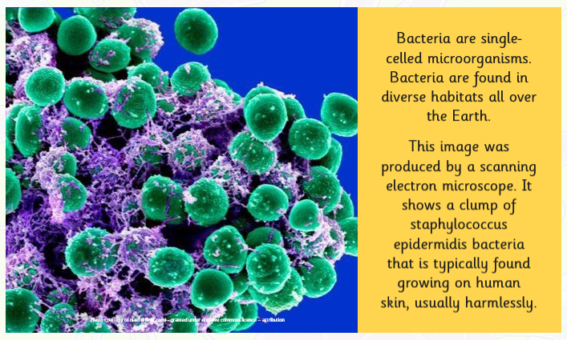
Micro-organisms

Slide 6
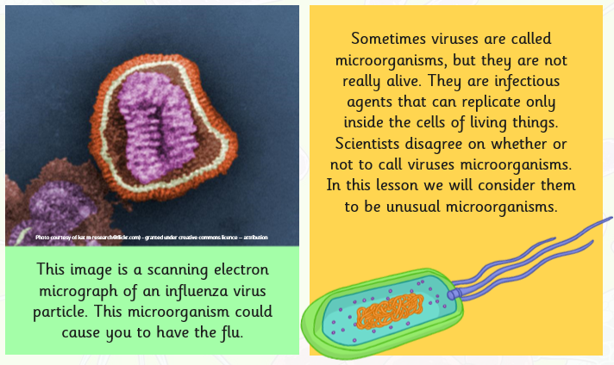
Micro-organisms

Slide 7
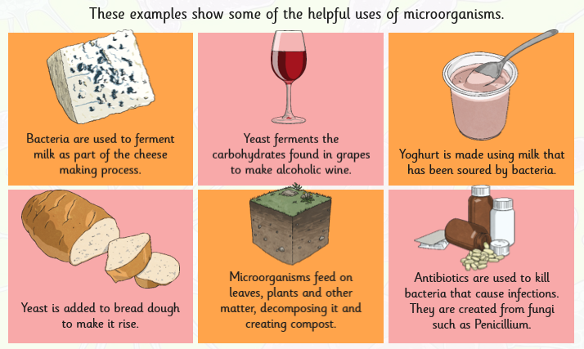
Helpful or harmful?
Micro-organisms can be both helpful and harmful to the human body, their spread needs to be controlled or contained

Slide 8
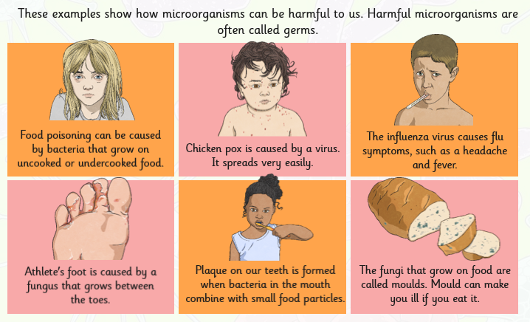
Helpful or harmful?

Slide 9
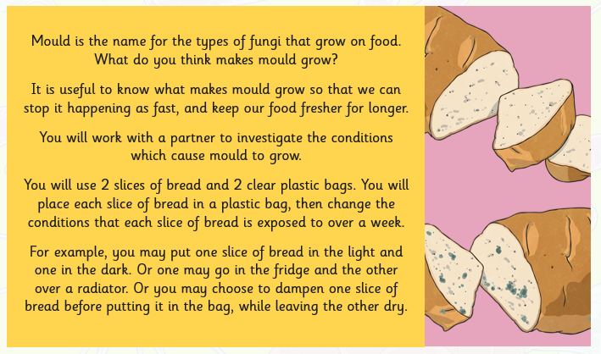
What is mould?

Slide 10
Setting up an investigation
What is your question? What are we investigating?
  How quickly does it take mould to grow in different conditions?
Independent variable
  What variable are we going to change?
Dependent variable
  What are we going to measure?
Control variable
  What are we keeping the same?
What is your hypothesis? (What is your prediction?)
  “I hypothesise that the mould will grow faster on the bread that is…”

Slide 11
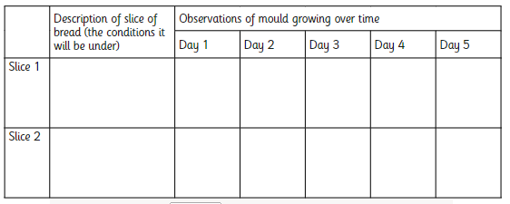
How to record my findings
In my table that I’ve drawn, I will describe what I can see on my bread.
After each day I will describe what I can see and discuss any new observations that I have identified.
Extra detail could be added as a drawing with detailed annotations explaining what has been drawn.

Slide 12
Conclusion
After 5 days have passed, you will have to take your findings and write down the differences that you have discovered.
You should explain what observations you have made
You must discuss the variables that you have used, then you must describe what went well with these variables and what we could do better next time
Finally you should revisit your hypothesis, and explain whether your prediction was right or wrong

