Slide 1
LO: identify problems in the world that concern me and talk to other people about them

Slide 2
Success criteria
I can identify that problems are global and not localised to one area
I can share my thoughts and opinions

Slide 3
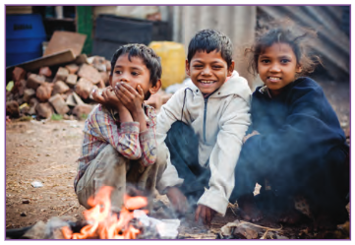
What is the difficulty these children face in their lives?
Where do you think this picture was taken?

Slide 4
What might these children be dreaming of for their future?
What might help their situation?
What feelings do you feel when you consider the situation these children are in?

Slide 5
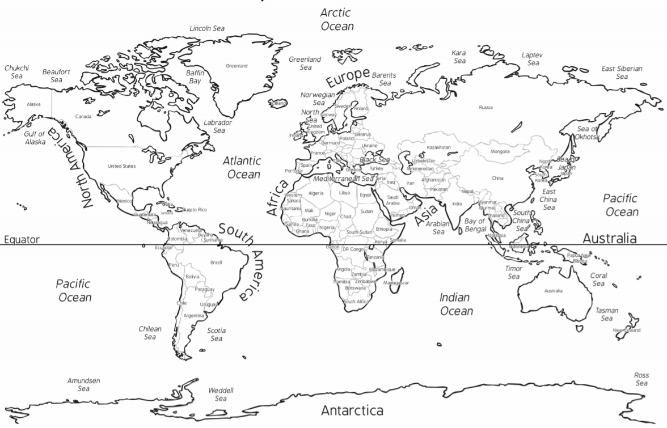
The children in the picture suffer from poverty. Where in the world might you see poverty?

Slide 6
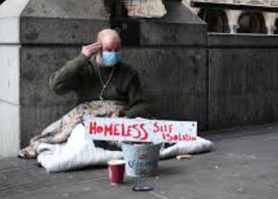
The children in the picture suffer from poverty. Where in the world might you see poverty?
Is poverty only in poor countries?

Slide 7
Independent task
Can you write a short paragraph on ‘your dream for the world’
Are there things in the world you don’t like?
Are there things in this world you want to change?
What could you do to make these changes? (sacrifice time and money to charities)

