Slide 1


Year 5 – Spring Block 3 – Decimals and Percentages – Decimals up to 2d.p.
About This Resource:
This PowerPoint has been designed to support your teaching of this small step. It includes a starter activity and an example of each question from the Varied Fluency and Reasoning and Problem Solving resources also provided in this pack. You can choose to work through all examples provided or a selection of them depending on the needs of your class.
National Curriculum Objectives:
Mathematics Year 5: (5F8) Read, write, order and compare numbers with up to three decimal places
Mathematics Year 5: (5F10) Solve problems involving number up to three decimal places
More Year 5 Decimals and Percentages resources.
Did you like this resource? Don’t forget to review it on our website.
© Classroom Secrets Limited 2019

Slide 2
Year 5 – Spring Block 3 – Decimals and Percentages
Step 1: Decimals up to 2d.p.
© Classroom Secrets Limited 2019

Slide 3
Introduction
Order the numbers below from smallest to largest.
26.2
25
24.9
26
26.7
20.9
© Classroom Secrets Limited 2019

Slide 4
Introduction
Order the numbers below from smallest to largest.
smallest largest
26.2
25
24.9
26
26.7
20.9
20.9
24.9
25
26
26.2
26.7
© Classroom Secrets Limited 2019

Slide 5
Varied Fluency 1
Circle the decimal number that is represented on the place value chart.
Ones | Tenths | Hundredths
1
0.1
0.01
0.01
0.1
0.1
1
0.01
0.1
0.1
0.01
A. 2.45 |  | B. 0.54 |  | C. 2.54
© Classroom Secrets Limited 2019

Slide 6
Varied Fluency 1
Circle the decimal number that is represented on the place value chart.
Ones | Tenths | Hundredths
1
0.1
0.01
0.01
0.1
0.1
1
0.01
0.1
0.1
0.01
A. 2.45 |  | B. 0.54 |  | C. 2.54
© Classroom Secrets Limited 2019

Slide 7
Varied Fluency 2
Match each decimal number to the correct visual representation.
A. | 1.28 | 1.
B. | 2.08 | 2.
C. | 1.11 | 3.
0.01
0.01
0.01
0.01
0.01
0.01
1
0.01
0.01
0.01
0.01
0.01
1
0.01
0.01
0.01
0.01
1
0.01
0.01
0.01
0.01
0.1
0.01
0.01
0.01
0.01
1
0.1
0.01
0.01
0.01
0.01
© Classroom Secrets Limited 2019

Slide 8
Varied Fluency 2
Match each decimal number to the correct visual representation.
A. | 1.28 | 1.
B. | 2.08 | 2.
C. | 1.11 | 3.
0.01
0.01
0.01
0.01
0.01
0.01
1
0.01
0.01
0.01
0.01
0.01
1
0.01
0.01
0.01
0.01
1
0.01
0.01
0.01
0.01
0.1
0.01
0.01
0.01
0.01
1
0.1
0.01
0.01
0.01
0.01
© Classroom Secrets Limited 2019

Slide 9
Varied Fluency 3
True or false?
0.42 = 3 tenths + 12 hundredths
0.1
0.1
0.01
0.01
0.01
0.1
0.01
0.01
0.01
0.01
0.01
0.01
0.01
0.01
0.01
© Classroom Secrets Limited 2019

Slide 10
Varied Fluency 3
True or false?
0.42 = 3 tenths + 12 hundredths
True
0.1
0.1
0.01
0.01
0.01
0.1
0.01
0.01
0.01
0.01
0.01
0.01
0.01
0.01
0.01
© Classroom Secrets Limited 2019

Slide 11
Varied Fluency 4
In which number does the 4 have the lowest value?
8.49 |  | 8.94 |  | 4.98
© Classroom Secrets Limited 2019

Slide 12
Varied Fluency 4
In which number does the 4 have the lowest value?
8.49 |  | 8.94 |  | 4.98
© Classroom Secrets Limited 2019

Slide 13
Reasoning 1
Spot the odd one out.
Explain your answer fully.
A.
3 + 0.1 + 0.15
D.
0.01
0.01
B.
0.01
three ones, 2 tenths and 5 hundredths.
0.01
0.01
0.01
0.1
0.1
C.
3.25
1
1
1
© Classroom Secrets Limited 2019

Slide 14
Reasoning 1
Spot the odd one out.
Explain your answer fully.
The odd one out is D because...
A.
3 + 0.1 + 0.15
D.
0.01
0.01
B.
0.01
three ones, 2 tenths and 5 hundredths.
0.01
0.01
0.01
0.1
0.1
C.
3.25
1
1
1
© Classroom Secrets Limited 2019

Slide 15
Reasoning 1
Spot the odd one out.
Explain your answer fully.
The odd one out is D because it represents 3.26. All of the others represent 3.25.
A.
3 + 0.1 + 0.15
D.
0.01
0.01
B.
0.01
three ones, 2 tenths and 5 hundredths.
0.01
0.01
0.01
0.1
0.1
C.
3.25
1
1
1
© Classroom Secrets Limited 2019

Slide 16
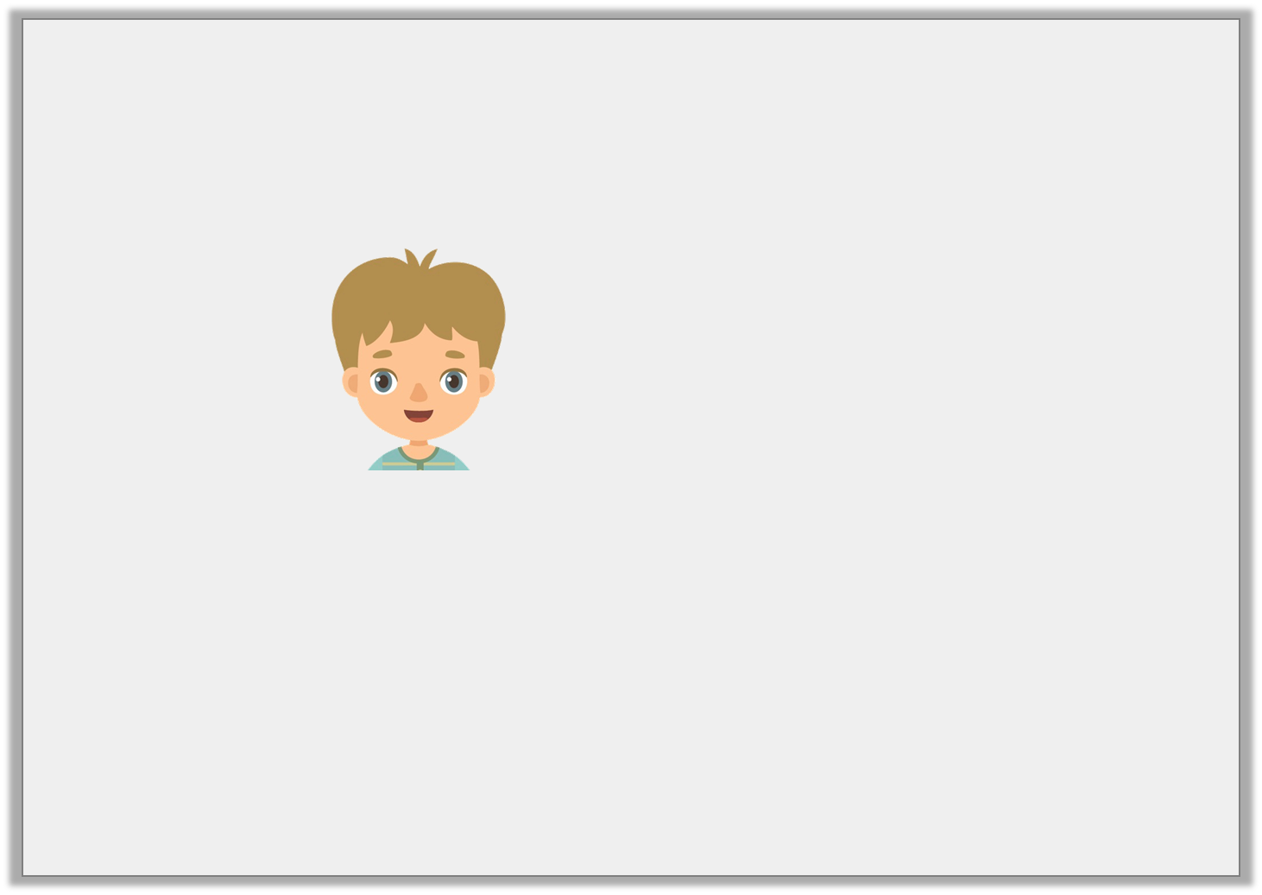
Problem Solving 1
Paul is thinking of a number.
What number is Paul thinking of? Is there more than one possible answer?
My number lies between
3 + 0.6 + 0.08
and 3 + 0.4 + 0.21
© Classroom Secrets Limited 2019

Slide 17
Problem Solving 1
Paul is thinking of a number.
What number is Paul thinking of? Is there more than one possible answer?
3.62, 3.63, 3.64, 3.65, 3.66 or 3.67
My number lies between
3 + 0.6 + 0.08
and 3 + 0.4 + 0.21
© Classroom Secrets Limited 2019

Slide 18
Reasoning 2
Harry has used place value counters to partition 3.06.
Is he correct? Prove it.
0.1
0.1
0.1
0.1
0.01
0.01
1
0.1
0.1
0.01
0.01
1
0.1
0.1
0.01
0.01
0.1
0.1
© Classroom Secrets Limited 2019

Slide 19
Reasoning 2
Harry has used place value counters to partition 3.06.
Is he correct? Prove it.
Harry is correct because...
0.1
0.1
0.1
0.1
0.01
0.01
1
0.1
0.1
0.01
0.01
1
0.1
0.1
0.01
0.01
0.1
0.1
© Classroom Secrets Limited 2019

Slide 20
Reasoning 2
Harry has used place value counters to partition 3.06.
Is he correct? Prove it.
Harry is correct because 10 tenths is the same as 1 one.
0.1
0.1
0.1
0.1
0.01
0.01
1
0.1
0.1
0.01
0.01
1
0.1
0.1
0.01
0.01
0.1
0.1
© Classroom Secrets Limited 2019

