Slide 1


Year 6 – Spring Block 1 – Decimals – Division to Solve Problems
About This Resource:
This PowerPoint has been designed to support your teaching of this small step. It includes a starter activity and an example of each question from the Varied Fluency and Reasoning and Problem Solving resources also provided in this pack. You can choose to work through all examples provided or a selection of them depending on the needs of your class.
National Curriculum Objectives:
Mathematics Year 6: (6C8) Solve problems involving addition, subtraction, multiplication and division
Mathematics Year 6: (6F9c) Use written division methods in cases where the answer has up to two decimal places
More resources which follow the same small steps as White Rose.
Did you like this resource? Don’t forget to review it on our website.
© Classroom Secrets Limited 2018

Slide 2
Year 6 – Spring – Block 1 – Decimals
Step 6: Division to Solve Problems
© Classroom Secrets Limited 2018

Slide 3
Introduction
Choose one digit to fill the gap in each set of calculations.
6
5
4
9
8
A
36 |  |  | ÷ |  | = | 9
2 |  |  | ÷ |  | = | 6
 |  |  | ÷ | 11 | =
B
12 |  |  | ÷ |  | = | 2
3 |  |  | ÷ |  | =
 |  | 0 | ÷ | 10 | =
36 |  |  | ÷ | 4 | = | 9
2 | 4 |  | ÷ | 4 | = | 6
4 |  | 4 | ÷ | 11 | = | 4
C
63 |  |  | ÷ |  | = | 7
 | 9 |  | ÷ |  | = | 11
 |  |  | ÷ | 11 | =
D
5 |  |  | ÷ | 6 | = | 9
8 |  |  | ÷ | 12 | = | 7
 |  | 8 | ÷ | 12 | =
© Classroom Secrets Limited 2018

Slide 4
Introduction
Choose one digit to fill the gap in each set of calculations.
6
5
4
9
8
A
36 |  |  | ÷ | 4 | = | 9
2 | 4 |  | ÷ | 4 | = | 6
4 |  | 4 | ÷ | 11 | = | 4
B
12 |  |  | ÷ | 6 | = | 2
3 | 6 |  | ÷ | 6 | = | 6
6 |  | 0 | ÷ | 10 | = | 6
36 |  |  | ÷ | 4 | = | 9
2 | 4 |  | ÷ | 4 | = | 6
4 |  | 4 | ÷ | 11 | = | 4
C
63 |  |  | ÷ | 9 | = | 7
9 | 9 |  | ÷ | 9 | = | 11
9 |  | 9 | ÷ | 11 | = | 9
D
5 |  | 4 | ÷ | 6 | = | 9
8 | 4 |  | ÷ | 12 | = | 7
4 |  | 8 | ÷ | 12 | = | 4
© Classroom Secrets Limited 2018

Slide 5
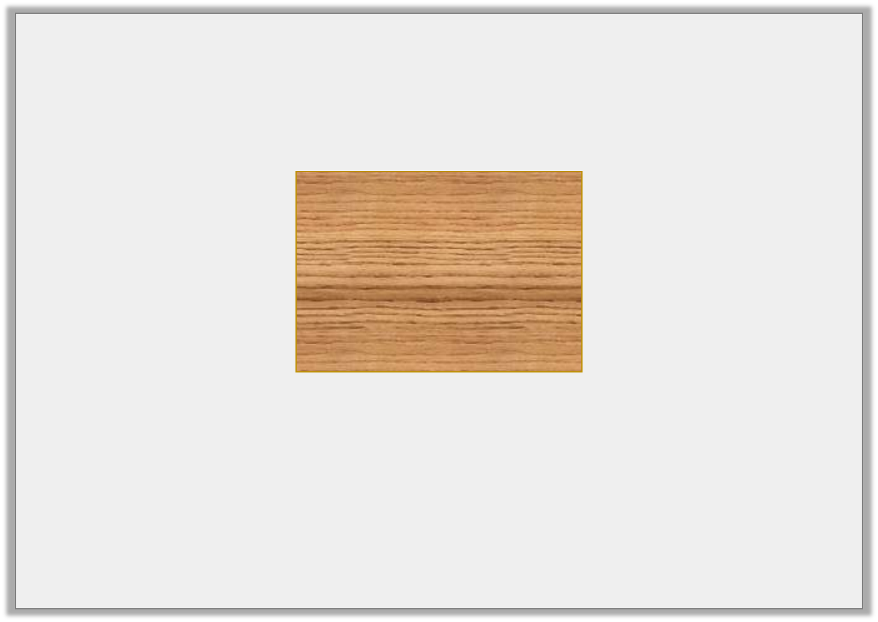
Varied Fluency 1
Dad is making a log store.
He needs 5 equal pieces from this plank.
How wide would each piece be?
12.75m
© Classroom Secrets Limited 2018

Slide 6
Varied Fluency 1
Dad is making a log store.
He needs 5 equal pieces from this plank.
How wide would each piece be?
12.75m ÷ 5 = 2.55m
12.75m
© Classroom Secrets Limited 2018

Slide 7

Varied Fluency 2
The school bee hives produce 57 litres of honey each year.
4 classes share the honey to sell on their stall at the fayre.
How much does each stall have?
© Classroom Secrets Limited 2018

Slide 8
Varied Fluency 2
The school bee hives produce 57 litres of honey each year.
4 classes share the honey to sell on their stall at the fayre.
How much does each stall have?
57 litres ÷ 4 = 14.25 litres per class
© Classroom Secrets Limited 2018

Slide 9
Varied Fluency 3
A farmer sells 45.5kg of carrots every week in harvest season.
He sells four times as many carrots to Asdi supermarket as to local markets.
How much does he sell to markets?
45.5kg
market | Asdi | Asdi | Asdi | Asdi
© Classroom Secrets Limited 2018

Slide 10
Varied Fluency 3
A farmer sells 45.5kg of carrots every week in harvest season.
He sells four times as many carrots to Asdi supermarket as to local markets.
How much does he sell to markets?
45.5 ÷ 5 = 9.1kg to markets
45.5kg
market | Asdi | Asdi | Asdi | Asdi
© Classroom Secrets Limited 2018

Slide 11
Varied Fluency 4
Create your own word problem for the calculation.
Now solve it!
34.4 | ÷ | 8 | =
© Classroom Secrets Limited 2018

Slide 12
Varied Fluency 4
Create your own word problem for the calculation.
Now solve it!
Various possible answers for a word problem with the same solution.
There is 34.4kg of flour to be shared equally between 8 bakeries. How much does each bakery get?
34.4 | ÷ | 8 | = | 4.3
© Classroom Secrets Limited 2018

Slide 13
Problem Solving 1
Which of these numbers when divided by 5 give an answer with two decimal places?
Find two more numbers.
7.5
61.6
9.75
© Classroom Secrets Limited 2018

Slide 14
Problem Solving 1
Which of these numbers when divided by 5 give an answer with two decimal places?
Find two more numbers.
Various answers, for example:
23.25 ÷ 5 = 4.65
1.75 ÷ 5 = 0.35
7.5
61.6
9.75
1.5
12.32
1.95
© Classroom Secrets Limited 2018

Slide 15
Reasoning 1
Edith has written the following comparisons.
Is she correct?
Find and explain any errors.
A | 5 | ÷ | 10 | = | 4 | ÷ | 8
B | 1.5 | ÷ | 5 | > | 0.4 | ÷ | 10
C | 18.2 | ÷ | 4 | < | 21.5 | ÷ | 5
© Classroom Secrets Limited 2018

Slide 16
Reasoning 1
Edith has written the following comparisons.
Is she correct?
Find and explain any errors.
She is incorrect because…
A | 5 | ÷ | 10 | = | 4 | ÷ | 8
B | 1.5 | ÷ | 5 | > | 0.4 | ÷ | 10
C | 18.2 | ÷ | 4 | < | 21.5 | ÷ | 5
© Classroom Secrets Limited 2018

Slide 17
Reasoning 1
Edith has written the following comparisons.
Is she correct?
Find and explain any errors.
She is incorrect because 4.55 > 4.3.
A | 5 | ÷ | 10 | = | 4 | ÷ | 8
B | 1.5 | ÷ | 5 | > | 0.4 | ÷ | 10
C | 18.2 | ÷ | 4 | < | 21.5 | ÷ | 5
© Classroom Secrets Limited 2018

Slide 18
Problem Solving 2
Use the digit cards to complete the calculation.
8
2
5
7
 | 2 | ÷ |  | = | 2.
© Classroom Secrets Limited 2018

Slide 19
Problem Solving 2
Use the digit cards to complete the calculation.
8
2
5
7
2 | 2 | ÷ | 8 | = | 2. | 7 |  | 5
© Classroom Secrets Limited 2018

