Slide 1
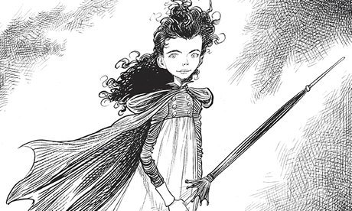
Wednesday 13th January 2021
LO: to use adverbs of possibility to show our opinion.
Maltravers definitely sneaks about the hall when everyone is asleep.
Video Link for this lesson: https://www.loom.com/share/fcec796aef314df3ac67b4e4dcb3a181

Slide 2
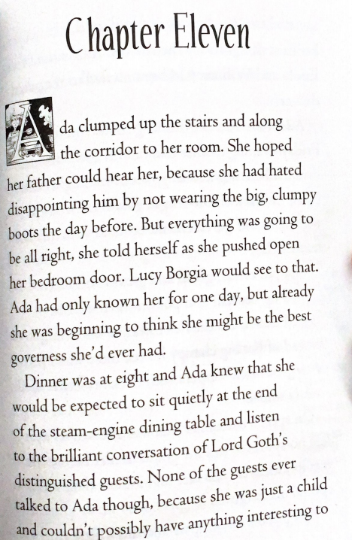
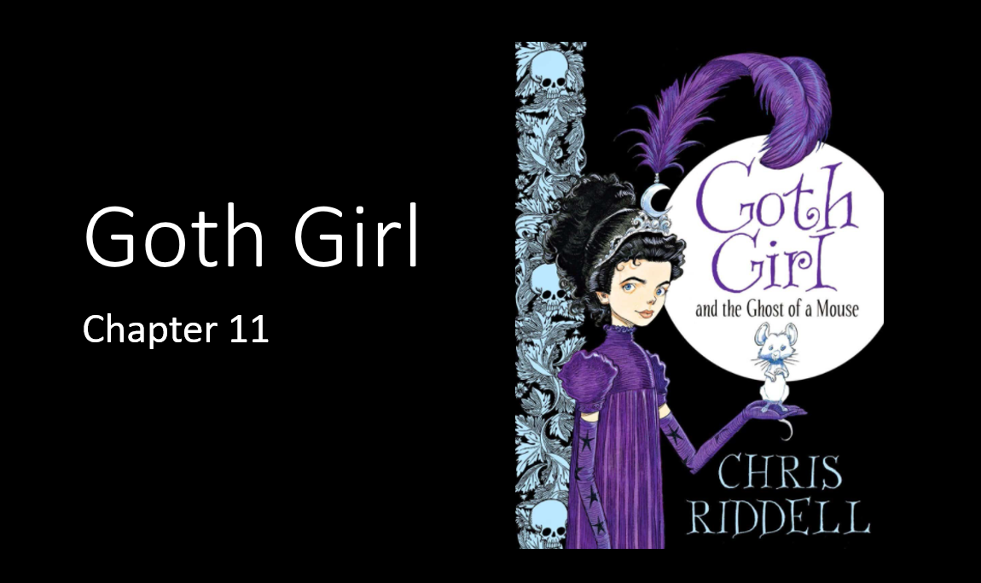
Task one for English today:
Make sure you have downloaded the PDF file of Goth Girl chapter 11.
Either read the chapter yourself or have the text open whilst you listen to Mr Hubbard read the chapter from the audio book on the website: www.brixington.devon.sch.uk/goth-girl-audiobook

Slide 3
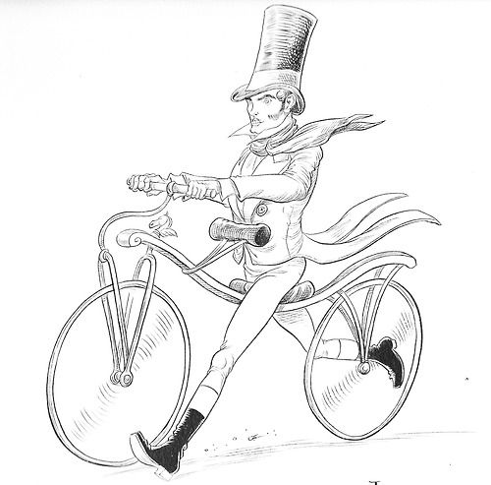
Adverbs
Adverbs tell us more about a verb.
Adverbs of possibility tell us how certain we are about the verb.
Maltravers is definitely hiding something.
Lord Goth will possibly win the bicycle race.
Ishmael will perhaps haunt Ada forever.

Slide 4
Adverbs
You can order these adverbs by certainty.
certainly
surely
definitely
perhaps
possibly
maybe
probably
LESS CERTAIN |  |  |  | CERTAIN
What order would you put these in?

Slide 5
Adverbs
You can order these adverbs by certainty.
certainly
surely
definitely
perhaps
possibly
maybe
probably
LESS CERTAIN |  |  |  | CERTAIN
What order would you put these in? Do you agree with this ordering?

Slide 6
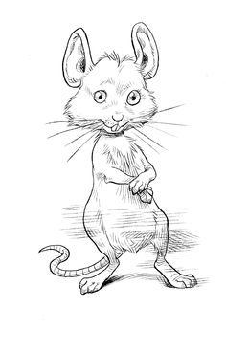
Adverbs
Adverbs of possibility usually go before the main verb.
I surely did.
The Attic Club certainly is a secret.
Mice definitely like cheese.
Some adverbs of possibility can go at the beginning of the sentence.
Maybe, Lucy Borgia will be able to help Ada.
Perhaps, things will work out in the end.
These adverbs modify the whole clause.

Slide 7
Thinking about our Predictions
Adverbs of possibility are useful when discussing opinions.
Think about the predictions you made about Goth Girl and the Ghost of a Mouse.
Which predictions are you more certain or less certain about?
Certainly, Ada’s next governess is…
Possibly, Marylebone is…
Maltravers is probably…
Adverbs of possibility: perhaps, maybe, possibly, probably, surely, definitely, certainly

Slide 8
Wednesday 13th January 2021
LO: to use adverbs of possibility to show our opinion.
Your task:
Write a sentence for each adverb of possibility to show your opinions of the characters in Goth Girl.
Adverbs of possibility: perhaps, maybe, possibly, probably, surely, definitely, certainly
Extend your sentences with the following:
A relative clause (who/whose/which/that/whom)
An expanded noun phrase (the heavy gold doors at the end of the hallway…)
Subordinating (ISAWAWABUBO) and co-ordinating (FANBOYS) conjunctions

