Slide 1
Ready-to-go Lesson Slides
Year 6
Number: Decimals
Lesson 5
Spr1

Slide 3
STARTER:
Start with the number 0.132 and travel to the FINISH square by moving horizontally or vertically each time.
What is your final answer?
0.132 | x 3 | x 10 | x 5
x 2 | x 5 | x 6 | x 10
x 2 | x 4 | x 4 | x 2
x 7 | x 5 | x 7 | x 3
x 4 | x 6 | x 5 | FINISH

Slide 4
STARTER:
Start with the number 0.132 and travel to the FINISH square
by moving horizontally or vertically each time.
What is your final answer?
For example:
0.132 x 2 = 0.264 → 0.264 x 5 = 1.32 → 1.32 x 6 = 7.92 →
7.92 x 4 = 31.68 → 31.68 x 7 = 221.76 → 221.76 x 3 = 665.28
0.132 | x 3 | x 10 | x 5
x 2 | x 5 | x 6 | x 10
x 2 | x 4 | x 4 | x 2
x 7 | x 5 | x 7 | x 3
x 4 | x 6 | x 5 | FINISH
Extension:
Which route will result in the smallest total?

Slide 5
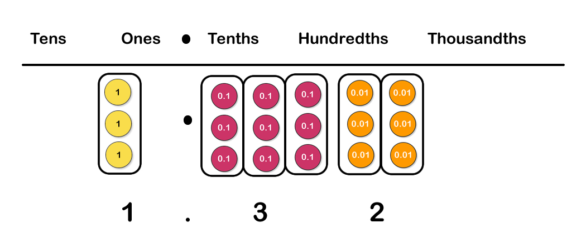
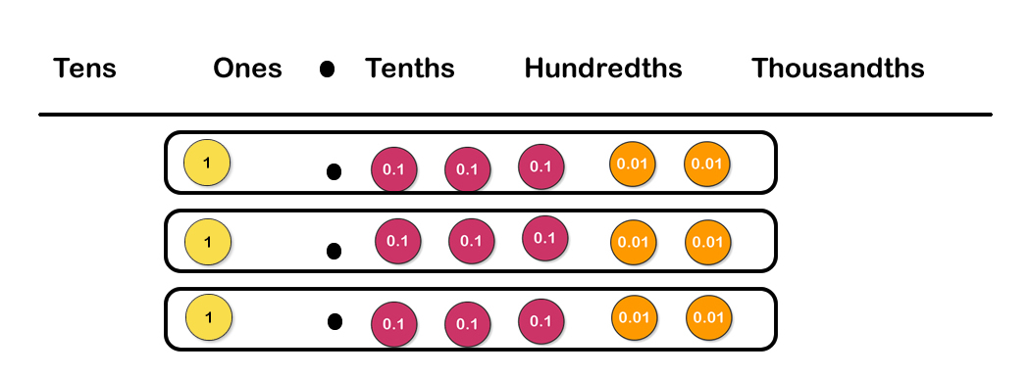
TALKING TIME:
These diagrams show how 3.96 can be divided by 3.
Which method shows sharing?
Which method shows grouping?

Slide 6
TALKING TIME:
These diagrams show how 3.96 can be divided by 3.
Which method shows sharing?
Which method shows grouping?
Here, 3.96 has been grouped into threes. The answer is 1.32.
Here, 3.96 has been shared into three equal parts. Each part is worth 1.32.

Slide 7
TALKING TIME:
Complete the sentences about this division:
3 ones divided by 3 equals ___ one.
9 tenths divided by 3 equals ___ tenths.
6 hundredths divided by 3 equals ___ hundredths.
3.96 divided by 3 equals ____ + ____ + ____, which is the same as _____.

Slide 8
TALKING TIME:
Complete the sentences about this division:
3 ones divided by 3 equals 1 one.
9 tenths divided by 3 equals 3 tenths.
6 hundredths divided by 3 equals 2 hundredths.
3.96 divided by 3 equals 1 + 0.3 + 0.02, which is the same as 1.32.

Slide 9
ACTIVITY 1:
Use grouping to find the answer to 1.44 ÷ 6.

Slide 10
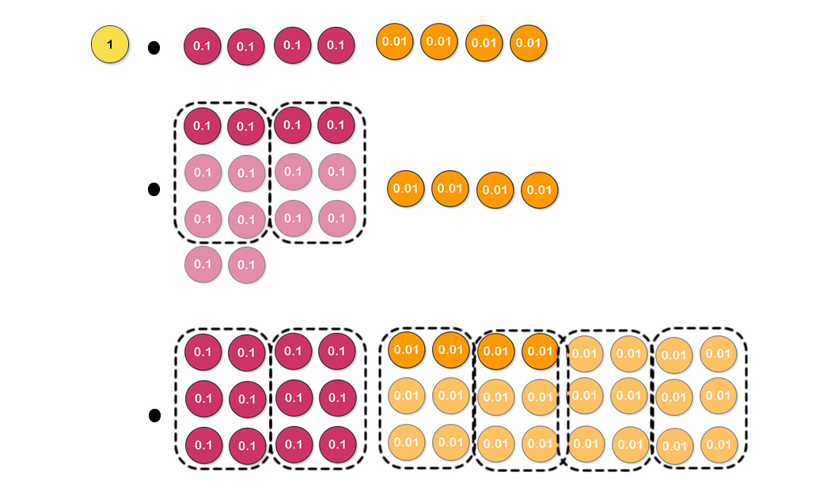
ACTIVITY 1:
Use grouping to find the answer to 1.44 ÷ 6.
1 one cannot be grouped into six, so exchange for 10 tenths then group into sixes.
2 tenths cannot be grouped into six, so exchange for 20 hundredths then group into sixes.
1.44 ÷ 6 = 0.24

Slide 11
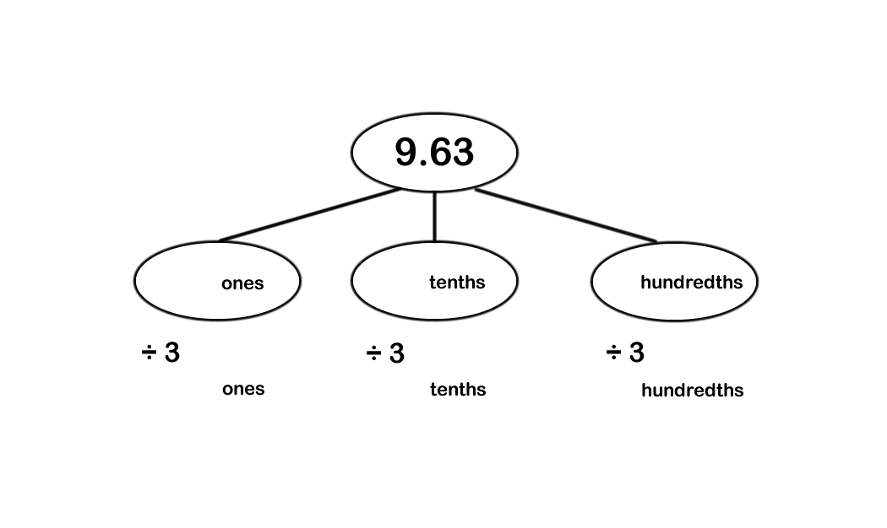
TALKING TIME:
Complete this part-whole diagram to find the answer to
9.63 ÷ 3.

Slide 12
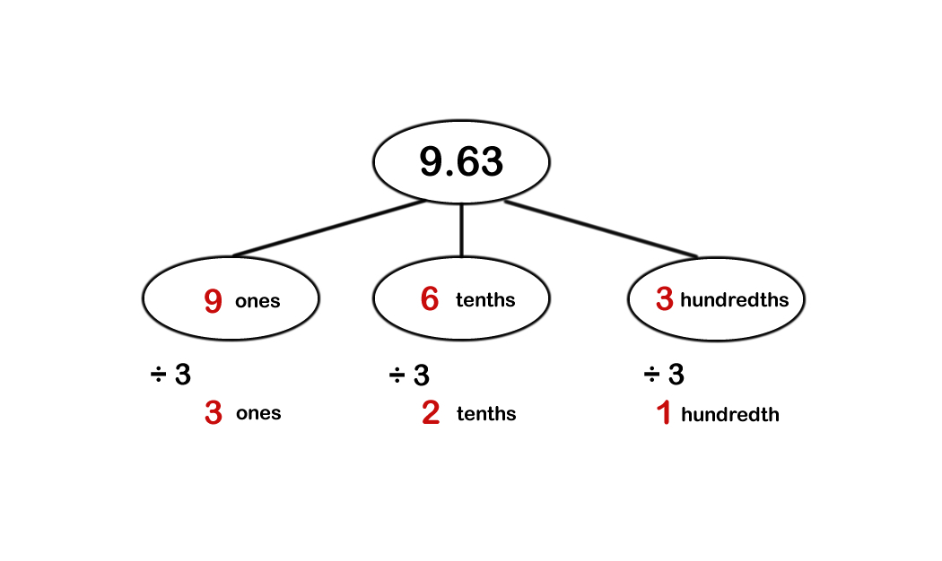
TALKING TIME:
Complete this part-whole diagram to find the answer to
9.63 ÷ 3.
9.63 ÷ 3 = 3.21

Slide 13
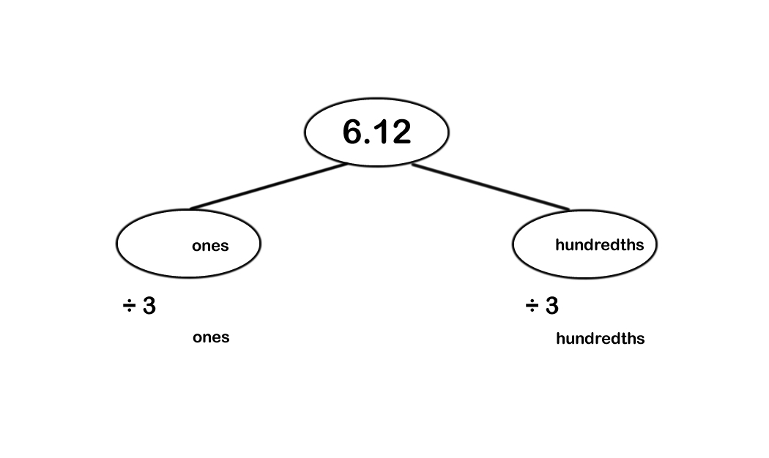
TALKING TIME:
Complete this part-whole diagram to find the answer to
6.12 ÷ 3.

Slide 14
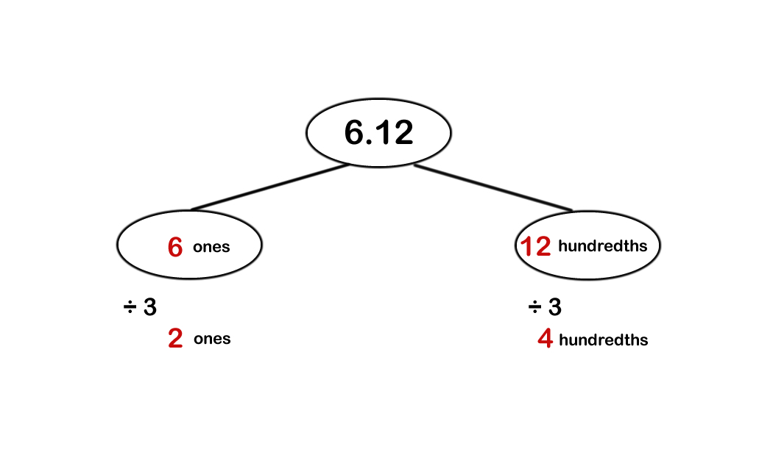
TALKING TIME:
Complete this part-whole diagram to find the answer to
6.12 ÷ 3.
6.12 ÷ 3 = 2.04

Slide 15
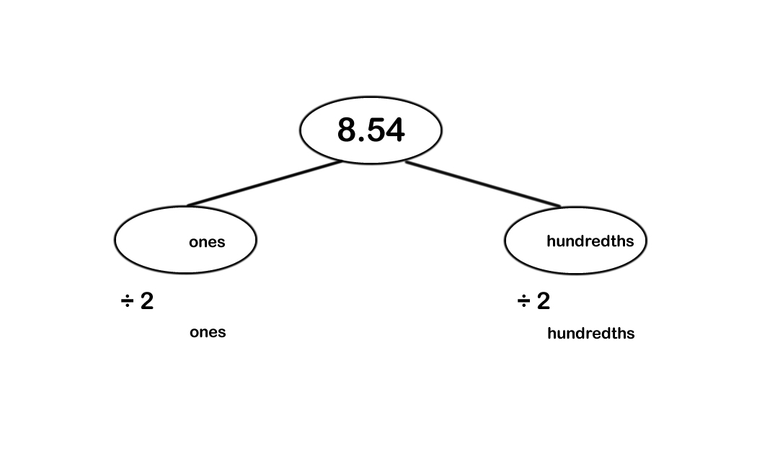
ACTIVITY 2:
Complete this part-whole diagram to find the answer to
8.54 ÷ 2.

Slide 16
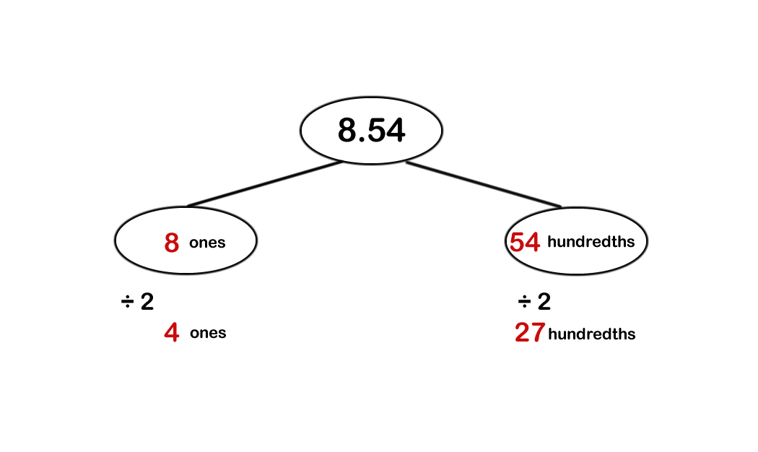
ACTIVITY 2:
Complete this part-whole diagram to find the answer to
8.54 ÷ 2.
8.54 ÷ 2 = 4.27

Slide 17
ACTIVITY 3:
A bag of sand weighs 12.69 kg.
It is tipped into three buckets, so that each bucket contains the same amount. How much sand is in each bucket?
Use a part-whole diagram to find the answer.

Slide 18
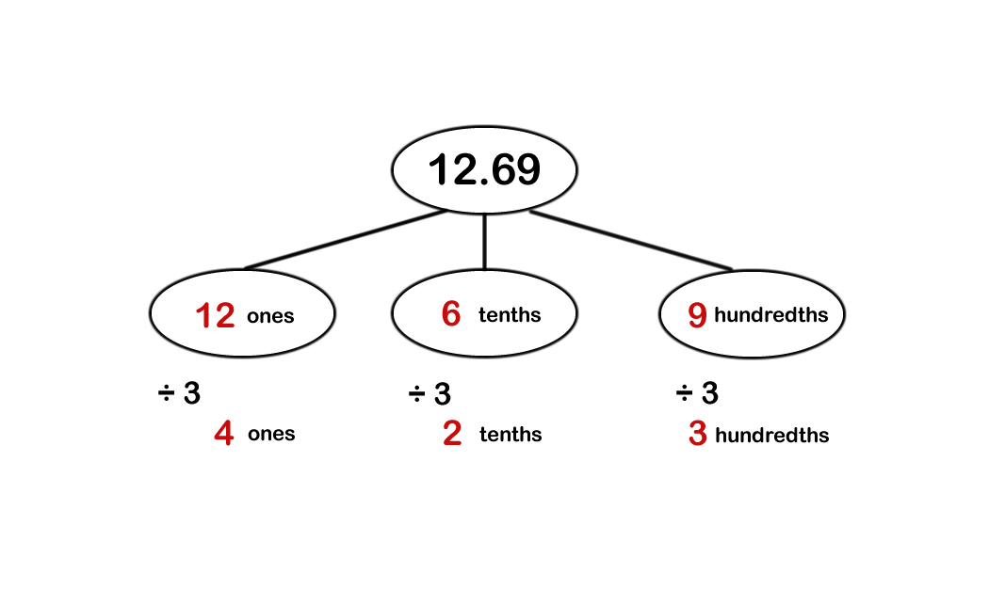
ACTIVITY 3:
A bag of sand weighs 12.69 kg.
It is tipped into three buckets, so that each bucket contains the same amount. How much sand is in each bucket?
Use a part-whole diagram to find the answer.
12.69 ÷ 3 = 4.23
There is 4.23 kg of sand in each bucket.

Slide 19
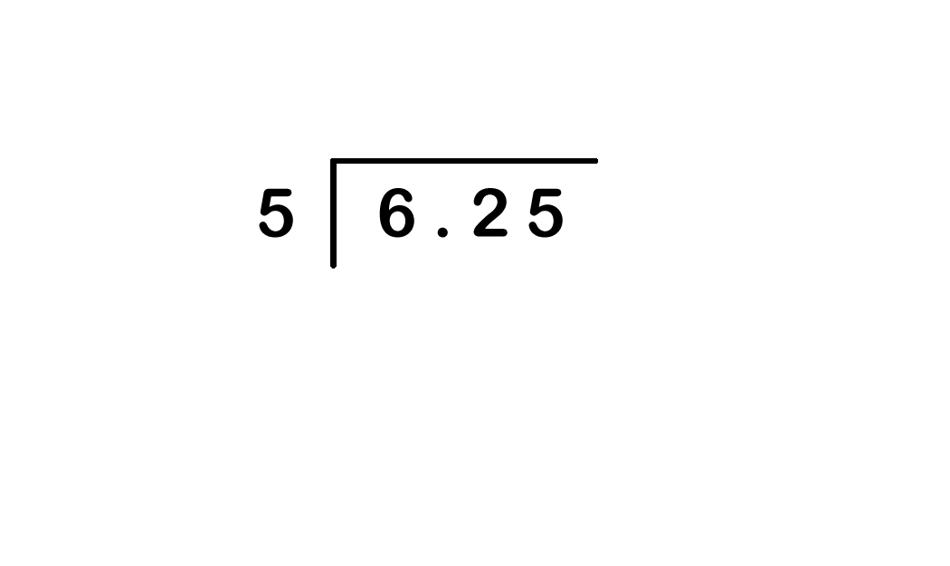
TALKING TIME:
Use the short division method to find the answer to 6.25 ÷ 5.

Slide 20
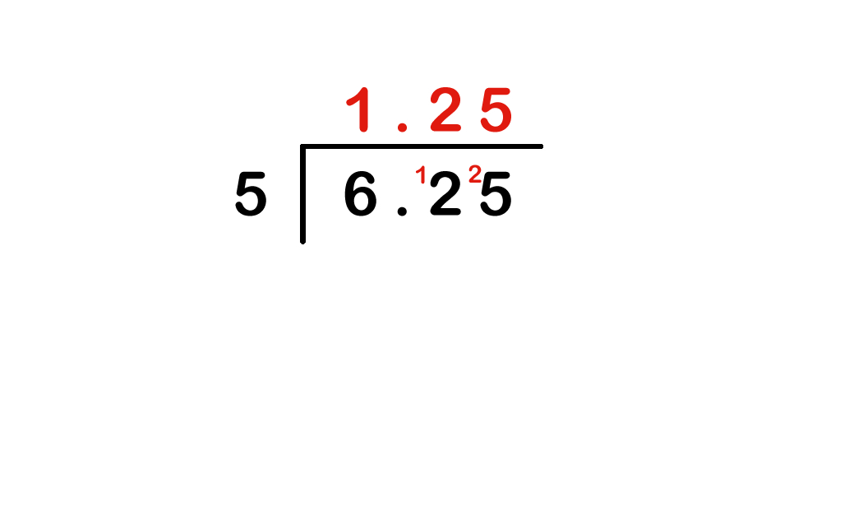
TALKING TIME:
Use the short division method to find the answer to 6.25 ÷ 5.

Slide 21
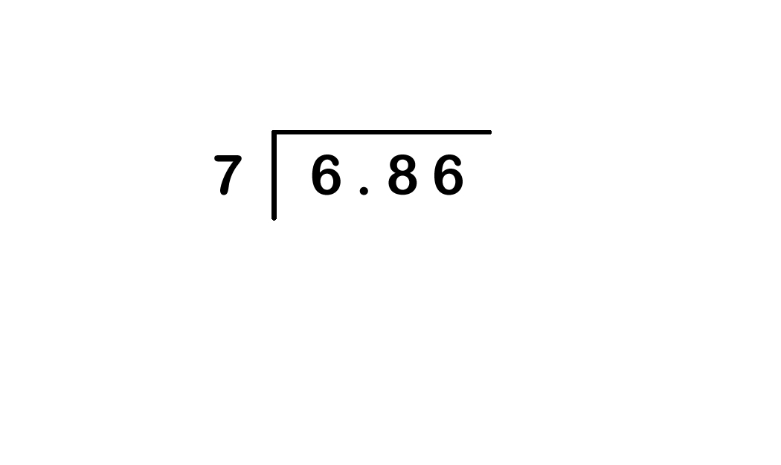
TALKING TIME:
Calculate 6.86 ÷ 7 using this method.

Slide 22
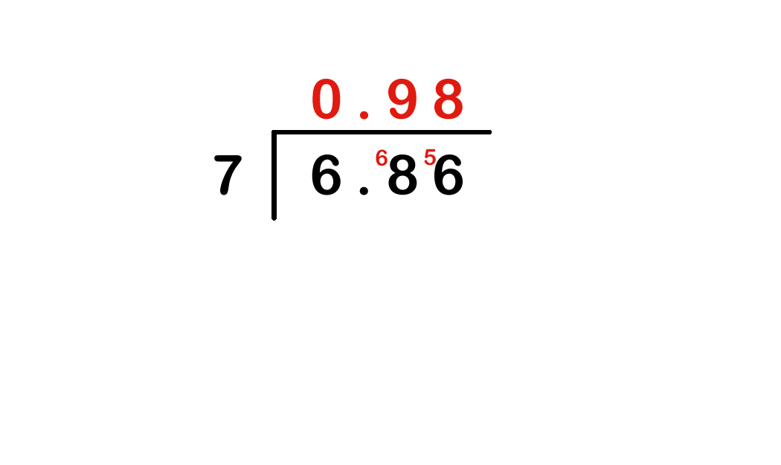
TALKING TIME:
Calculate 6.86 ÷ 7 using this method.

Slide 23
ACTIVITY 4:
Tom buys four notebooks for £3.04. The notebooks all cost the same amount. How much does one notebook cost?
Use the short division method to find the answer.

Slide 24
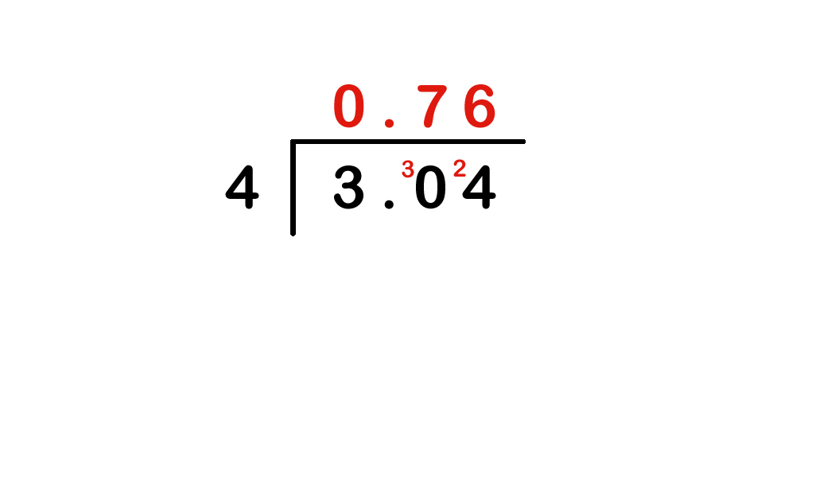
ACTIVITY 4:
Tom buys four notebooks for £3.04. The notebooks all cost the same amount. How much does one notebook cost?
Use the short division method to find the answer.
3.04 ÷ 4 = 0.76
Each notebook costs 76p (or £0.76)

Slide 25
EVALUATION:
True or False?
There are four lots of 0.21 in 0.84.
b) 96.36 ÷ 3 = 32.23
c) 0.55 ÷ 5 = 0.5
86.24 ÷ 2 = 43.12
e) If £5.65 is shared equally between 5 people, they will each have £1.13

Slide 26
EVALUATION:
True or False?
There are four lots of 0.21 in 0.84. TRUE
b) 96.36 ÷ 3 = 32.23 FALSE
c) 0.55 ÷ 5 = 0.5 FALSE
86.24 ÷ 2 = 43.12 TRUE
e) If £5.65 is shared equally between 5 people, they will each have £1.13 TRUE

Slide 27


