Slide 1


Year 6 – Spring Block 1 – Decimals – Divide Decimals by Integers
About This Resource:
This PowerPoint has been designed to support your teaching of this small step. It includes a starter activity and an example of each question from the Varied Fluency and Reasoning and Problem Solving resources also provided in this pack. You can choose to work through all examples provided or a selection of them depending on the needs of your class.
National Curriculum Objectives:
Mathematics Year 6: (6F9a) Identify the value of each digit in numbers given to three decimal places and multiply and divide numbers by 10, 100 and 1000 giving answers up to three decimal places
Mathematics Year 6: (6F9c) Use written division methods in cases where the answer has up to two decimal places
More resources which follow the same small steps as White Rose.
Did you like this resource? Don’t forget to review it on our website.
© Classroom Secrets Limited 2018

Slide 2
Year 6 – Spring Block 1 – Decimals
Step 5: Divide Decimals by Integers
© Classroom Secrets Limited 2018

Slide 3
Introduction
Using place value counters and the grid below, partition the number 4.35.
Ones​ | Tenths​ | Hundredths​
​ | ​ | ​
© Classroom Secrets Limited 2018

Slide 4
Introduction
Using place value counters and the grid below, partition the number 4.35.
Ones​ | Tenths​ | Hundredths​
​ | ​ | ​
1
0.1
0.01
1
0.1
0.01
1
0.1
0.01
1
0.01
0.01
© Classroom Secrets Limited 2018

Slide 5
Varied Fluency 1
Circle the correct answer.
5.10 ÷ 5 =
10.2 1.02 1.2
© Classroom Secrets Limited 2018

Slide 6
Varied Fluency 1
Circle the correct answer.
5.10 ÷ 5 =
10.2 1.02 1.2
© Classroom Secrets Limited 2018

Slide 7
Varied Fluency 2
Calculate:
i. 10.55 ÷ 5 =
4.02 ÷ 2 =
8.16 ÷ 4 =
© Classroom Secrets Limited 2018

Slide 8
Varied Fluency 2
Calculate:
i. 10.55 ÷ 5 = 2.11
4.02 ÷ 2 = 2.01
8.16 ÷ 4 = 2.04
© Classroom Secrets Limited 2018

Slide 9
Varied Fluency 3
Calculate the missing integers.
i. | 8.88 | ÷ |  | = | 2.22
ii. | 20.05 | ÷ |  | = | 4.01
© Classroom Secrets Limited 2018

Slide 10
Varied Fluency 3
Calculate the missing integers.
i. | 8.88 | ÷ | 4 | = | 2.22
ii. | 20.05 | ÷ | 5 | = | 4.01
© Classroom Secrets Limited 2018

Slide 11
Varied Fluency 4
Jake and his two friends have raised £30.27 from a sponsored swim.
They can’t agree on one charity to send the money to, so they decide to split the money equally between three charities.
How much will each charity receive?
© Classroom Secrets Limited 2018

Slide 12
Varied Fluency 4
Jake and his two friends have raised £30.27 from a sponsored swim.
They can’t agree on one charity to send the money to, so they decide to split the money equally between three charities.
How much will each charity receive?
£30.27 ÷ 3 = £10.09
© Classroom Secrets Limited 2018

Slide 13
Reasoning 1
True or False? 5.15 ÷ 5 = 1.3
Explain your answer.
1
1
1
0.1
0.01
0.01
1
1
0.01
0.01
0.01
© Classroom Secrets Limited 2018

Slide 14
Reasoning 1
True or False? 5.15 ÷ 5 = 1.3
Explain your answer.
False because…
1
1
1
0.1
0.01
0.01
1
1
0.01
0.01
0.01
© Classroom Secrets Limited 2018

Slide 15
Reasoning 1
True or False? 5.15 ÷ 5 = 1.3
Explain your answer.
False because 5.15 ÷ 5 = 1.03
1
1
1
0.1
0.01
0.01
1
1
0.01
0.01
0.01
© Classroom Secrets Limited 2018

Slide 16
Problem Solving 1
Calculate the missing digits
5.___5 ÷ 5 = 1.01
B. 16.2___ ÷ 4 = 4.06
© Classroom Secrets Limited 2018

Slide 17
Problem Solving 1
Calculate the missing digits
5.05 ÷ 5 = 1.01
B. 16.24 ÷ 4 = 4.06
© Classroom Secrets Limited 2018

Slide 18
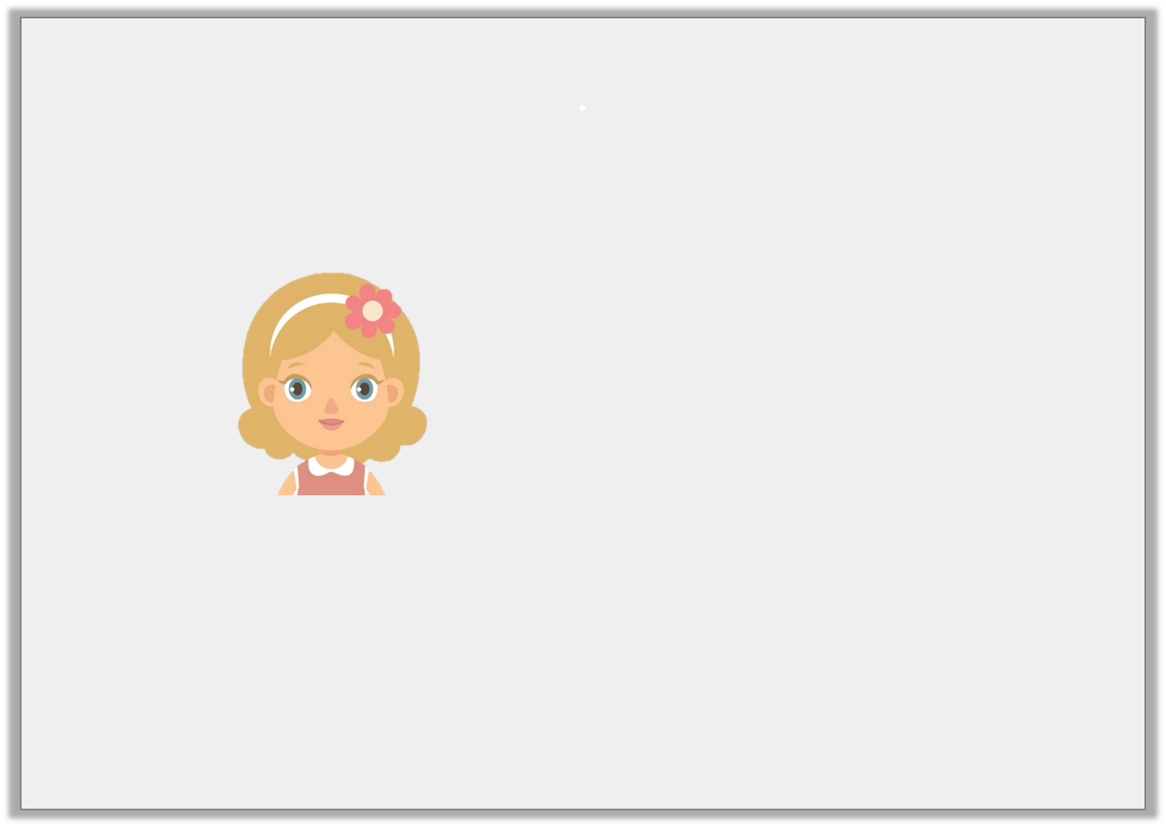
Reasoning 2
Poppy says:
Is she correct? Explain how you know.
.
I think that the answers to
6.22 ÷ 2 and 9.33 ÷ 3 are the same.
© Classroom Secrets Limited 2018

Slide 19
Reasoning 2
Poppy says:
Is she correct? Explain how you know.
Poppy is correct because… .
.
I think that the answers to
6.22 ÷ 2 and 9.33 ÷ 3 are the same.
© Classroom Secrets Limited 2018

Slide 20
Reasoning 2
Poppy says:
Is she correct? Explain how you know.
Poppy is correct because both calculations give an answer of 3.11.
.
I think that the answers to
6.22 ÷ 2 and 9.33 ÷ 3 are the same.
© Classroom Secrets Limited 2018

