Slide 1
LO: Revise colours, animals and questions from last term

Slide 2

LO: Revise colours, animals and questions from last term
Follow the link below to watch the book and to revise colours and animals.
https://www.youtube.com/watch?v=adwpzO8816Q

Slide 3
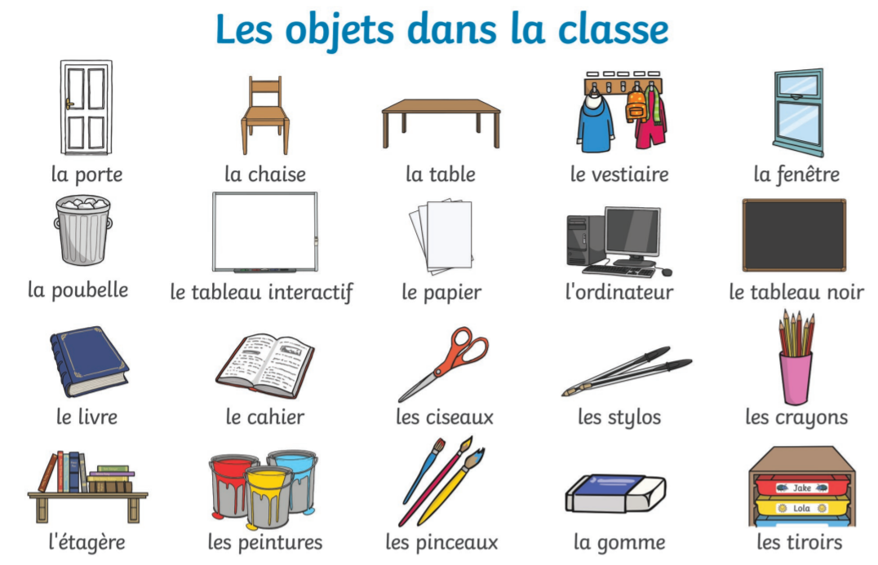
LO: Revise colours, animals and questions from last term
Can you find and take pictures of items we might find in our classroom with the correct English and French label next to them.

Slide 4
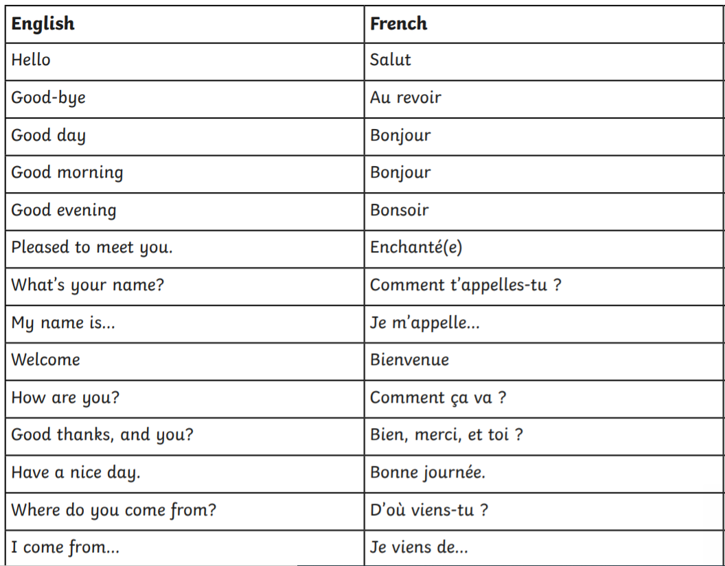
LO: Revise colours, animals and questions from last term
Can you please create a small conversation greeting someone asking them how their day is and answering that question back. Finally, saying goodbye.

