Slide 1
LO: to convert decimals to fractions.

Slide 2
Success criteria
Use place value to determine my denominator
Identify patterns
Simplify fractions

Slide 3
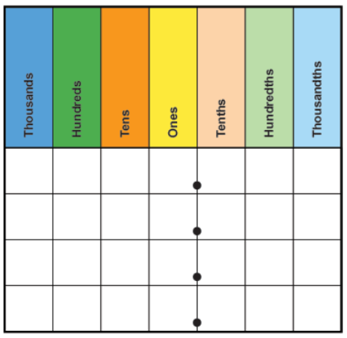
Reactivate our learning
Todays skills we will need to use…
  Place value
  Fractions
  Decimals

Slide 4
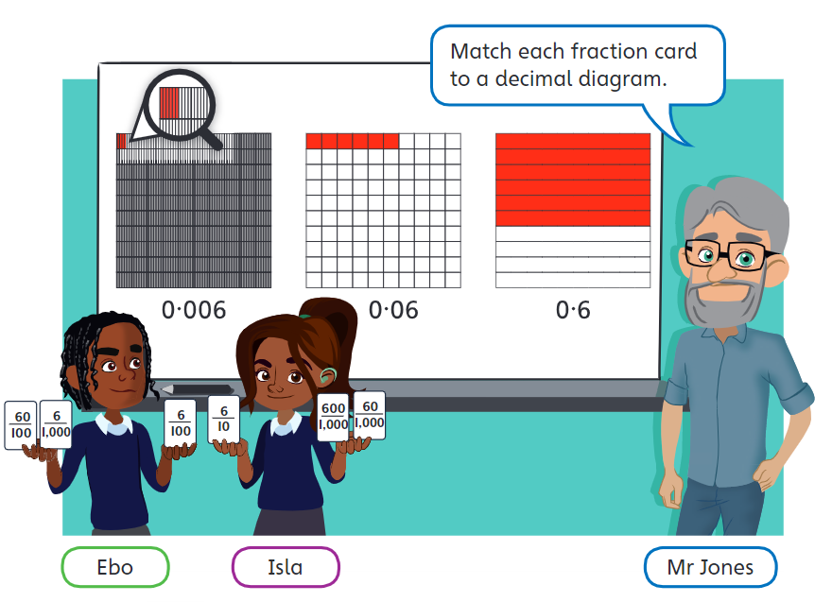
0 6
0 0 6
0 0 0 6
Fraction tells us how many parts of a whole we have

Slide 5
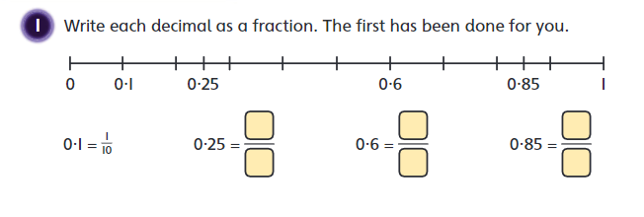
Can we simplify our fractions?
0 1
25
100
1
4
0 2 5
=
0 8 5

Slide 6
Can we simplify our fractions?
0 1
25
100
1
4
0 2 5
=
0 8 5
85
100
=
17
20

Slide 7
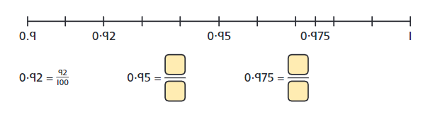
Please pause the video and have a go at these questions

Slide 8
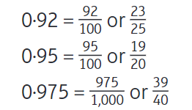
Answers

Slide 9
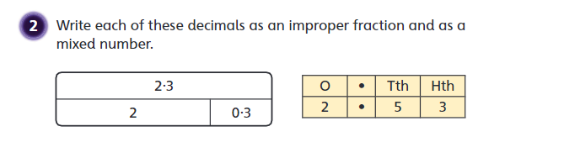
What happens if we have a number in the ones column?
2.53
0.53
?
253
100
53
100
= 2
100

