Slide 1
Tuesday 2nd February 2021
LO: to compare democracy and dictatorship (tyranny).
History of Democracy: www.youtube.com/watch?v=f-feDZRxJKw
British Democracy: www.youtube.com/watch?v=LX1Ul0oX9DY

Slide 2
Success criteria
Define ‘democracy’
Define ‘dictatorship’
Find similarities and differences between the two
Summarise your point of view

Slide 3



Term 3
POLITICS AND THE NEED FOR RULES

Slide 4
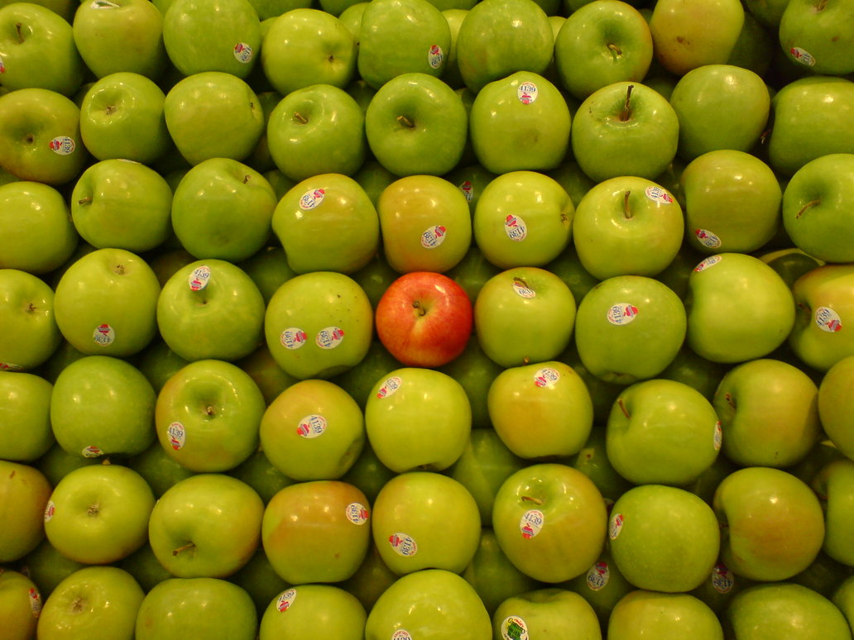
THE ODD ONE OUT!

Slide 5
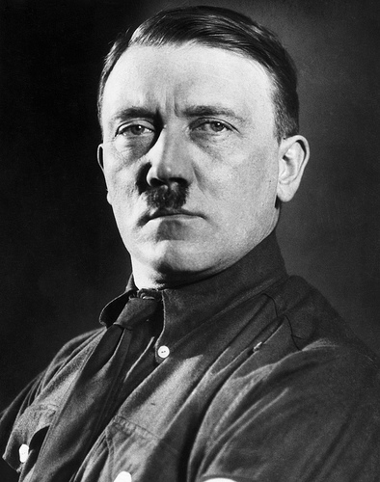
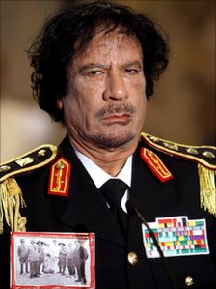
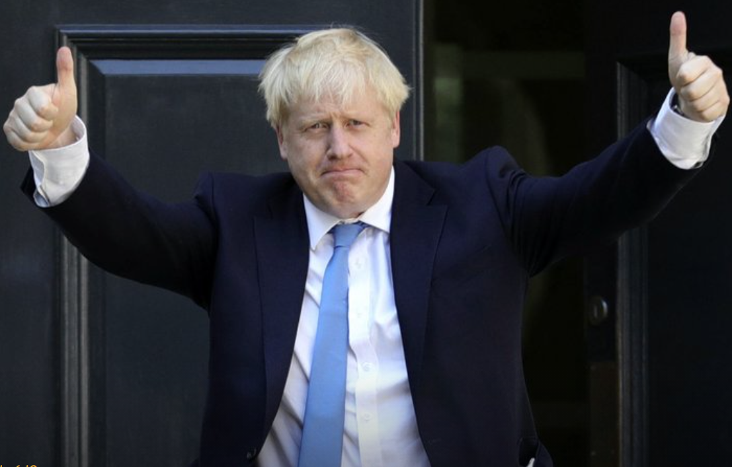
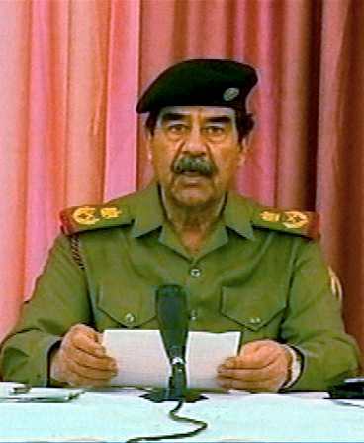
Adolf Hitler
Colonel Gaddafi
Boris Johnson
Saddam Hussein
Adolf Hitler

Slide 6
Answer:
Boris Johnson

Slide 7
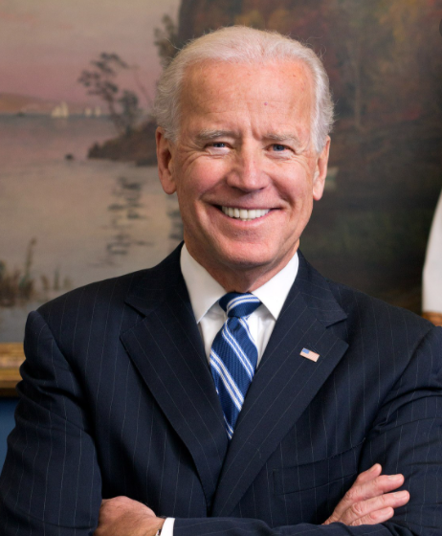
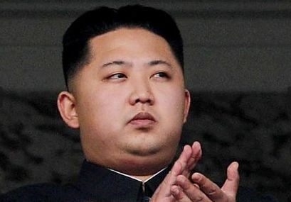
LO: compare democracy and dictatorship (tyranny).
America is a democracy
North Korea is a dictatorship
Joe Biden
Kim Jong-un

Slide 8
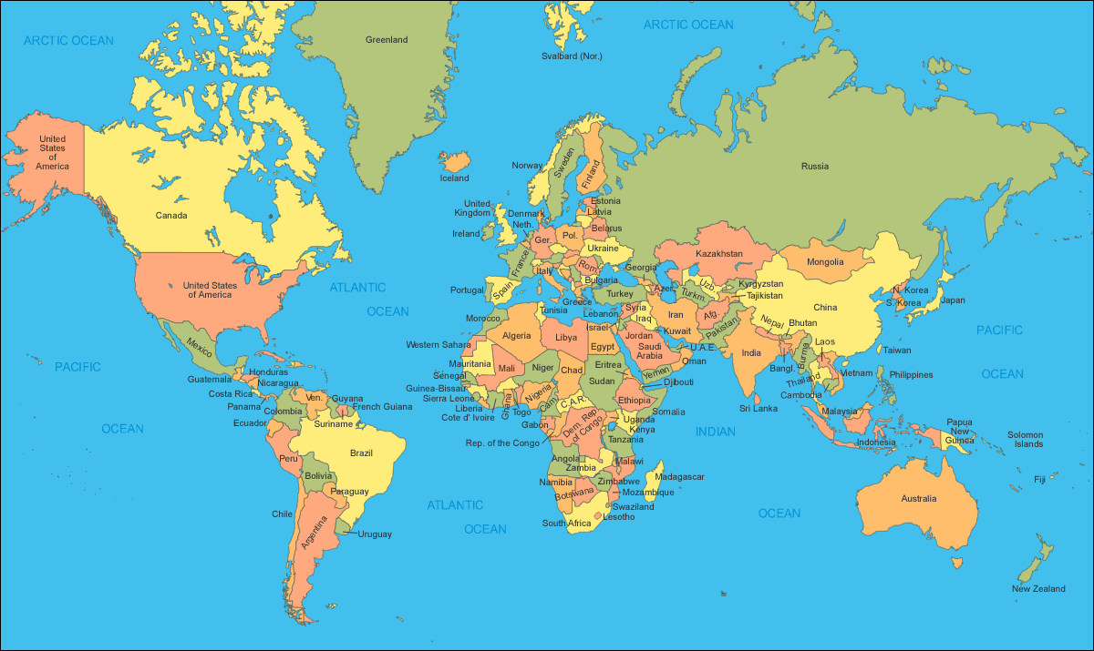

Slide 9
Democracy:
A form of government where the people share in deciding how things are run.
(Ruled by the people)

Slide 10
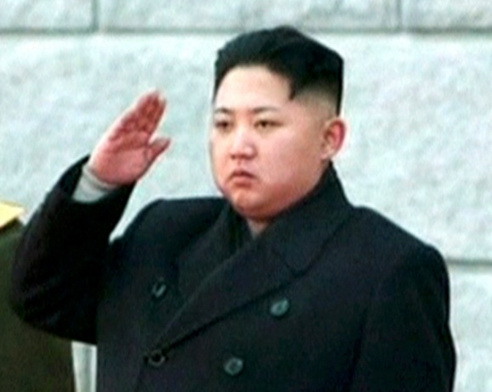
Dictatorship:
A form of government where the leader has total power.

Slide 11
Debate Line
Cadbury’s is the best chocolate?
Nike is the best sports make?
Democracy is the best way to run a country?
Dictatorships never work?
We don’t need to worry about how other countries treat their people?
We should help countries like Iraq?

Slide 12
Democracy or Dictatorship?
Free and fair elections.
Democracy
People in charge are beyond the law.
Dictatorship
Ordinary people feel powerless.
Dictatorship
People can change things.
Democracy
The majority (most people) get their way.
Democracy

Slide 13
Democracy or Dictatorship?
Only a small group of people get their way.
Dictatorship
The leader can declare war on anyone he wants.
Dictatorship
You get a chance to change the leader.
Democracy
It normally takes violence to change the leader.
Dictatorship

Slide 14
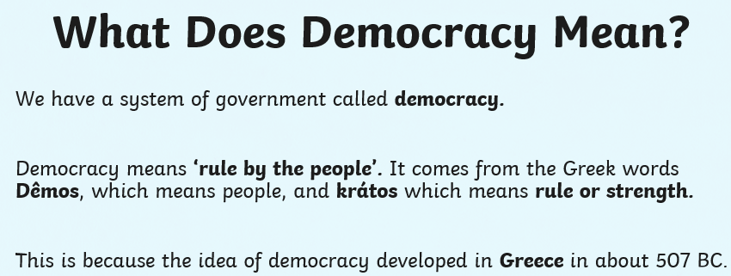

Slide 15
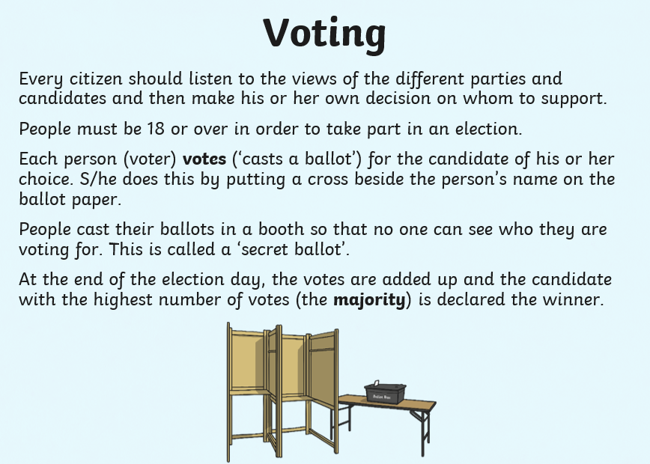
Have you at school participated in a democratic vote? Perhaps electing your new head of houses?

Slide 16
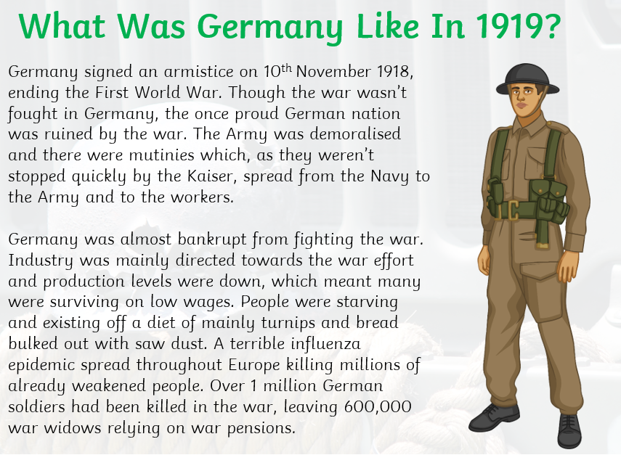

Slide 17
How did a democratic state like Germany end up being ruled by a tyrannical man like Hitler?
The majority of the people living in Germany were starving
Germany was almost bankrupt
Many German people hated that the democratic government surrendered in WW1

Slide 18
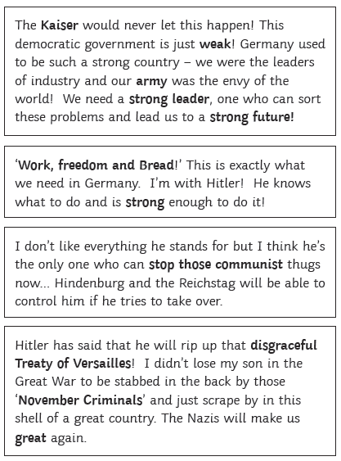
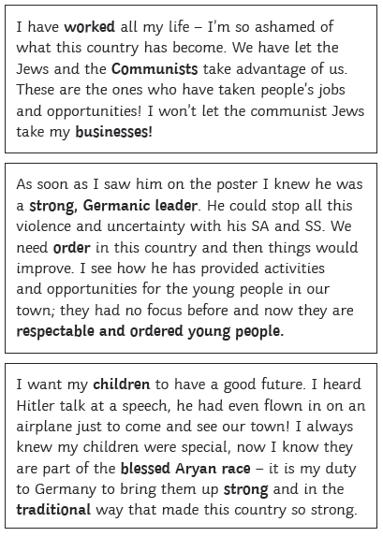
These are primary sources that came from people that actually lived in Germany during Hitler’s rise to power

Slide 19
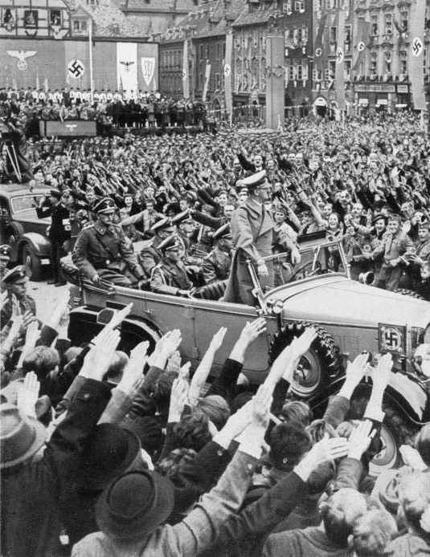
In 1933 Hitler and the Nazi party gained a majority in the Reichstag. People liked the promises and polices the Nazi party made and voted for them democratically

Slide 20
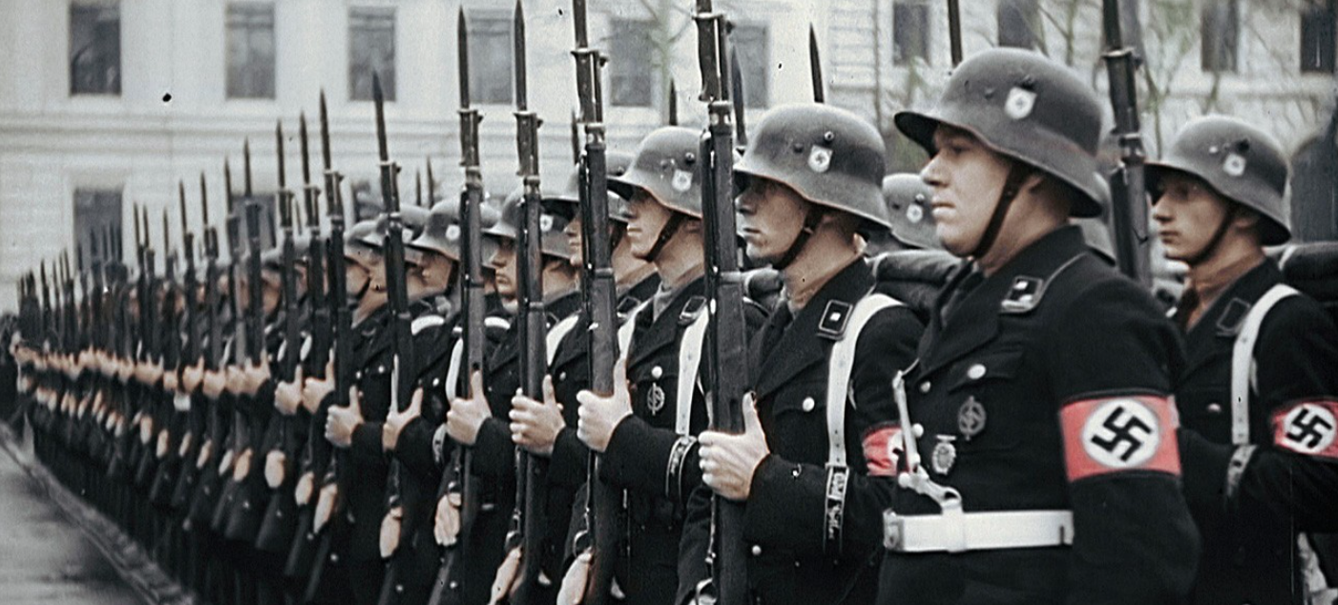
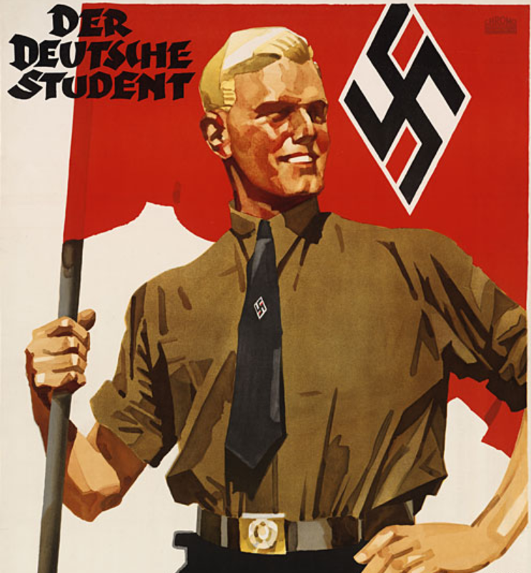
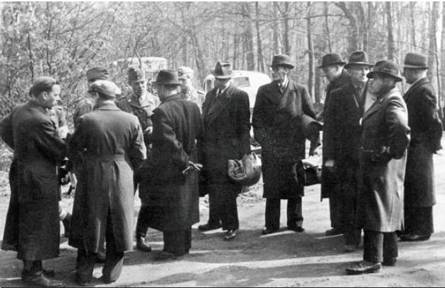
What happened next?

Slide 21
Your Task:
Create a comparison of similarities and differences between democracy and dictatorship
Which is the best way to rule a country and why do you think this?
Democracy and Dictatorship
Similarities Differences

