Slide 1


Encryption
An Introduction to Encryption

Slide 2
IYE RKFO LBKSXC SX IYEB ROKN. IYE RKFO POOD SX IYEB CRYOC. IYE MKX CDOOB IYEBCOVP SX KXI NSBOMDSYX IYE MRYYCO
Can you work out the message?
Clue: the key is 10
Notes:
For the teacher! The message says Good Afternoon using the Caesar Cipher!

Slide 3
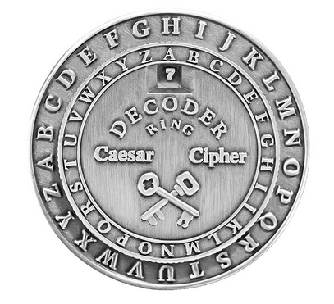
LO: To understand encryption

Slide 4

Encryption
Encryption is a process that changes information (plaintext) into unfamiliar information (ciphertext).
Encryption uses a mathematical rule and some secret information. This is called the encryption key.
Example:
Plaintext
Can you work out what this message says?
Ciphertext
Zxk vlr tloh lrq texq qefp jbppxdb pxvp?

Slide 5
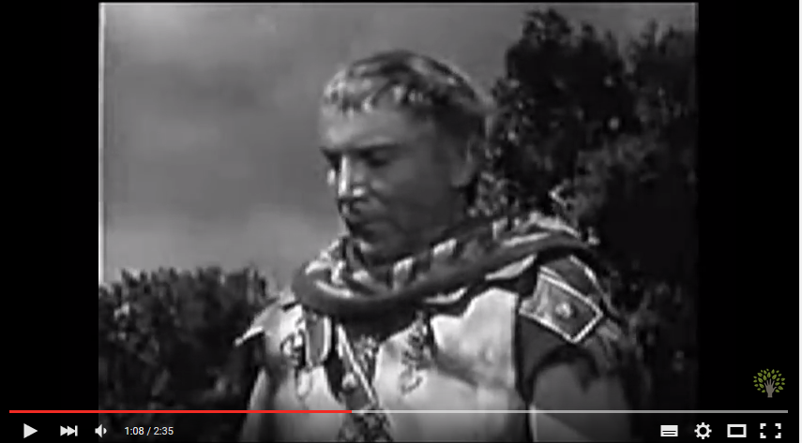
Caesar Cipher

Slide 6
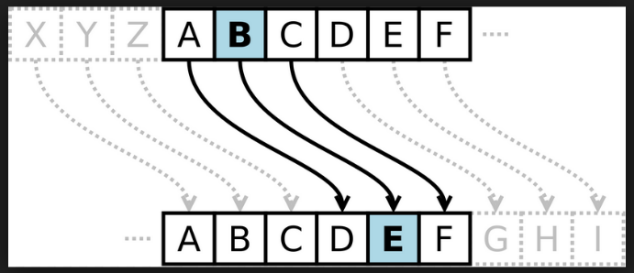
The Caesar Cipher
One of the oldest methods of encryption is the Caesar Cipher. The cipher works by moving each letter in a message forward a specific number of places in the alphabet. To decrypt the message, you need to know how many places each letter was moved (this is called the key).
Also known as the shift cipher, Caesar's code or Caesar shift – it is one of the simplest and most widely known encryption techniques.
Notes:
Key 3

Slide 7

Improving the Caesar Cipher
How could you improve the Caesar Cipher?
Notes:
Discuss with the class.

Slide 8
The Keyword Cipher
The Keyword Cipher uses a Keyword to rearrange the letters in the alphabet. These different letters are then substituted for the letters in the message to create a secret message. That Keyword is needed to decipher the secret message.
Can you spot the keyword in the ciphertext?
Can you work out how to use the Keyword Cipher?

Slide 9

Instructions for the Keyword Cipher
1) Begin by choosing a keyword and a key letter; for example:
keyword = computing and key letter = f
2) Write out the alphabet – this is your plaintext.
3) Write your keyword underneath the plaintext, starting with the key letter.
4) Write the remaining alphabet underneath the plaintext – this is your ciphertext.
Notes:
Hand out the Key Word Cipher Template PDF to students to complete.

Slide 10
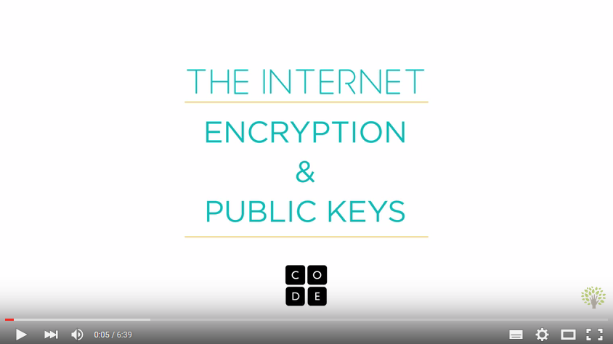
Notes:
Stop at 1.45 mins – students to write their name and a fact about themselves using the Caesar Cipher, key = shift 7. Pass encrypted message to partner to decrypt.

Slide 11
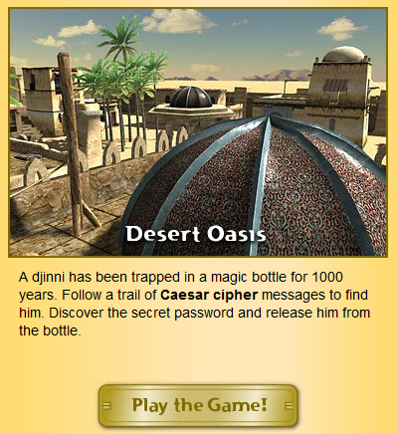
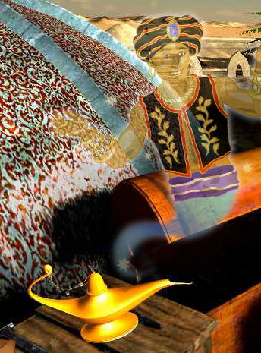
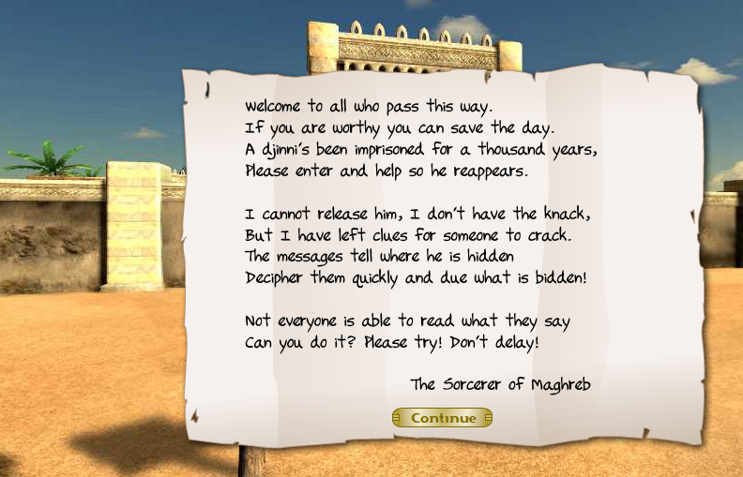
Desert Oasis Game
Group Id: 1856
Group Password: computing
Set the Djinni free!
Notes:
Click on the Desert Oasis image when viewing the slideshow in full screen – the image has the hyperlink to the online Desert Oasis game for the students to play.

Slide 12
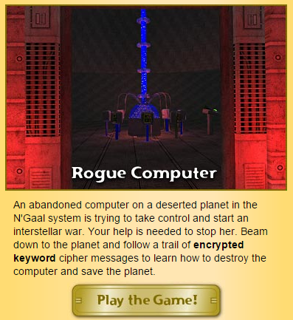
Rogue Computer Game:

Slide 13
Plenary Questions
What does encrypt mean?
What does decrypt mean?
What is the Caesar Cipher?
What are the advantages of encryption?
What are the disadvantages of encryption?

