Slide 1
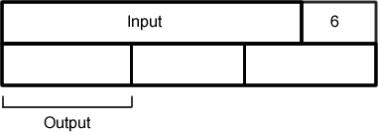

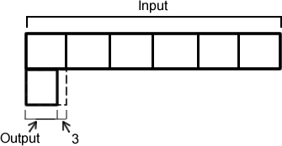
STARTER:
These bar models represent some different expressions.
Match up the bar models with the expression that they show.
3a + 6
a ÷ 6 – 3
(a + 6) ÷ 3

Slide 2
STARTER:
These bar models represent some different expressions.
Match up the bar models with the expression that they show.
3a + 6
a ÷ 6 – 3
Extension:
Invent a similar puzzle for a friend to solve.
(a + 6) ÷ 3

Slide 3


Introduction
If = 10 and = 5
Calculate:
+ + +
© Classroom Secrets Limited 2019

Slide 4
Introduction
If = 10 and = 5
Calculate:
+ + +
10 + 10 + 10 + 5 = 35
© Classroom Secrets Limited 2019

Slide 5
Varied Fluency 1
Match the expressions to their values.
If = 10 and = 0.25.
A. | ( | x | ) | +
B. |  | + |  | +
C. |  | – |  | +
19.75
2.75
30
© Classroom Secrets Limited 2019

Slide 6
Varied Fluency 1
Match the expressions to their values.
If = 10 and = 0.25.
A. | ( | x | ) | +
B. |  | + |  | +
C. |  | – |  | +
19.75
2.75
30
© Classroom Secrets Limited 2019

Slide 7
TALKING TIME:
If
and
What is worth?
= 10
= 7
x x

Slide 8
TALKING TIME:
If
and
What is worth?
If we substitute each value for the different symbols, then this expression becomes: 10 x 7 x 10
= 70 x 10
= 700 So the expression is worth 700.
= 10
= 7
x x

Slide 9
TALKING TIME:
If
and
What is worth?
= 14
= 9
– +

Slide 10
TALKING TIME:
If
and
What is worth?
If we substitute each value for the different letters, then this expression becomes: 9 – 14 + 9
= – 5 + 9
= 4 So the expression is worth 4.
= 14
= 9
– +

Slide 11
TALKING TIME:
What is the same? What is different?
= 23 = 8
+ +
x = 23 y = 8
x + x + y
Which letter is the yellow star the same as?
Which letter does the blue square represent?
Would the expression x + y + x get the same result?

Slide 12
TALKING TIME:
What is the same? What is different?
Both representations show the same algebraic expression (the total of two of one thing added to one of another). The only difference between them is that the first expression uses symbols instead of numbers and the second expression uses letters. Other than that, they both are the same.
= 23 = 8
+ +
x = 23 y = 8
x + x + y

Slide 13
TALKING TIME:
Substitute these values:
into this expression:
What is the answer?
a = 15 b = 10
(12 + a) x b

Slide 14
TALKING TIME:
Substitute these values:
into this expression:
What is the answer?
a = 15 b = 10
(12 + a) x b
(12 + a) x b
= (12 + 15) x 10
= 27 x 10
= 270

Slide 15
Varied Fluency 2
True or false?
If a = , b = 10 and c = 7.
(8a + c) x b = 84
1
4
© Classroom Secrets Limited 2019

Slide 16
Varied Fluency 2
True or false?
If a = , b = 10 and c = 7.
(8a + c) x b = 84
False; 9 x 10 = 90
1
4
© Classroom Secrets Limited 2019

Slide 17
Varied Fluency 3
. Tick the substitution used for this expression if the value is 4..
(2q – 2p) ÷ r
p = 0.5 q = 2.5 r = 10
p = 0.5 q = 2.5 r = 1
© Classroom Secrets Limited 2019

Slide 18
Varied Fluency 3
. Tick the substitution used for this expression if the value is 4..
(2q – 2p) ÷ r
p = 0.5 q = 2.5 r = 10
p = 0.5 q = 2.5 r = 1 |  | 
© Classroom Secrets Limited 2019

Slide 19
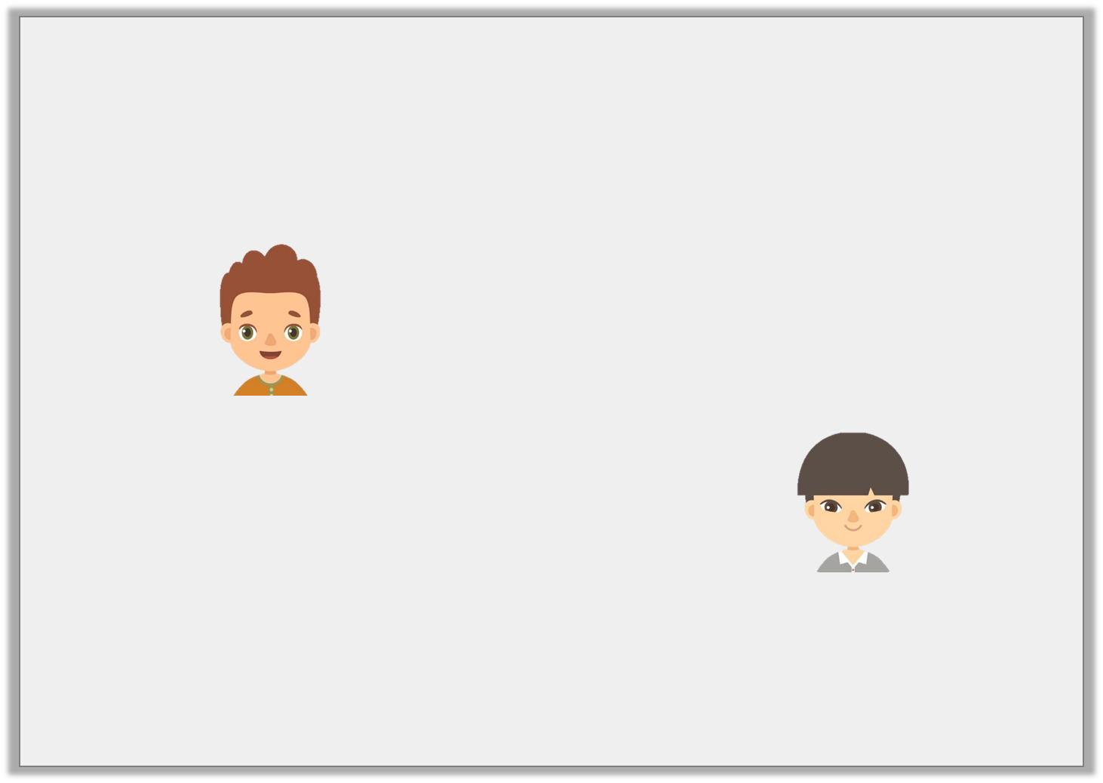
Varied Fluency 4
. Who is correct?
a = 10, b = 25 and c = 2
2b – a is
25 – 10 = 15
Sam
2b – a is
50 – 10 = 40
Jay
© Classroom Secrets Limited 2019

Slide 20
Varied Fluency 4
. Who is correct?
a = 10, b = 25 and c = 2
Jay
2b – a is
25 – 10 = 15
Sam
2b – a is
50 – 10 = 40
Jay
© Classroom Secrets Limited 2019

Slide 21
ACTIVITY 1:
Substitute these values:
into these expressions. What are the answers?
a = 2.4 b = 10 c = 5
b – c
2a + b
(a x b) + c
(a + c) x b
(c – a ) ÷ b

Slide 22
ACTIVITY 1:
Substitute these values:
into these expressions. What are the answers?
a = 2.4 b = 10 c = 5
b – c = 10 – 5 = 5
2a + b = 4.8 + 10 = 14.8
(a x b) + c = (2.4 x 10) + 5 = 24 + 5 = 29
(a + c) x b = (2.4 + 5) x 10 = 7.4 x 10 = 74
(c – a ) ÷ b = (5 – 2.4) ÷ 10 = 2.6 ÷ 10 = 0.26

Slide 23
ACTIVITY 2:
1
2
w = y = 8 z = 3.25
Substitute these values into the expressions.
What is each expression worth?
5w
(z x 100) + y
6z – 1
2w – 8

Slide 24
ACTIVITY 2:
1
2
w = y = 8 z = 3.25
Substitute these values into the expressions.
What is each expression worth?
1
2
1
2
5w = 5 x = 2
(z x 100) + y = (3.25 x 100) + 8 = 325 + 8 = 333
6z – 1 = (6 x 3.25) – 1 = 19.5 – 1 = 18.5
2w – 8 = (2 x ) – 8 = 1 – 8 = – 7
1
2

Slide 25
ACTIVITY 3:
Here are two equations:
q = 100 ÷ p
r = 5q + 80
What is r worth if p is worth 20?

Slide 26
ACTIVITY 3:
Here are two equations:
q = 100 ÷ p
r = 5q + 80
What is r worth if p is worth 25?
If p = 25, then q = 100 ÷ 25, so q must be worth 4
As q = 4, r = (5 x 4) + 80 which equals 20 + 80 or 100.
r is worth 100

Slide 27
ACTIVITY 4:
Lottie says,
Is Lottie correct? Explain your answer.
.
In the equation
y = 6a,
if a is worth 8, then
y must be worth 68.

Slide 28
ACTIVITY 4:
Lottie says,
Is Lottie correct? Explain your answer.
Lottie is not correct. She thinks that 6a simply means the digit 6 with another digit next to it and that the letter a represents the missing number of ones (like 6_ ). However, it actually means 6 lots of a or 6 x a. So, if a is worth 8, then y is worth 6 x 8 which equals 48.
.
In the equation
y = 6a,
if a is worth 8, then
y must be worth 68.

Slide 29

Reasoning 1
a = 5b ÷ 2
c = a + 5.5
Sophie says:
Is she correct?
Explain your answer.
If b = 8 then c = 25.
© Classroom Secrets Limited 2019

Slide 30
Reasoning 1
a = 5b ÷ 2
c = a + 5.5
Sophie says:
Is she correct?
Explain your answer.
Sophie is not correct because…
If b = 8 then c = 25.
© Classroom Secrets Limited 2019

Slide 31
Reasoning 1
a = 5b ÷ 2
c = a + 5.5
Sophie says:
Is she correct?
Explain your answer.
Sophie is not correct because a = 40 ÷ 2 = 20, so c = 20 + 5.5 = 25.5.
If b = 8 then c = 25.
© Classroom Secrets Limited 2019

Slide 32
Problem Solving 1
Ryan is calculating the perimeter of a rectangle.
He is using the equation P = 2a + 2b.
When a = 12.5cm, he calculates that P = 45cm.
What is the value of b?
a
b
Not to scale
© Classroom Secrets Limited 2019

Slide 33
Problem Solving 1
Ryan is calculating the perimeter of a rectangle.
He is using the equation P = 2a + 2b.
When a = 12.5cm, he calculates that P = 45cm.
What is the value of b?
10cm
a
b
Not to scale
© Classroom Secrets Limited 2019

Slide 34
Reasoning 2
True or false?
a = (5b ÷ 2) – 8c
When b = 6 and c = 0.25,
a = 28.
Explain your answer.
© Classroom Secrets Limited 2019

Slide 35
Reasoning 2
True or false?
a = (5b ÷ 2) – 8c
When b = 6 and c = 0.25,
a = 28.
Explain your answer.
The answer is false because...
© Classroom Secrets Limited 2019

Slide 36
Reasoning 2
True or false?
a = (5b ÷ 2) – 8c
When b = 6 and c = 0.25,
a = 28.
Explain your answer.
The answer is false because a = (30 ÷ 2) – 2, so a = 15 – 2 = 13.
© Classroom Secrets Limited 2019

Slide 37
EVALUATION:
True or False?
If y = 7, then 2y – 15 = – 1.
If h = 9, then 5h is equal to 59 .
If a = 10, then the expression 45 ÷ a will give the same
answer as 0.45a.
If w = 7, y = 0.5 and z = w x y, then the value of z is 4.5
a = 3b – 14
c = a ÷ 100
If b is worth 10, then c will be worth 0.16.

Slide 38
EVALUATION:
True or False?
If y = 7, then 2y – 15 = – 1. TRUE
If h = 9, then 5h is equal to 59 . FALSE
If a = 10, then the expression 45 ÷ a will give the same
answer as 0.45a. TRUE
If w = 7, y = 0.5 and z = w x y, then the value of z is 4.5 FALSE
a = 3b – 14
c = a ÷ 100
If b is worth 10, then c will be worth 0.16. TRUE

