Slide 1


2.15 Short division Step 1:1
8 sticks shared equally between 4 children.
How many sticks each?
4
4
4
4
8 ÷ 4 =
2
Notes:
One four is one each. That’s four.
Two fours is two each. That’s eight.
Eight divided between four is equal to two each.
So, each child gets two sticks.

Slide 2


2.15 Short division Step 1:2
84 sticks shared equally between 4 children. How many sticks each?
84 ÷ 4 =
8 tens ÷ 4 = 2 tens
Notes:
Four tens are one ten each. That’s forty.
Eight tens are two tens each. That’s eighty.
Eight tens divided between four is equal to two tens each.

Slide 3
2.15 Short division Step 1:2
84 sticks shared equally between 4 children. How many sticks each?
84 ÷ 4 =
8 tens ÷ 4 = 2 tens
4 ones ÷ 4 = 1 one
Notes:
Four ones is one each. That’s four.
Four ones divided by four is equal to one one each.

Slide 4
2.15 Short division Step 1:2
84 sticks shared equally between 4 children. How many sticks each?
84 ÷ 4 =
21
8 tens ÷ 4 = 2 tens
4 ones ÷ 4 = 1 one
84 ÷ 4 = 21
Notes:
Eight tens and four ones divided between four is equal to two tens and one one.
Each child gets twenty-one sticks.

Slide 5
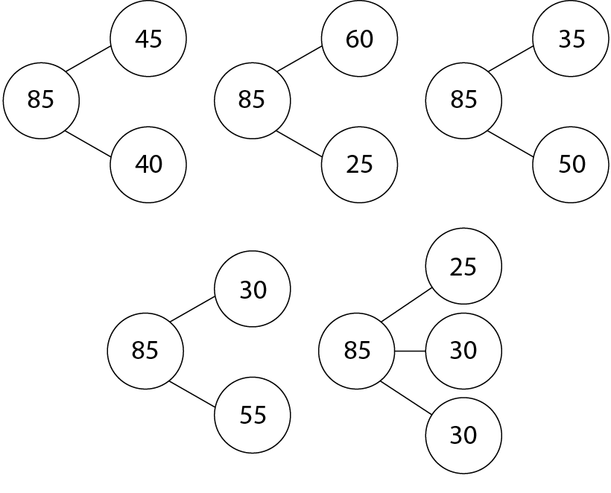
2.15 Short division Step 1:7
Notes:
Decide which way of partitioning the dividend
is helpful for the calculation “85 ÷ 6”.
Explain why.

Slide 6
Year 5, Unit 4, Learning Outcome 20
Learning Outcome 20
Pupils divide a two-digit number by a single-digit number using partitioning and representations (with exchanging)
The following slides have been collated to support the teaching of this learning outcome.

Slide 7
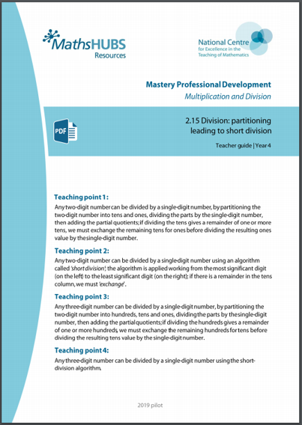
Year 5, Unit 4, Learning Outcome 20
Additional teacher guidance for this outcome should be read first and can be found in this segment of the NCETM Primary Mastery Professional Development Materials:
2.15 Division: partitioning leading to short division
The spine materials are divided into ‘teaching points’ and ‘steps in learning’.
Teaching point | Steps in learning | Pages
1 | 1:3-1:4 and 1:7 | 4-9 and 12-13

Slide 8

2.15 Short division Step 1:3
72 sticks shared equally between 3 children. How many sticks each?
72 ÷ 3 =
7 tens ÷ 3 = 2 tens r 1 ten
Notes:
Three tens are one ten each. That’s thirty.
Six tens are two tens each. That’s sixty.
There is one ten left over.
Seven tens divided between three is equal to two tens each, with a
remainder of one ten.

Slide 9
2.15 Short division Step 1:3
72 sticks shared equally between 3 children. How many sticks each?
72 ÷ 3 =
7 tens ÷ 3 = 2 tens r 1 ten
12 ones ÷ 3 = 4 ones
Notes:
One ten is equal to ten ones.
So, one ten and two ones is equal to twelve ones.
Three ones are one each. That’s three.
Six ones are two each. That’s six.
Nine ones are three each. That’s nine.
Twelve ones are four each. That’s twelve.
Twelve ones divided between three is equal to four ones each.

Slide 10
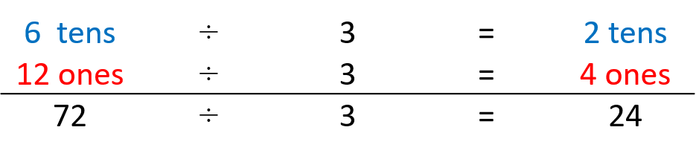
2.15 Short division Step 1:3
72 sticks shared equally between 3 children. How many sticks each?
72 ÷ 3 =
24
7 tens ÷ 3 = 2 tens r 1 ten
12 ones ÷ 3 = 4 ones
Notes:
Each child gets twenty-four sticks.

Slide 11
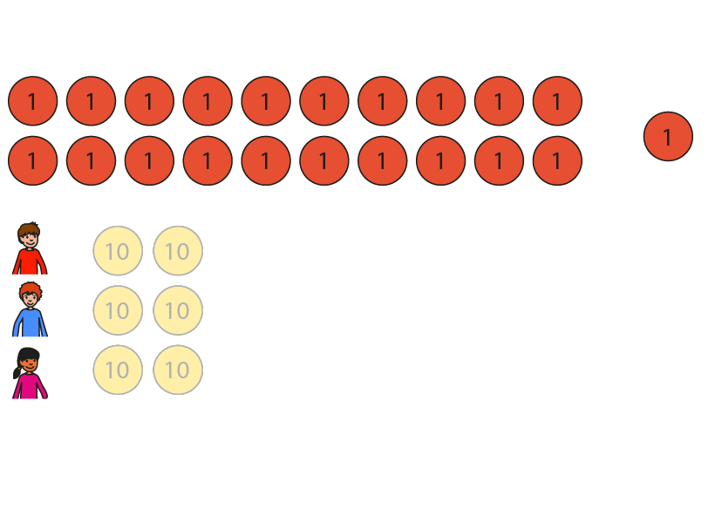


2.15 Short division Step 1:4
81 marbles shared equally between 3 children. How many marbles each?
81 ÷ 3 =
8 tens ÷ 3 = 2 tens r 2 tens
Notes:
Three tens are one ten each. That’s thirty.
Six tens are two tens each. That’s sixty.
There are two tens left over.
Eight tens divided between three is equal to two tens each, with a
remainder of two tens.

Slide 12
2.15 Short division Step 1:4
81 marbles shared equally between 3 children. How many marbles each?
81 ÷ 3 =
8 tens ÷ 3 = 2 tens r 2 tens
21 ones ÷ 3 = 7 ones
Notes:
Two tens and one one is equal to twenty-one ones.
Three ones are one each. That’s three.
Six ones are two each. That’s six…
Twenty-one ones are seven each. That’s twenty-one.
Twenty-one ones divided between three is equal to seven ones each.

Slide 13
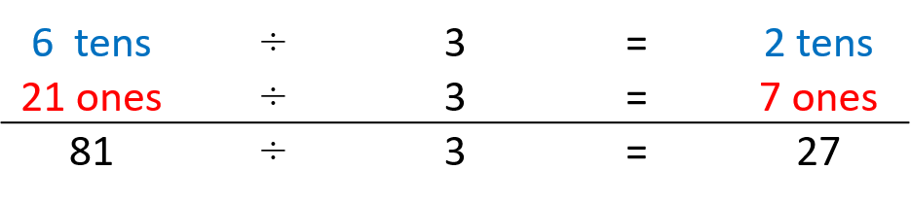
2.15 Short division Step 1:4
81 marbles shared equally between 3 children. How many marbles each?
81 ÷ 3 =
27
8 tens ÷ 3 = 2 tens r 2 tens
21 ones ÷ 3 = 7 ones
Notes:
Each child gets twenty-seven marbles.

Slide 14
2.15 Short division Step 1:7
Notes:
Decide which way of partitioning the dividend
is helpful for the calculation “85 ÷ 6”.
Explain why.

Slide 15
Year 5, Unit 4, Learning Outcome 21
Learning Outcome 21
Pupils divide a two-digit number by a single-digit number using partitioning and representations (with exchanging and remainders)
The following slides have been collated to support the teaching of this learning outcome.

Slide 16
Year 5, Unit 4, Learning Outcome 21
Additional teacher guidance for this outcome should be read first and can be found in this segment of the NCETM Primary Mastery Professional Development Materials:
2.15 Division: partitioning leading to short division
The spine materials are divided into ‘teaching points’ and ‘steps in learning’.
Teaching point | Steps in learning | Pages
1 | 1:5 and 1:7 | 10-13

Slide 17
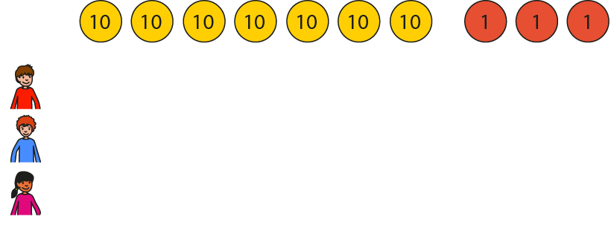
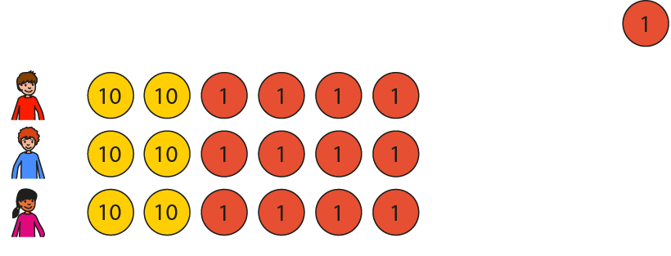
2.15 Short division Step 1:5
73 marbles shared equally between 3 children. How many marbles each?
73 ÷ 3 =
7 tens ÷ 3 = 2 tens r 1 ten
Notes:
Seven tens divided between three is equal to two tens each, with a
remainder of one ten.

Slide 18
2.15 Short division Step 1:5
73 marbles shared equally between 3 children. How many marbles each?
73 ÷ 3 =
7 tens ÷ 3 = 2 tens r 1 ten
13 ones ÷ 3 = 4 ones r 1 one
Notes:
One ten and three ones is equal to thirteen ones.
Thirteen ones divided between three is equal to four ones each, with a
remainder of one one.

Slide 19
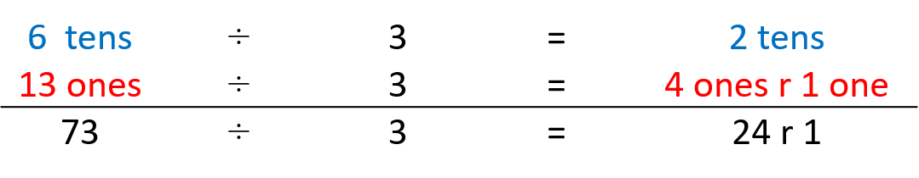
2.15 Short division Step 1:5
73 marbles shared equally between 3 children. How many marbles each?
73 ÷ 3 =
24 r 1
7 tens ÷ 3 = 2 tens r 1 ten
13 ones ÷ 3 = 4 ones r 1 one
Notes:
Each child gets twenty-four marbles; there is one marble left over.

Slide 20
2.15 Short division Step 1:7
Notes:
Decide which way of partitioning the dividend
is helpful for the calculation “85 ÷ 6”.
Explain why.

Slide 21
Year 5, Unit 4, Learning Outcome 22
Learning Outcome 22
Pupils divide a two-digit number by a single-digit number using short division (no exchanging, no remainders)
The following slides have been collated to support the teaching of this learning outcome.

Slide 22
Year 5, Unit 4, Learning Outcome 22
Additional teacher guidance for this outcome should be read first and can be found in this segment of the NCETM Primary Mastery Professional Development Materials:
2.15 Division: partitioning leading to short division
The spine materials are divided into ‘teaching points’ and ‘steps in learning’.
Teaching point | Steps in learning | Pages
2 | 2:1-2:4 and 2:10 | 14-16 and 21-22

Slide 23
2.15 Short division Step 2:1
84 sticks shared equally between 4 children. How many sticks each?
84 ÷ 4 =
Step 1 – write the divisor and dividend:
10s
1s
84 divided by 4.

Slide 24
2.15 Short division Step 2:1
84 sticks shared equally between 4 children. How many sticks each?
84 ÷ 4 =
Step 1 – write the divisor and dividend:
Step 2 – share the 10s:
10s
1s
8 tens ÷ 4 = 2 tens
8 tens divided by 4 is equal to 2 tens.
84 divided by 4.

Slide 25
2.15 Short division Step 2:1
84 sticks shared equally between 4 children. How many sticks each?
84 ÷ 4 =
Step 2 – share the 10s:
Step 3 – share the 1s:
10s
1s
8 tens ÷ 4 = 2 tens
4 ones ÷ 4 = 1 one
4 ones divided by 4 is equal to 1 one.
8 tens divided by 4 is equal to 2 tens.

Slide 26
2.15 Short division Step 2:1
84 sticks shared equally between 4 children. How many sticks each?
84 ÷ 4 =
Step 3 – share the 1s:
Summary
10s
1s
8 tens ÷ 4 = 2 tens
4 ones ÷ 4 = 1 one
4 ones divided by 4 is equal to 1 one.
Each child gets 21 sticks.

Slide 27

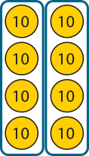

2.15 Short division Step 2:1
84 sticks shared equally between 4 children. How many sticks each?
84 ÷ 4 =
21
Summary
10s
1s
2
2
1
1
4
8
8
4
4
8 tens ÷ 4 = 2 tens
4 ones ÷ 4 = 1 one
Each child gets 21 sticks.
Notes:
Eight tens and four ones divided by four is equal to two tens and one one.
Each child gets twenty-one sticks.

Slide 28
2.15 Short division Step 2:2
84 | ÷ | 4 | = | 21
dividend | ÷ | divisor | = | quotient

Slide 29
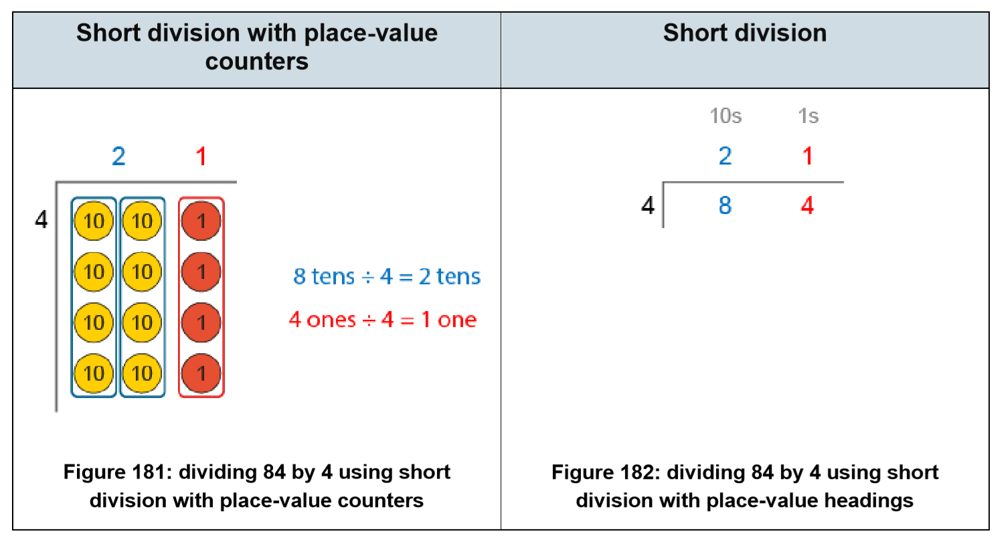
5MD-4 Divide using a formal written method

Slide 30
Year 5, Unit 4, Learning Outcome 23
Learning Outcome 23
Pupils divide a two-digit number by a single-digit number using short division (with exchanging)
The following slides have been collated to support the teaching of this learning outcome.

Slide 31
Year 5, Unit 4, Learning Outcome 23
Additional teacher guidance for this outcome should be read first and can be found in this segment of the NCETM Primary Mastery Professional Development Materials:
2.15 Division: partitioning leading to short division
The spine materials are divided into ‘teaching points’ and ‘steps in learning’.
Teaching point | Steps in learning | Pages
2 | 2:5-2:6 and 2:10 | 17-19 and 21-22

Slide 32



2.15 Short division Step 2:5
72 sticks shared equally between 3 children. How many sticks each?
72 ÷ 3 =
Step 1 – write the divisor and the dividend:
3
Notes:
Seventy-two divided by three.

Slide 33

2.15 Short division Step 2:5
72 sticks shared equally between 3 children. How many sticks each?
72 ÷ 3 =
Step 1 – write the divisor and the dividend:
Step 2 – share the 10s:
2
3
7 tens ÷ 3 = 2 tens r 1 ten
Notes:
Write ‘2’ in the tens column…

Slide 34
2.15 Short division Step 2:5
72 sticks shared equally between 3 children. How many sticks each?
72 ÷ 3 =
Step 2 – share the 10s:
Step 3 – exchange:
2
3
7 tens ÷ 3 = 2 tens r 1 ten
Notes:
… and write ‘1’ to the left of the ones digit of the dividend to make twelve ones.

Slide 35

2.15 Short division Step 2:5
72 sticks shared equally between 3 children. How many sticks each?
72 ÷ 3 =
24
Step 4 – share the 1s:
Step 3 – exchange:
2
4
3
7 tens ÷ 3 = 2 tens r 1 ten
12 ones ÷ 3 = 4 ones
Notes:
Write ‘4’ in the ones column.

Slide 36
Year 5, Unit 4, Learning Outcome 24
Learning Outcome 24
Pupils divide a two-digit number by a single-digit number using short division (with exchanging and remainders)
The following slides have been collated to support the teaching of this learning outcome.

Slide 37
Year 5, Unit 4, Learning Outcome 24
Additional teacher guidance for this outcome should be read first and can be found in this segment of the NCETM Primary Mastery Professional Development Materials:
2.15 Division: partitioning leading to short division
The spine materials are divided into ‘teaching points’ and ‘steps in learning’.
Teaching point | Steps in learning | Pages
2 | 2:7-2:10 | 19-22

Slide 38

2.15 Short division Step 2:7
73 sticks shared equally between 3 children. How many sticks each?
73 ÷ 3 =
Step 1 – write the divisor and the dividend:
3
Notes:
Seventy-three divided by three.

Slide 39
2.15 Short division Step 2:7
73 sticks shared equally between 3 children. How many sticks each?
73 ÷ 3 =
Step 1 – write the divisor and the dividend:
Step 2 – share the 10s:
2
3
7 tens ÷ 3 = 2 tens r 1 ten
Notes:
Write ‘2’ in the tens column…

Slide 40
2.15 Short division Step 2:7
73 sticks shared equally between 3 children. How many sticks each?
73 ÷ 3 =
Step 2 – share the 10s:
Step 3 – exchange:
2
3
7 tens ÷ 3 = 2 tens r 1 ten
Notes:
… and write ‘1’ to the left of the ones digit of the dividend to
make thirteen ones.

Slide 41
2.15 Short division Step 2:7
73 sticks shared equally between 3 children. How many sticks each?
73 ÷ 3 =
24 r 1
Step 4 – share the 1s:
Step 3 – exchange:
2
4
r 1
3
7 tens ÷ 3 = 2 tens r 1 ten
13 ones ÷ 3 = 4 ones r 1 one
Notes:
Write ‘4 r1’ in the ones column.

Slide 42
Year 5, Unit 4, Learning Outcome 25
Learning Outcome 25
Pupils divide a three-digit number by a single-digit number using partitioning and representations (no exchanging, no remainders)
The following slides have been collated to support the teaching of this learning outcome.

Slide 43
Year 5, Unit 4, Learning Outcome 25
Additional teacher guidance for this outcome should be read first and can be found in this segment of the NCETM Primary Mastery Professional Development Materials:
2.15 Division: partitioning leading to short division
The spine materials are divided into ‘teaching points’ and ‘steps in learning’.
Teaching point | Steps in learning | Pages
3 | 3:1 and 3:4 | 23-24 and 26-27

Slide 44



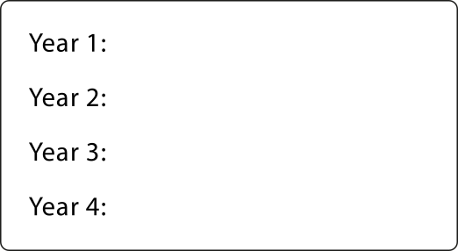
2.15 Short division Step 3:1
848 pencils shared equally between 4 year groups. How many pencils each?
848 ÷ 4 =
Step 1 – presenting the problem:

Slide 45
2.15 Short division Step 3:1
848 pencils shared equally between 4 year groups. How many pencils each?
848 ÷ 4 =
Step 1 – presenting the problem:
Step 2 – sharing the 100s:
8 hundreds ÷ 4 = 2 hundreds
Notes:
Eight hundreds divided between four is equal to two hundreds each.

Slide 46
2.15 Short division Step 3:1
848 pencils shared equally between 4 year groups. How many pencils each?
848 ÷ 4 =
Step 2 – sharing the 100s:
Step 3 – sharing the 10s:
8 hundreds ÷ 4 = 2 hundreds
4 tens ÷ 4 = 1 ten
Notes:
Four tens divided between four is equal to one ten each.

Slide 47
2.15 Short division Step 3:1
848 pencils shared equally between 4 year groups. How many pencils each?
848 ÷ 4 =
Step 4 – sharing the 1s:
Step 3 – sharing the 10s:
8 hundreds ÷ 4 = 2 hundreds
4 tens ÷ 4 = 1 ten
8 ones ÷ 4 = 2 ones
Notes:
Eight ones divided between four is equal to two ones each.

Slide 48
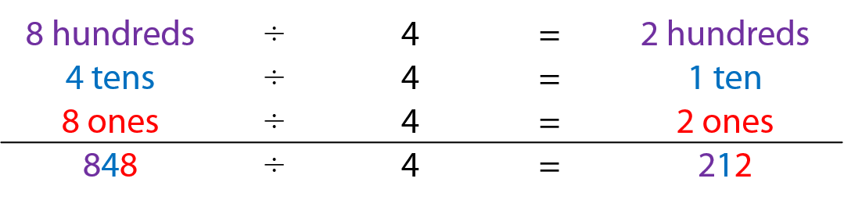
2.15 Short division Step 3:1
848 pencils shared equally between 4 year groups. How many pencils each?
848 ÷ 4 =
212
Step 4 – sharing the 1s:
Step 5 – adding:
8 hundreds ÷ 4 = 2 hundreds
4 tens ÷ 4 = 1 ten
8 ones ÷ 4 = 2 ones
Notes:
Each year group gets two hundred and twelve pencils.

Slide 49
Year 5, Unit 4, Learning Outcome 26
Learning Outcome 26
Pupils divide a three-digit number by a single-digit number using partitioning and representations (one exchange, no remainders)
The following slides have been collated to support the teaching of this learning outcome.

Slide 50
Year 5, Unit 4, Learning Outcome 26
Additional teacher guidance for this outcome should be read first and can be found in this segment of the NCETM Primary Mastery Professional Development Materials:
2.15 Division: partitioning leading to short division
The spine materials are divided into ‘teaching points’ and ‘steps in learning’.
Teaching point | Steps in learning | Pages
3 | 3:2 and 3:4 | 24-27

Slide 51
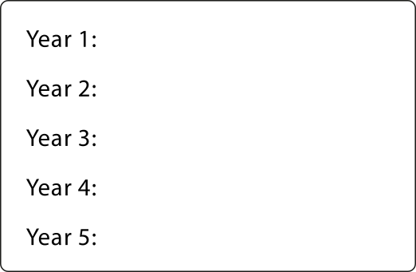
2.15 Short division Step 3:2
705 pencils shared equally between 5 year groups. How many pencils each?
705 ÷ 5 =
Step 1 – presenting the problem:

Slide 52
2.15 Short division Step 3:2
705 pencils shared equally between 5 year groups. How many pencils each?
705 ÷ 5 =
Step 1 – presenting the problem:
Step 2 – sharing the 100s:
7 hundreds ÷ 5 = 1 hundred r 2 hundreds
Notes:
Seven hundreds divided between five is equal to one hundred each,
with a remainder of two hundreds.

Slide 53
2.15 Short division Step 3:2
705 pencils shared equally between 5 year groups. How many pencils each?
705 ÷ 5 =
Step 3 – exchanging the remaining hundreds for tens:
Step 2 – sharing the 100s:
7 hundreds ÷ 5 = 1 hundred r 2 hundreds
2 hundreds = 20 tens
Notes:
Two hundreds is equal to twenty tens.

Slide 54
2.15 Short division Step 3:2
705 pencils shared equally between 5 year groups. How many pencils each?
705 ÷ 5 =
Step 3 – exchanging the remaining hundreds for tens:
Step 4 – sharing the 10s:
7 hundreds ÷ 5 = 1 hundred r 2 hundreds
2 hundreds = 20 tens
20 tens ÷ 5 = 4 tens
Notes:
Twenty tens divided between five is equal to four tens each.

Slide 55
2.15 Short division Step 3:2
705 pencils shared equally between 5 year groups. How many pencils each?
705 ÷ 5 =
Step 4 – sharing the 10s:
Step 5 – sharing the 1s:
7 hundreds ÷ 5 = 1 hundred r 2 hundreds
2 hundreds = 20 tens
20 tens ÷ 5 = 4 tens
5 ones ÷ 5 = 1 one
Notes:
Five ones divided between five is equal to one one each.

Slide 56
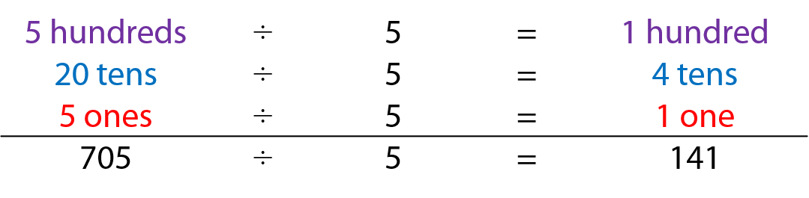
2.15 Short division Step 3:2
705 pencils shared equally between 5 year groups. How many pencils each?
705 ÷ 5 =
141
Step 6 – adding:
Step 5 – sharing the 1s:
7 hundreds ÷ 5 = 1 hundred r 2 hundreds
2 hundreds = 20 tens
20 tens ÷ 5 = 4 tens
5 ones ÷ 5 = 1 one
Notes:
Each year group gets one hundred and forty-one pencils.

Slide 57
Year 5, Unit 4, Learning Outcome 27
Learning Outcome 27
Pupils divide a three-digit number by a single-digit number using partitioning and representations (with exchanging and remainders)
The following slide supports the teaching of this learning outcome.

Slide 58
Year 5, Unit 4, Learning Outcome 27
Additional teacher guidance for this outcome should be read first and can be found in this segment of the NCETM Primary Mastery Professional Development Materials:
2.15 Division: partitioning leading to short division
The spine materials are divided into ‘teaching points’ and ‘steps in learning’.
Teaching point | Steps in learning | Pages
3 | 3:3-3:4 | 26-27

Slide 59
Year 5, Unit 4, Learning Outcome 28
Learning Outcome 28
Pupils divide a three-digit number by a single-digit number using short division
The following slides have been collated to support the teaching of this learning outcome.

Slide 60
Year 5, Unit 4, Learning Outcome 28
Additional teacher guidance for this outcome should be read first and can be found in this segment of the NCETM Primary Mastery Professional Development Materials:
2.15 Division: partitioning leading to short division
The spine materials are divided into ‘teaching points’ and ‘steps in learning’.
Teaching point | Steps in learning | Pages
4 | 4:1-4:4 and 4:10 | 29-31 and 35-36

Slide 61



2.15 Short division Step 4:1
848 pencils shared equally between 4 year groups. How many pencils each?
848 ÷ 4 =
Step 1 – writing the divisor and the dividend:
4
Notes:
Eight-hundred and forty-eight divided by four.

Slide 62

2.15 Short division Step 4:1
848 pencils shared equally between 4 year groups. How many pencils each?
848 ÷ 4 =
Step 1 – writing the divisor and the dividend:
Step 2 – sharing the 100s:
2
4
8 hundreds ÷ 4 = 2 hundreds
Notes:
Write ‘2’ in the hundreds column.

Slide 63

2.15 Short division Step 4:1
848 pencils shared equally between 4 year groups. How many pencils each?
848 ÷ 4 =
Step 2 – sharing the 100s:
Step 3 – sharing the 10s:
2
1
4
8 hundreds ÷ 4 = 2 hundreds
4 tens ÷ 4 = 1 ten
Notes:
Write ‘1’ in the tens column.

Slide 64

2.15 Short division Step 4:1
848 pencils shared equally between 4 year groups. How many pencils each?
848 ÷ 4 =
212
Step 3 – sharing the 10s:
Step 4 – sharing the 1s:
2
1
2
4
8 hundreds ÷ 4 = 2 hundreds
4 tens ÷ 4 = 1 ten
8 ones ÷ 4 = 2 ones
Notes:
Write ‘2’ in the ones column.

Slide 65
2.15 Short division Step 4:3
705 books shared equally between 5 year groups. How many books each?
705 ÷ 5 =
Step 1 – writing the divisor and dividend:
5
Notes:
Seven hundred and five divided by five.

Slide 66
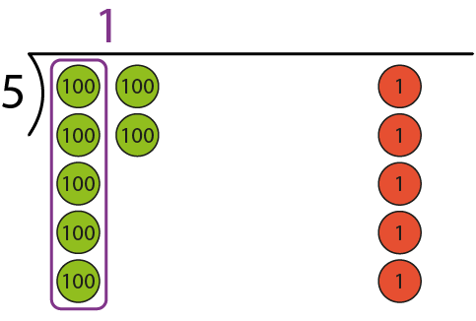
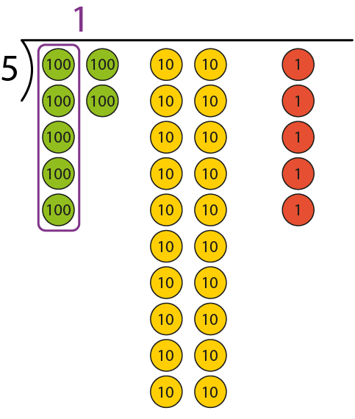

2.15 Short division Step 4:3
705 books shared equally between 5 year groups. How many books each?
705 ÷ 5 =
Step 1 – writing the divisor and dividend:
Step 2 – sharing the 100s:
1
5
5
7 hundreds ÷ 5 = 1 hundred r 2 hundreds
Notes:
Write ‘1’ in the hundreds column…

Slide 67
2.15 Short division Step 4:3
705 books shared equally between 5 year groups. How many books each?
705 ÷ 5 =
Step 2 – sharing the 100s:
Step 3 – exchanging:
1
5
7 hundreds ÷ 5 = 1 hundred r 2 hundreds
2 hundred = 20 tens
Notes:
… and write ‘2’ to the left of the tens digit of the dividend to make twenty tens.

Slide 68
2.15 Short division Step 4:3
705 books shared equally between 5 year groups. How many books each?
705 ÷ 5 =
Step 3 – exchanging:
Step 4 – sharing the 10s:
1
4
5
7 hundreds ÷ 5 = 1 hundred r 2 hundreds
2 hundred = 20 tens
20 tens ÷ 5 = 4 tens
Notes:
Write ‘4’ in the tens column.

Slide 69
2.15 Short division Step 4:3
705 books shared equally between 5 year groups. How many books each?
705 ÷ 5 =
141
Step 5 – sharing the 1s:
Step 4 – sharing the 10s:
1
4
1
5
7 hundreds ÷ 5 = 1 hundred r 2 hundreds
2 hundred = 20 tens
20 tens ÷ 5 = 4 tens
5 ones ÷ 5 = 1 one
Notes:
Write ‘1’ in the ones column.

Slide 70
Year 5, Unit 4, Learning Outcome 29
Learning Outcome 29
Pupils divide a three-digit number by a single-digit number using short division (with exchanging and remainders)
The following slides have been collated to support the teaching of this learning outcome.

Slide 71
Year 5, Unit 4, Learning Outcome 29
Additional teacher guidance for this outcome should be read first and can be found in this segment of the NCETM Primary Mastery Professional Development Materials:
2.15 Division: partitioning leading to short division
The spine materials are divided into ‘teaching points’ and ‘steps in learning’.
Teaching point | Steps in learning | Pages
4 | 4:5-4:6 and 4:10 | 31-33 and 35-36

Slide 72

2.15 Short division Step 4:5
612 ÷ 4 =
Step 1 – writing the divisor and the dividend:
4
Notes:
Six hundred and twelve divided by four.

Slide 73
2.15 Short division Step 4:5
612 ÷ 4 =
Step 1 – writing the divisor and the dividend:
Step 2 – sharing the 100s:
1
4
6 hundreds ÷ 4 = 1 hundred r 2 hundreds
Notes:
Write ‘1’ in the hundreds column…

Slide 74
2.15 Short division Step 4:5
612 ÷ 4 =
Step 2 – sharing the 100s:
Step 3 – exchanging:
1
4
6 hundreds ÷ 4 = 1 hundred r 2 hundreds
2 hundreds = 20 tens
Notes:
… and write ‘2’ to the left of the tens digit of the dividend to make twenty-one tens.

Slide 75
2.15 Short division Step 4:5
612 ÷ 4 =
Step 4 – sharing the 10s:
Step 3 – exchanging:
1
5
4
6 hundreds ÷ 4 = 1 hundred r 2 hundreds
2 hundreds = 20 tens
21 tens ÷ 4 = 5 tens r 1 ten
Notes:
Write ‘5’ in the tens column…

Slide 76
2.15 Short division Step 4:5
612 ÷ 4 =
Step 4 – sharing the 10s:
Step 5 – exchanging:
1
5
4
6 hundreds ÷ 4 = 1 hundred r 2 hundreds
2 hundreds = 20 tens
21 tens ÷ 4 = 5 tens r 1 ten
1 ten = 10 ones
Notes:
… and write ‘1’ to the left of the ones digit of the dividend to make twelve ones.

Slide 77
2.15 Short division Step 4:5
612 ÷ 4 =
153
Step 6 – sharing the 1s:
Step 5 – exchanging:
1
5
3
4
6 hundreds ÷ 4 = 1 hundred r 2 hundreds
2 hundreds = 20 tens
21 tens ÷ 4 = 5 tens r 1 ten
1 ten = 10 ones
12 ones ÷ 4 = 3 ones
Notes:
Write ‘3’ in the ones column.

Slide 78
Year 5, Unit 4, Learning Outcome 30
Learning Outcome 30
Pupils solve short division problems accurately when the hundreds digit is smaller than the divisor
The following slides have been collated to support the teaching of this learning outcome.

Slide 79
Year 5, Unit 4, Learning Outcome 30
Additional teacher guidance for this outcome should be read first and can be found in this segment of the NCETM Primary Mastery Professional Development Materials:
2.15 Division: partitioning leading to short division
The spine materials are divided into ‘teaching points’ and ‘steps in learning’.
Teaching point | Steps in learning | Pages
4 | 4:7-4:10 | 34-36

Slide 80
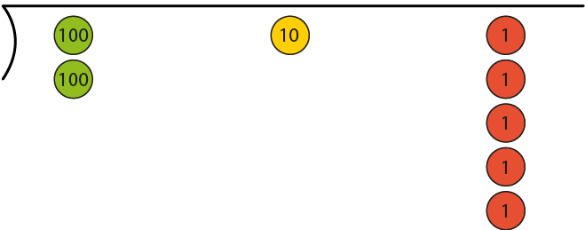
2.15 Short division Step 4:7
215 ÷ 5 =
Step 1 – writing the dividend and divisor:
5
Notes:
Two hundred and fifteen divided by five.

Slide 81
2.15 Short division Step 4:7
215 ÷ 5 =
Step 1 – writing the dividend and divisor:
Step 2 – sharing the 100s:
0
5
2 hundreds ÷ 5 = 0 hundreds r 2 hundreds
Notes:
Write ‘0’ in the hundreds column…

Slide 82
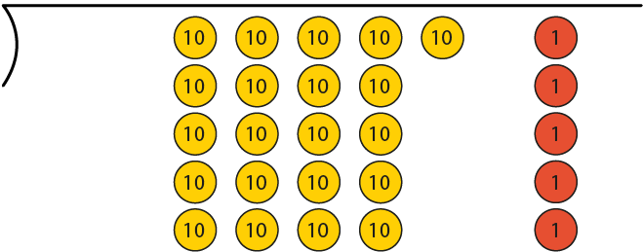
2.15 Short division Step 4:7
215 ÷ 5 =
Step 2 – sharing the 100s:
Step 3 – exchanging:
0
5
2 hundreds ÷ 5 = 0 hundreds r 2 hundreds
2 hundreds = 20 tens
Notes:
… and write ‘2’ to the left of the tens digit of the dividend to make twenty-one tens.

Slide 83
2.15 Short division Step 4:7
215 ÷ 5 =
Step 4 – sharing the 10s:
Step 3 – exchanging:
0
4
5
2 hundreds ÷ 5 = 0 hundreds r 2 hundreds
2 hundreds = 20 tens
21 tens ÷ 5 = 4 tens r 1 ten
Notes:
Write ‘4’ in the tens column…

Slide 84
2.15 Short division Step 4:7
215 ÷ 5 =
Step 4 – sharing the 10s:
Step 5 – exchanging:
0
4
5
2 hundreds ÷ 5 = 0 hundreds r 2 hundreds
2 hundreds = 20 tens
21 tens ÷ 5 = 4 tens r 1 ten
1 ten = 10 ones
Notes:
… and write ‘1’ to the left of the ones digit of the dividend to make fifteen ones.

Slide 85
2.15 Short division Step 4:7
215 ÷ 5 =
43
Step 6 – sharing the 1s:
Step 5 – exchanging:
0
4
3
5
2 hundreds ÷ 5 = 0 hundreds r 2 hundreds
2 hundreds = 20 tens
21 tens ÷ 5 = 4 tens r 1 ten
1 ten = 10 ones
15 ones ÷ 5 = 3 ones
Notes:
Write ‘3’ in the ones column.

Slide 86
2.15 Short division Step 4:8
6
800 ÷ 5
648 ÷ 6
8
5
6
426 ÷ 6
712 ÷ 4
4
7
6
4
8 > 5
6 = 6
4 < 6
7 > 4
three-digit quotient
three-digit quotient
three-digit quotient
two-digit quotient

Slide 87
Year 5, Unit 4, Learning Outcome 31
Learning Outcome 31
Pupils will use efficient strategies of division to solve problems
The following slides have been collated to support the teaching of this learning outcome.

Slide 88
Year 5, Unit 4, Learning Outcome 31
Additional teacher guidance for this outcome should be read first and can be found in this segment of the NCETM Primary Mastery Professional Development Materials:
2.15 Division: partitioning leading to short division
The spine materials are divided into ‘teaching points’ and ‘steps in learning’.
Teaching point | Steps in learning | Pages
4 | 4:11 | 37

Slide 89
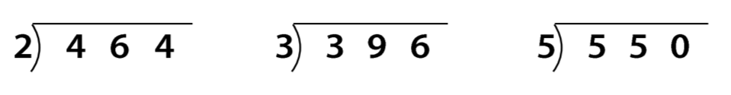
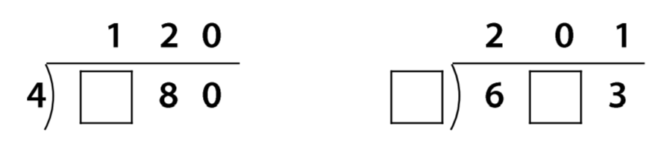
5MD-4 Divide using a formal written method
It is now really important to practise with other examples without resources to build fluency.
Complete these calculations.

