Slide 1
Wednesday 3rd February 2021
Personal, Social and Health Education (PSHE)
Please teach me to…
work with other people to help make the world a better place
describe some ways in which I can work with other people to help make the world a better place
empathise with people who are suffering or who are living in difficult situations
identify why I am motivated to do this

Slide 2
Vocabulary:
Dream
Hope
Goal
Achievement
Money
Sponsorship
Suffering
Hardship
Empathy
Motivation

Slide 3
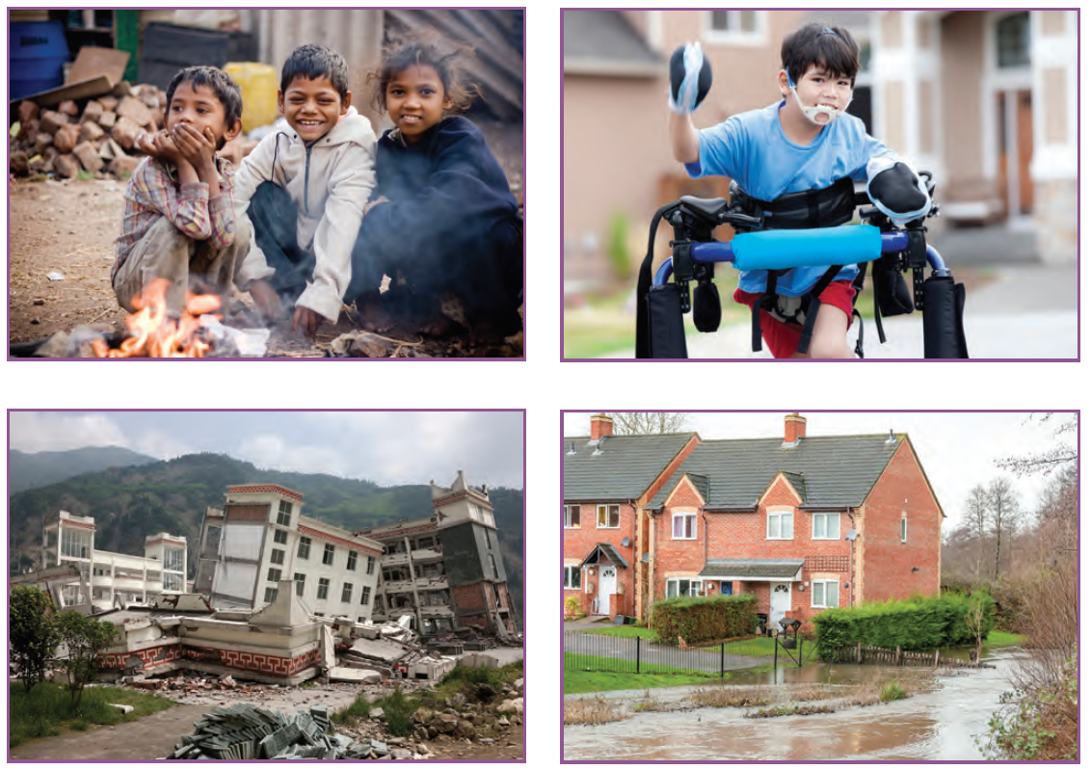

Slide 4


Slide 5
Check out these websites to show ways in which appeals or charities have been supported:
http://www.guardian.co.uk/media/gallery/2008/nov/06/blue-peter-appeals-bbc
http://www.bbc.co.uk/cbbc/shows/blue-peter
http://www.bbc.co.uk/programmes/p00q4x31
http://www.rednoseday.com/schools

Slide 6
Your task:
Think about who you might like to support or to hold an event for. It might be that you want to raise money for Comic Relief or a more local charity that might be significant for you. Submit your ideas for charities you’d like to support in the whole class catch up session on Thursday.
The next two PSHE lessons will be a group challenge for the class that will lead to an event which provides an opportunity to raise money for the class’s chosen charity.

Slide 7
Possible ideas:
Devise a virtual sponsorship event that could take place on a Zoom call, for example:
An hour-long dance extravaganza
run/three-legged races around the playground
bake-off
fitness challenge (for example, how many press-ups in a minute?)
yoga session
quiz

Slide 8
How am I going to start?
1. Prepare a PowerPoint presentation to raise awareness for your chosen charity
2. Design a poster to advertise your event
3. Design an invitation for parents/carers which can be given to all parents/carers across the school
4. Collect materials
5. Plan a route (for a sponsored walk or run) or plan recipes for a bake-off event, etc.

Slide 9
Questions checklist:
What challenges/ideas do I know of that can help others?
How might it feel to take part in a fundraising challenge?
What ideas of a challenge or an event do I have?
Have I ever supported a charity?
What charity would I like to support?
How might I contribute to this challenge?
How will I work together as a team at home?
What skills will I need?
What will my role be?
How will my chosen event make a difference for others in the world?
How can I help to make the world a better place?
Why might it be important to get involved?

