Slide 1
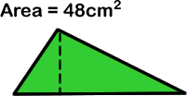
STARTER:
The area of this triangle is 48cm².
Its base and height are both whole numbers of centimetres.
What could the triangle’s base and height be?
Base | Height

Slide 2
STARTER:
The area of this triangle is 48cm².
Its base and height are both whole numbers of centimetres.
What could the triangle’s base and height be?
Base | Height
96cm | 1cm
48cm | 2cm
32cm | 3cm
24cm | 4cm
16cm | 6cm
12cm | 8cm

Slide 3
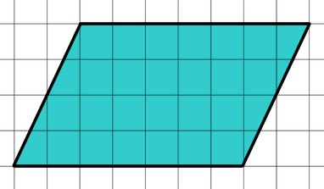
TALKING TIME:
How would you estimate the area of this parallelogram?

Slide 4
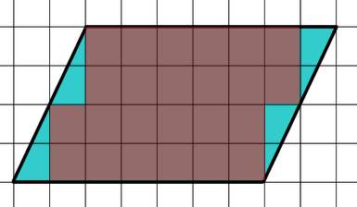
TALKING TIME:
How would you estimate the area of this parallelogram?
STEP ONE:
Count the number of whole squares.
There are 24 whole squares.

Slide 5
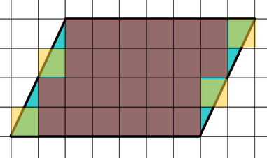
TALKING TIME:
How would you estimate the area of this parallelogram?
STEP TWO:
Count the number of nearly-whole squares.
Count these as whole squares.
There are 4 nearly-whole squares.

Slide 6
TALKING TIME:
How would you estimate the area of this parallelogram?
STEP THREE:
Count the number of squares that are about half.
Count these as half squares.
There are 0 squares that are about half.

Slide 7
TALKING TIME:
How would you estimate the area of this parallelogram?
STEP FOUR:
Ignore the squares that are covered less than a half.

Slide 8
TALKING TIME:
How would you estimate the area of this parallelogram?
STEP FIVE:
Add the number of whole squares (24), the number of nearly-whole squares (4) and the number of almost half squares (0). 24 + 4 + 0 = 28. The estimated area is 28cm².

Slide 9
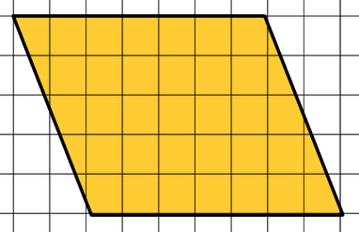
ACTIVITY 1:
Estimate the area of this parallelogram.
Whole squares | Nearly-whole squares | Almost half squares | Total area (cm²)

Slide 10
ACTIVITY 1:
Estimate the area of this parallelogram.
Whole squares | Nearly-whole squares | Almost half squares | Total area (cm²)
29 | 4 | 4 | 35
What is your estimate like, compared to this one?
How is it the same?
How is it different?

Slide 11
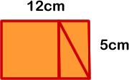

TALKING TIME:
Jordan has two triangles and a square.
He puts them together in different ways to make two different
quadrilaterals.
What do you notice?
What are the two shapes that Jordan makes?
Is there anything interesting about them?
What is the area of the first shape?
Can you tell what the area of the second shape is without working anything out?

Slide 12
TALKING TIME:
Jordan has two triangles and a square.
He puts them together in different ways to make two different
quadrilaterals.
What do you notice?
The two quadrilaterals Jordan makes are a rectangle and a parallelogram. As they are made out of the same shapes, we know that they have the same area.
The rectangle has an area of 12 x 5 = 70cm². So, the parallelogram must also have an area of 70cm².

Slide 13




ACTIVITY 2:
Cut a square out of paper and a rectangle with the same
height. Make sure that the height of your square and the
width of your rectangle are both whole numbers of squares.
b) Cut the rectangle across its diagonal so that you make two
identical triangles with a height equal to the square.
Use your shapes to make a large rectangle. What is its area?
Now rearrange them to make a parallelogram. What is its area?

Slide 14


ACTIVITY 2:
Cut a square out of paper and a rectangle with the same
height. Make sure that the height of your square and the
width of your rectangle are both whole numbers of squares.
b) Cut the rectangle across its diagonal so that you make two
identical triangles with a height equal to the square.
Use your shapes to make a large rectangle. What is its area?
The area should be found by using the l x w formula.
Now rearrange them to make a parallelogram. What is its area?
The parallelogram’s area is the same as the rectangle’s because
it is made of the same shapes.

Slide 15



TALKING TIME:
Point to the perpendicular height and the base of these
parallelograms.
Is there only one possible answer to this question, or more than one possibility? Why?

Slide 16
TALKING TIME:
Point to the perpendicular height and the base of these
parallelograms.
height
base
height
height
base
base

Slide 17
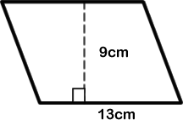
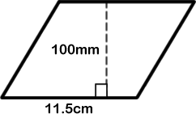
ACTIVITY 3:
Use the formula base x perpendicular height to find the area of these parallelograms.

Slide 18
ACTIVITY 3:
Use the formula base x perpendicular height to find the area of these parallelograms.
base x perpendicular height
= 13 x 9
= 117cm²
Extension:
Your friend says, “This formula is just the same as finding the area of a rectangle!”
Can you prove to them why this works with parallelograms?
base x perpendicular height
= 11.5 x 10
= 115 cm²

Slide 19
ACTIVITY 4:
A design on a ceiling of a museum is a large parallelogram.
The area of the parallelogram is between 25 and 28 square metres. Its base is longer than its height.
What could the dimensions of the parallelogram be?

Slide 20
ACTIVITY 4:
A design on a ceiling of a museum is a large parallelogram.
The area of the parallelogram is between 25 and 28 square metres. Its base is longer than its height.
What could the dimensions of the parallelogram be?
For example:
Base (m) | Perpendicular height (m) | Area (m²)
13 | 2 | 26
18 | 1 ½ | 27
11 | 2 ½ | 27 ½
Extension:
Choose a suitable scale and draw some of your answers to scale.
What is a good scale to use?

Slide 21
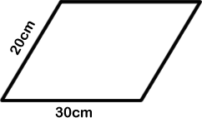
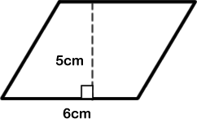
EVALUATION:
True or False?
The area of a parallelogram is found by multiplying
its perpendicular height by its base.
The area of this parallelogram is
found by multiplying 20 by 30.
c) The area of this parallelogram is (l x w) ÷ 2, which
equals (6 x 5) ÷ 2 = 15cm².
d) Any parallelogram has the same area as a rectangle with the same base and height.

Slide 22
EVALUATION:
True or False?
The area of a parallelogram is found by multiplying
its perpendicular height by its base. TRUE
The area of this parallelogram is
found by multiplying 20 by 30.
FALSE
c) The area of this parallelogram is (l x w) ÷ 2, which
equals (6 x 5) ÷ 2 = 15cm². FALSE
d) Any parallelogram has the same area as a rectangle with the same base and height. TRUE

