Slide 1
Ready-to-go Lesson Slides
Year 6
Perimeter, Area and Volume
Lesson 1
Spr5

Slide 3
STARTER:
Which one is different?
A) A rectangle with a length of 18cm and a width of 2cm
B) A square with a length of 6cm
C) A rectangle with a length of 12cm and a width that is ¼ of the length
D) A square with a length of 7cm
E) A rectangle with a length of 9cm and a width 5cm less

Slide 4
STARTER:
Which one is different?
A) A rectangle with a length of 18cm and a width of 2cm
B) A square with a length of 6cm
C) A rectangle with a length of 12cm and a width that is ¼ of the length
D) A square with a length of 7cm
E) A rectangle with a length of 9cm and a width 5cm less
D is the odd one out. All the other shapes have an area of 36cm².
D has an area of 49cm² instead.

Slide 5
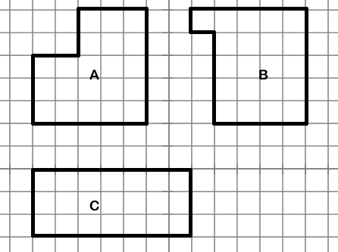
TALKING TIME:
What is the same? What is different?

Slide 6
TALKING TIME:
What is the same? What is different?
Each of the shapes is a rectilinear shape. Each of the shapes has an area of 21cm². A and B are not quadrilaterals (they are L-shaped hexagons). C is a quadrilateral.

Slide 7
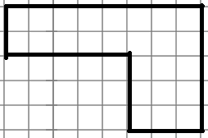
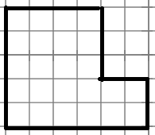
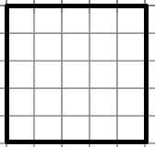
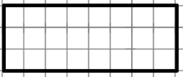
ACTIVITY 1:
Use the Carroll diagram to sort these shapes.
 | Quadrilateral | Not quadrilateral
Area of 24cm²
Area of 25cm²

Slide 8
ACTIVITY 1:
Use the Carroll diagram to sort these shapes.
 | Quadrilateral | Not quadrilateral
Area of 24cm²
Area of 25cm²
Extension:
Draw an extra shape for each section of the diagram.

Slide 9
TALKING TIME:
How many rectangles can you find that have an area of 48cm²?
Use a table to record your answers.
What do you notice about the dimensions of your rectangles?
Length (cm) | Width (cm) | Area (cm²)

Slide 10
TALKING TIME:
How many rectangles can you find that have an area of 48cm²?
Use a table to record your answers.
What do you notice about the dimensions of your rectangles?
Each of the pairs of dimensions is a factor pair that makes 48. For example, 1 x 48 = 48 and 2 x 24 = 48. Each factor pair makes a different rectangle. 48 has 10 factors, so we know that these make 5 pairs and so 5 rectangles.
Length (cm) | Width (cm) | Area (cm²)
48 | 1 | 48
24 | 2 | 48
16 | 3 | 48
12 | 4 | 48
8 | 6 | 48

Slide 11
ACTIVITY 2:
Use your knowledge of factors to predict how many rectangles
are possible with an area of 90cm².

Slide 12
ACTIVITY 2:
Use your knowledge of factors to predict how many rectangles
are possible with an area of 90cm².
The factors of 90 are 1, 2, 3, 5, 6, 9, 10, 15, 18, 30, 45 and 90.
These can make 6 different factor pairs, so the number of
different rectangles should be 6.
Now use a table to check whether your answer is correct.

Slide 13
ACTIVITY 2:
Use your knowledge of factors to predict how many rectangles
are possible with an area of 90cm².
The factors of 90 are 1, 2, 3, 5, 6, 9, 10, 15, 18, 30, 45 and 90.
These can make 6 different factor pairs, so the number of
different rectangles should be 6.
Now use a table to check whether your answer is correct.
Length (cm) | Width (cm) | Area (cm²)
90 | 1 | 90
45 | 2 | 90
30 | 3 | 90
18 | 5 | 90
15 | 6 | 90
10 | 9 | 90

Slide 14
ACTIVITY 3:
Use your knowledge of factors to predict how many rectangles
are possible with an area of 100cm².

Slide 15
ACTIVITY 3:
Use your knowledge of factors to predict how many rectangles
are possible with an area of 100cm².
The factors of 100 are 1, 2, 4, 5, 10, 20, 25, 50 and 100.
These can make 5 different factor pairs if we use the
Number 10 twice to make 10 x 10. This means that there
should be 5 different rectangles (the 10 x 10 square can be
classed as a regular rectangle).
Now use a table to check whether your answer is correct.

Slide 16
ACTIVITY 3:
Use your knowledge of factors to predict how many rectangles
are possible with an area of 100cm².
The factors of 100 are 1, 2, 4, 5, 10, 20, 25, 50 and 100.
These can make 5 different factor pairs if we use the
Number 10 twice to make 10 x 10. This means that there
should be 5 different rectangles (the 10 x 10 square can be
classed as a regular rectangle).
Now use a table to check whether your answer is correct.
Extension:
Sketch 5 more rectilinear shapes that also have an area of 100 cm squared.
Is there a way to find your answers quickly, using your knowledge of rectangles to help?
Length (cm) | Width (cm) | Area (cm²)
100 | 1 | 100
50 | 2 | 100
25 | 4 | 100
20 | 5 | 100

Slide 17


ACTIVITY 4:
James says that these two shapes have the same area.
Is James correct? Explain your answer.

Slide 18
ACTIVITY 4:
James says that these two shapes have the same area.
Is James correct? Explain your answer.
Yes, James is correct.
18 x 0.5 = 9, so the rectangle has an area of 9m².
The square has equal side lengths.
3 x 3 = 9, so the square also has an area of 9m².

Slide 19
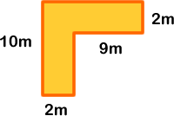
EVALUATION:
True or False?
The number 12 has 6 different factors.
b) There are 6 different rectangles that can be drawn
that have an area of 12 cm².
A square with side length 7cm and a rectangle with a length of 25cm and a width of 2cm have the same area.
The area of this shape is the same as the
area of a rectangle with a length of 19cm and
a width that is 17cm less than this.

Slide 20
EVALUATION:
True or False?
The number 12 has 6 different factors. TRUE
b) There are 6 different rectangles that can be drawn
that have an area of 12 cm². FALSE
A square with side length 7cm and a rectangle with a length of 25cm and a width of 2cm have the same area. FALSE
The area of this shape is the same as the
area of a rectangle with a length of 19cm and
a width that is 17cm less than this.
TRUE

Slide 21


