Slide 1
Ready-to-go Lesson Slides
Year 6
Perimeter, Area and Volume
Lesson 4
Spr5

Slide 3
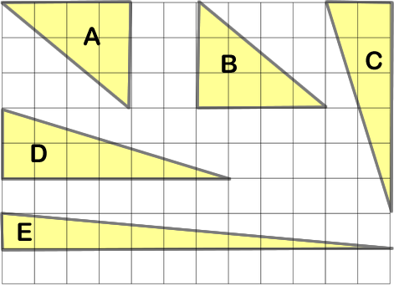
STARTER:
Which one is different?

Slide 4
STARTER:
Which one is different?
If we estimate the area of each triangle, we can see that they all have an approximate area of 6cm², except triangle D.
Triangle D has an area of about 7cm² instead.

Slide 5
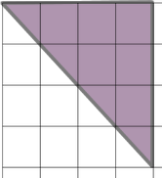
TALKING TIME:
a) Find the area of the triangle by counting squares.
b) Then turn the triangle into a rectangle by using the same
length and width.
c) Find the area of the rectangle and complete the sentence.
The area of the triangle is _____ the area of the rectangle.

Slide 6
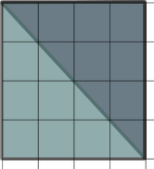
TALKING TIME:
a) Find the area of the triangle by counting squares.
b) Then turn the triangle into a rectangle by using the same
length and width.
c) Find the area of the rectangle and complete the sentence.
The area of the triangle is half the area of the rectangle.
Area = 8cm²
Area = 16cm²

Slide 7
ACTIVITY 1:
Cut out a rectangle from squared paper.
Work out its area (try to do this without counting squares).
Then cut your rectangle across the diagonal so that it makes a
right-angled triangle. Find the area of your triangle by either
counting squares or using estimation.
What do you notice?

Slide 8
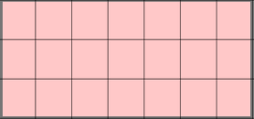
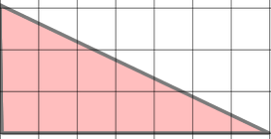
ACTIVITY 1:
Cut out a rectangle from squared paper.
Work out its area (try to do this without counting squares).
Then cut your rectangle across the diagonal so that it makes a
right-angled triangle. Find the area of your triangle by either
counting squares or using estimation.
What do you notice?
The area of your triangle should be half of the area of your
rectangle.

Slide 9
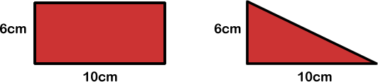
TALKING TIME:
The area of a rectangle is found by using the formula l x h
(length x height).
How could we use this to find the area of the triangle below?

Slide 10
TALKING TIME:
The area of a rectangle is found by using the formula l x h
(length x height).
How could we use this to find the area of the triangle below?
The area of the rectangle is 6cm x 10cm = 60cm².
The length and height of the triangle are exactly the same and so we can see that its area is half of the area of the rectangle.
60 ÷ 2 = 30, so the area of the triangle is 30cm².

Slide 11
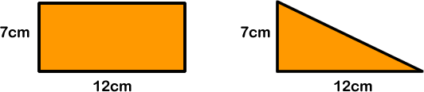
TALKING TIME:
What is the area of the triangle?
Can you invent a formula to find the area of a triangle?

Slide 12
TALKING TIME:
What is the area of the triangle?
The area of the rectangle is l x h = 12 x 7 = 84cm².
84 ÷ 2 = 42, so the area of the triangle is 42cm².
Can you invent a formula to find the area of a triangle?
The area of a triangle can be found by calculating half of the base x height.
½ x b x h or (b x h) ÷ 2

Slide 13
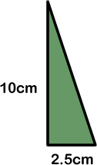
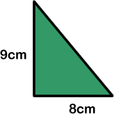
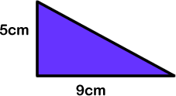
ACTIVITY 2:
Calculate the area of these triangles.
(b x h) ÷ 2 =
(b x h) ÷ 2 =
(b x h) ÷ 2 =

Slide 14
ACTIVITY 2:
Calculate the area of these triangles.
(b x h) ÷ 2 = (8 x 9) ÷ 2
= 72 ÷ 2
= 36 cm²
(b x h) ÷ 2 = (9 x 5) ÷ 2
= 45 ÷ 2
= 22.5 cm²
(b x h) ÷ 2 = (2.5 x 10) ÷ 2
= 25 ÷ 2
= 12.5 cm²

Slide 15
ACTIVITY 3:
Ellie says, “If you tell me two measurements of a triangle, I will
find its area.”
Is Ellie correct?
Explain your answer.

Slide 16
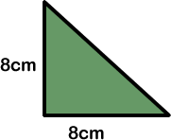
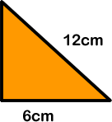
ACTIVITY 3:
Ellie says, “If you tell me two measurements of a triangle, I will
find its area.”
Is Ellie correct?
Explain your answer.
Yes – Ellie is correct, but only if the two measurements are
the triangle’s base and its height.
For example, Ellie could calculate this triangle’s area
because she knows the triangle’s base and height.
But she could not use the formula to calculate this
triangle’s area because the two measurements do not
include both the base and the height.

Slide 17
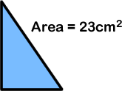
ACTIVITY 4:
What could the base and height of this triangle be?

Slide 18
ACTIVITY 4:
What could the base and height of this triangle be?
The base and height should be two numbers that multiply together to give 46.
There are two pairs:
Base = 1cm, Height = 46cm Base = 2cm, Height = 23cm
…and the opposite measurements:
Base = 46cm, Height 1cm Base = 23cm, Height = 2cm

Slide 19
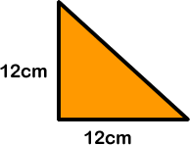
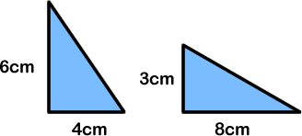
EVALUATION:
True or False?
This triangle has an area of 144 cm².
These triangles have the same area.
c) The area of a triangle is ½ of the product of its base and its height.
d) A triangle with an 8cm base and 2.5 cm height will have an area of 20cm².

Slide 20
EVALUATION:
True or False?
This triangle has an area of 144 cm².
FALSE
These triangles have the same area.
TRUE
c) The area of a triangle is ½ of the product of its base and its height. TRUE
d) A triangle with an 8cm base and 2.5 cm height will have an area of 20cm².
FALSE

Slide 21


