Slide 1
Ready-to-go Lesson Slides
Year 6
Perimeter, Area and Volume
Lesson 3
Spr5

Slide 3
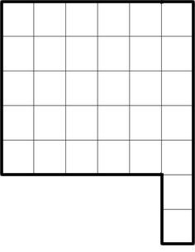
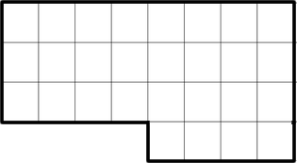
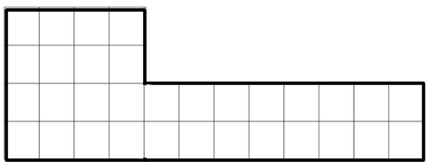
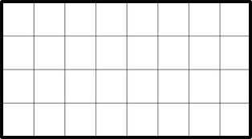
STARTER:
Which one is different?

Slide 4
STARTER:
Which one is different?
Although the last shape is the only rectangle, the first shape is different because it has a different area to the others.
All of the shapes have an area of 32cm². The first shape has an area of 28cm² instead.

Slide 5
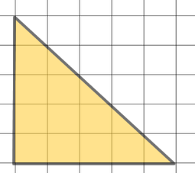
TALKING TIME:
How could you find the area of this triangle?

Slide 6
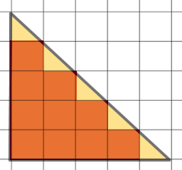
TALKING TIME:
How could you find the area of this triangle?
It has been drawn on squared paper, so we can use the squares to help us.
Also, the angle of the diagonal side shows that the triangle is made up of whole squares and half squares.
There are 11 whole squares and 5 half squares, which equals
13 ½ squares altogether, so we can say that the area of the
triangle is 13 ½ cm².

Slide 7
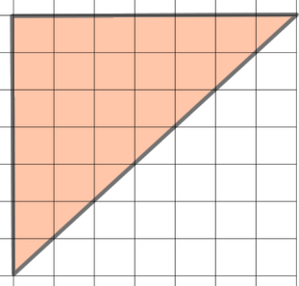
TALKING TIME:
Count the squares to find the area of this triangle.
Compare this triangle with the one on the previous slide.
What is the same? What is different?
Why can we find the area by counting squares?

Slide 8
TALKING TIME:
Count the squares to find the area of this triangle.
There are 21 whole squares.
There are 7 half squares.
The total area of the triangle is 24 ½ cm².

Slide 9
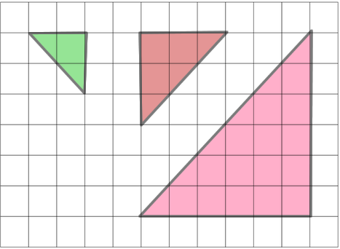
ACTIVITY 1:
Find the area of these triangles by counting the squares.

Slide 10
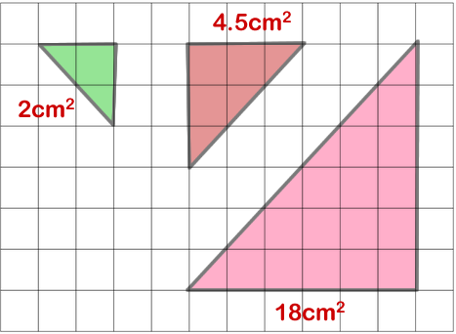
ACTIVITY 1:
Find the area of these triangles by counting the squares.

Slide 11
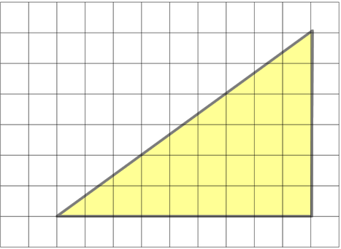
TALKING TIME:
How could you find the area of this triangle?
What is different about this triangle, compared with the ones we have looked at already?
Why does this make it more difficult to find an exact area?

Slide 12
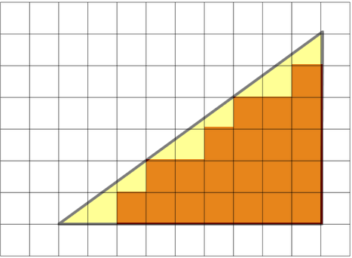
TALKING TIME:
How could you find the area of this triangle?
STEP ONE: Count the whole squares.
There are 21 whole squares. We can count these as 1 each.

Slide 13
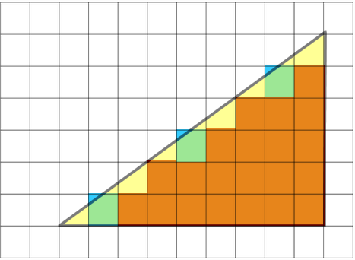
TALKING TIME:
How could you find the area of this triangle?
STEP TWO: Look for any squares that are nearly whole. Round these up to a whole square. There are 3 nearly whole squares. We can add these to our whole squares to get a total of 24 (21 + 3 = 24 whole squares).

Slide 14
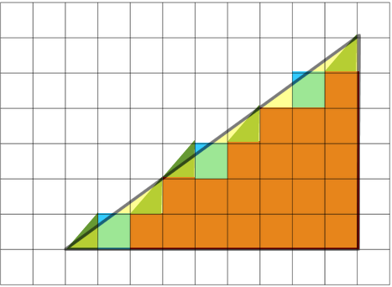
TALKING TIME:
How could you find the area of this triangle?
STEP THREE: Look for any squares that are about ½. Count each of these as if it were ½. There are 5 squares that are about ½ (5 x ½ = 2 ½ ). We can add these to total too (24 + 2 ½ = 26 ½ squares).

Slide 15
TALKING TIME:
How could you find the area of this triangle?
STEP FOUR: Ignore any squares that are less than half covered!
The values of the whole squares, nearly whole squares and half squares will give an approximate answer. 21 + 3 + (5 x ½ ) = 26 ½ squares
This triangle has an actual area of 27 squares, so you can see that this way of finding an estimated answer is pretty accurate!

Slide 16
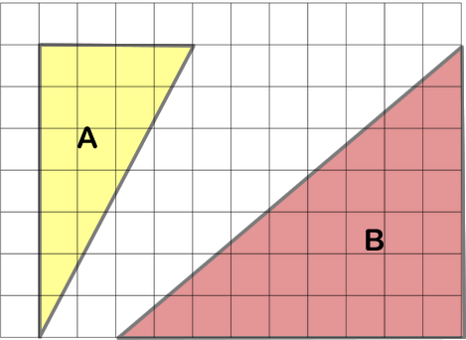
ACTIVITY 2:
Use the estimation method to find the approximate area of these
triangles.
Triangle | Whole squares | Nearly-whole | About half squares | Estimated area

Slide 17
ACTIVITY 2:
Use the estimation method to find the approximate area of these
triangles.
How do your estimates compare to these ones?
Interestingly, the actual areas are 14 square cm and 31 ½ square cm.
Perhaps your estimates were closer!
Triangle | Whole squares | Nearly-whole | About half squares | Estimated area
A | 9 | 4 | 2 | 14cm²
B | 24 | 4 | 5 | 30 ½ cm²

Slide 18
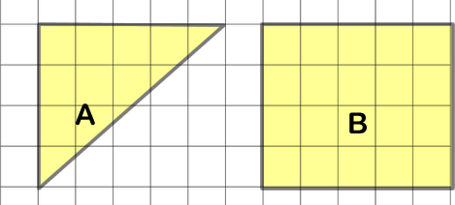
ACTIVITY 3:
Estimate the area of the triangle and find the area of the
rectangle. What do you notice?

Slide 19
ACTIVITY 3:
Estimate the area of the triangle and find the area of the
rectangle. What do you notice?
Estimated area of triangle = 6 whole squares + 3 nearly-whole
squares + 4 about half squares = 6 + 2 + (4 x ½ ) = 10 squares
Area of rectangle = length x width = 5 x 4 = 20 squares
The area of the triangle is half of the area of the rectangle.

Slide 20
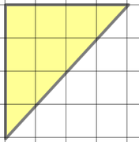
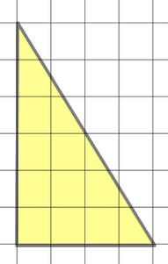
EVALUATION:
True or False?
This triangle has an area of 9 cm.
23 ½ cm is a good estimate for this
triangle’s area.
c) A triangle covers 12 whole squares, 4 nearly-whole squares and 5 half squares. Its area is approximately 21 cm.

Slide 21
EVALUATION:
True or False?
This triangle has an area of 9 cm².
FALSE (It is 8cm²).
23 ½ cm² is a good estimate for this
triangle’s area.
TRUE
c) A triangle covers 12 whole squares, 4 nearly-whole squares and 5 half squares. Its area is approximately 21 cm². FALSE

Slide 22


