Slide 1
STARTER:
Which one is different?
A) A rectangle made up of two squares side by side, both with side lengths of 8cm.
B) A square with a length of 11cm.
C) A rectangle with a length of 62cm and a width of 2cm.
D) A rectangle with a length of 32cm and a width of 4cm.
E) A rectangle with a length of 16cm and a width that is half of its length.

Slide 2
STARTER:
Which one is different?
A) A rectangle made up of two squares side by side, both with side lengths of 8cm.
B) A square with a length of 11cm.
C) A rectangle with a length of 62cm and a width of 2cm.
D) A rectangle with a length of 32cm and a width of 4cm.
E) A rectangle with a length of 16cm and a width that is half of its length.
B is the odd one out. All the other shapes have an area of 128cm².
B has an area of 121cm² instead.

Slide 3
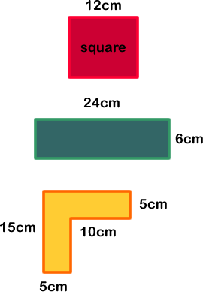
TALKING TIME:
Two of these shapes have the same area. Which are they?
a)
b)
c)

Slide 4
TALKING TIME:
Two of these shapes have the same area. Which are they?
a)
Shapes (a) and (b) have
the same area. They both
b) have an area of 144cm².
c)

Slide 5
TALKING TIME:
Two of these shapes have the same perimeter. Which are they?
a)
b)
c)

Slide 6
TALKING TIME:
Two of these shapes have the same perimeter. Which are they?
a)
Shapes (b) and (c) have
the same perimeter.
b) They both have a
perimeter of 60cm.
c)

Slide 7
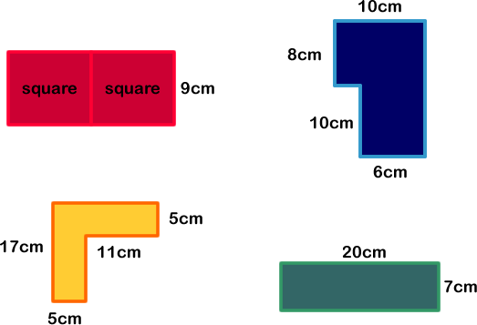
ACTIVITY 1:
Do any of these shapes have the same perimeter?

Slide 8
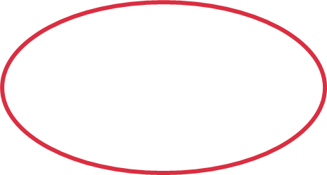
ACTIVITY 1:
Do any of these shapes have the same perimeter?
Yes. These two shapes
both have a perimeter of
54cm.

Slide 9
ACTIVITY 2:
Do any of these shapes have the same area?

Slide 10
ACTIVITY 2:
Do any of these shapes have the same area?
Yes. These three shapes
all have an area of 140cm².

Slide 11
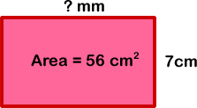
TALKING TIME:
How do you know what the missing value is?

Slide 12
TALKING TIME:
How do you know what the missing value is?
The area equals 56 square centimetres, so we know that the width (7) multiplied by the length will equal 56. 7 x 8 = 56, so the length must be 8cm.
However, it is written in mm, so the missing value is 80.

Slide 13
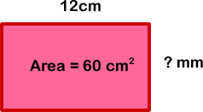
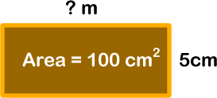
ACTIVITY 3:
Calculate the missing values.

Slide 14
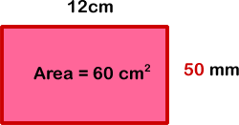
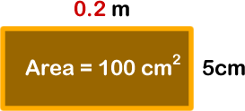
ACTIVITY 3:
Calculate the missing values.

Slide 15
ACTIVITY 4:
Draw two rectilinear shapes that both have a perimeter of 62cm.
Calculate their area.

Slide 16
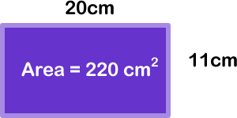
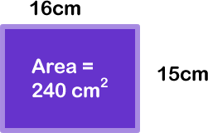
ACTIVITY 4:
Draw two rectilinear shapes that both have a perimeter of 62cm.
Calculate their area.
For example:

Slide 17
ACTIVITY 5:
Sam is cutting a rectangular piece of paper to draw a cartoon on.
He wants it to have a perimeter of 26cm, but with as much
space to draw his cartoon as possible.
What should the dimensions of the rectangle be?
Length (cm) | Width (cm) | Area (cm²) | Perimeter (cm)

Slide 18
ACTIVITY 5:
Sam is cutting a rectangular piece of paper to draw a cartoon on.
He wants it to have a perimeter of 26cm, but with as much
space to draw his cartoon as possible.
What should the dimensions of the rectangle be?
Length (cm) | Width (cm) | Area (cm²) | Perimeter (cm)
12 | 1 | 12 | 26
11 | 2 | 22 | 26
10 | 3 | 30 | 26
9 | 4 | 36 | 26
8 | 5 | 40 | 26
7 | 6 | 42 | 26
The rectangle should have the largest area possible. This rectangle is the one
with a length of 7cm and a width of 6cm.

Slide 19
ACTIVITY 6:
Leah is looking back at her results for Activity 5.
She says, “If the perimeter stays the same, the rectangle with
the largest area will always be the one that is the ‘squarest’!”
Explore Leah’s idea. Is she correct?

Slide 20
ACTIVITY 6:
Leah is looking back at her results for Activity 5.
She says, “If the perimeter stays the same, the rectangle with
the largest area will always be the one that is the ‘squarest’!”
Explore Leah’s idea. Is she correct?
Yes – Leah is correct.
If the perimeter of a rectangle is kept the same, the one
with the largest area will be the one where the length and
the width are closest in size (or even equal, in the case of a square).
For example, the largest enclosure that a farmer can make using a length of wire fencing that is 40m long is a 10 x 10 square.
Use this idea to find the largest enclosure that a farmer could make using wire fencing that is 50m long.
Remember – you don’t have to go through every single possibility now you know this!

Slide 21
EVALUATION:
True or False?
A square with a side length of 5m and a rectangle
with a length of 50m and a width of 0.5m both have
the same perimeter.
The shapes in question (a) both have the same area.
Two rectangles with different perimeters can have the same area.
Two rectangles have the same perimeter. The one that is the ‘squarest’ (with the length and the width closest together) will be the one with the smallest area.

Slide 22
EVALUATION:
True or False?
A square with a side length of 5m and a rectangle
with a length of 50m and a width of 0.5m both have
the same perimeter. FALSE
The shapes in question (a) both have the same area. TRUE
Two rectangles with different perimeters can have the same area. TRUE
Two rectangles have the same perimeter. The one that is the ‘squarest’ (with the length and the width closest together) will be the one with the smallest area. FALSE (it will have the largest area!)

