Slide 1
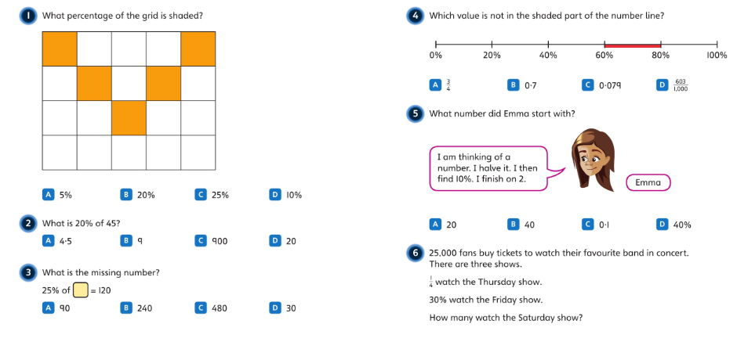

Slide 2
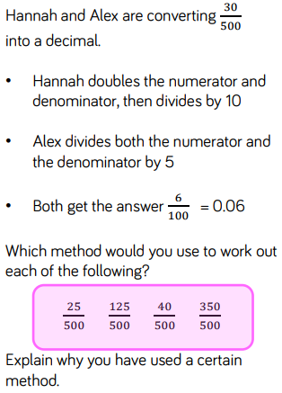
18/1/21
LO: to convert between fractions, decimals and percentages.
Success Criteria:
I can represent percentages as decimals;
I can divide a numerator by a denominator to convert a fraction to a decimal;
I can apply my place value knowledge.
Starter:

Slide 3
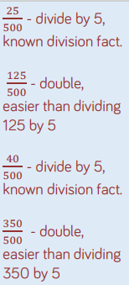
18/1/21
LO: to convert between fractions, decimals and percentages.
Success Criteria:
I can represent percentages as decimals;
I can divide a numerator by a denominator to convert a fraction to a decimal;
I can apply my place value knowledge.
Starter:

Slide 4
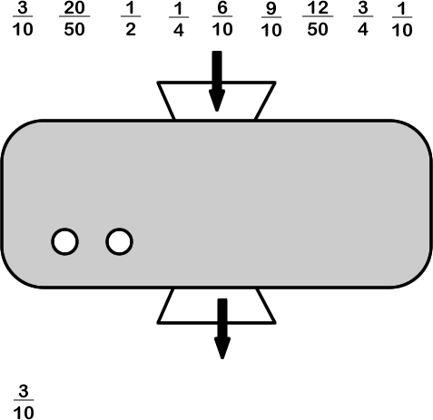
STARTER:
This machine converts fractions into equivalent fractions that are expressed in hundredths. For example, 3/10 goes in and 30/100 comes out.
What will come from the rest of these fractions?

Slide 5
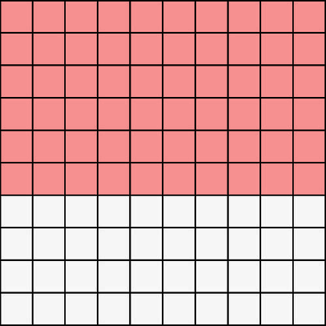
TALKING TIME:
60
100
What fraction of the hundred square is shaded?
Can you write this as a percentage?
60%

Slide 6
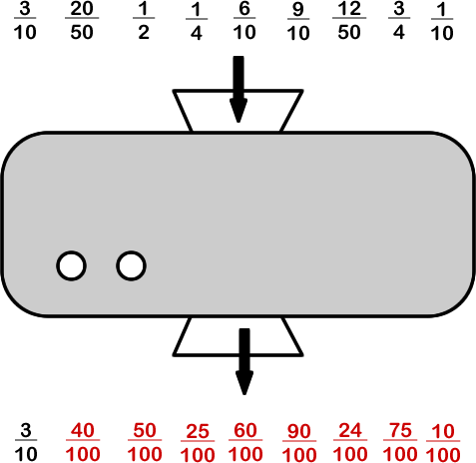
STARTER:
This machine converts fractions into equivalent fractions that are expressed in hundredths. For example, 3/10 goes in and 30/100 comes out.
What will come from the rest of these fractions?

Slide 7
TALKING TIME:
What fraction of the hundred square is shaded?
Can you write this as a percentage?

Slide 8
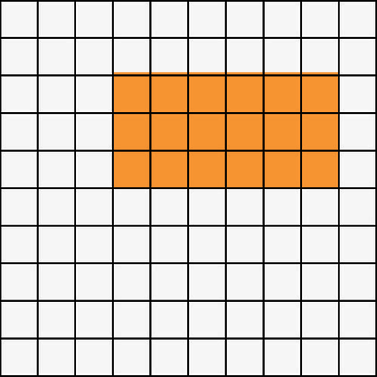
TALKING TIME:
What fraction of the hundred square is shaded?
Can you write this as a percentage?

Slide 9
TALKING TIME:
18
100
What fraction of the hundred square is shaded?
Can you write this as a percentage?
18%

Slide 10
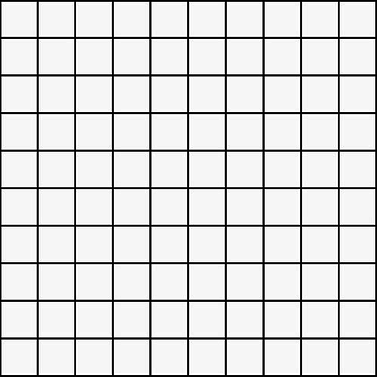
ACTIVITY 1:
Shade in a hundred square to show 50%.
Can you write this as two fractions?

Slide 11
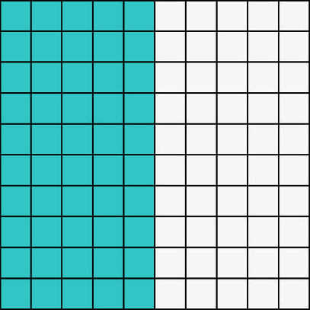
ACTIVITY 1:
Shade in a hundred square to show 50%.
Can you write this as two fractions?
For example:
50
100
1
2

Slide 12
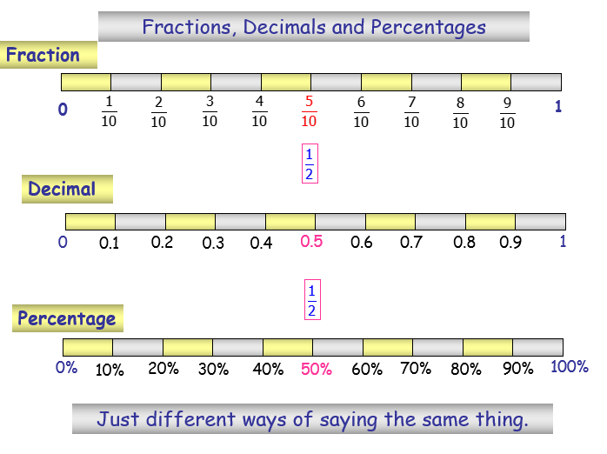
18/1/21
LO: to convert between fractions, decimals and percentages.

Slide 13
What does the word ‘percent’ mean? How can you represent this?

Slide 14
Which denominator is the easiest to convert into a percentage?
Why is this easiest?
Which other denominators are easier to convert into percentages?

Slide 15
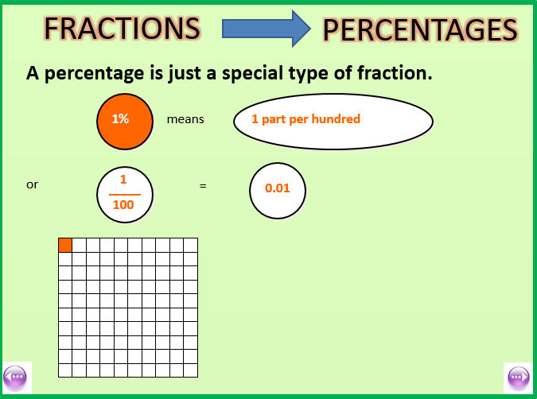
18/1/21
LO: to convert between fractions, decimals and percentages.

Slide 16
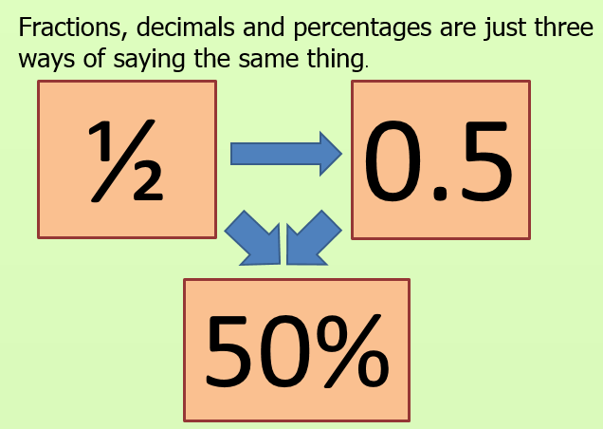
18/1/21
LO: to convert between fractions, decimals and percentages.

Slide 17
If the denominator is 50, 25, 20 or 10 how would you convert it in
to 100?
What would you need to do to the numerator?

Slide 18
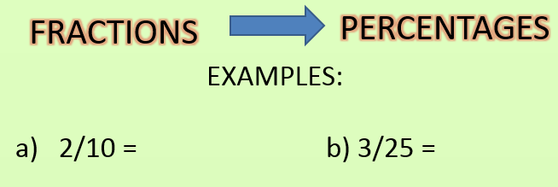
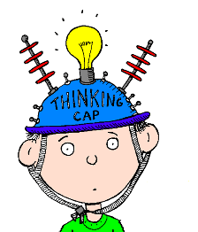
18/1/21
LO: to convert between fractions, decimals and percentages.
How do I do it??

Slide 19

18/1/21
LO: to convert between fractions, decimals and percentages.
What went wrong??
3/15 = 45%

Slide 20
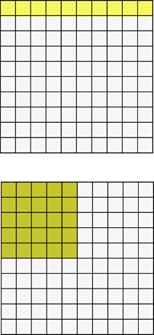
ACTIVITY 2:
Find the shaded percentages and fractions.

Slide 21
ACTIVITY 2:
Find the shaded percentages and fractions.
10
100
1
10
10% = or
25
100
1
4
25% = or

Slide 22
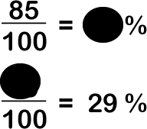
TALKING TIME:
Explain what the missing numbers are.
How do you know?

Slide 23
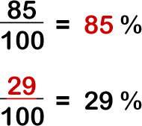
TALKING TIME:
Explain what the missing numbers are.
How do you know?

Slide 24
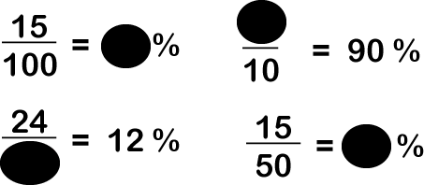
ACTIVITY 3:
Complete the missing numbers using your knowledge of fractions and percentages.

Slide 25
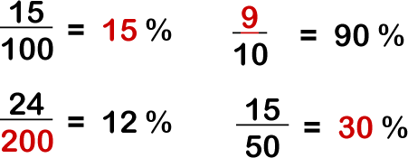
ACTIVITY 3:
Complete the missing numbers using your knowledge of fractions and percentages.

Slide 26
ACTIVITY 4:
Complete the table.
Fraction | Fraction (in hundredths) | Percentage
9 10 | ? 100 | ? %
9 ? | 45 100 | ? %
9 ? | ? 100 | 36%

Slide 27
ACTIVITY 4:
Complete the table.
Fraction | Fraction (in hundredths) | Percentage
9 10 | 90 100 | 90 %
9 20 | 45 100 | 45 %
9 25 | 36 100 | 36%

Slide 28


Varied Fluency 1
Match the fractions to the correct percentages.
 |  |  |  | 76%
 |  |  |  | 60%
 |  |  |  | 45%
 |  |  |  | 82%
6
10
82
100
41
50
76
100
9
20
60
100
19
25
45
100
© Classroom Secrets Limited 2018

Slide 29
Varied Fluency 1
Match the fractions to the correct percentages.
 | = |  | = | 60%
 | = |  | = | 82%
 | = |  | = | 45%
 | = |  | = | 76%
6
10
60
100
41
50
82
100
9
20
45
100
19
25
76
100
© Classroom Secrets Limited 2018

Slide 30
Varied Fluency 3
Which numbers are the same value?
2
25
54
100
9
10
8
100
90%
27
50
54%
90
100
8%
© Classroom Secrets Limited 2018

Slide 31
Varied Fluency 3
Which numbers are the same value?
= =
= =
= =
2
25
8
100
8%
9
10
90
100
90%
27
50
54
100
54%
© Classroom Secrets Limited 2018

Slide 32
ACTIVITY 5:
India, Joe and Carla have taken a maths test.
India says, “I got 3/5 of the test correct.”
Joe says, “I got 55% of the test right.”
Carla says, “I got 7/10 of the test right.”
Put the names of each child in order from least to most correct questions.

Slide 33
ACTIVITY 5:
India, Joe and Carla have taken a maths test.
India says, “I got 3/5 of the test correct.”
Joe says, “I got 55% of the test right.”
Carla says, “I got 7/10 of the test right.”
Put the names of each child in order from least to most correct questions.
India = 3/5 = 60/100 = 60% correct
Joe = 55% correct
Carla = 7/10 = 70/100 = 70% correct
In order: JOE, INDIA, CARLA

Slide 34
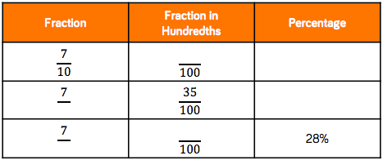
18/1/21
LO: to convert between fractions, decimals and percentages.
Success Criteria:
I can represent percentages as decimals;
I can convert fractions into fractions over ten, hundred or a thousand to express as a decimal;
I can apply my place value knowledge.
Activity 2:
Copy and complete the table below.
Extension:
Add a fourth column showing each fraction/percentage as a decimal!

Slide 35
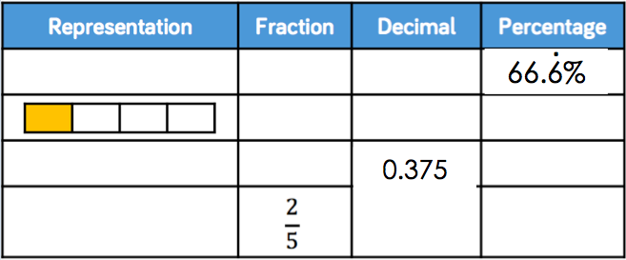
18/1/21
LO: to convert between fractions, decimals and percentages.
Success Criteria:
I can represent percentages as decimals;
I can convert fractions into fractions over ten, hundred or a thousand to express as a decimal;
I can apply my place value knowledge.
Activity 3:
Complete the table.
Can you record the fraction in its simplest form?
10 squares wide
four squares wide

Slide 36

Reasoning 1
George says,
Is he correct? Convince me.
40% is the same
as .
8
20
© Classroom Secrets Limited 2018

Slide 37
Reasoning 1
George says,
Is he correct? Convince me.
George is correct because…
40% is the same
as .
8
20
© Classroom Secrets Limited 2018

Slide 38
Reasoning 1
George says,
Is he correct? Convince me.
George is correct because = 40%
40% is the same
as .
8
20
8
20
© Classroom Secrets Limited 2018

Slide 39
Problem Solving 1
Competitors in an archery competition need more than 60% to get to the final. What percent did each child score?
Who gets to the final?
Name | Score
Maddie
Laila
Declan
Morris
1
10
36
50
20
25
19
100
© Classroom Secrets Limited 2018

Slide 40
Problem Solving 1
Competitors in an archery competition need more than 60% to get to the final. What percent did each child score?
Who gets to the final?
Maddie 10%, Laila 72%, Declan 80%, Morris 19%
so Laila and Declan get through to the next round.
Name | Score
Maddie
Laila
Declan
Morris
1
10
36
50
20
25
19
100
© Classroom Secrets Limited 2018

Slide 41
Problem Solving 2
Convert the fractions to percentages and sort them into the correct columns.
Less than 50% | Equal to 50% | More than 50%
12
20
9
25
18
50
45
50
41
100
8
10
© Classroom Secrets Limited 2018

Slide 42
Problem Solving 2
Convert the fractions to percentages and sort them into the correct columns.
Less than 50% | Equal to 50% | More than 50%
= 36% |  | = 60%
= 36% |  | = 80%
= 41% |  | = 90%
9
25
12
20
18
50
8
10
41
100
45
50
© Classroom Secrets Limited 2018

Slide 43
18/1/21
LO: to convert between fractions, decimals and percentages.
Success Criteria:
I can represent percentages as decimals;
I can convert fractions into fractions over ten, hundred or a thousand to express as a decimal;
I can apply my place value knowledge.
Activity 4:
(a) In a Maths test, Tom answered 62% of the questions correctly.
Lily answered three fifths of the questions correctly.
Jane got an average per point of 0.63
Rank their scores from best to worst.
Explain your answer.
(b) In a Reading comprehension, Bob answered two thirds of the questions correctly.
Mike answered 73% of the questions correctly.
Jane got an average per point of 0.7
Rank their scores from best to worst.
Explain your answer.

Slide 44
18/1/21
LO: to convert between fractions, decimals and percentages.
Success Criteria:
I can represent percentages as decimals;
I can convert fractions into fractions over ten, hundred or a thousand to express as a decimal;
I can apply my place value knowledge.
Activity 4:
Answers.
(a)
Jane got the best score as 0.63 is more than Tom’s score of 0.62 (62%), and 0.03 more than Lily’s score of 0.60 (three fifths).
(b)
Mike got the highest mark as 73% is 0.73 as a decimal number, Jane came second as 0.7 is the same as 70%, and Bob got the lowest mark as two thirds is equivalent to 0.667 (to three decimal places).

Slide 45
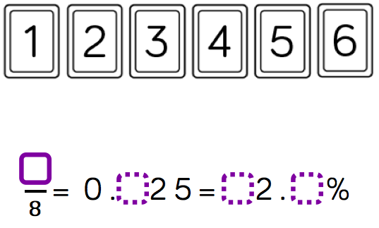
18/1/21
LO: to convert between fractions, decimals and percentages.
Success Criteria:
I can represent percentages as decimals;
I can convert fractions into fractions over ten, hundred or a thousand to express as a decimal;
I can apply my place value knowledge.
Evaluation:
Use the digit cards to complete the missing information.
How many ways can you find?

Slide 46
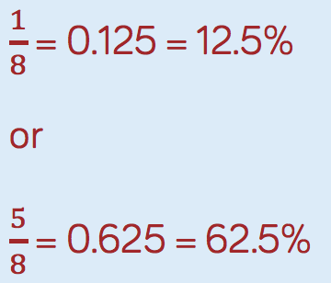
18/1/21
LO: to convert between fractions, decimals and percentages.
Success Criteria:
I can represent percentages as decimals;
I can convert fractions into fractions over ten, hundred or a thousand to express as a decimal;
I can apply my place value knowledge.
Evaluation:
There are two possible solutions

Slide 47
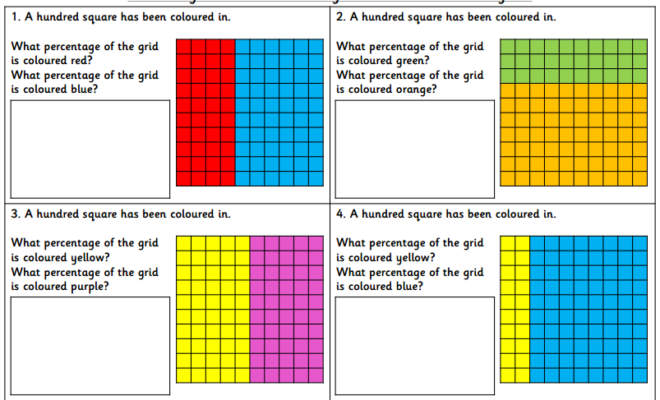

Slide 48
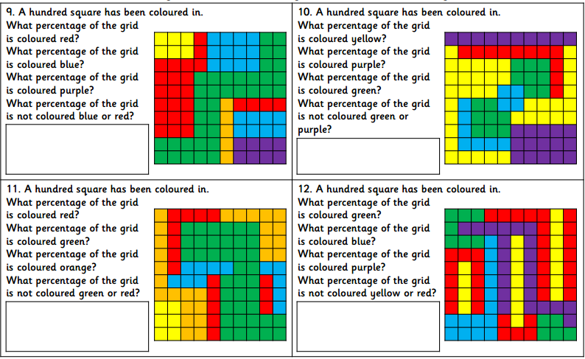

Slide 49
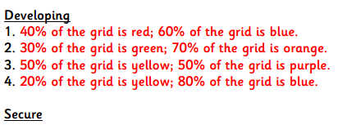
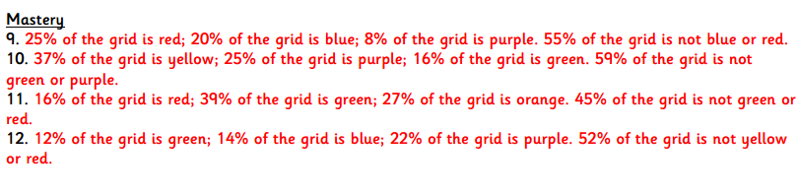

Slide 50
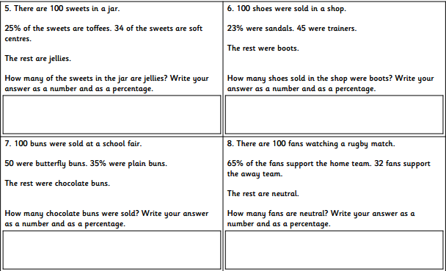

Slide 51
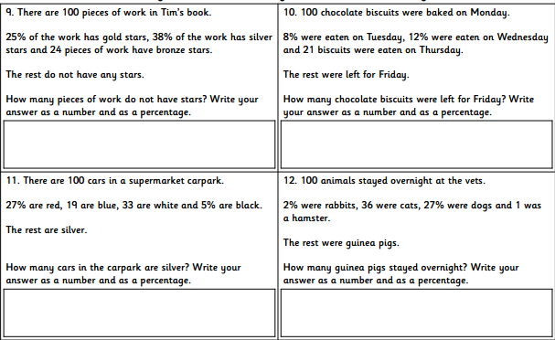

Slide 52
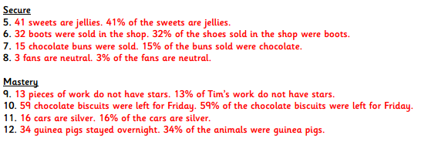

Slide 53
EVALUATION:
True or False?
If you colour half of a hundred square in, you have
coloured ½ %.
b) 25% is the same as a quarter.
40/100 = 40%
d) 9/10 = 9%
A percentage is an amount out of 100.

Slide 54
EVALUATION:
True or False?
If you colour half of a hundred square in, you have
coloured ½ %. FALSE
b) 25% is the same as a quarter. TRUE
40/100 = 40% TRUE
d) 9/10 = 9% FALSE
A percentage is an amount out of 100. TRUE

