Slide 1
LO: to understand who Carl Linnaeus is and to classify plants and animals

Slide 2
Success criteria
To know who Carl Linnaeus is and understand his importance to science
We will be able to classify plants and animals
Understand how we classify plants and animals

Slide 3
Who is Carl Linnaeus
Watch this video on to learn more about Carl Linnaeus
http://ed.ted.com/on/90vRVJZ6

Slide 4
Carl Linnaeus
A Swedish scientist that created the Systema Naturae.
This book looks at ways in which we can pick out key characteristics and then begin to sort them into different groups.
We call this classification

Slide 5
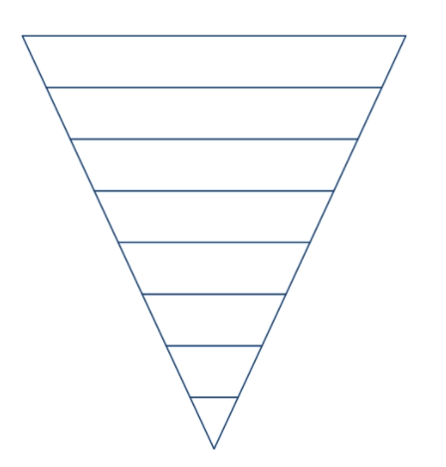
Kingdoms
Kingdom: Most scientists now list 5 kingdoms
Animal,
Plant,
Protists (amoebas and such),
Fungi and
Montera (bacteria).

Slide 6
Phylum
There are more than 30 Phyla in the
animal kingdom and around 10 in the
plant kingdom

Slide 7
Class
Phyla are divided into classes
Most common classes are:
Mammals
Birds
Fish
Amphibians
Reptiles

Slide 8
Order
This is where the living things we are
classifying begin to filter out into smaller
groups, you as scientists have to group
the living things by their characteristics

Slide 9
Family
This is where we further break down
our living things into smaller groups

Slide 10
Genus
Two or more species that share
unique body structures or other
characteristics are considered to be
closely related and are placed
together in a genus. Sometimes a
genus might include only a single
species if there is nothing else in the
world that has similarities with it.
The genus is the first part of the
scientific name of a species. The
genus is always spelled with a capital letter and in italics.

Slide 11
Species
Species are where a group of
individuals will breed with each other
to create fertile offspring
Sometimes different species can breed
but the offspring they create will be
infertile. An example of this are when
a donkey and horse breed they will
have a mule for offspring, mules are
not fertile which means they can’t
have offspring of their own.

Slide 12
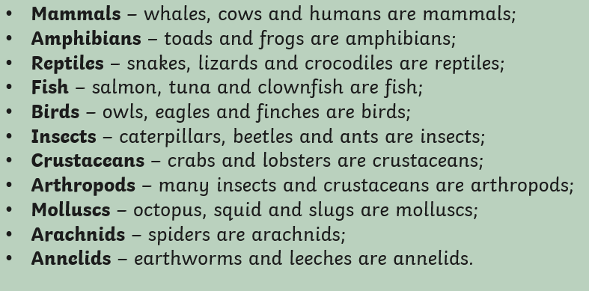
A good place to start! (animals)

Slide 13
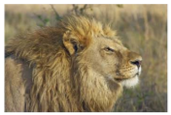
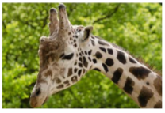
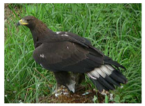
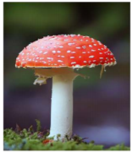
Animals
Fungi
Mammals
Birds

Slide 14
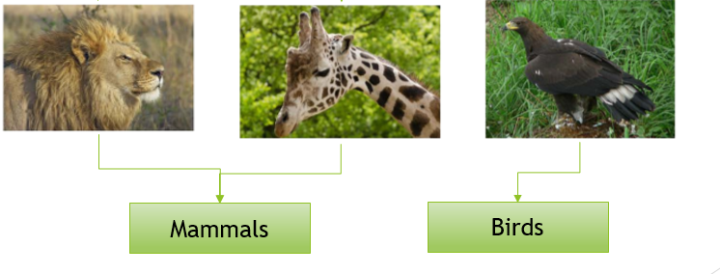
Does not have a long neck
Long neck

Slide 15


