Slide 1
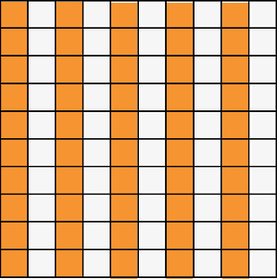
STARTER:
Which one is different?
1
2
50
100
5
20
50%

Slide 2
STARTER:
Which one is different?
1
2
50
100
5
20
50%
5
20
is the odd one out.
All the others are equivalent with a half.

Slide 3
TALKING TIME:
If we know how to get from decimal to fraction…
?
100
0.65 =
…and we know how to get from hundredths to percentage…
?
100
= ? %
…then we can get from decimal to percentage!
0.65 = ? %

Slide 4
TALKING TIME:
If we know how to get from decimal to fraction…
65
100
0.65 =
…and we know how to get from hundredths to percentage…
65
100
= 65 %
…then we can get from decimal to percentage!
0.65 = 65 %

Slide 5
TALKING TIME:
How do you know what the missing number is?
0.3 = ? %

Slide 6
TALKING TIME:
How do you know what the missing number is?
0.3 is the same as 3/10, which is equivalent to 30/100.
We can use this fraction in hundredths to identify that 0.3 is equal to 30%.
0.3 = ? %

Slide 7
TALKING TIME:
Describe the steps you would use to find out what the missing percentage is worth.
0.7 = ? %

Slide 8
TALKING TIME:
Describe the steps you would use to find out what the missing percentage is worth.
0.7 is the same as 7/10, which is equivalent to 70/100.
We can use this fraction in hundredths to identify that 0.7 is equal to 70%.
0.7 = ? %

Slide 9


Varied Fluency 1
Use the shaded part of the 100 square to write an equivalent fraction, decimal and percentage.
© Classroom Secrets Limited 2018

Slide 10
Varied Fluency 1
Use the shaded part of the 100 square to write an equivalent fraction, decimal and percentage.
Fraction:
Decimal: 0.08
Percentage: 8%
8
100
© Classroom Secrets Limited 2018

Slide 11
Varied Fluency 2
Which numbers are missing?
= |  | = | 80%
5
© Classroom Secrets Limited 2018

Slide 12
Varied Fluency 2
Which numbers are missing?
= |  | = | 80%
 | 0.8
4
5
© Classroom Secrets Limited 2018

Slide 13
ACTIVITY 1
Complete the table.
Decimal | Fraction | Percentage
 |  | 75%
0.83
 | 2 or 20 10 100
 |  | 10%

Slide 14
ACTIVITY 2
Complete the missing values.
0.2 = __ %
47% = ?
100
c) 90% = ?
10
d) 0.75 = 3
?

Slide 15
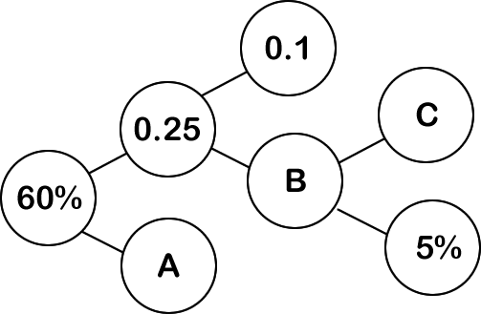
ACTIVITY 3
How could you complete this part-whole diagram in different ways?

Slide 16
ACTIVITY 3
How could you complete this part-whole diagram in different
ways?
A = 0.35, 35% or 35/100
B = 0.15, 15% or 15/100
C = 0.1, 10%, 10/100 or 1/10
Now invent your own part-whole puzzle to challenge your friends with!

Slide 17
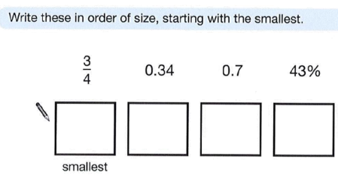
19/1/21
LO: to find equivalent fractions decimals and percentages.
Success Criteria:
I can place a percentage as a fraction over 10 or 100, or convert to a decimal;
I can divide a numerator by a denominator to convert a fraction to a decimal;
I can express and round (when needed) decimals to three decimal places.
Activity 2:
a)
b)
82
100
0.8
0.801
81%

Slide 18
19/1/21
LO: to find equivalent fractions decimals and percentages.
Success Criteria:
I can place a percentage as a fraction over 10 or 100, or convert to a decimal;
I can divide a numerator by a denominator to convert a fraction to a decimal;
I can express and round (when needed) decimals to three decimal places.
Activity 2:
a)
3
4
0.34
43%
0.7
b)
82
100
0.8
0.801
81%
82
100
0.8
0.801
81%

Slide 19

Reasoning 1
Jaxon says,
Do you agree? Prove it.
If I eat seven eighths of my birthday cake, there will be 0.25, or 25% left.
© Classroom Secrets Limited 2018

Slide 20
Reasoning 1
Jaxon says,
Do you agree? Prove it.
I do not agree because…
If I eat seven eighths of my birthday cake, there will be 0.25, or 25% left.
© Classroom Secrets Limited 2018

Slide 21
Reasoning 1
Jaxon says,
Do you agree? Prove it.
I do not agree because if Jaxon eats seven eighths there will be one eighth left. One eighth is equivalent to 0.125 and 12.5%.
If I eat seven eighths of my birthday cake, there will be 0.25, or 25% left.
© Classroom Secrets Limited 2018

Slide 22
Problem Solving 1
Ethan scored 62.5% on his Science test.
Felix got of his answers correct.
Jaiden expresses her result as a decimal, which is 0.75.
Who scored the highest?
Show your working.
7
8
© Classroom Secrets Limited 2018

Slide 23
Problem Solving 1
Ethan scored 62.5% on his Science test.
Felix got of his answers correct.
Jaiden expresses her result as a decimal, which is 0.75.
Who scored the highest?
Show your working.
Ethan: 62.5% = 0.625 =
Felix: = 0.875 = 87.5%
Jaiden: 0.75 = 75% =
Felix scored the highest.
7
8
5
8
7
8
3
4
© Classroom Secrets Limited 2018

Slide 24
Reasoning 2
May thinks that of the squares are shaded.
Iqra thinks that 30% of the squares are shaded.
India thinks that 0.2 of the squares are shaded.
Who is correct? Explain your answer.
1
10
© Classroom Secrets Limited 2018

Slide 25
Reasoning 2
May thinks that of the squares are shaded.
Iqra thinks that 30% of the squares are shaded.
India thinks that 0.2 of the squares are shaded.
Who is correct? Explain your answer.
India is correct because…
1
10
© Classroom Secrets Limited 2018

Slide 26
Reasoning 2
May thinks that of the squares are shaded.
Iqra thinks that 30% of the squares are shaded.
India thinks that 0.2 of the squares are shaded.
Who is correct? Explain your answer.
India is correct because ten out of fifty squares are shaded which is
equivalent to , 0.2 and 20%.
1
10
1
5
© Classroom Secrets Limited 2018

Slide 27
EVALUATION:
True or False?
100% = 0.100
b) 1/5 is the same as 0.2.
65% = 65/100
d) 0.4 = 4%
7% = 7/100
If a cake is split into four equal parts and one of them is eaten,
0.25 of the cake is left.

Slide 28
EVALUATION:
True or False?
100% = 0.100 FALSE
b) 1/5 is the same as 0.2. TRUE
65% = 65/100 TRUE
d) 0.4 = 4% FALSE
7% = 7/100 TRUE
If a cake is split into four equal parts and one of them is eaten,
0.25 of the cake is left. FALSE

