Slide 1
LO: to locate the main countries that fought in WWII

Slide 2
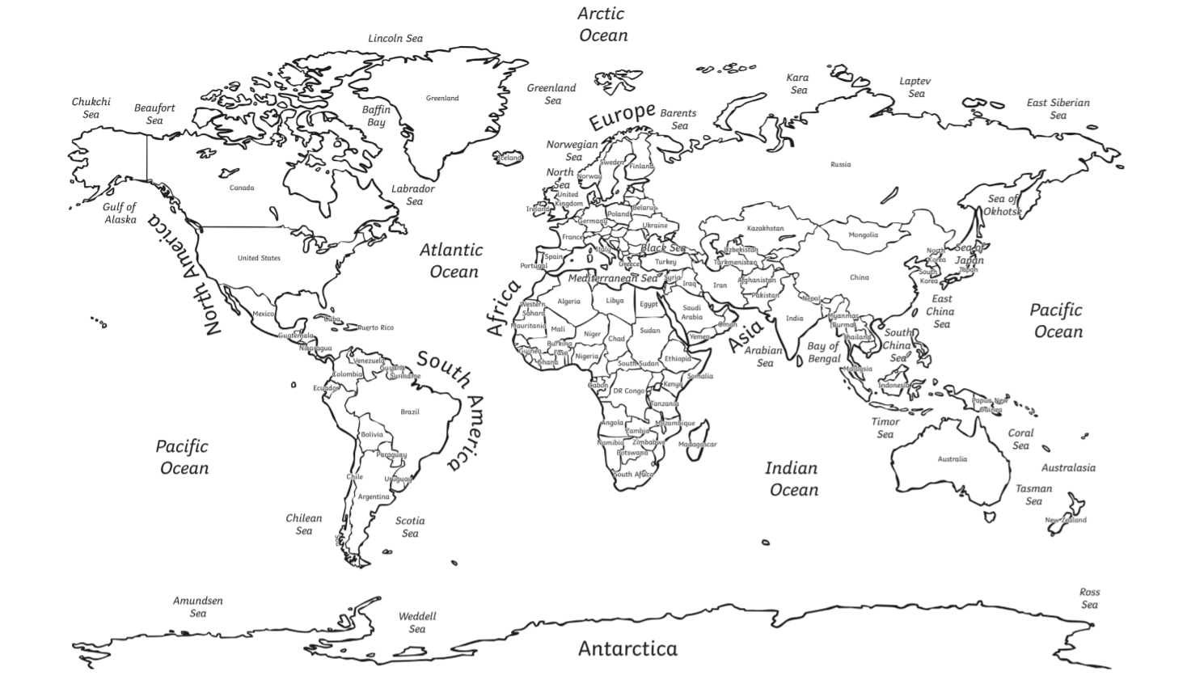

Slide 4
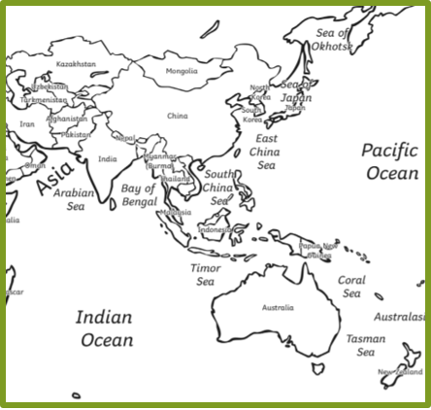
What major countries were in WWII in Asia?
Axis
  Japan (controlled most of China and Korea)
Allies
  India
  Australia
  Dutch East Indies (present day Indonesia)
  Thailand

Slide 5
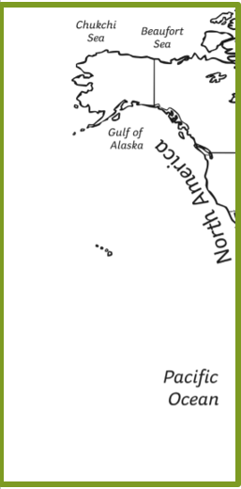
Pacific ocean
Allies
  USA
  Canada

