Slide 1
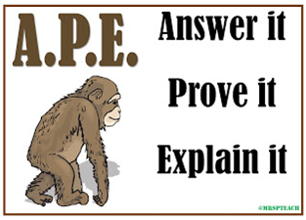
20/01/2019
LO: find basic percentages of amounts.
Success Criteria:
Find 50%, 25%, 10% and 1% of an amount
Understand percentages as parts of 100 and that the whole amount is 100%
Use different representations, e.g. bar model.

Slide 2
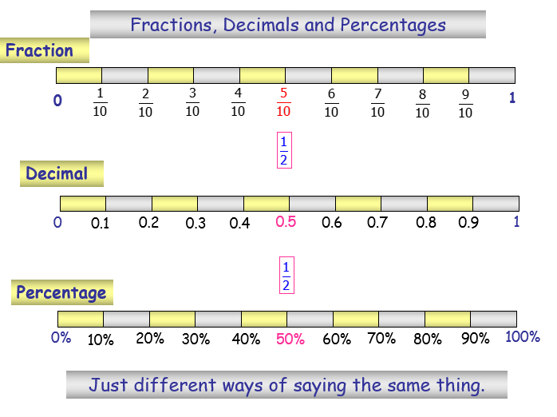

Slide 3
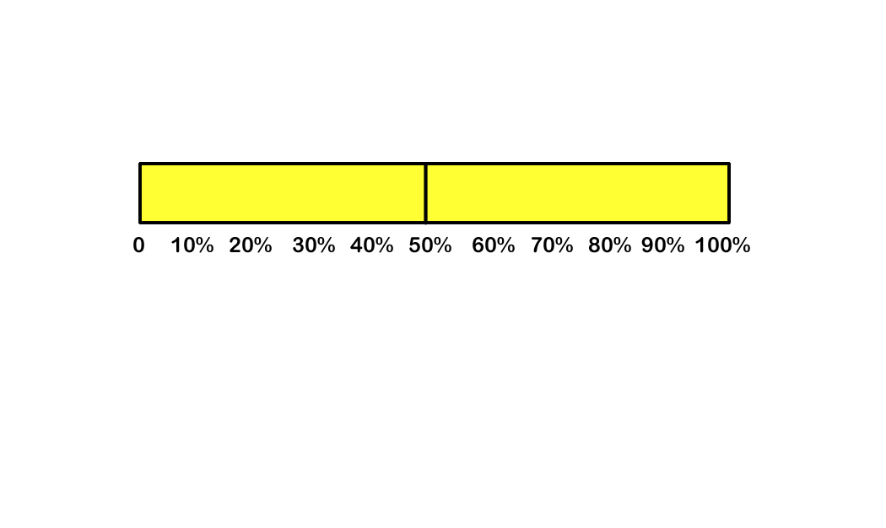
TALKING TIME:
Explain how to use this bar model to find 50% of 240.
?
240

Slide 4
TALKING TIME:
Explain how to use this bar model to find 50% of 240.
The whole is worth 240.
50% is one half of the whole amount, so if we divide by 2, we can find its value.
240 ÷ 2 = 120, so 50% of 240 is 120.
120
240

Slide 5
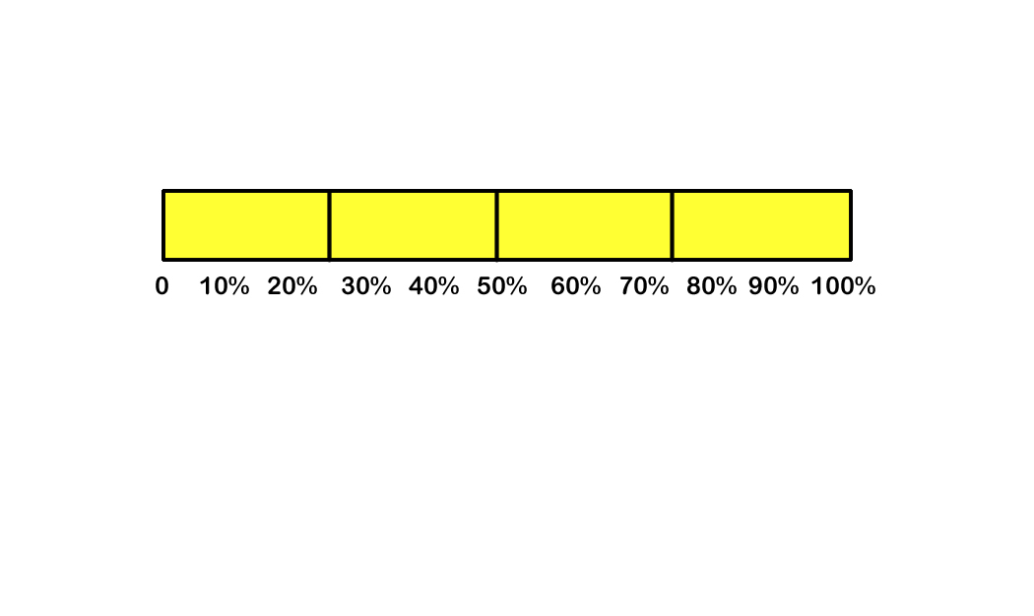
TALKING TIME:
Find 25% of 600 using this bar model.
?
600

Slide 6
TALKING TIME:
Find 25% of 600 using this bar model.
The whole is worth 600.
25% is one quarter of the whole, so if we divide by 4, we can find its value.
600 ÷ 4 = 150, so 25% of 600 is 150.
?
600

Slide 7
ACTIVITY 1:
Sketch bar models to find these percentages.
50% of 96
10% of 590

Slide 8
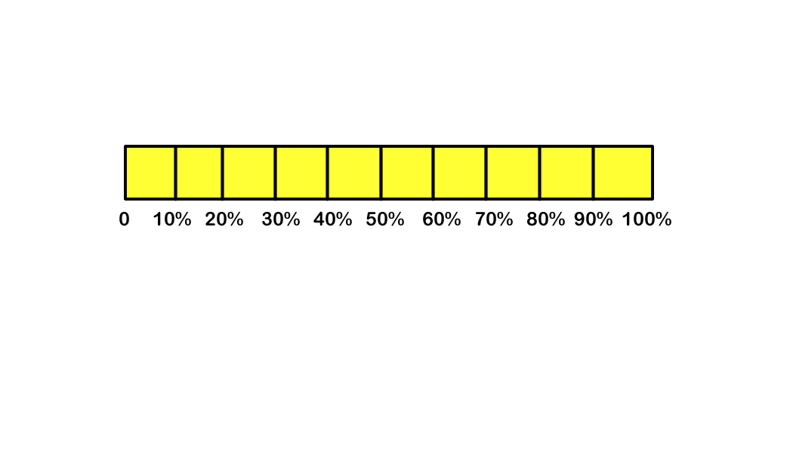
ACTIVITY 1:
Sketch bar models to find these percentages.
50% of 96 =
10% of 590 = 59 590 ÷ 10 = 59
48
96 ÷ 2 = 48
96
590

Slide 9
TALKING TIME:
Complete the missing value and explain why you chose it.
To find 10% of a number, we need to divide by ____.

Slide 10
TALKING TIME:
Complete the missing value and explain why you chose it.
To find 10% of a number, we need to divide by 10.
This is because there are ten lots of 10% in 100, so dividing by 10 helps us to find one of those lots of 10%.

Slide 11
ACTIVITY 2:
Complete the missing values and explain why you chose them.
To find 50% of a number, we need to divide by ___
b) To find 25% of a number, we need to divide by ___
c) To find 10% of a number, we need to divide by ___
d) To find 1% of a number, we need to divide by ___

Slide 12
ACTIVITY 2:
Complete the missing values and explain why you chose them.
a) To find 50% of a number, we need to divide by 2.
This is because there are two lots of 50% in 100,
so dividing by 2 helps us to find one of those lots of 50%.
b) To find 25% of a number, we need to divide by 4.
This is because there are four lots of 25% in 100, so dividing by 4 helps us to find one of those lots of 25%.
c) To find 10% of a number, we need to divide by 10.
This is because there are ten lots of 10% in 100,
so dividing by 10 helps us to find one of those lots of 10%.
d) To find 1% of a number, we need to divide by 100.
This is because there are one hundred lots of 1% in 100,
so dividing by 100 helps us to find one of those lots of 1%.

Slide 13
TALKING TIME:
Find 1% of 2m.

Slide 14
TALKING TIME:
Find 1% of 2m.
There are two ways to express this answer.
Both involve dividing by 100 to find 1%, but we can find 1% of an amount of metres or centimetres:
Method 1:
2 ÷ 100 = 0.02 1% of 2m = 0.02m
Method 2:
2m = 200cm
200 ÷ 100 = 2 1% of 2m = 2cm

Slide 15
ACTIVITY 3:
Find these percentages of amounts.
Show your working.
10% of 600
10% of 60
10% of 6
1% of 680 km
10% of 1 hour
10% of 1 metre
25% of 1 hour
10% of 1 kg
1% of 300 g

Slide 16
ACTIVITY 3:
Find these percentages of amounts.
Show your working.
10% of 600 600 ÷ 10 = 60
10% of 60 60 ÷ 10 = 6
10% of 6 6 ÷ 10 = 0.6
1% of 680 km 680 ÷ 100 = 6.8 km
10% of 1 hour 1 hour = 60 min 60 ÷ 10 = 6 min
10% of 1 metre 1 ÷ 10 = 0.1 m or 100 ÷ 10 = 10 cm
25% of 1 hour 1 hour = 60 min 60 ÷ 4 = 15 min
10% of 1 kg 1kg ÷ 10 = 0.1kg
1% of 300 g 300 ÷ 100 = 3g

Slide 17
TALKING TIME:
Fatima thinks,
Is Fatima correct? Explain your answer.
To find 10%, I need to divide by 10.
So, to find 25%, I must need to divide by 25.

Slide 18
TALKING TIME:
Fatima thinks,
Is Fatima correct? Explain your answer.
Fatima is not correct. The first sentence is right, but Fatima does not understand why we divide by 10 to find 10%. The reason is because there are ten 10s in 100. There are four 25s in 100, so we must divide by 4 to find 25%.
To find 10%, I need to divide by 10.
So, to find 25%, I must need to divide by 25.

Slide 19


Problem Solving 1
Mahalia is trying to raise £1,300. She wanted to raise 50% of that total amount at a fundraising party. She kept a record of how much people gave:
How much money did she raise at the party? Did she reach 50% of £1,300?
Person | Amount given
Phil Coffers | 1% of £18,600
Frieda Spendit | 10% of £2,230
Will Paywell | 25% of £1,004
© Classroom Secrets Limited 2018

Slide 20
Problem Solving 1
Mahalia is trying to raise £1,300. She wanted to raise 50% of that total amount at a fundraising party. She kept a record of how much people gave:
How much money did she raise at the party? Did she reach 50% of £1,300?
She raised £660. Yes, she reached her target. 50% of £1,300 is £650.
Person | Amount given
Phil Coffers | 1% of £18,600
Frieda Spendit | 10% of £2,230
Will Paywell | 25% of £1,004
© Classroom Secrets Limited 2018

Slide 21
Problem Solving 2
Iris and Jakub are trying to get the largest answer by changing one part of the calculation below.
Iris says, “If I find 25% of 4kg, instead of 10%, my answer will be largest.”
Jakub says, “I will change the number of kilograms to find a larger answer.”
What number could Jakub change 4kg to in order to get the largest answer?
10% of 4kg = 400g
© Classroom Secrets Limited 2018

Slide 22
Problem Solving 2
Iris and Jakub are trying to get the largest answer by changing one part of the calculation below.
Iris says, “If I find 25% of 4kg, instead of 10%, my answer will be largest.”
Jakub says, “I will change the number of kilograms to find a larger answer.”
What number could Jakub change 4kg to in order to get the largest answer?
Any amount larger than 10kg. Possible answer: 12kg
10% of 4kg = 400g
© Classroom Secrets Limited 2018

Slide 23
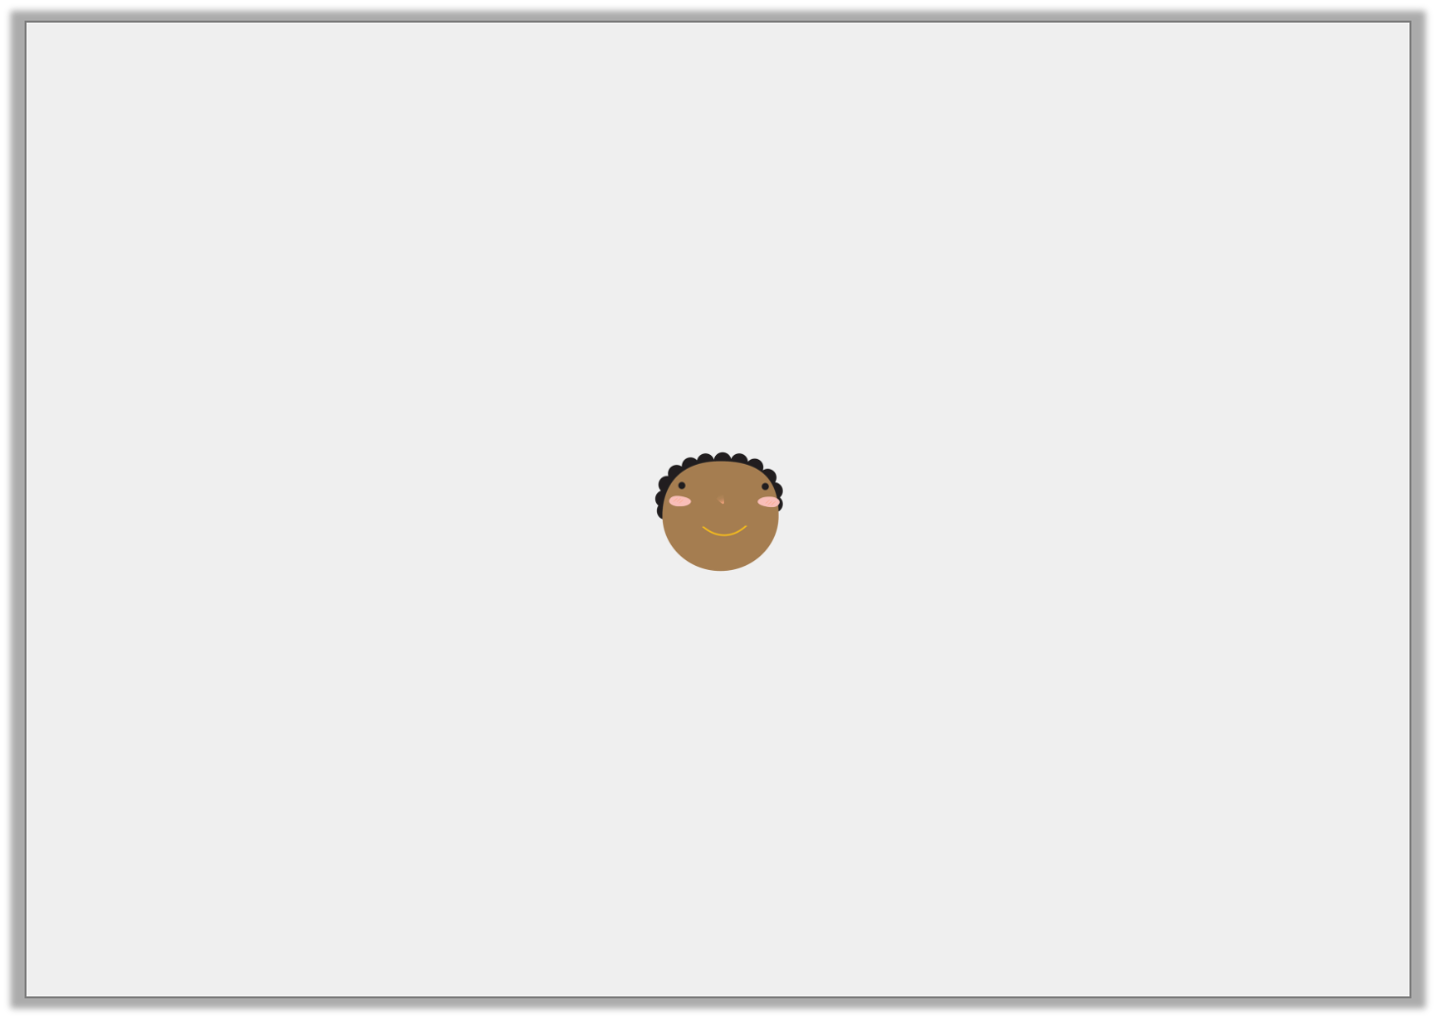
Reasoning 1
Abe is thinking about percentages.
Give one example to show Abe’s statement can be true, and one example to show it can be false.
50% of one amount will be more than 25% of a different amount.
© Classroom Secrets Limited 2018

Slide 24
Reasoning 1
Abe is thinking about percentages.
Give one example to show Abe’s statement can be true, and one example to show it can be false.
An example showing it to be true is…
An example showing it to be false is…
50% of one amount will be more than 25% of a different amount.
© Classroom Secrets Limited 2018

Slide 25
Reasoning 1
Abe is thinking about percentages.
Give one example to show Abe’s statement can be true, and one example to show it can be false.
An example showing it to be true is: 50% of 8 = 4, and 25% of 4 = 1 An example showing it to be false is: 50% of 2 = 1, and 25% of 12 = 3
Lots of other answers are possible.
50% of one amount will be more than 25% of a different amount.
© Classroom Secrets Limited 2018

Slide 26
EVALUATION:
True or False?
50% of 300 = 300 ÷ 50 = 6
25% of 460 = 460 ÷ 4 = 115
To find 1% of a number, we divide by 1.
d) To find 10% of a number, we divide by 10.
We can find 25% of a number by finding 50% and then halving it.
f) 1% of 6 km = 60 metres

Slide 27
EVALUATION:
True or False?
50% of 300 = 300 ÷ 50 = 6 FALSE
25% of 460 = 460 ÷ 4 = 115 TRUE
To find 1% of a number, we divide by 1. FALSE
d) To find 10% of a number, we divide by 10. TRUE
We can find 25% of a number by finding 50% and then halving it.
TRUE
f) 1% of 6 km = 60 metres TRUE

