Slide 1
LO: to create my own steps to success to achieve a goal

Slide 2
Success criteria
I know how to create a goal
I know how to split my goal up into smaller steps

Slide 3
Setting a goal
When trying to achieve a goal that you have set out for yourself it can be tough to stay motivated all the way up to success.
A fantastic method of keeping motivated and achieving the goal is to set yourself small steps to success
Have a think, when in school would you use small steps in order to be successful? Perhaps it’s laid out to you at the start of every lesson in the form of success criteria?

Slide 4
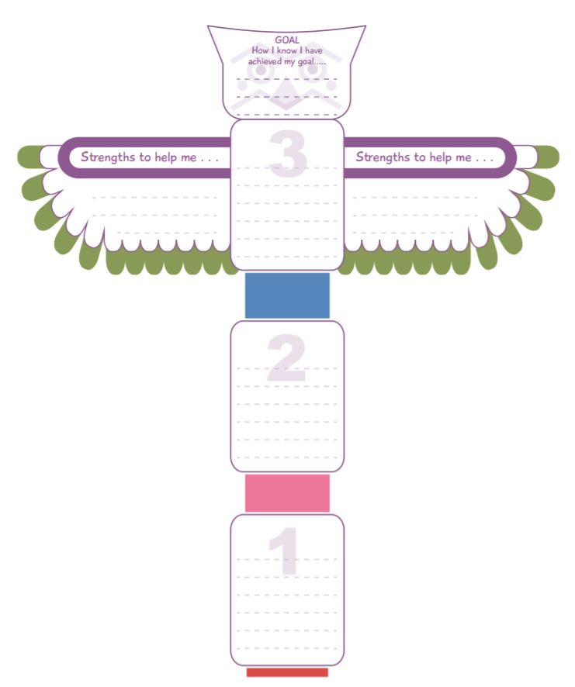
Totem poles
Totem poles are a fantastic way to break down our goals into small bitesize steps.
If we achieve the 3 small steps we have then that means we will have achieved our main goal at the very top
On the wings we also have strengths that we have that will help us towards achieving our goals

Slide 5
Example
Goal
To improve my handwriting
Reflect on the progress I have made and highlight any areas I can still improve on
Strengths to help me
Perseverance, endeavour, reflection
Practise writing and offer to be a scribe during writing activities
Buy a pen I enjoy writing with or ask for a pen grip

Slide 6
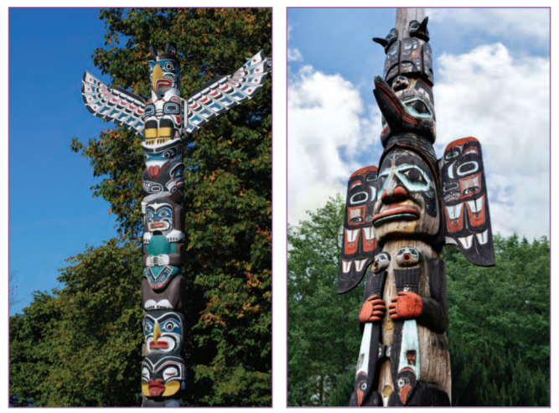
Totem poles
Take a look at these totem poles! What creatures can you see?
What characteristics do these creatures have?
Are you fierce like an eagle?
Curious like a cat?
Observant like an owl?
When you design your own totem pole have a think of what animals you might relate to the most

Slide 7
Independent task
For your independent task I would like you to create your very own totem pole
You can use the one provided or you can choose to create your own that incorporates the animals you might relate with the most.
You need to make sure you have a goal set up on the top of your totem pole with 3 small steps to success, when you achieve these small steps it will ultimately lead you to achieving the main big goal at the top

