Slide 1
LO: to explore shading techniques to represent an object

Slide 2
Success criteria
I can use shading to show depth in my pictures
I can explore different techniques to find the best one to represent an object

Slide 3

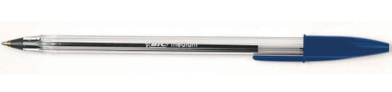
What equipment will we be using?
The medium we will be using is pen and ink
We will be using only one colour and that is black!
Using a normal ball point is absolutely
fine

Slide 4
What is shading?
Creating the differences between light and dark areas
Adding depth to an image

Slide 5
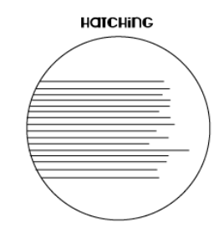
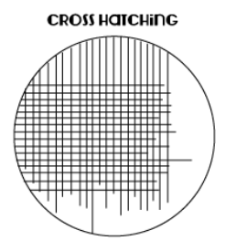
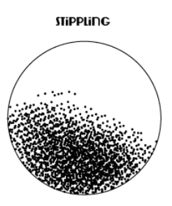
Shading techniques
Hatching technique is drawing lines in the
same direction, the further apart your
lines are the lighter the shading will be.
The closer together the lines are, the
darker the shading will be
Cross hatching technique is drawing lines
that go across each other, again the
closer the lines are to each other, the
darker the shading will be
Stippling technique are loads of small
dots, the closer together the dots are,
the darker the shading will be

Slide 6
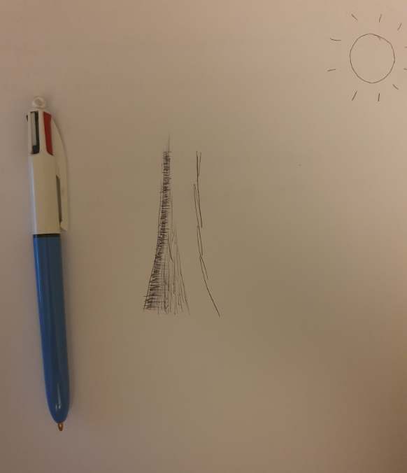
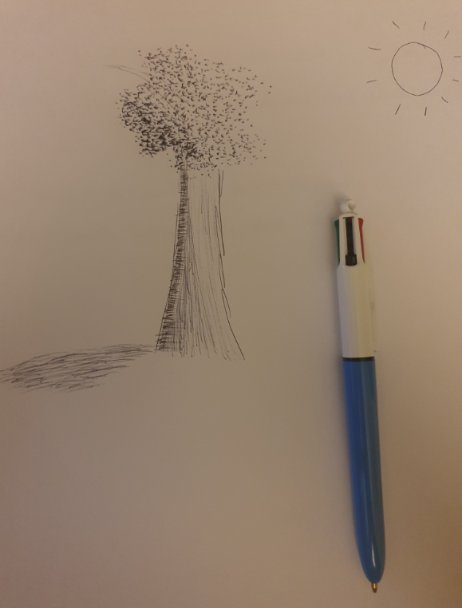
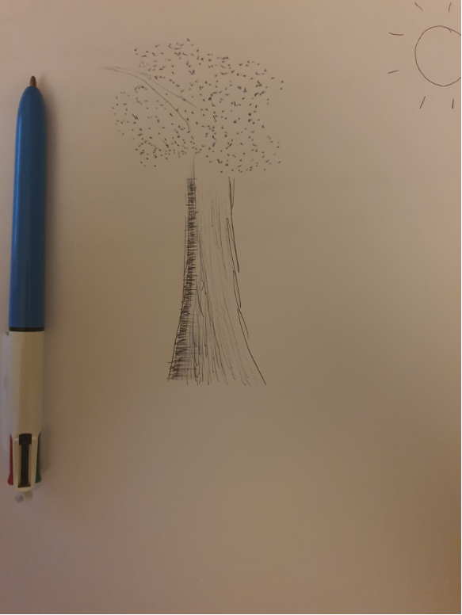
Where is the light source? Where is there the most shade?
Here you can see a tree has been drawn using the three techniques we’ve looked at

Slide 7
Independent task
For your task please draw an object or perhaps something from nature like a tree or a flower
Have a look at where they light source is coming from, it might be the sun or a light in the room.
Explore using all the techniques we’ve seen and remember if you think it goes wrong, think of it as a happy accident and incorporate it into your drawing. We use the word explore because we know it won’t be perfect first time so keep practising and trying new things.

