Slide 1

Introduction
Match the measurements to the most appropriate units of measure.
The weight of an elephant.
ml
seconds
How long it takes to brush your teeth.
m
The amount of milk needed to make a Yorkshire pudding mixture.
minutes
The duration of a film.
hours, minutes
The length of a school book.
kg
mm
The height of a giraffe.
cm
© Classroom Secrets Limited 2019

Slide 2

Introduction
Match the measurements to the most appropriate units of measure.
The weight of an elephant.
ml
seconds
How long it takes to brush your teeth.
m
The amount of milk needed to make a Yorkshire pudding mixture.
minutes
The duration of a film.
hours, minutes
The length of a school book.
kg
mm
The height of a giraffe.
cm
© Classroom Secrets Limited 2019

Slide 3
STARTER:
Leah is converting between two metric units of measure.
She divides by 1000 to find the answer.
Which units could she be converting between?
There are lots of possible answers to this question.
How many can you find?

Slide 4
STARTER:
Leah is converting between two metric units of measure.
She divides by 1000 to find the answer.
Which units could she be converting between?
tonnes → kilograms
kilograms → grams
litres → millilitres
kilometres → metres
metres → millimetres

Slide 5
TALKING TIME:
A teacup holds 200 ml of water.
How many teacups can be filled from a 2 litre bottle of water?
Explain how you would find the answer to this problem.

Slide 6
TALKING TIME:
A teacup holds 200 ml of water.
How many teacups can be filled from a 2 litre bottle of water?
Explain how you would find the answer to this problem.
First, convert 2 litres into millilitres:
2 x 1000 = 2,000, so 2 litres = 2,000 ml
Next, divide 2,000 by 200 to find the number of teacups that can be filled.
2,000 ÷ 200 = 10
So, 10 teacups can be filled from a 2 litre bottle.

Slide 7
TALKING TIME:
A packet of crisps weighs 75g.
How heavy are 25 packets of crisps?
Give your answer in kilograms.
Describe two methods that you could use to solve this problem.
You do not need to work out the answer, just explain how you
would find it.

Slide 8
TALKING TIME:
A packet of crisps weighs 75g.
How heavy are 25 packets of crisps?
Give your answer in kilograms.
Describe two methods that you could use to solve this problem.
You do not need to work out the answer, just explain how you
would find it.
For example:
METHOD ONE:
Multiply 75 by 25 to find the total mass of 25 packets in grams.
Divide this number by 1000 to find the total mass in kilograms.
METHOD TWO:
Divide 75 by 1000 to find the mass of a packet of crisps in kilograms.
Multiply this number by 25 to find the mass of 25 packets.

Slide 9
TALKING TIME:
Ellie needs to find a quarter of a distance in metres and give her
answer in millimetres. She says,
What advice would you give Ellie?
I wonder whether I should convert from metres into millimetres first and then divide by 4 or divide by 4 first and then convert?

Slide 10
TALKING TIME:
Ellie needs to find a quarter of a distance in metres and give her
answer in millimetres. She says,
What advice would you give Ellie?
It does not make any difference whether Ellie
converts before or after dividing by 4.
The answer will be the same either way.
I wonder whether I should convert from metres into millimetres first and then divide by 4 or divide by 4 first and then convert?

Slide 11
ACTIVITY 1:
A tin of baked beans weighs 415g.
How heavy are 32 tins of beans?
Give your answer in kilograms.

Slide 12
ACTIVITY 1:
A tin of baked beans weighs 415g.
How heavy are 32 tins of beans?
Give your answer in kilograms.
4 1 5
x 3 2
8 3 0 (415 x 2)
1 2 4 5 0 (415 x 30)
1 3 2 8 0
13,280 ÷ 1,000 = 13.28 kg
So, 32 tins of beans weigh 13.28 kg altogether.

Slide 13
ACTIVITY 2:
The length of Sam’s driveway is 7.45 m.
Jo’s driveway is 390 cm longer than Sam’s.
How long is Jo’s driveway in metres?

Slide 14
ACTIVITY 2:
The length of Sam’s driveway is 7.45 m.
Jo’s driveway is 390 cm longer than Sam’s.
How long is Jo’s driveway in metres?
390 ÷ 1,000 = 0.39m
7 . 4 5
+ 0 . 3 9
7 . 8 4 m
Jo’s driveway is 7.84 m long.

Slide 15

Varied Fluency 1
Adam, Rachael and John have been growing sunflowers.
Adam’s is the tallest, Rachael’s is of the height of Adam’s.
John’s grew the least at only half the size of Rachael’s, measuring 56.25cm
How tall is Adam’s flower in cm?
3
4
© Classroom Secrets Limited 2019

Slide 16
Varied Fluency 1
Adam, Rachael and John have been growing sunflowers.
Adam’s is the tallest, Rachael’s is of the height of Adam’s.
John’s grew the least at only half the size of Rachael’s, measuring 56.25cm
How tall is Adam’s flower in cm?
150 cm
3
4
© Classroom Secrets Limited 2019

Slide 17
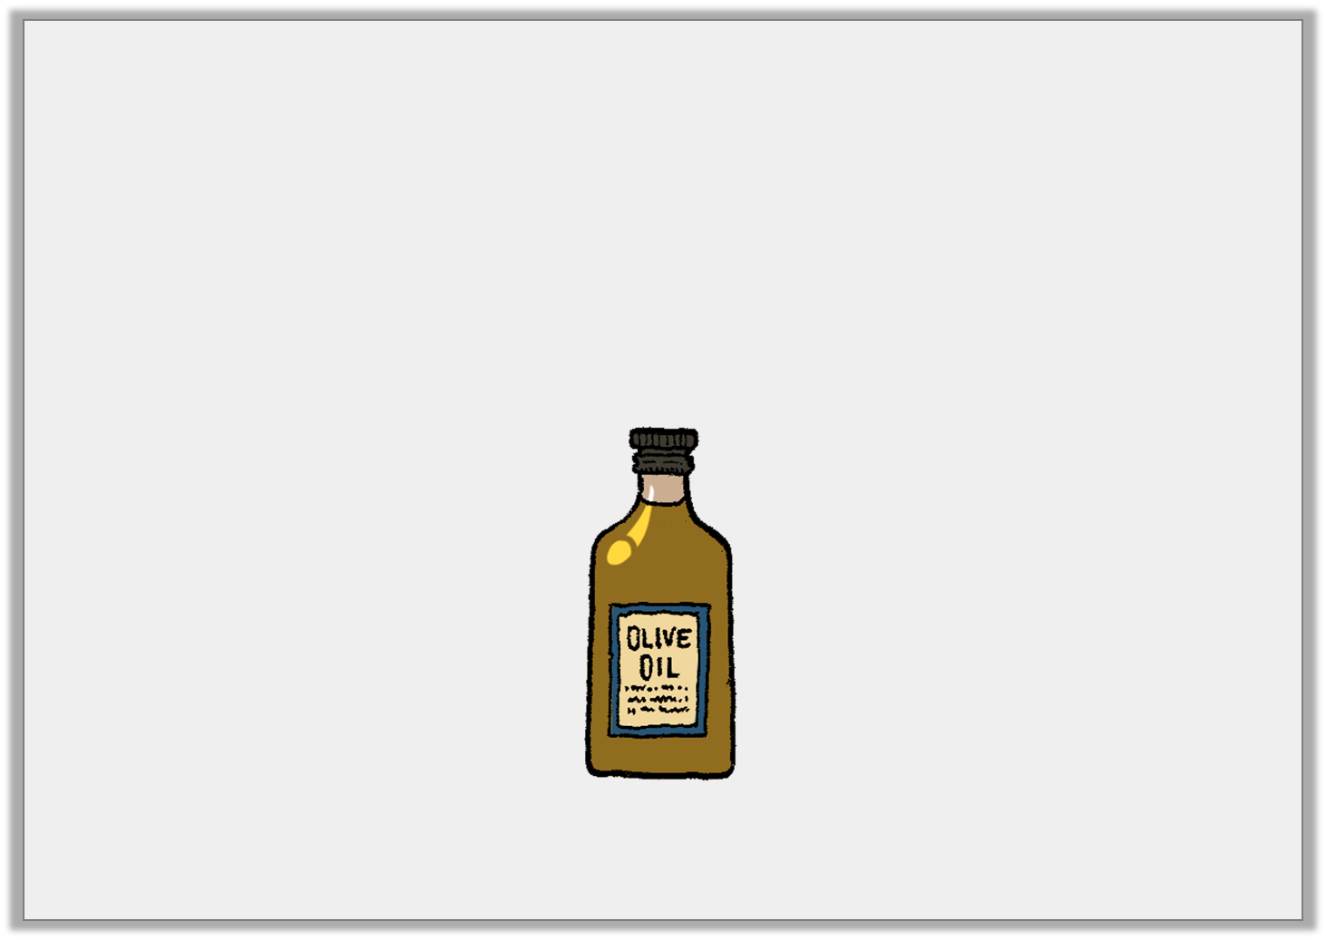
Varied Fluency 2
True or false?
Esme is filling eighty 20ml bottles using 1 litres of oil.
She will not have enough oil to fill all eighty bottles.
3
4
© Classroom Secrets Limited 2019

Slide 18
Varied Fluency 2
True or false?
Esme is filling eighty 20ml bottles using 1 litres of oil.
She will not have enough oil to fill all eighty bottles.
False
3
4
© Classroom Secrets Limited 2019

Slide 19
Varied Fluency 3
Amanda is timing how long it takes her two daughters to tidy their rooms.
Emily’s is tidy after 2 hours, then she spends 17 minutes dusting and vacuuming.
Charlotte has finished everything after 3.25 hours.
How many minutes quicker was Emily than Charlotte?
1
4
© Classroom Secrets Limited 2019

Slide 20
Varied Fluency 3
Amanda is timing how long it takes her two daughters to tidy their rooms.
Emily’s is tidy after 2 hours, then she spends 17 minutes dusting and vacuuming.
Charlotte has finished everything after 3.25 hours.
How many minutes quicker was Emily than Charlotte?
43 minutes
1
4
© Classroom Secrets Limited 2019

Slide 21
Varied Fluency 4
Victoria weighs her puppy every month and keeps a record in the table.
How much heavier in grams was her puppy in May, compared to January?
January | February | March | April | May
0.04kg | 54g | 0.13kg | 390g | kg
1
2
© Classroom Secrets Limited 2019

Slide 22
Varied Fluency 4
Victoria weighs her puppy every month and keeps a record in the table.
How much heavier in grams was her puppy in May, compared to January?
460g
January | February | March | April | May
0.04kg | 54g | 0.13kg | 390g | kg
1
2
© Classroom Secrets Limited 2019

Slide 23
ACTIVITY 3:
Invent a problem that fits these rules:
- It must involve converting from a smaller unit of
measurement to a larger unit.
- It must also involve multiplication to find the
answer.

Slide 24
ACTIVITY 3:
Invent a problem that fits these rules:
- It must involve converting from a smaller unit of
measurement to a larger unit.
- It must also involve multiplication to find the
answer.
For example:
The length of a pencil is 140 mm.
If 52 pencils are placed end to end, how many metres long will the line of pencils be?

Slide 25
ACTIVITY 4:
Three children are growing sunflowers.
Their flowers have grown a total of 2.65 m altogether.
Krishna’s sunflower is 0.8 m taller than Daniel’s.
Ashleigh’s sunflower is 80 cm taller than Krishna’s.
How tall is each child’s sunflower in metres?
Draw bar models to help you find the answer.

Slide 26
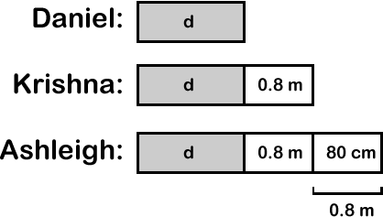
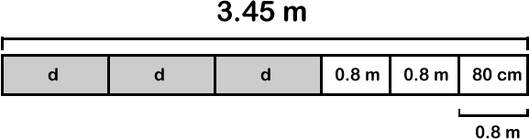
ACTIVITY 4:
Three children are growing sunflowers.
Their flowers have grown a total of 2.65 m altogether.
Krishna’s sunflower is 0.8 m taller than Daniel’s.
Ashleigh’s sunflower is 80 cm taller than Krishna’s.
How tall is each child’s sunflower in metres?
Draw bar models to help you find the answer.
3.45 – (0.8 x 3) = 3.45 – 2.4 = 1.05
1.05 ÷ 3 = 0.35 Daniel’s sunflower is 0.35 m tall.
0.35 + 0.8 = 1.15 Krishna’s sunflower is 1.15 m tall.
1.15 + 0.8 = 1.95 Ashleigh’s sunflower is 1.95 m tall.

Slide 27
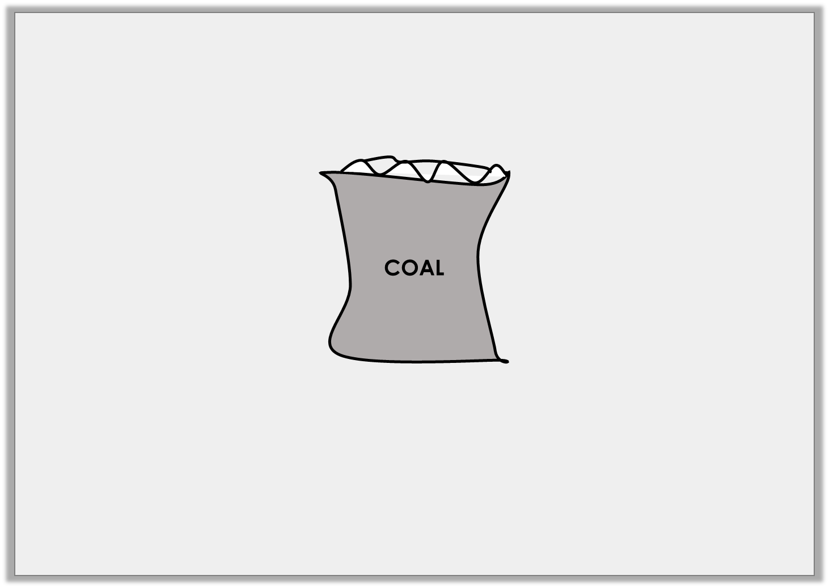
Problem Solving 1
The weight of one sack of coal is 4050g. The lorry load has 25 coal sacks altogether.
What is the total weight of coal in kg?
© Classroom Secrets Limited 2019

Slide 28
Problem Solving 1
The weight of one sack of coal is 4050g. The lorry load has 25 coal sacks altogether.
What is the total weight of coal in kg?
101.25kg
© Classroom Secrets Limited 2019

Slide 29
Problem Solving 2
The length of a train carriage is 20.06m. The length of a van is only 405cm. Arrange the digit cards to make the following statement match.
2
0
?
6
?
.
0
?
m
cm
>
4
5
0
© Classroom Secrets Limited 2019

Slide 30
Problem Solving 2
The length of a train carriage is 20.06m. The length of a van is only 405cm. Arrange the digit cards to make the following statement match. 2006cm > 4.05m
2
0
0
6
4
.
0
5
m
cm
>
4
5
0
© Classroom Secrets Limited 2019

Slide 31

Reasoning 1
A petrol tank holds 45 litres. Dave puts 12 litres of fuel in his car and says,
Is he correct? Explain your answer.
3
4
I have space for 30 litres left in the tank.
© Classroom Secrets Limited 2019

Slide 32
Reasoning 1
A petrol tank holds 45 litres. Dave puts 12 litres of fuel in his car and says,
Is he correct? Explain your answer.
No, Dave is incorrect because...
3
4
I have space for 30 litres left in the tank.
© Classroom Secrets Limited 2019

Slide 33
Reasoning 1
A petrol tank holds 45 litres. Dave puts 12 litres of fuel in his car and says,
Is he correct? Explain your answer.
No, Dave is incorrect because there is space for more than 30 litres in the tank. (32.25l)
3
4
I have space for 30 litres left in the tank.
© Classroom Secrets Limited 2019

Slide 34
EVALUATION:
True or False?
A can of lemonade holds 330ml. Six cans hold
1.98 litres of lemonade.
The length of a double decker bus is 10 m. If 50
buses are parked bumper to bumper, they will reach
a distance of 5km.
c) The difference between a piece of string 560 mm long and another piece of string 55 cm long is 10 mm.
d) The total of a parcel weighing 1.2 kg and another parcel weighing 750 g is 751.2 g.

Slide 35
EVALUATION:
True or False?
A can of lemonade holds 330ml. Six cans hold
1.98 litres of lemonade. TRUE
The length of a double decker bus is 10 m. If 50
buses are parked bumper to bumper, they will reach
a distance of 5km. FALSE
c) The difference between a piece of string 560 mm long and another piece of string 55 cm long is 10 mm. TRUE
d) The total of a parcel weighing 1.2 kg and another parcel weighing 750 g is 751.2 g. FALSE

