Slide 1
STARTER:
List as many metric units of measurement as you can that you could use to measure…
…the mass of something.
…the width of something.
…the capacity of something.

Slide 2
STARTER:
List as many metric units of measurement as you can that you could use to measure…
…the mass of something.
grams (g), kilograms (kg)
(you may also have seen milligrams (mg) – for example, written on ingredients of food products.
…the width of something.
millimetres (mm), centimetres (cm), metres (m), kilometres (km)
…the capacity of something.
millilitres (l), litres (l)
Find one example of each in your classroom.

Slide 3
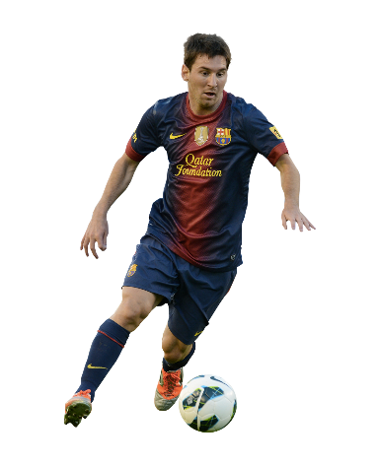
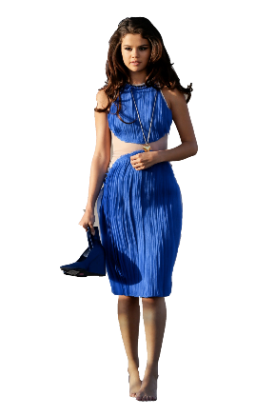
27/02/2019
LO: To convert between metric units of measurement
Success Criteria:
I can use my skills of multiplying and dividing by 10, 100 and 1,000;
I can convert in both directions for example: from grams to kilograms and vice versa;
I can convert where the number of decimal places given varies and understand the role of zero as a place holder.
Starter:
Who is taller? By how much?
Answer. Prove. Explain.
1.7m
165cm

Slide 4
27/02/2019
LO: To convert between metric units of measurement
Success Criteria:
I can use my skills of multiplying and dividing by 10, 100 and 1,000;
I can convert in both directions for example: from grams to kilograms and vice versa;
I can convert where the number of decimal places given varies and understand the role of zero as a place holder.
Starter:
Messi is taller by 5cm or 0.05m, because 1.7m is 170cm and 165cm is 1.65m
1.7m
165cm

Slide 5
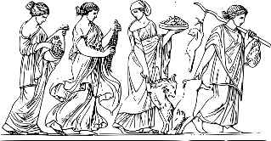
27/02/2019
LO: To convert between metric units of measurement
Success Criteria:
I can use my skills of multiplying and dividing by 10, 100 and 1,000;
I can convert in both directions for example: from grams to kilograms and vice versa;
I can convert where the number of decimal places given varies and understand the role of zero as a place holder.
Talking time:
The prefix kilo is derived from the Greek word χίλιοι (chilioi), meaning "thousand".
Can you think of any metric units of measurement that use the prefix kilo?
How many can you think of?

Slide 6
27/02/2019
LO: To convert between metric units of measurement
Success Criteria:
I can use my skills of multiplying and dividing by 10, 100 and 1,000;
I can convert in both directions for example: from grams to kilograms and vice versa;
I can convert where the number of decimal places given varies and understand the role of zero as a place holder.
Talking time:
The prefix kilo is derived from the Greek word χίλιοι (chilioi), meaning "thousand".
Can you think of any metric units of measurement that use the prefix kilo?
How many can you think of?
Kilometre and kilograms are the most commonly used. You will learn about other units of measurement in later learning too!

Slide 7
27/02/2019
LO: To convert between metric units of measurement
Success Criteria:
I can use my skills of multiplying and dividing by 10, 100 and 1,000;
I can convert in both directions for example: from grams to kilograms and vice versa;
I can convert where the number of decimal places given varies and understand the role of zero as a place holder.
Talking time:
The prefix kilo is derived from the Greek word χίλιοι (chilioi), meaning "thousand".
Can you think of any metric units of measurement that use the prefix kilo?
How many can you think of?
Kilometre and kilograms are the most commonly used. You will learn about other units of measurement in later learning too!
Can you think of any relationships between ‘kilo’ units of measurement and other units of measurement?

Slide 8
27/02/2019
LO: To convert between metric units of measurement
Success Criteria:
I can use my skills of multiplying and dividing by 10, 100 and 1,000;
I can convert in both directions for example: from grams to kilograms and vice versa;
I can convert where the number of decimal places given varies and understand the role of zero as a place holder.
Talking time:
The prefix kilo is derived from the Greek word χίλιοι (chilioi), meaning "thousand".
Can you think of any metric units of measurement that use the prefix kilo?
How many can you think of?
Can you think of any relationships between ‘kilo’ units of measurement and other units of measurement?
There are 1,000 grams in a kilogram (kg); there are 1,000 metres in a kilometre (km)

Slide 9
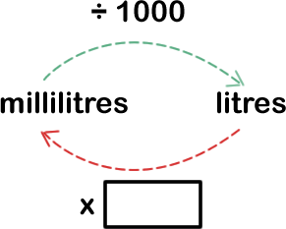
TALKING TIME:
Complete the missing values.
There are ___ ml in 1 l.
4,000 ml = ___ l
6l = _____ml

Slide 10
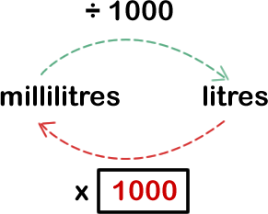
TALKING TIME:
Complete the missing values.
There are 1000 ml in 1 l.
4,000 ml = 4 l
6l = 6,000 ml

Slide 11
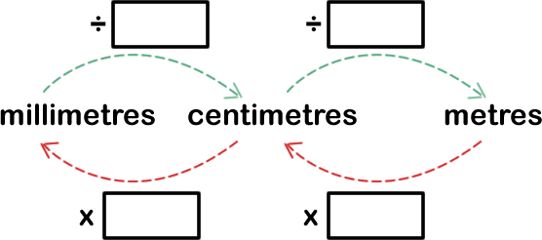
TALKING TIME:
Complete the missing values.
There are __ mm in 1 cm and there are ___ cm in 1 m.
50 mm = __ cm
9 m = ___ cm = ____ mm

Slide 12
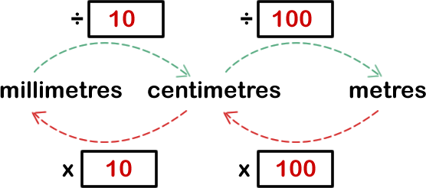
TALKING TIME:
Complete the missing values.
There are 10 mm in 1 cm and there are 100 cm in 1 m.
50 mm = 5 cm
9 m = 900 cm = 9,000 mm

Slide 13
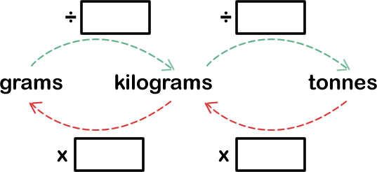
ACTIVITY 1:
Fill in the missing values and then use the information to
complete the conversion tables.
g | kg
 | 0.5
3,010
 | 1.60
5,009
kg | tonnes
 | 10.4
6,150
 | 0.75
250

Slide 14
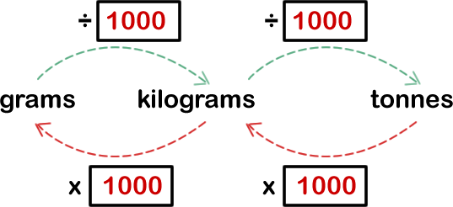
ACTIVITY 1:
Fill in the missing values and then use the information to
complete the conversion tables.
g | kg
500 | 0.5
3,010 | 3.01
1,600 | 1.60
5,009 | 5.009
kg | tonnes
10,400 | 10.4
6,150 | 6.15
750 | 0.75
250 | 0.25

Slide 15
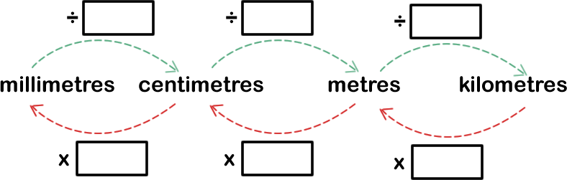
ACTIVITY 2:
Fill in the missing values and then use the information to
complete the conversion table.
mm | cm | m | km
 |  | 6.5
 | 150
100,000
 |  |  | 7

Slide 16
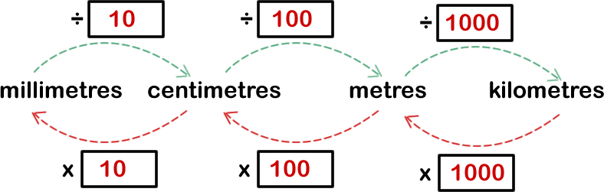
ACTIVITY 2:
Fill in the missing values and then use the information to
complete the conversion table.
mm | cm | m | km
6,500 | 650 | 6.5 | 0.0065
1,500 | 150 | 1.5 | 0.0015
100,000 | 10,000 | 100 | 0.1
7,000,000 | 700,000 | 7,000 | 7

Slide 17
27/02/2019
LO: To convert between metric units of measurement
Success Criteria:
I can use my skills of multiplying and dividing by 10, 100 and 1,000;
I can convert in both directions for example: from grams to kilograms and vice versa;
I can convert where the number of decimal places given varies and understand the role of zero as a place holder.
Activity 1:
(a) There are ________ grams in a kilogram.
(b) There are ________ kg in one tonne.
(c) Copy and complete the tables below:
g | kg
1,250
 | 3.07
2,025
kg | tonnes
2,303
 | 7.007
275

Slide 18
27/02/2019
LO: To convert between metric units of measurement
Success Criteria:
I can use my skills of multiplying and dividing by 10, 100 and 1,000;
I can convert in both directions for example: from grams to kilograms and vice versa;
I can convert where the number of decimal places given varies and understand the role of zero as a place holder.
Activity 1:
(a) There are 1,000 grams in a kilogram.
(b) There are 1,000 kg in one tonne.
(c) Copy and complete the tables below:
g | kg
1,250 | 1.25
3,070 | 3.07
2,025 | 2.025
kg | tonnes
2,303 | 2.303
7,007 | 7.007
275 | 0.275

Slide 19
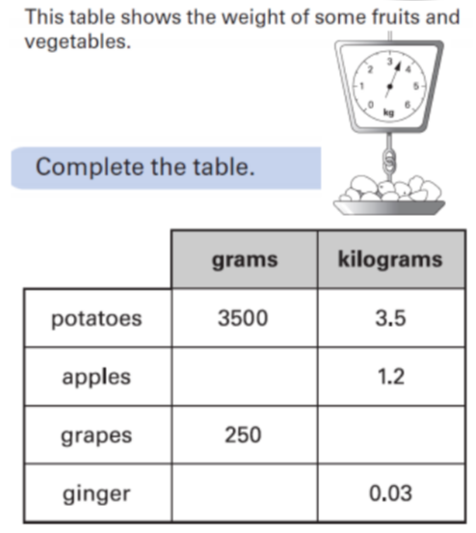
27/02/2019
LO: To convert between metric units of measurement
Success Criteria:
I can use my skills of multiplying and dividing by 10, 100 and 1,000;
I can convert in both directions for example: from grams to kilograms and vice versa;
I can convert where the number of decimal places given varies and understand the role of zero as a place holder.
Activity 1:
(d)

Slide 20
27/02/2019
LO: To convert between metric units of measurement
Success Criteria:
I can use my skills of multiplying and dividing by 10, 100 and 1,000;
I can convert in both directions for example: from grams to kilograms and vice versa;
I can convert where the number of decimal places given varies and understand the role of zero as a place holder.
Activity 1:
(d)
1,200
0.25
30

Slide 21
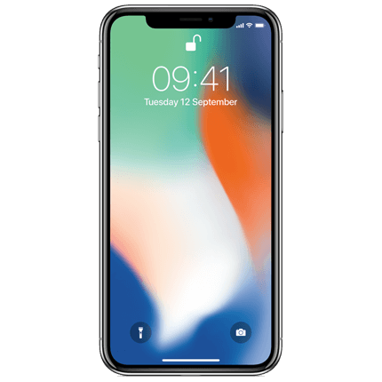
27/02/2019
LO: To convert between metric units of measurement
Success Criteria:
I can use my skills of multiplying and dividing by 10, 100 and 1,000;
I can convert in both directions for example: from grams to kilograms and vice versa;
I can convert where the number of decimal places given varies and understand the role of zero as a place holder.
Talking time:
The iPhone X is 14.4cm in height.
What is its height in mm?

Slide 22
27/02/2019
LO: To convert between metric units of measurement
Success Criteria:
I can use my skills of multiplying and dividing by 10, 100 and 1,000;
I can convert in both directions for example: from grams to kilograms and vice versa;
I can convert where the number of decimal places given varies and understand the role of zero as a place holder.
Talking time:
The iPhone X is 14.4cm in height.
What is its height in mm? 144mm

Slide 23
27/02/2019
LO: To convert between metric units of measurement
Success Criteria:
I can use my skills of multiplying and dividing by 10, 100 and 1,000;
I can convert in both directions for example: from grams to kilograms and vice versa;
I can convert where the number of decimal places given varies and understand the role of zero as a place holder.
Talking time:
The iPhone X is 7.1mm in width.
What is its width in cm?

Slide 24
27/02/2019
LO: To convert between metric units of measurement
Success Criteria:
I can use my skills of multiplying and dividing by 10, 100 and 1,000;
I can convert in both directions for example: from grams to kilograms and vice versa;
I can convert where the number of decimal places given varies and understand the role of zero as a place holder.
Talking time:
The iPhone X is 7.1mm in width.
What is its width in cm? 71mm

Slide 25
27/02/2019
LO: To convert between metric units of measurement
Success Criteria:
I can use my skills of multiplying and dividing by 10, 100 and 1,000;
I can convert in both directions for example: from grams to kilograms and vice versa;
I can convert where the number of decimal places given varies and understand the role of zero as a place holder.
Talking time:
The iPhone X is 0.77cm in depth.
What is its depth in mm?

Slide 26
27/02/2019
LO: To convert between metric units of measurement
Success Criteria:
I can use my skills of multiplying and dividing by 10, 100 and 1,000;
I can convert in both directions for example: from grams to kilograms and vice versa;
I can convert where the number of decimal places given varies and understand the role of zero as a place holder.
Talking time:
The iPhone X is 0.77cm in depth.
What is its depth in mm? 7.7mm

Slide 27
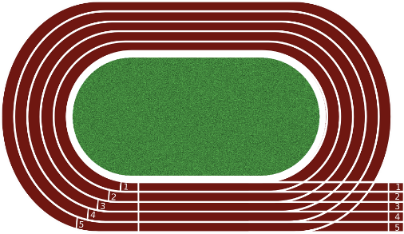
27/02/2019
LO: To convert between metric units of measurement
Success Criteria:
I can use my skills of multiplying and dividing by 10, 100 and 1,000;
I can convert in both directions for example: from grams to kilograms and vice versa;
I can convert where the number of decimal places given varies and understand the role of zero as a place holder.
Talking time:
Olympic long-distance runners can compete in a 5,000m race.
How far must they run in kilometres?

Slide 28
27/02/2019
LO: To convert between metric units of measurement
Success Criteria:
I can use my skills of multiplying and dividing by 10, 100 and 1,000;
I can convert in both directions for example: from grams to kilograms and vice versa;
I can convert where the number of decimal places given varies and understand the role of zero as a place holder.
Talking time:
Olympic long-distance runners can compete in a 5,000m race.
How far must they run in kilometres?
5km

Slide 29
TALKING TIME:
Raheem says,
Is Raheem right? Explain your answer.
If I have 67 of one metric unit of measurement and I convert it to another metric unit of measurement, my answer will always only have a 6, 7 and some zeros in it.

Slide 30
TALKING TIME:
Raheem says,
Is Raheem right? Explain your answer.
Yes – Raheem is correct. Converting between metric units (whether this is km to m, g to kg or even l to ml) always involved multiplying or dividing by 10, 100, 1000 and so on. When we multiply or divide by these numbers, the digits in a number simply shift – they do not change. So, the digits 6 and 7 will simply shift in either direction and zeros will be used as place holders.
If I have 67 of one metric unit of measurement and I convert it to another metric unit of measurement, my answer will always only have a 6, 7 and some zeros in it.

Slide 31
ACTIVITY 3:
Mia says,
Is Mia correct? Explain your answer.
If I convert an amount of millilitres into litres, there will always be a zero in the ones place. For example,
52ml → 0.052 l
125 ml → 0.125 l

Slide 32
ACTIVITY 3:
Mia says,
Is Mia correct? Explain your answer.
No – Mia is not correct. If the number of millilitres is 1000 or above, then there will be 1 or more ones in the ones place. For example,
2,500 ml → 2.5 ml
1,930 ml → 1.93 ml
If I convert an amount of millilitres into litres, there will always be a zero in the ones place. For example,
52ml → 0.052 l
125 ml → 0.125 l

Slide 33
ACTIVITY 4:
Sort these measurements from shortest to longest.
14 ¼ metres
1950 cm
0.25 km
8000 mm
13 m + 130 cm

Slide 34
ACTIVITY 4:
Sort these measurements from shortest to longest.
14 ¼ metres
8000 mm
1950 cm
14 ¼ metres
0.25 km
13 m + 130 cm
8000 mm
1950 cm
13 m + 130 cm
0.25 km

Slide 35
DAY 2

Slide 36


Varied Fluency 1
True or false?
20% of 3,500ml is larger than 0.8L.
© Classroom Secrets Limited 2019

Slide 37
Varied Fluency 1
True or false?
False, 20% of 3,500ml is 700ml.
700ml is smaller than 800ml.
20% of 3,500ml is larger than 0.8L.
© Classroom Secrets Limited 2019

Slide 38
Varied Fluency 2
Put these measurements in order from smallest to largest.
155cm
2.6m
0.6m
1,050mm
155mm
165cm
© Classroom Secrets Limited 2019

Slide 39
Varied Fluency 2
Put these measurements in order from smallest to largest.
155mm; 0.6m; 1,050mm; 155cm; 165cm; 2.6m
155cm
2.6m
0.6m
1,050mm
155mm
165cm
© Classroom Secrets Limited 2019

Slide 40
Varied Fluency 3
Complete the missing operation and measurement to convert between g and kg.
285g |  | = |  | kg
© Classroom Secrets Limited 2019

Slide 41
Varied Fluency 3
Complete the missing operation and measurement to convert between g and kg.
285g | ÷ 1,000 | = | 0.285 | kg
© Classroom Secrets Limited 2019

Slide 42
Varied Fluency 4
Find and correct the errors in these conversions:
a. | 1,565g | = | 1.565kg
b. | 2.35L | = | 235ml
c. | 15cm | = | 150mm
d. | 1,500mm | = | 1.05m
© Classroom Secrets Limited 2019

Slide 43
Varied Fluency 4
Find and correct the errors in these conversions:
a. | 1,565g | = | 1.565kg
b. | 2.35L | = | 2,350ml
c. | 15cm | = | 150mm
d. | 1,500mm | = | 1.5m
© Classroom Secrets Limited 2019

Slide 44
Reasoning 1
Roland thinks that he walked the farthest on Wednesday.
Do you agree? Explain why.
 | 9am | 12pm | 3pm
Mon | 3.565km | 2,425m | 2,475m
Tue | 1.5km | 1,050m | 5,255m
Wed | 6,065m | 2km | 500m
Thu | 4,650m | 3.05km | 1,455m
Fri | 2.075km | 50m | 3,615m
© Classroom Secrets Limited 2019

Slide 45
Reasoning 1
Roland thinks that he walked the farthest on Wednesday.
Do you agree? Explain why.
Roland is incorrect because…
 | 9am | 12pm | 3pm
Mon | 3.565km | 2,425m | 2,475m
Tue | 1.5km | 1,050m | 5,255m
Wed | 6,065m | 2km | 500m
Thu | 4,650m | 3.05km | 1,455m
Fri | 2.075km | 50m | 3,615m
© Classroom Secrets Limited 2019

Slide 46
Reasoning 1
Roland thinks that he walked the farthest on Wednesday.
Do you agree? Explain why.
Roland is incorrect because he walked 9.155km (9,155m) on Thursday, which is farther than any other day.
 | 9am | 12pm | 3pm
Mon | 3.565km | 2,425m | 2,475m
Tue | 1.5km | 1,050m | 5,255m
Wed | 6,065m | 2km | 500m
Thu | 4,650m | 3.05km | 1,455m
Fri | 2.075km | 50m | 3,615m
total
8.465km
7.805km
8.565km
9.155km
5.74km
© Classroom Secrets Limited 2019

Slide 47
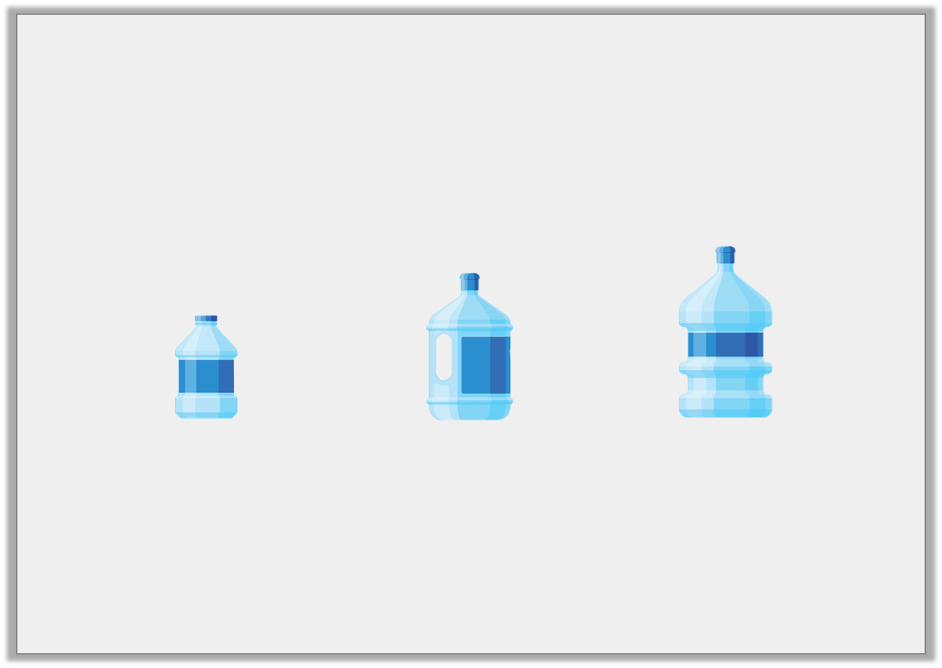
Problem Solving 1
A garden pond has a maximum water allowance of 24.865L
Josie uses 6 bottles in total and fills her pond to capacity. How many of each size did she use?
Small 2.485L |  | Medium 4,625ml |  | Large 6,020ml
© Classroom Secrets Limited 2019

Slide 48
Problem Solving 1
A garden pond has a maximum water allowance of 24.865L
Josie uses 6 bottles in total and fills her pond to capacity. How many of each size did she use?
2x Small; 3x Medium; 1x Large
Small 2.485L |  | Medium 4,625ml |  | Large 6,020ml
© Classroom Secrets Limited 2019

Slide 49
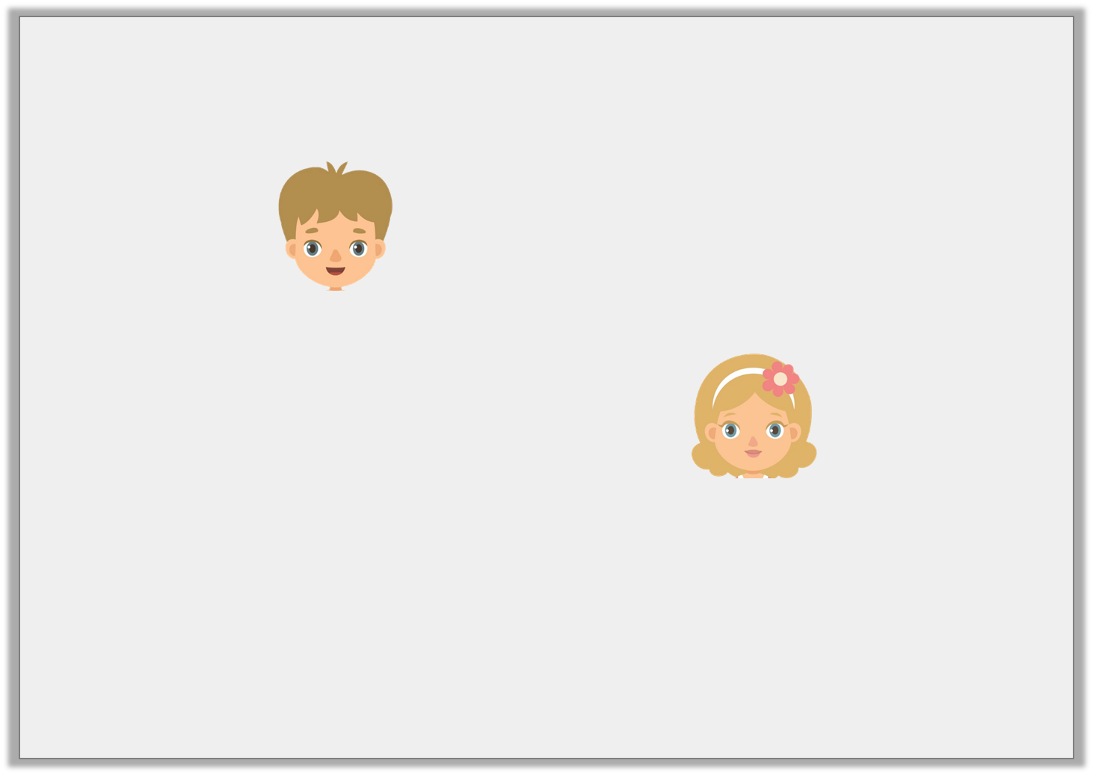
Reasoning 2
Olly and Annie are converting 21,865cm into metres.
Who is correct? Explain why.
The answer is 21.865m.
Olly
The answer is 218.65m.
Annie
© Classroom Secrets Limited 2019

Slide 50
Reasoning 2
Olly and Annie are converting 21,865cm into metres.
Who is correct? Explain why.
Annie is correct because…
The answer is 21.865m.
Olly
The answer is 218.65m.
Annie
© Classroom Secrets Limited 2019

Slide 51
Reasoning 2
Olly and Annie are converting 21,865cm into metres.
Who is correct? Explain why.
Annie is correct because to convert cm to m, you need to divide by 100.
21,865 ÷ 100 = 218.65
The answer is 21.865m.
Olly
The answer is 218.65m.
Annie
© Classroom Secrets Limited 2019

Slide 52
EVALUATION:
True or False?
To convert from kilometres into metres, multiply the
number of kilometres by 1000 because
1000 m = 1 km.
350 g = 350,000 kg
To convert from millilitres into litres, multiply the number of millilitres by 1000 because 1000 ml = 1 l.
0.05 m = 5cm
To convert from a smaller unit of measurement to a larger unit of measurement, divide.

Slide 53
EVALUATION:
True or False?
To convert from kilometres into metres, multiply the
number of kilometres by 1000 because
1000 m = 1 km. TRUE
350 g = 350,000 kg FALSE
To convert from millilitres into litres, multiply the number of millilitres by 1000 because 1000 ml = 1 l. FALSE (We divide instead!)
0.05 m = 5cm TRUE
To convert from a smaller unit of measurement to a larger unit of measurement, divide. TRUE

