Slide 1
Ready-to-go Lesson Slides
Year 6
Measurement: Converting Units
Lesson 4
Spr4

Slide 3
STARTER:
Which one is incorrect?
length of a blackbird = 0.29 m
length of a seagull = 410 mm
length of a robin = 28 cm
length of a crow = 0.063 m
length of a woodpecker = 0.00038 km

Slide 4
STARTER:
Which one is incorrect?
length of a blackbird = 0.29 m
= 29cm
length of a seagull = 410 mm
= 41cm
length of a robin = 28 cm
= 28cm
length of a crow = 0.063 m
= 6.3cm (too small!)
length of a woodpecker = 0.00038 km
= 38 cm
The length of a crow is incorrect. Each of the measurements have been converted into centimetres above to help show why.

Slide 5
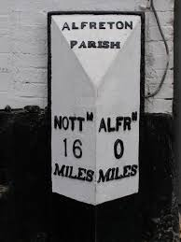
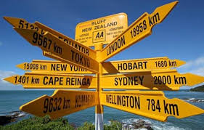
TALKING TIME:
What do you know about the units of measurement on these
signs?

Slide 6
TALKING TIME:
What do you know about the units of measurement on these
signs?
Miles are an imperial unit of measurement and kilometres are a metric unit.
In the UK, signposts are labelled using miles. In many other countries, kilometres are used instead.

Slide 7
TALKING TIME:
5 miles ≈ 8 km
How many miles are about the same as 16 km?

Slide 8
TALKING TIME:
5 miles ≈ 8 km
How many miles are about the same as 16 km?
8 km ≈ 5 miles
16 km ≈ 10 miles
x 2
x 2

Slide 9
TALKING TIME:
5 miles ≈ 8 km
How many kilometres are about the same as 25 miles?

Slide 10
TALKING TIME:
5 miles ≈ 8 km
How many kilometres are about the same as 25 miles?
5 miles ≈ 8 km
25 miles ≈ 40 km
x 5
x 5

Slide 11
ACTIVITY 1:
5 miles ≈ 8 km
Use this fact to complete the conversion table.
miles | kilometres
15 miles
 | 80 km
0.5 miles
 | 64 km

Slide 12
ACTIVITY 1:
5 miles ≈ 8 km
Use this fact to complete the conversion table.
miles | kilometres
15 miles | 24 km
50 miles | 80 km
0.5 miles | 0.8 km
40 miles | 64 km

Slide 13
TALKING TIME:
Complete the sentences to work out how many kilometres are
about the same as 1 mile.
5 miles are about the same as ___ km.
If we double these values, we can see that __ miles are
about the same as ___ km.
If we divide both values by 10, we can see that 1 mile is about the same
as ___ km.
1 mile ≈ ___ km

Slide 14
TALKING TIME:
Complete the sentences to work out how many kilometres are
about the same as 1 mile.
5 miles are about the same as 8 km.
If we double these values, we can see that 10 miles are
about the same as 16 km.
If we divide both values by 10, we can see that 1 mile is about the same
as 1.6 km.
1 mile ≈ 1.6 km

Slide 15
ACTIVITY 2:
1 mile ≈ 1.6 km
Use this fact to help solve these problems:
Mo’s family have gone to France for a holiday. A sign
says that the nearest town is 16km away. About how
many miles away is the town?
A car is travelling at 20 miles per hour. The speedometer also shows the speed in km per hour. About how fast is the car travelling in km/h?

Slide 16
ACTIVITY 2:
1 mile ≈ 1.6 km
Use this fact to help solve these problems:
Mo’s family have gone to France for a holiday. A sign
says that the nearest town is 16km away. About how
many miles away is the town?
16 ÷ 1.6 = 10
1 x 10 = 10, so the town is about 10 miles away.
A car is travelling at 20 miles per hour. The speedometer also shows the speed in km per hour. About how fast is the car travelling in km/h?
20 x 1.6 = 32
So, the car is travelling at about 32 km per hour.

Slide 17
ACTIVITY 3:
5 miles ≈ 8 km
Sketch a bar model to show how to represent this problem.
A map shows that the distance between two beaches is
72 km. About how many miles apart are the beaches?

Slide 18
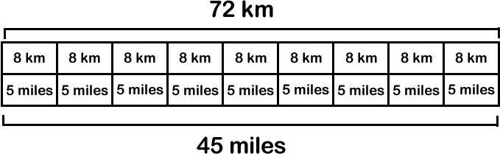
ACTIVITY 3:
5 miles ≈ 8 km
Sketch a bar model to show how to represent this problem.
A map shows that the distance between two beaches is
72 km. About how many miles apart are the beaches?
The beaches are about 45 miles apart.

Slide 19
ACTIVITY 4:
5 miles ≈ 8 km
Estimate the distance from Alfreton Parish to Nottingham.

Slide 20
ACTIVITY 4:
5 miles ≈ 8 km
Estimate the distance from Alfreton Parish to Nottingham.
The signpost says that the
distance is 16 miles.
We know that 5 miles are about 8 km and so 15 miles (3 lots of 5) are about 24 km (3 lots of 8).
16 miles is just over 15 miles, so we can estimate that the distance is just over 24 km.

Slide 21
ACTIVITY 5:
5 miles ≈ 8 km
About how far in miles is it from the signpost to Sydney?

Slide 22
ACTIVITY 5:
5 miles ≈ 8 km
About how far in miles is it from the signpost to Sydney?
The signpost says that
the distance is 2,000 km.
We know that 8 km are about the same as
5 miles. 2,000 ÷ 8 = 250, so there are 250 lots
of 8 in 2,000.
250 lots of 5 equals 1,250, so we can say that
the distance from the signpost to Sydney is
about 1,250 km.

Slide 23
EVALUATION:
True or False?
A mile is longer than a kilometre.
As a mile is an imperial measurement and a kilometre
is a metric measurement, we cannot convert between
them.
c) 8 km is about the same as 5 miles.
If we want to convert 45 miles into kilometres, we can divide by 5 to see how many 5s are in 45 and then multiply this number by 8.
100 miles are about the same as 800 km.

Slide 24
EVALUATION:
True or False?
A mile is longer than a kilometre. FALSE
As a mile is an imperial measurement and a kilometre
is a metric measurement, we cannot convert between
them. FALSE
c) 8 km is about the same as 5 miles. TRUE
If we want to convert 45 miles into kilometres, we can divide by 5 to see how many 5s are in 45 and then multiply this number by 8. TRUE
100 miles are about the same as 800 km. FALSE

Slide 25


