Slide 1


Year 6 – Spring Block 4 – Converting Units – Metric Measures
About This Resource:
This PowerPoint has been designed to support your teaching of this small step. It includes a starter activity and an example of each question from the Varied Fluency and Reasoning and Problem Solving resources also provided in this pack. You can choose to work through all examples provided or a selection of them depending on the needs of your class.
National Curriculum Objectives:
Mathematics Year 6: (6M6) Convert between miles and kilometres
Mathematics Year 6: (6M9) Solve problems involving the calculation and conversion of units of measure, using decimal notation up to three decimal places where appropriate
Mathematics Year 6: (6M5) Use, read, write and convert between standard units, converting measurements of length, mass, volume and time from a smaller unit of measure to a larger unit, and vice versa, using decimal notation to up to three decimal places
More Year 6 Converting Units resources.
Did you like this resource? Don’t forget to review it on our website.
© Classroom Secrets Limited 2019

Slide 2
Year 6 – Spring Block 4 – Converting Units
Step 1: Metric Measures
© Classroom Secrets Limited 2019

Slide 3
Introduction
kilogram
kg
ml
centimetres
kilometres
km
cm
mililitres
© Classroom Secrets Limited 2019

Slide 4
Introduction
kilogram
kg
ml
centimetres
kilometres
km
cm
mililitres
© Classroom Secrets Limited 2019

Slide 5
Varied Fluency 1
Match the units of measurement to the correct purpose.
weight
centilitres
litres
mm
grams
length
volume
© Classroom Secrets Limited 2019

Slide 6
Varied Fluency 1
Match the units of measurement to the correct purpose.
weight
centilitres
litres
mm
grams
length
volume
© Classroom Secrets Limited 2019

Slide 7
Varied Fluency 2
Find the odd one out.
A. 5km
B. 127cm
C. 2.5kg
D. The length of a football pitch
© Classroom Secrets Limited 2019

Slide 8
Varied Fluency 2
Find the odd one out.
2.5kg.
The others are all measurements of length.
A. 5km
B. 127cm
C. 2.5kg
D. The length of a football pitch
© Classroom Secrets Limited 2019

Slide 9
Varied Fluency 3
Which of the following objects could be 100m long?
hall
running track
bench
© Classroom Secrets Limited 2019

Slide 10
Varied Fluency 3
Which of the following objects could be 100m long?
Running track
hall
running track
bench
© Classroom Secrets Limited 2019

Slide 11
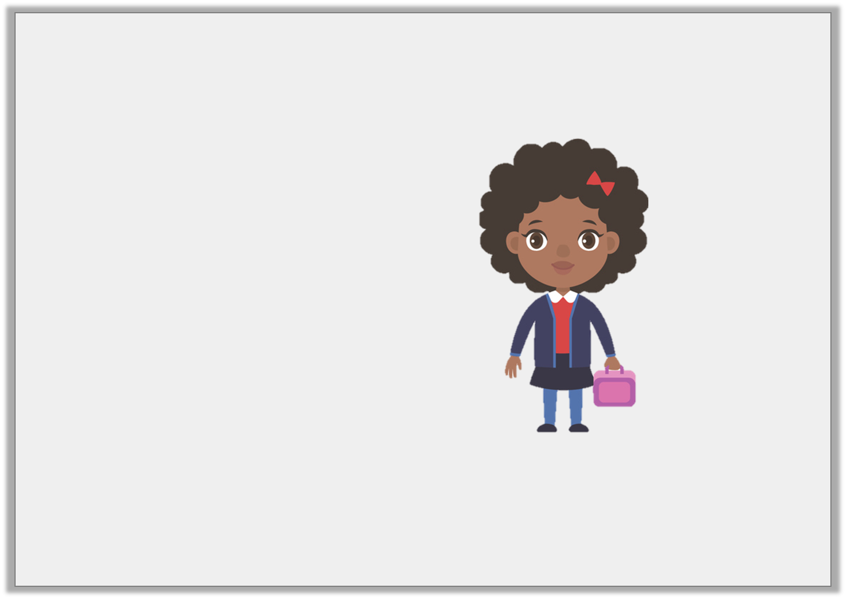
Varied Fluency 4
Match the most accurate estimates to the item.
125cm tall
weighs 20g
weighs 20kg
© Classroom Secrets Limited 2019

Slide 12
Varied Fluency 4
Match the most accurate estimates to the item.
125cm tall and weighs 20kg
125cm tall
weighs 20g
weighs 20kg
© Classroom Secrets Limited 2019

Slide 13
Reasoning 1
Felix is measuring the height of his classmates’ and recording his results.
He has forgotten to write the unit of measurement.
Which unit measurement could he be using for each length? Convince me.
Peter | 1.1
Lizzy | 102
Isla | 0.9
© Classroom Secrets Limited 2019

Slide 14
Reasoning 1
Felix is measuring the height of his classmates’ and recording his results.
He has forgotten to write the unit of measurement.
Which unit measurement could he be using for each length? Convince me.
All the heights are similar and in a class of children, there wouldn’t be too much difference in their heights.
Peter | 1.1 | m
Lizzy | 102 | cm
Isla | 0.9 | m
© Classroom Secrets Limited 2019

Slide 15
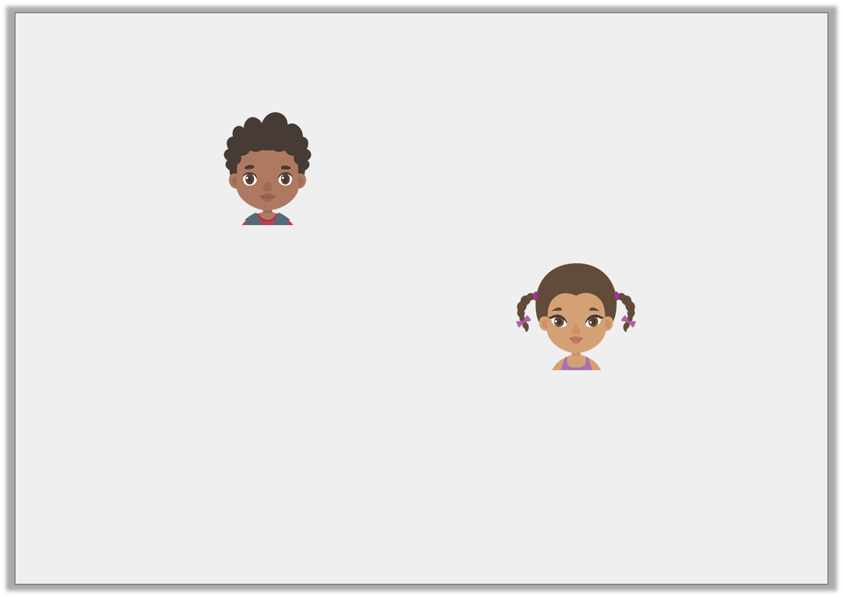
Reasoning 2
The children are estimating how far it is to walk to assembly.
Who do you agree with and why?
I think it will be around 117m.
Sam
I think it will be around 117cm.
India
© Classroom Secrets Limited 2019

Slide 16
Reasoning 2
The children are estimating how far it is to walk to assembly.
Who do you agree with and why?
I agree with Sam because…
I think it will be around 117m.
Sam
I think it will be around 117cm.
India
© Classroom Secrets Limited 2019

Slide 17
Reasoning 2
The children are estimating how far it is to walk to assembly.
Who do you agree with and why?
I agree with Sam because metres is the correct unit of measure for this distance. 117cm is not far enough.
I think it will be around 117m.
Sam
I think it will be around 117cm.
India
© Classroom Secrets Limited 2019

Slide 18
Problem Solving 1
If we know that one bottle of lemonade has volume of 1 litre, make estimates for the following:
a bath
a sink
a can of drink
a cup of coffee
© Classroom Secrets Limited 2019

Slide 19
Problem Solving 1
If we know that one bottle of lemonade has volume of 1 litre, make estimates for the following:
Estimates may vary.
a bath | 80L
a sink | 10L
a can of drink | 0.5L
a cup of coffee | 0.5L
© Classroom Secrets Limited 2019

