Slide 1
PSHE – Healthy Me
Lesson 01

Slide 2
Learning objectives:
Please teach me to…
know the impact of food on the body, e.g. creating energy, giving comfort and altering mood
be motivated to give my body the best combination of food for my physical and emotional health

Slide 3
Vocabulary:
Mood
Energy
Balanced diet

Slide 4
Ask yourself, honestly:
• I can get to bed on time every night
• I can tell you about how to eat healthily
• I can tell you how to be active to stay healthy
• I drink lots of water every day
• I try to eat at least 5 portions of fruit and vegetables every day
• I try not to eat lots of sweets and chocolates
• I make sure I exercise every day
• I rest when I am tired
• I know what to do if I’m feeling upset

Slide 5
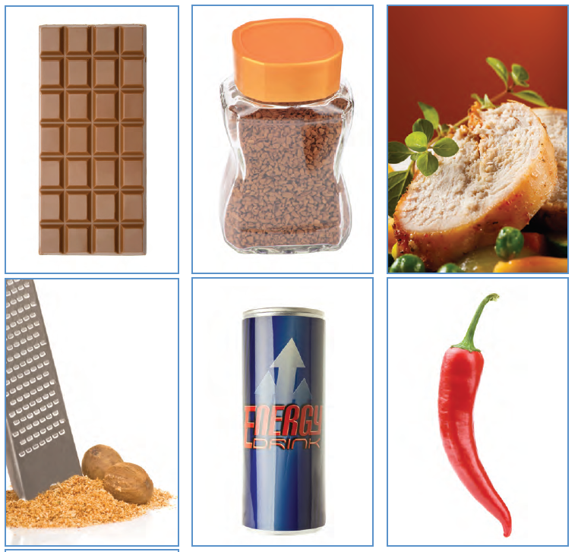
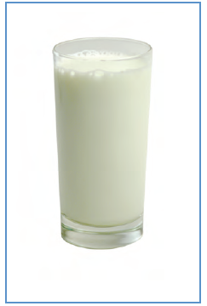
What do these foods and drinks have in common?

Slide 6

They can alter someone’s
MOOD

Slide 7
What does what?
Chocolate: can improve your mood, especially dark chocolate
Coffee: can make you feel more alert
Turkey: contains a chemical called tryptophan than can help you feel calmer
Nutmeg: in high quantities, it can make people have hallucinations
Energy Drinks: can make you feel very alert
Chillies: can help turn a bad mood into a good mood
Milk: warm milk can help you feel sleepy

Slide 8
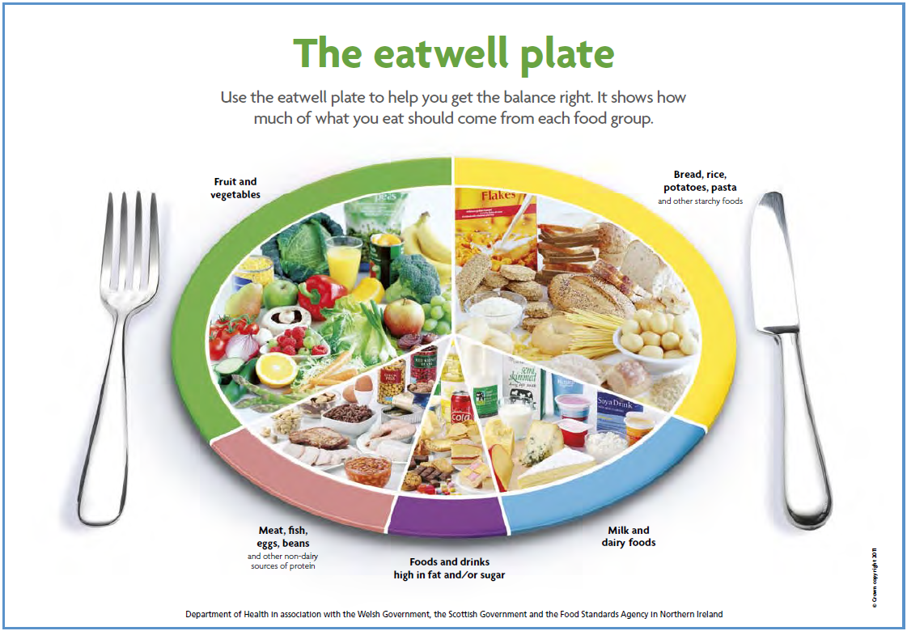

Slide 9
Play the True or False Quiz

Slide 10
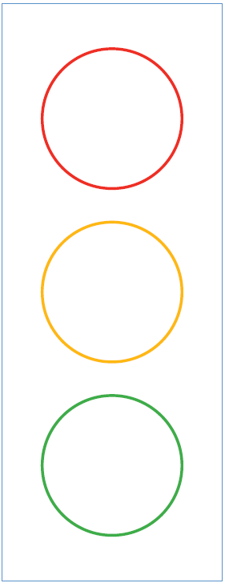
Your task:
I’m not going to buy packets of crisps at the supermarket
Print off or draw a ‘Stop! Start! Continue!’ template
Complete it on your own by thinking about how you will improve your lifestyle, specifically your diet by stopping something, starting to do something, and continuing something that you already do.
Try and think of three things for each traffic light
Around the circles, write about how you will motivate yourself to achieve your goals.
There’s an example here →
I am going to Stop eating crisps every day
I am going to set a repeating alarm on my phone
I am going to start to walk for 30 minutes every day
I am going to continue eating five fruit and veg a day.
I’m going to make sure the fruit bowl is always stocked up

